Slide 1
Pre-statistical harmonization of cognitive instruments: The BP-Cog project
Emily Briceño
University of Michigan

Slide 2
Acknowledgements
Funded in part by Grant R13AG030995 from the National Institute on Aging
The views expressed in written conference materials or publications and by speakers and moderators do not necessarily reflect the official policies of the Department of Health and Human Services; nor does mention by trade names, commercial practices, or organizations imply endorsement by the U.S. Government.

Slide 3
Pre-statistical harmonization of cognitive instruments
Identify relevant data sets
Review individual study characteristics
Identify variables of interest
Griffith et al., 2012, AHRQ

Slide 4
Pre-statistical harmonization of cognitive instruments
Identify relevant cognitive instruments
Cognitive domain
Measurement precision
Sensitivity to change
Practice effects
Sensitivity to demographics
Cultural relevance and validity

Slide 5
Pre-statistical harmonization of cognitive instruments
Identify relevant cognitive instruments
Identify cognitive instrument
scores/variables/
test items
Instrument type:
Single score
Multiple sub-scores
Multiple items
Score type:
Raw scores
Demographically corrected scores
Normative data source

Slide 6
Pre-statistical harmonization of cognitive instruments
Identify relevant cognitive instruments
Identify cognitive instrument
scores/variables/
test items
Identify equivalent scores/variables/
test items

Slide 7
Pre-statistical harmonization of cognitive instruments
Identify relevant cognitive instruments
Instrument
version, adaptation, administration procedures
Identify cognitive instrument
scores/variables/
test items
Identify equivalent scores/variables/
test items

Slide 8
Pre-statistical harmonization of cognitive instruments
Identify relevant cognitive instruments
Instrument
version, adaptation, administration procedures
Identify cognitive instrument
scores/variables/
test items
Scoring procedures, response coding
Identify equivalent scores/variables/
test items

Slide 9
Pre-statistical harmonization: BP-Cog study
PI: Deb Levine, MD, MPH
Study goal: To evaluate associations between BP over the life course and racial/ethnic disparities in cognitive decline
To accomplish this goal, we harmonized cognitive data from ARIC, CARDIA, CHS, FOS, MESA, NOMAS

Slide 10
Pre-statistical harmonization: Methods
Pre-statistical harmonization steps:
1. Cognitive instruments were identified and categorized into cognitive domains (e.g., memory, executive functioning).
2. Cohort study investigators were contacted to request unpublished administration, scoring, and procedural details of cognitive test batteries.
3. Detailed review of cognitive test procedures was completed for each cohort.

Slide 11
Pre-statistical harmonization: Methods
Procedural details for cognitive test administration were gleaned from documentation provided by cohort studies:
Published test version (e.g., WAIS-R, WAIS-III)
Study-specific test adaptations
Administration and scoring procedures
Scores/items available for each instrument
Response coding procedures
Possible minimum/maximum raw scores (based upon instrument structure and procedures)
Available data for each test item were reviewed for score ranges and distributions.

Slide 12
Pre-statistical harmonization methods: Documentation
Study | Test | Item | Coding | Additional scoring notes | Harmonized variable
MESA | CASI | Number repetition backwards (1-2-3) | 1=Correct, 0=Error/Refused, 9=not attempted | If unable, coach for 3-2-1, but score 0 | uu18
MESA | CASI | Number repetition backwards (6-8-2) | 2 = Correct; 0= Error/refused; 9=not attempted |  | uu19
MESA | CASI | Number repetition backwards (3-5-2-9) | 2 = Correct; 0= Error/refused; 9=not attempted | (If score is 0 in both A and B , score C 0 ) | uu20
MESA | CASI | Place of Birth: City | 1=Correct, 0=Error/Refused, 9=not attempted | Correct noted from previous records | uu32
CHS | 3MSE | Place of Birth: City | 1= Answer given; 0 = Can't do/Refused; 9 = not att | Question is repeated at end; if consisent, credit is awarded | uu32
MESA | CASI | Place of Birth: State/Country | 1=Correct, 0=Error/Refused, 9=not attempted | Correct noted from previous records | uu33
CHS | 3MSE | Place of Birth: State | 1= Answer given; 0 = Can't do/Refused; 9 = not att | Question is repeated at end; if consisent, credit is awarded | uu33
MESA | CASI | Date of Birth, year | 2: Correct 1: Missed by 1-3 years; 0: Missed by >3 years; 9: Not attempted | None noted | uu34
MESA | CASI | Date of Birth, month | 1=Correct, 0=Error/Refused, 9=not attempted | None noted | uu35
MESA | CASI | Date of Birth, day | 1=Correct, 0=Error/Refused, 9=not attempted | None noted | uu36
MESA | CASI | Current age |  | None noted | uu37
MESA | CASI | Minutes in an hour | 2= Correct; 0= Error/Refused; 9 = Not attempted/disabled | None noted | uu38
MESA | CASI | Days in a year | 2= Correct; 0= Error/Refused; 9 = Not attempted/disabled | None noted | uu39
MESA | CASI | Direction of sun set | 2= Correct; 0= Error/Refused; 9 = Not attempted/disabled | If confused, can provide 4 choices (North, South, East, West) | uu40
CHS | TICS | First Name | 1=Correct, 0=cannot/refused | None noted | uu49
NOMAS | TICS | First Name | 1=Correct, 0= incorrect | None noted | uu49
ARIC | TICS | First Name | 1=Correct; 0 =Incorrect | Nickname OK | uu49
CHS | TICS | Last Name | 1=Correct, 0=cannot/refused | None noted | uu50
NOMAS | TICS | Last Name | 1=Correct, 0= incorrect | None noted | uu50
ARIC | TICS | Last Name | 1=Correct; 0 =Incorrect | None noted | uu50
ARIC | MMSE | Orientation: Year | 1= Correct; 0 = Incorrect/Not Attempted/Refused | None noted | uu51
ARIC | TICS | Orientation: Year | 1=Correct; 0 =Incorrect | Must be precise | uu51

Slide 13
Results: Identification of relevant cognitive instruments
Domain | ARIC | CARDIA | CHS | FOS | MESA | NOMAS
Executive function/ processing speed | Digit Symbol | Digit Symbol | Digit Symbol |  | Digit Symbol
 |  |  |  |  |  | SDMT
 | Animal Naming | Animal Naming | Animal Naming | Animal Naming | Animal Naming | Animal Naming
 |  |  | Semantic Gen.
 | Letter Fluency | Letter Fluency | Letter Fluency | Letter Fluency |  | Letter Fluency
 | Trail Making |  | Trail Making | Trail Making
 |  | Stroop Test | Stroop NST
 |  |  |  |  |  | Color Trails; Odd Man Out
 |  |  | Ravens; Baddeley-Papagno
 |  |  |  | Similarities
 | Digit Span |  | Digit Span | Digit Span | Digit Span
 |  |  |  |  |  | Digit ordering; LNS
Learning/ Memory |  | RAVLT | CVLT |  |  | CVLT-II
 | DWR
 |  |  |  | WMS Paired Assoc.
 | Logical Memory |  |  | Logical Memory
 |  |  | Rey O CFT Recall
 |  |  |  | WMS-R VR
General Mental Status | MMSE |  | MMSE | MMSE |  | MMSE
 |  | MoCA
 | TICS |  | TICS |  |  | TICS
 |  |  | 3MSE
 |  |  |  |  | CASI
Language | Boston Naming |  | Boston Naming | Boston Naming |  | Boston Naming
Motor |  |  | Grooved Pegboard |  |  | Grooved Pegboard
 | Finger Tapping |  |  | Finger Tapping

Slide 14
Results: Variability across equivalent instruments
Cognitive Instrument | Variables | ARIC | FOS | CARDIA | CHS- Memory Study | CHS | NOMAS | MESA
Logical Memory | Immediate recall | WMS-R | WMS
 | Delayed recall | WMS-R | WMS
 | Recognition |  | WMS
Digit Symbol | Total correct | WAIS-R |  | WAIS-III |  | WAIS-R |  | WAIS-III
 | Incidental learning | WAIS-R
Symbol Digit Substitution | Total correct |  |  |  |  |  | x
Animal naming | Total correct | x | x | x | x | 30-sec, 4-legged; max = 10 | x | 30-sec & 60-sec; 4-legged
Digit Span | Forward subtest, total correct |  |  |  | WAIS-R |  |  | WAIS-III
 | Forward subtest, highest string |  | WAIS
 | Backward subtest, total score | WMS-R |  |  | WAIS-R |  |  | WAIS-III
 | Backward subtest, highest string |  | WAIS
Boston Naming Test | Total correct: 30-item | x | x |  | x
 | Total correct: 15-item |  |  |  |  |  | x
Word List Learning | Total recalled across learning trials |  |  | RAVLT | CVLT (modified) |  | CVLT (modified)
 | Short delay free recall |  |  | RAVLT | CVLT (modified)
 | Long delay free recall |  |  | RAVLT | CVLT |  | CVLT (modified)
 | CVLT, semantic clustering |  |  |  | x

Slide 15
Results Example: Digit Symbol/Symbol Digit Tests
1 | 2 | 3 | 4 | 5 | 6 | 7 | 8 | 9
Cohort | Test Name | Version | Time Limit | Score Range | Data Range
ARIC | Digit Symbol Substitution Test | WAIS-R | 90 sec | 0-92 | 0-92
CARDIA | Digit Symbol Coding Test | WAIS-III | 120 sec | 0-133 | 0-125
CHS | Digit Symbol Substitution Test | WAIS-R | 90 sec | 0-92 | 0-90
MESA | Digit Symbol Coding Test | WAIS-III | 120 sec | 0-133 | 0-120
NOMAS | Symbol Digit Modalities Test | NA | 90 sec | 0-110 | 0-67
Raw score of 50:
WAIS-R version:
50/90 = 0.56 items/sec
WAIS-III version:
50/120 = 0.42 items/second

Slide 16
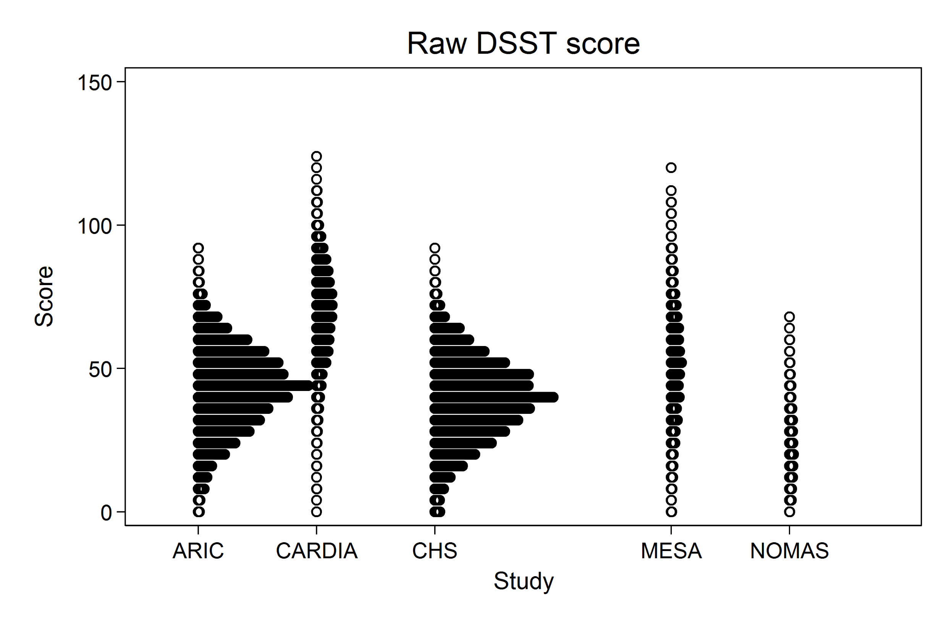
Pre-statistical harmonization for BP-Cog
Results Example: Digit Symbol/Symbol Digit Tests
WAIS-III; 120 sec
WAIS-R; 90 sec
SDMT; 90 sec

Slide 17
Results Example: Digit Span
Cohort | Test Version | Digit String Length | Metric | Score Range | Data Range
ARIC | WMS-R (Backward only) | 2-7 (backward) | Total score | 0-12 (backward) | 0-12 (backward)
CHS | WAIS-R | 2-8 (backward) | Total Score & Longest string | Total: 0-14 (backward) String: 2-8 (backward) | Total: 0-13 (backward) String: 1-8 (backward)
FOS | WAIS | 2-8 (backward) | Longest string | 0-8 (backward) | 0-8 (backward)
MESA | WAIS-III | 2-8 (backward) | Total Score | 0-14 (backward) | 0-14 (backward)

Slide 18
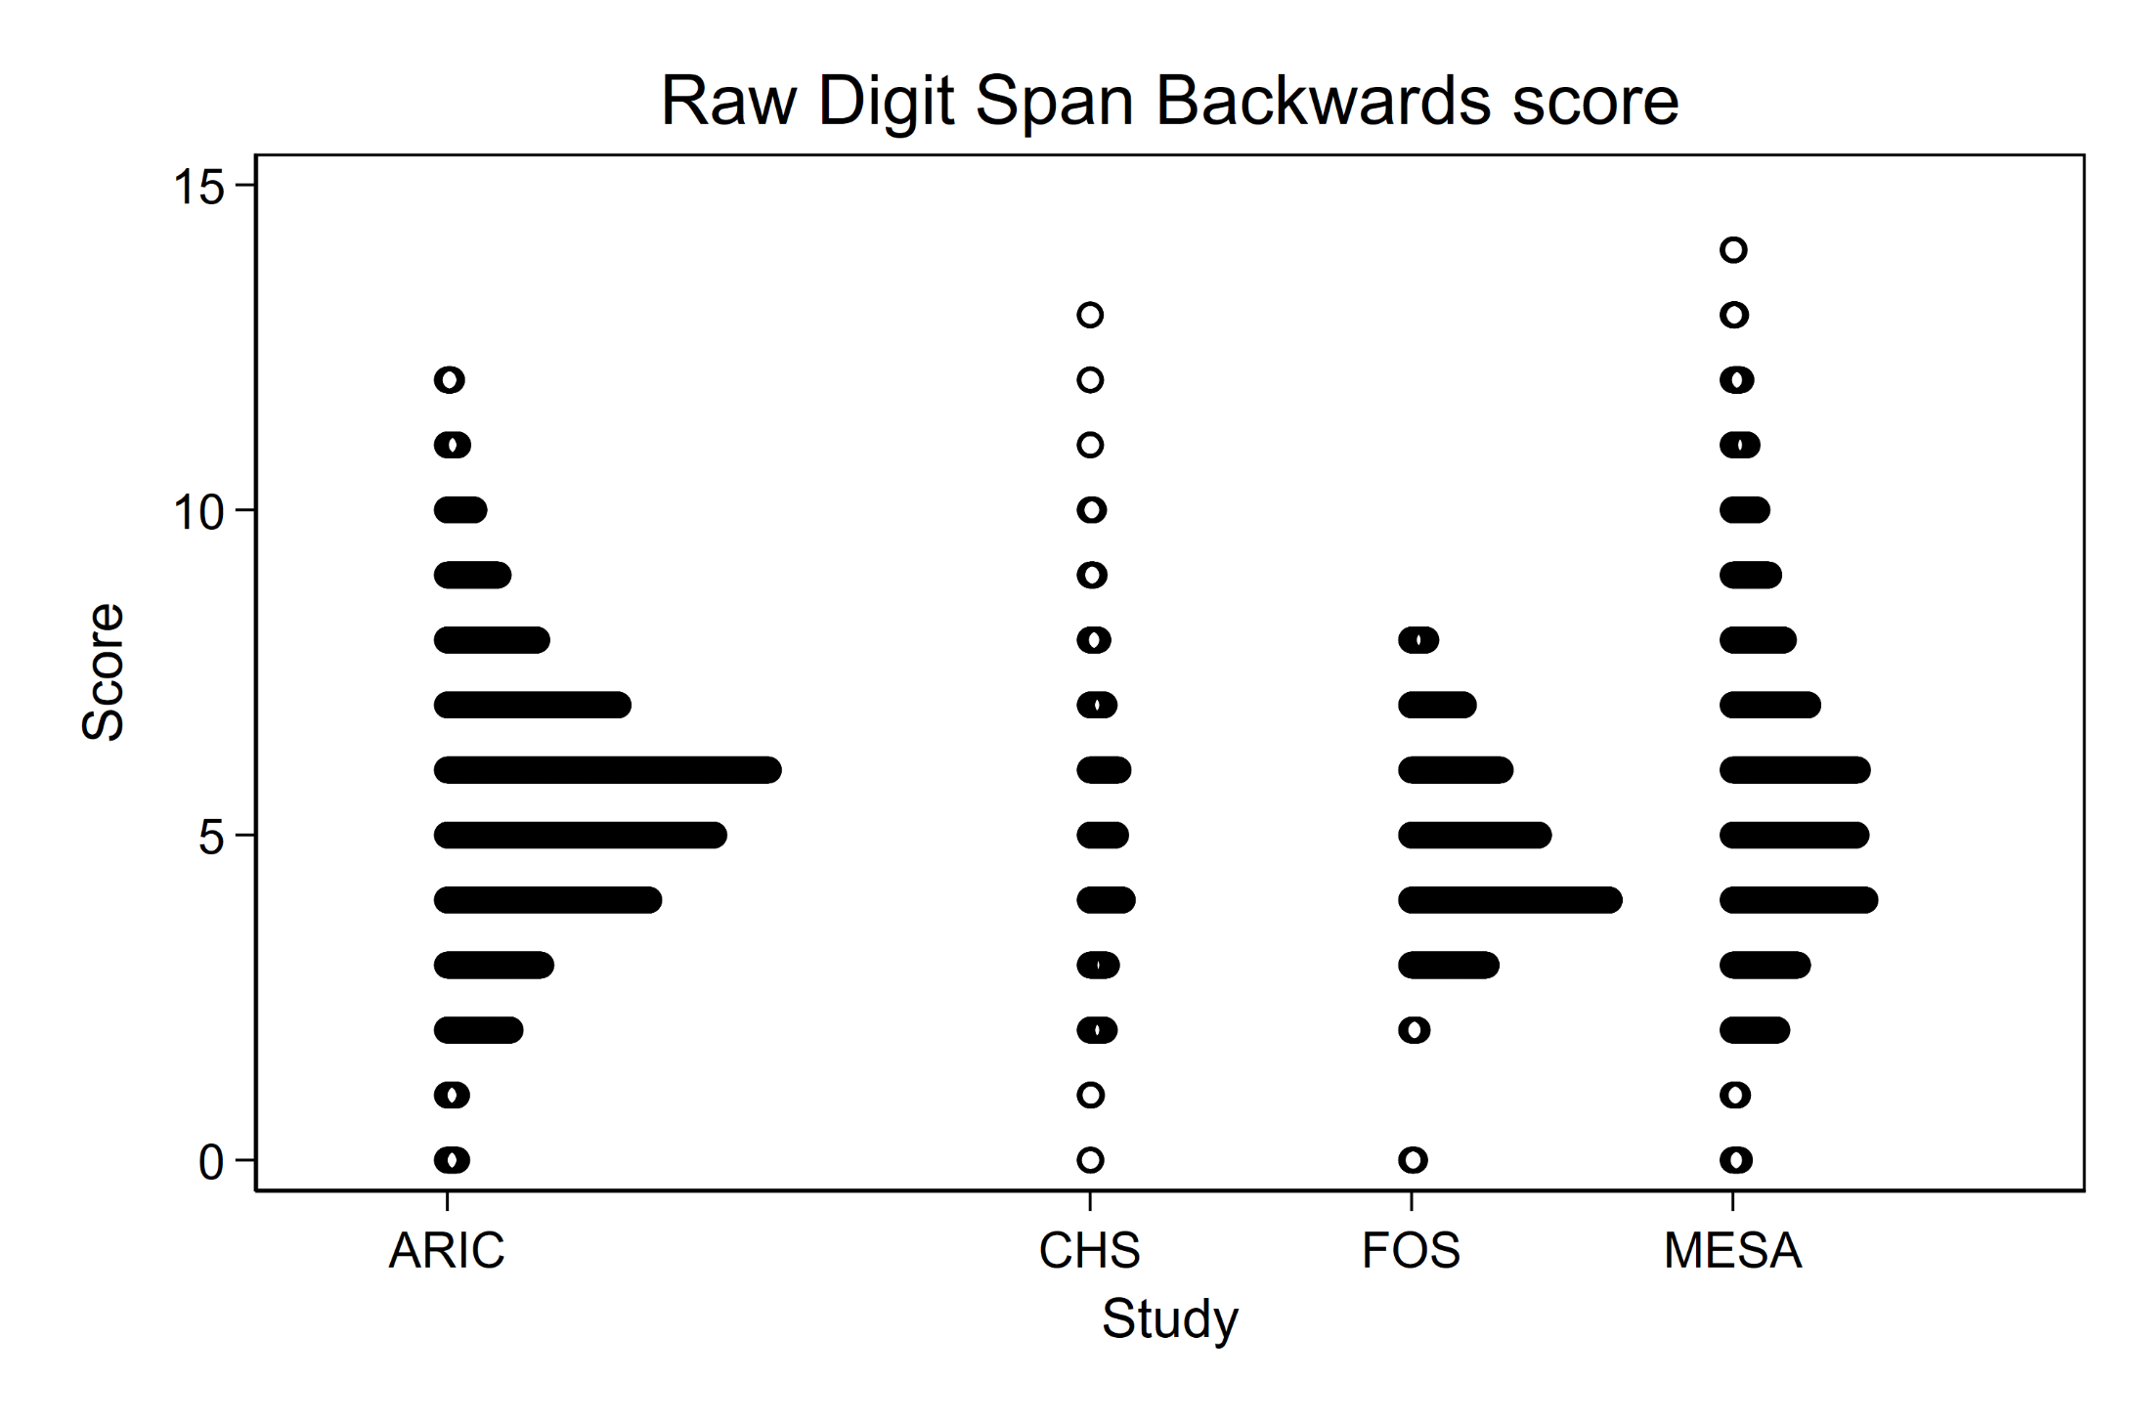
Results Example: Digit Span
Notes:
So again when we look at the distributions across studies- this all makes a lot more sense. We can see that ARIC has a bit of a lower tail than CHS and MESA, and FOS looks quite a bit different because it is a different type of score.

Slide 19
Results: Item-level differences across cognitive screening instruments
We reviewed common items across different cognitive screening instruments (i.e., MMSE, 3MSE, CASI, MoCA, TICS)
WORLD vs serial subtraction:
NOMAS, CHS: administered both; scored the higher of the two responses
ARIC, NOMAS: administered only WORLD backwards.
Orientation to season:
MMSE (NOMAS): correct within 2 weeks
MMSE (ARIC): correct coded by month (March is correct for winter/spring; June is correct for spring/summer; Sept is correct for summer/fall)
CASI (MESA): correct within 1 month
Orientation to month:
CASI (MESA): 2= accurate within 5 days; 1= missed by 1 month, and 0 = missed by 2+ months
MMSE (NOMAS): 1=correct (count correct if error in first day of new month or last day in old month); 0=incorrect.
MMSE (ARIC): 1 = correct; 0 = incorrect

Slide 20
Results: To lump or to split?
Orientation to place:
“Are we in a clinic, store, or home?”
CHS (3MSE); MESA (CASI)
“What is this address?”
CHS (MMSE)
“What is the name of this hospital?”
NOMAS (MMSE): Name of hospital or “Medical Center”
“What is the name of this place?”
FOS (MMSE): Any appropriate answer (note: address is asked for home visits)
ARIC (MMSE): Scoring details not available

Slide 21
Results: To lump or to split?

Slide 22
Summary
Pre-statistical harmonization is a necessary time investment
Pre-statistical harmonization can uncover critical differences across seemingly equivalent cognitive tests
These differences may impact test score interpretation and distributions
How to account for these differences? Ask your favorite statistical harmonization expert

Slide 23
Questions
emilande@med.umich.edu

