Slide 1
Phenotypes
Paul K. Crane, MD MPH
University of Washington

Slide 2
Objectives
Understand the case-control AD phenotype
Moving beyond the case-control AD phenotype

Slide 3
Conclusions
“It’s the phenotype, stupid!”
  Crane lab aphorism
(Others include:
  “There’s no such thing as a small grant.”
  “Look at your data. And your data labels.”)

Slide 4
The AD case-control phenotype
Lovely to have drugs that could prevent or treat AD
So let’s see whether people with AD have any genetic characteristics that are different from otherwise similar people who don’t have AD
Follow through on those genetic characteristics and discover some druggable targets
And cure AD!!!

Slide 5
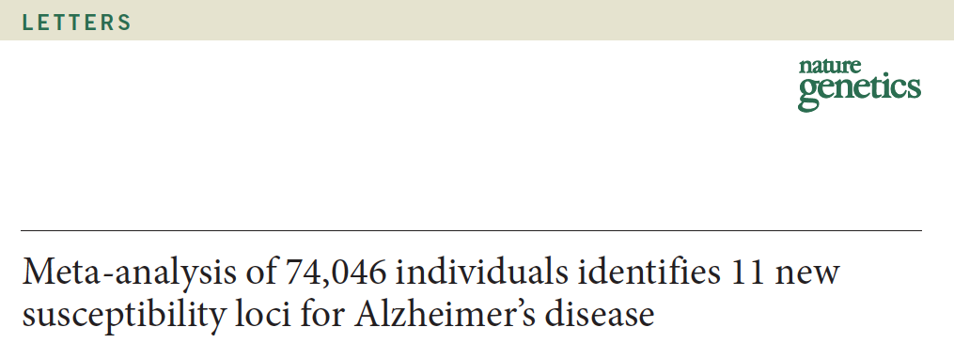
ADGC PLUS THREE OTHER CONSORTIA: IGAP
2013

Slide 6
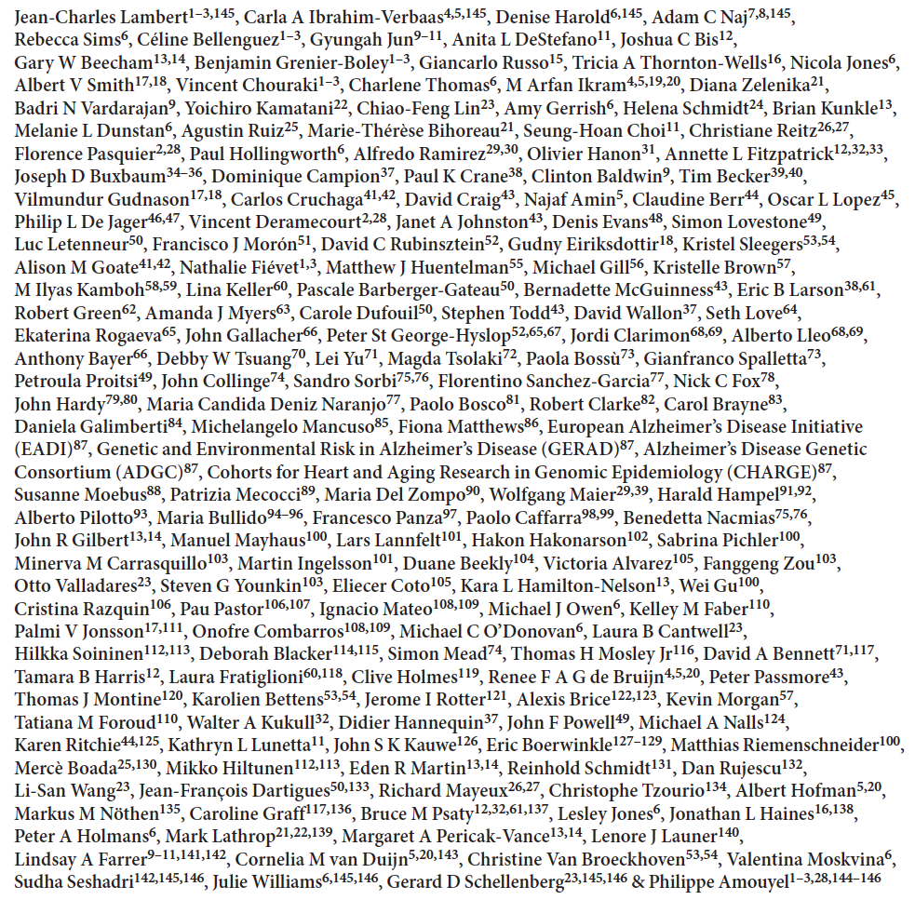

Slide 7
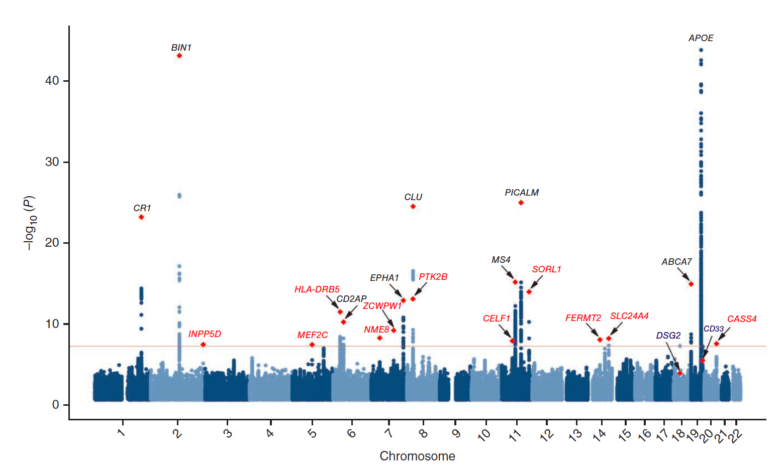
IGAP Manhattan plot

Slide 8
(Not EOAD genes with n=74,000)
APP
Presenilin 2
Presenilin 1

Slide 9
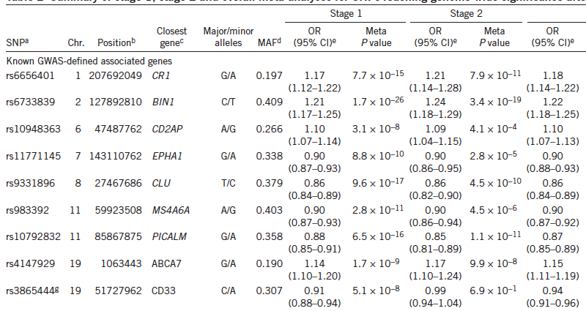
Previously identified loci

Slide 10
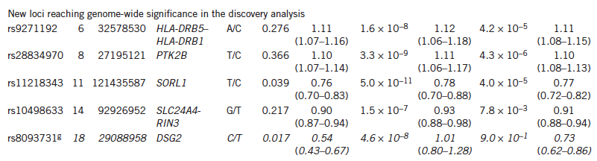
New loci from discovery sample
(not confirmed)

Slide 11
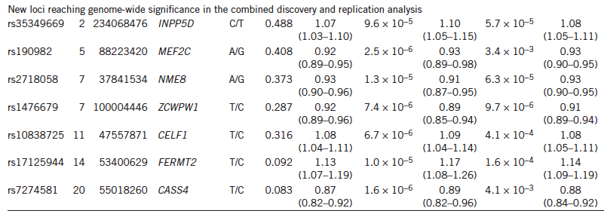
New in combined analyses

Slide 12
MAF of IGAP SNPs
Not very rare – rarest that was confirmed was the SORL1 SNP at 3.8% MAF
  0-5% - 1 SNP
  5-10% - 2 SNPs
  10-15% - 0 SNPs
  15-20% - 2 SNPs
  20-25% - 1 SNP
  25-30% - 3 SNPs
  30-35% - 4 SNPs
  35-40% - 4 SNPs
  40-45% - 3 SNPs
  45-50% - 1 SNP
Median MAF is 31%

Slide 13
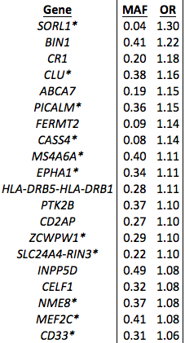
ORs of IGAP SNPs
Power is directly related to OR
Power is also directly related to MAF

Slide 14
ORs of IGAP SNPs
IQR:
1.08-1.16

Slide 15

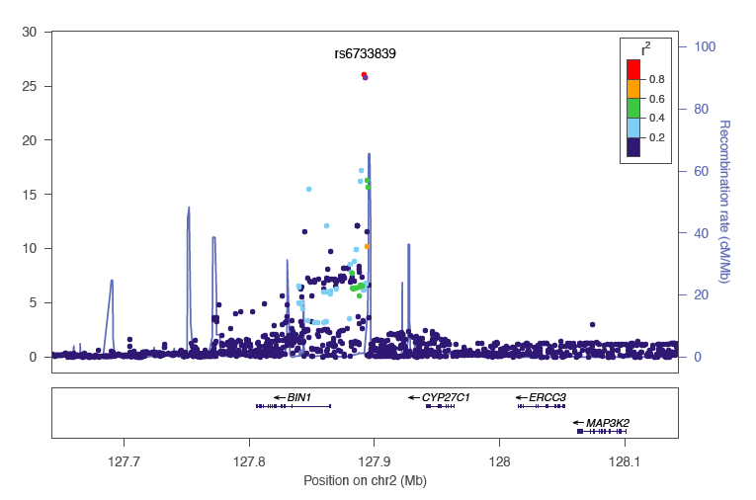
Other things to note

Slide 16
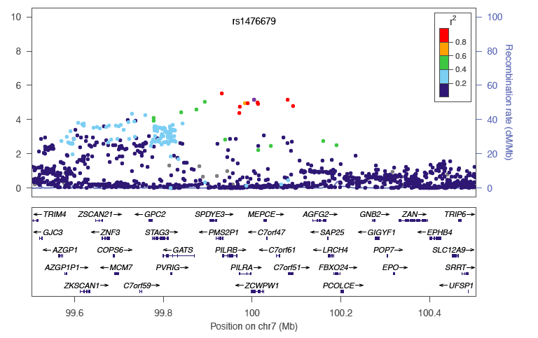
Which gene???

Slide 17
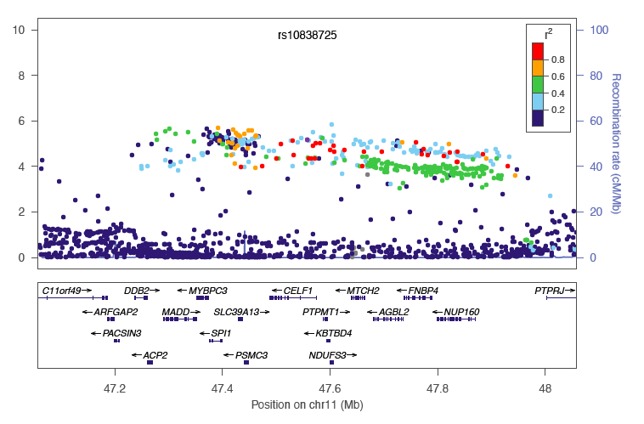
Which gene???

Slide 18
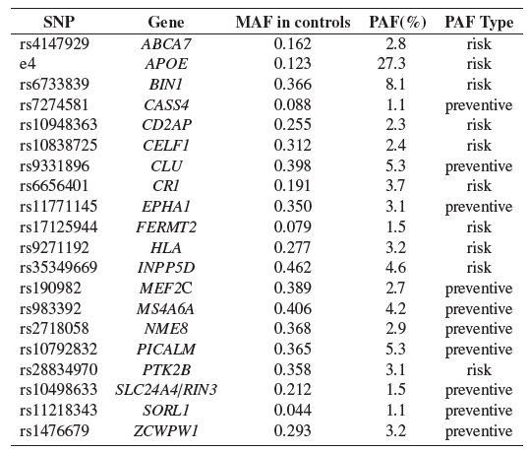
Individual level prediction

Slide 19

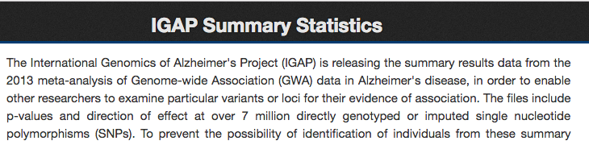
IGAP summary data

Slide 20
Conclusions - IGAP
Large sample and growing
1000 Genomes imputation
  Possible for new loci with HRC imputation and beyond
Mega-meta analysis
SNPs identified to date are skewed towards common SNPs
Odds ratios IQR 1.08-1.16
  For common SNPs pretty small ORs would have been found

Slide 21
Objectives
Understand the case-control AD phenotype
  And a couple of cool extensions!
Considerations in moving beyond the case-control AD phenotype

Slide 22
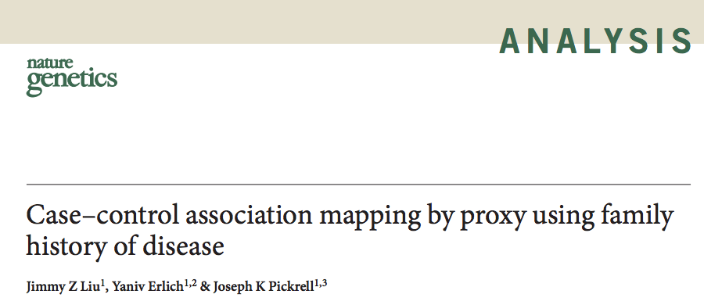
Cool use of data: UK Biobank GWAX
March 2017

Slide 23
AD analyses
Of 500K people in UK Biobank, 55 had AD
But 60,000 had 1 or 2 parents with AD
“proxy case-control association study” which they term “genome-wide association study by proxy, or GWAX”
  Too cool!!!
1000 G imputation, 10.5 million SNPs on n=116,000 people

Slide 24
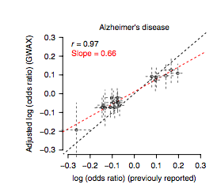
UK Biobank
Log of odds ratios
For IGAP SNPs
From GWAX
IGAP log of odds ratios for IGAP SNPs

Slide 25
UK Biobank
Log of odds ratios
For IGAP SNPs
From GWAX
IGAP log of odds ratios for IGAP SNPs
Pretty strong evidence that these phenotypes are producing “the same thing”

Slide 26
Can we make the AD phenotype better?
If we can refine the AD phenotype, we’ll improve power
Phenotype = f(G + E)
If we can regress the E from the phenotype, we have a revised equation:
  Phenotype* = f(G)

Slide 27
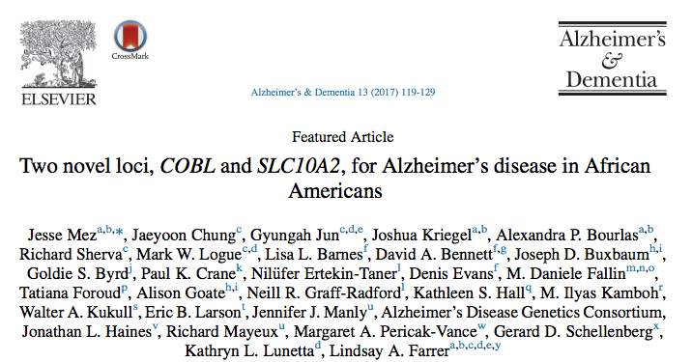
Extension to case-control phenotype

Slide 28
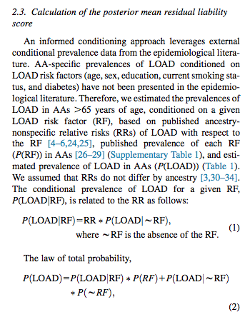
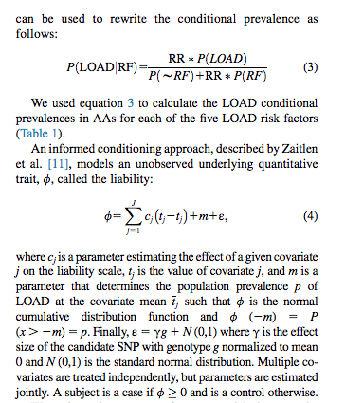

Slide 29
Summary: the AD phenotype
IGAP is a really big (n=74K) case-control GWAS
They found 20 common SNPs each with modest effect sizes
UK Biobank did a clever thing with GWAX
Mez et al. did a clever thing with AD|other stuff

Slide 30
Objectives
Understand the case-control AD phenotype
Considerations in moving beyond the case-control AD phenotype

Slide 31
2 flavors
Broad category 1: continuous analogues of the AD case-control phenotype (“endophenotypes”)
Broad category 2: other phenotypes that might be orthogonal to the case-control phenotype

Slide 32
Endophenotypes
Concept used in medicine first in schizophrenia research
Schizophrenia yes / no is inefficient
Are there other quantifiable things that could be examined?
AD-relevant endophenotypes: imaging (hippocampal volume; ERC thickness; amyloid positivity); CSF (amyloid/tau); cognition (global; memory)

Slide 33
AD-related endophenotypes
Expense
Replicability
  A uniquely rich dataset required to produce a fancy phenotype can’t be replicated
Quantitative
  “Amyloid positive” is a very expensive binary phenotype!

Slide 34
Cognitive AD endophenotypes
AD is one factor influencing global cognitive scores (or memory scores or any other cognitive domain)
… But there are many others
  Other neurodegenerative conditions
And premorbid intelligence / familiarity with cognitive tests / education / educational quality / SES / etc. etc. etc.
  It’s a mess!

Slide 35
AND it’s hard!
Studies measure AD the same way (NINCDS/ADRDA) but essentially nothing else is measured the same way
Some form of harmonization or co-calibration is needed
Or a really big sample (UK Biobank) eliminates the problem

Slide 36
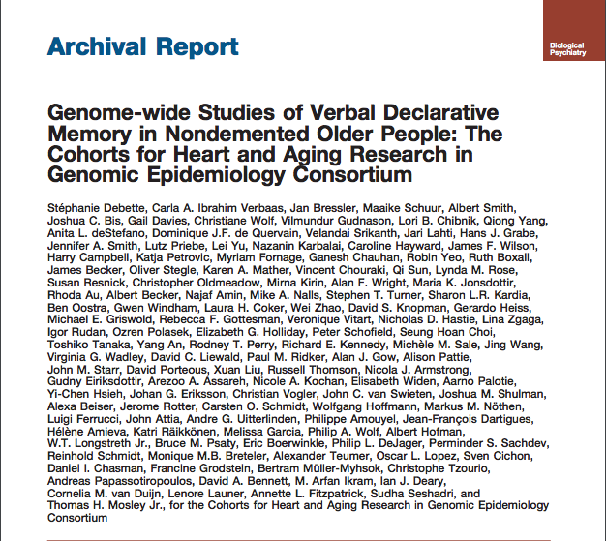
Biological Psychiatry 2015

Slide 37
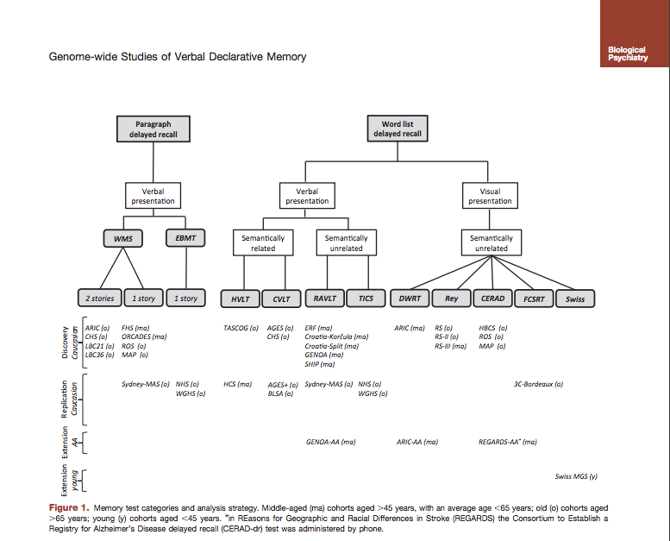

Slide 38
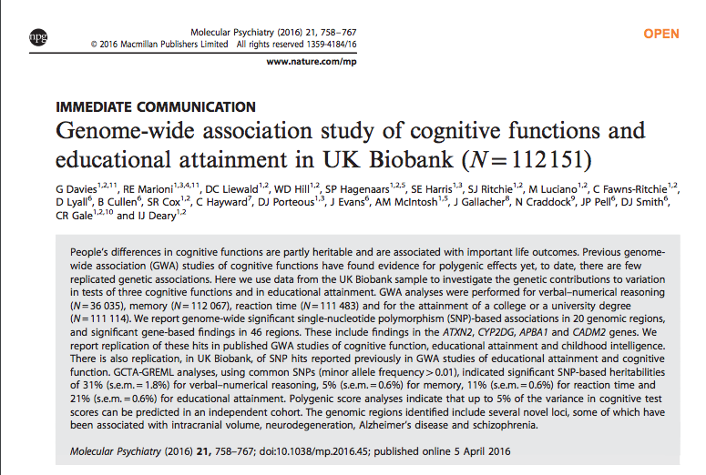

Slide 39
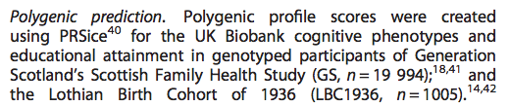

Slide 40
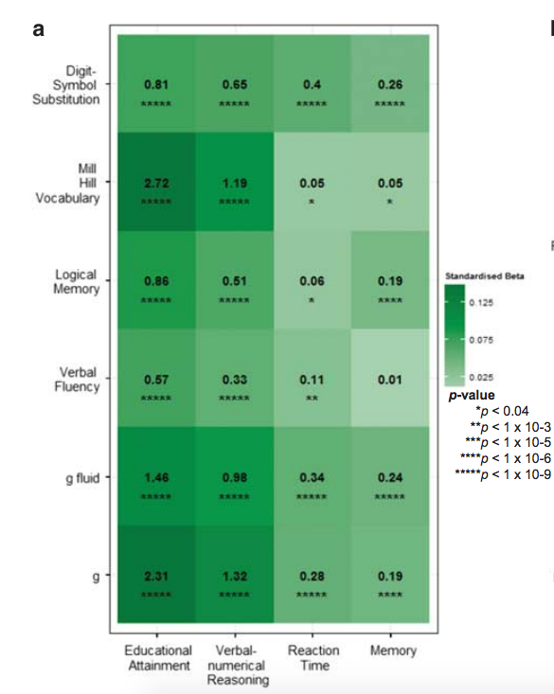
Heat maps of associations between the polygenic profile scores for cognitive phenotypes in UK Biobank and cognitive ability in
Generation Scotland (a) Stronger associations are indicated by darker shades. The amount of variance
(%) explained is indicated for each association.
N=20,000

Slide 41
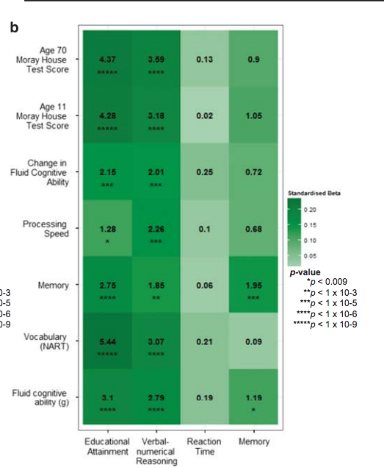
Heat maps of associations between the polygenic profile scores for cognitive phenotypes in UK Biobank and cognitive ability in
Lothian Birth Cohort 1936 (b). Stronger associations are indicated by darker shades. The amount of variance (%) explained is indicated for each association.
N=1000
!!!

Slide 42
Comments on these studies
Larger and larger samples with better and better data for GWAS of cognition / cognitive-related traits / educational attainment / IQ / etc.
For people interested in lifecourse epidemiology / educational quality / etc., these may provide important tools
Relatively small studies (e.g. ADNI) could be used in these sorts of ways
  Predict educational attainment in ADNI and use as a covariate?
  Use ADNI similar to the Lothian Birth Cohort study?

Slide 43
Objectives
Understand the case-control AD phenotype
Considerations in moving beyond the case-control AD phenotype
  Broad category 1: continuous analogues of the AD case-control phenotype
  Broad category 2: other phenotypes that might be orthogonal to the case-control phenotype

Slide 44
Conceptually….
Different flavors of AD

Slide 45
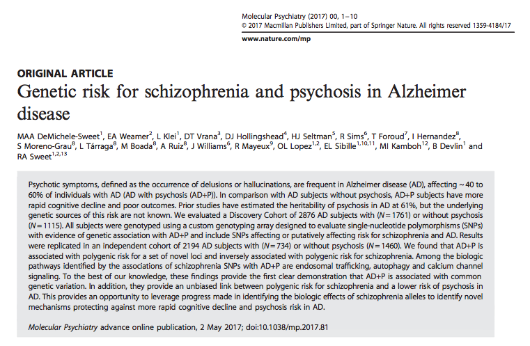

Slide 46
Design and findings
1300 AD with psychosis and 735 AD w/o psychosis
No genome-wide hits, some suggestive loci
Trend toward association with 11 schizophrenia SNPs
  Seven of these in the opposite direction
Took suggestive hits in a replication sample
  Taken together, predicted psychosis

Slide 47
Contrasts among people with AD
We have characterized memory, language, executive functioning, and visuospatial functioning (M, E, L, and V)
Started with ACT, then with ACT / ADNI / ROS / MAP / Pittsburgh
Co-calibrated scores are in the dataset (on same metric as all the other studies)
We used these to subgroup people with AD

Slide 48
Psychometric methods
Expert committee considered all cognitive items
  Neuropsychologists (Trittschuh, Saykin) and a behavioral neurologist (Mez)
Identified items as primary indicators of a domain
Confirmatory factor analysis models using Mplus (Muthen and Muthen)

Slide 49
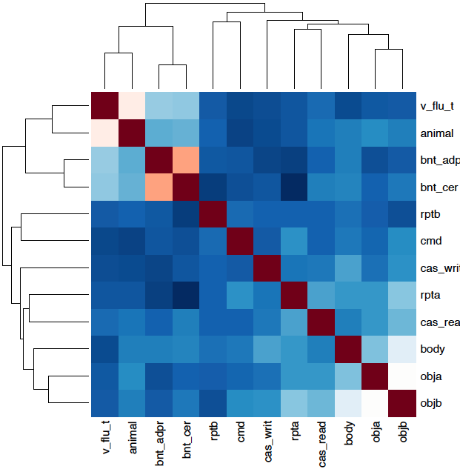
Hierarchical clustering example: Language
Letter fluency
Category fluency
Boston naming ADRC
Boston naming CERAD
Object naming A
Object naming B

Slide 50
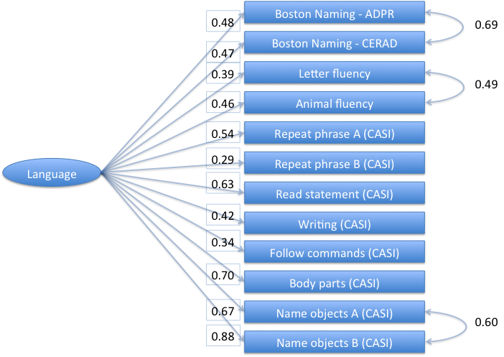
Final bi-factor model for language

Slide 51
Differences from Average Subtyping Approach
Obtained average using (M + E + L + V)/4
Differences between each domain and that average
Used ≥0.75 SD (ACT paper) or ≥0.80 SD (5 study paper)

Slide 52

Scores in each domain

Slide 53

Determine average score

Slide 54

Differences from individual average

Slide 55

Isolated substantial language deficit

Slide 56
PPA!!!
… This person had primary progressive aphasia

Slide 57


Slide 60
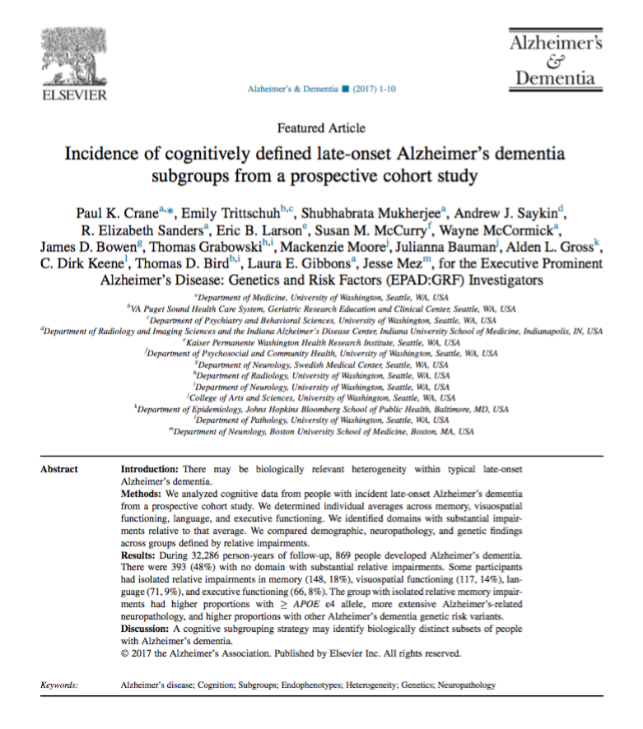
Applied that framework to people with undifferentiated typical AD in ACT

Slide 61
Findings: APOE and neuropathology
Group with isolated substantial memory impairment had higher proportion with APOE ε4 alleles
Group with isolated substantial memory impairment had higher proportion with Braak stage at least IV and higher proportion with cerebral amyloid angiopathy
  “Hyper-AD” looking group

Slide 62
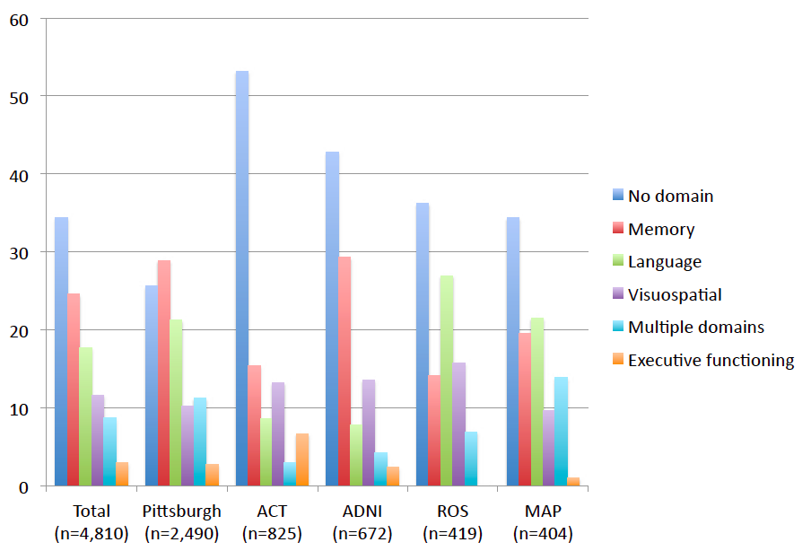
Subgroup makeup across studies

Slide 63
Implications
The phenotypic subtypes of typical LOAD vary a lot across different studies
If there are different implications for these different groups, there may be difficulties in replicating findings
What experts think of as “typical LOAD” reflects their own experience and their own data
  Their experience of “typical LOAD” may not reflect the experience of other experts with experience in other populations

Slide 64
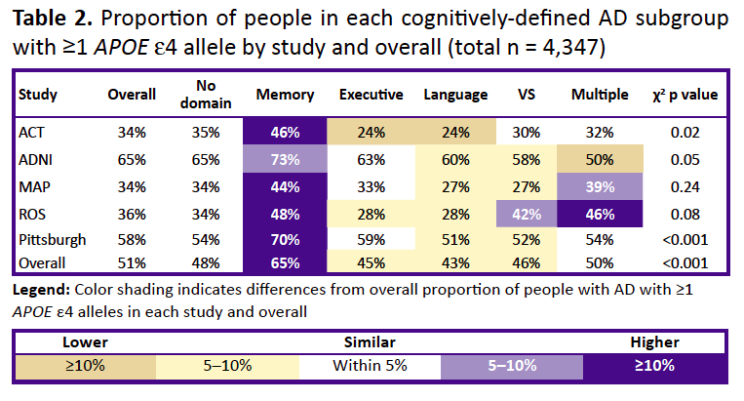
699 of the 1,073 people with isolated substantial relative memory impairment had ≥1 APOE ε4 allele (65%) 1,524 of the 3,274 people in other subgroups (46%) did (χ²_{(1, 111)} p = 3.9 x 10⁻²⁶)

Slide 66
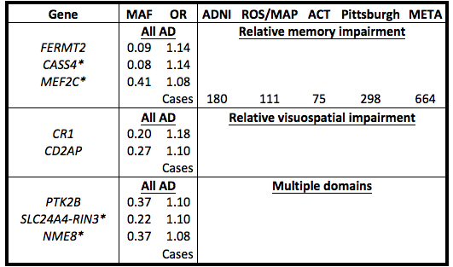
Selected IGAP SNPs

Slide 67
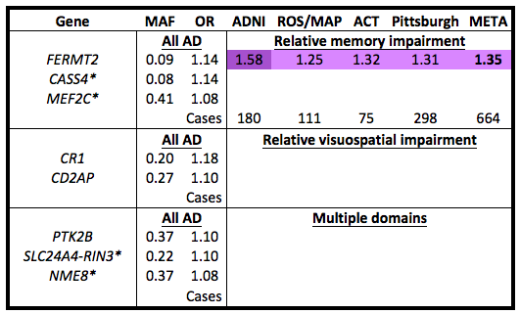
Selected IGAP SNPs

Slide 68
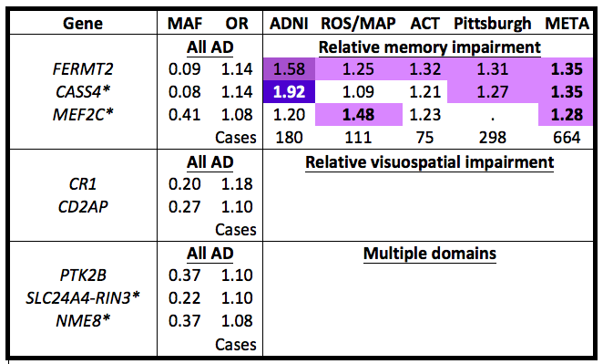
Selected IGAP SNPs

Slide 69
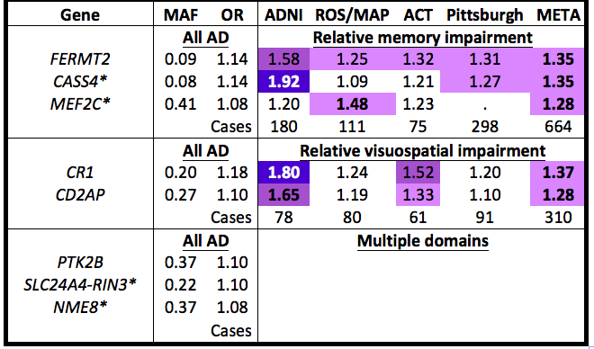
Selected IGAP SNPs

Slide 70
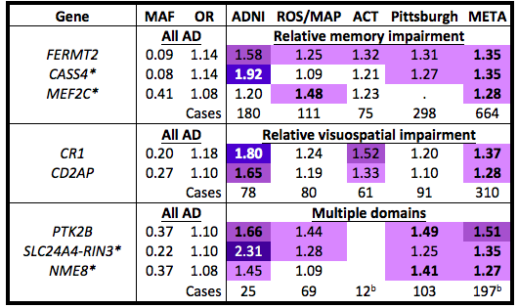
Selected IGAP SNPs

Slide 71
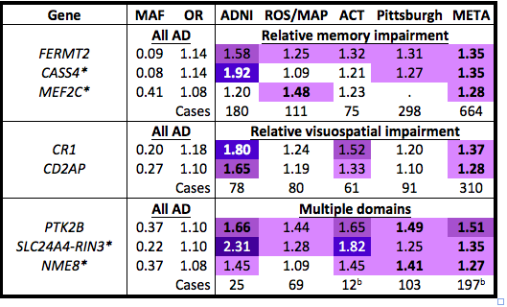
Selected IGAP SNPs

Slide 72
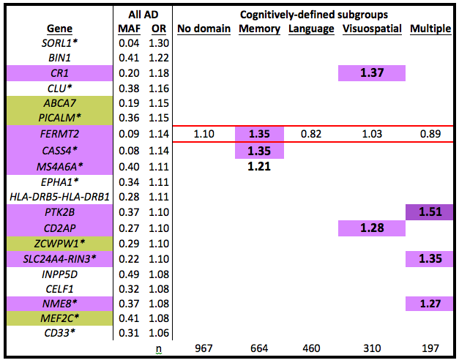
All IGAP SNPs

Slide 73
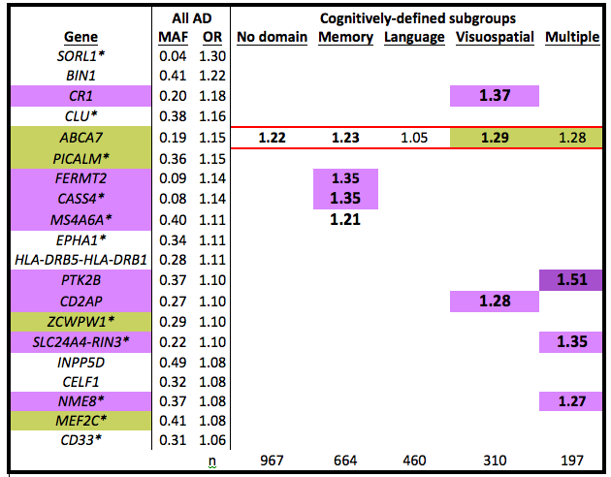
All IGAP SNPs

Slide 74
All IGAP SNPs are not created equal
If subsets of people with AD drive associations with different IGAP SNPs, we may mislead ourselves if we consider them to be qualitatively the same
Implications for our understanding of the genetic architecture of LOAD

Slide 75
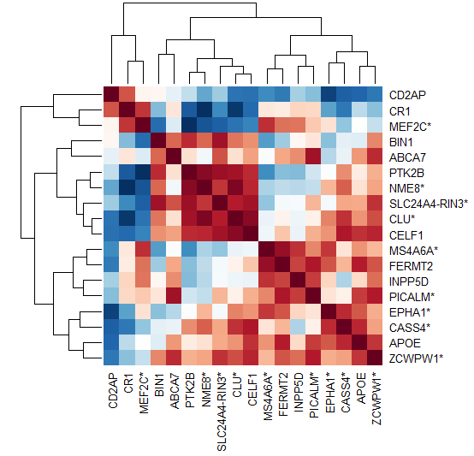
Heat map of IGAP SNPs and APOE

Slide 77
VS
VS
=
=
Mult
Mult
Mult
Mem
Mem
=
Mem
Mem
=

Slide 78
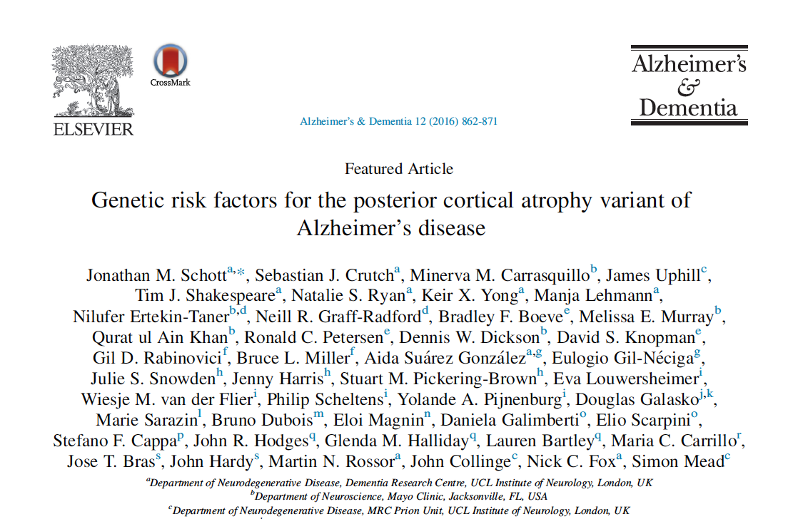

Slide 79
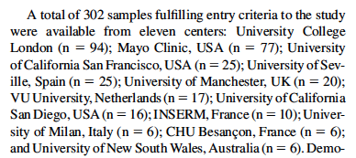
They looked at strength of association at 19 of 20 IGAP SNPs

Slide 80
We compared VS to PCA and to IGAP
AD (IGAP)
PCA (Schott et al.)
Beta = 0.38, SE =0.17, t = 2.22, p = 0.041,
R sq = 0.22, Adj R sq = 0.18
Correlation = 0.47
Beta = 0.47, SE = 0.18, p = 0.020,
R sq = 0.28, Adj R sq = 0.24
Correlation = 0.53

Slide 81
Conclusions: Genetic analyses
IGAP SNPs driven by visuospatial group do not cluster with the other SNPs
  Visuospatial group has a stronger association with PCA than it does with AD
  (Recall these are all people with AD who met NINCDS-ADRDA criteria and are included in the IGAP case-control phenotype!!!)
Successful subgrouping strategy may provide a tool to further our understanding of the mechanisms underlying distinct subgroups
  May point to new directions for research and therapeutic development

Slide 82
Genome wide
We used the same data-sets to perform GWAS
Still the case-control phenotype, except “case” is each sub-domain separately
  Really small samples for each
  Executive functioning too small at all
Hypothesis: might see something even with these really small groups because each one is a cleaner phenotype

Slide 83
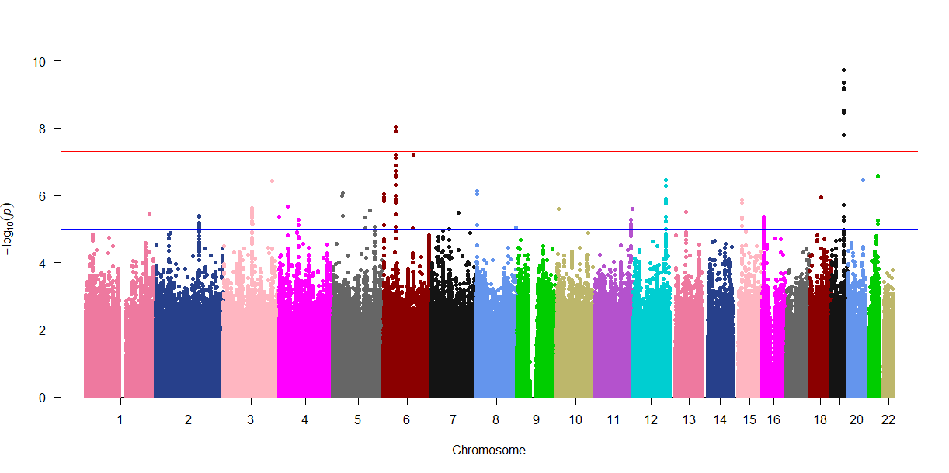
Isolated substantial relative visuospatial impairment (n=310) - truncated
Meta-analysis odds ratio for the tag SNP: 2.04.

Slide 84
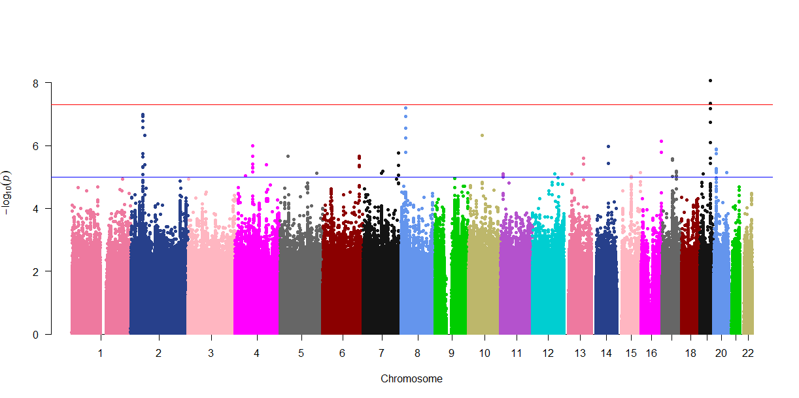
Multiple domains – truncated (n=197)

Slide 85
GWAS: Conclusions
Cleaner phenotypes lead to much greater power
Novel locus on chromosome 6 with an OR>2 for one subset
Many other loci poised to become significant with more data

Slide 86
Objectives
Understand the case-control AD phenotype
Considerations in moving beyond the case-control AD phenotype
  Broad category 1: continuous analogues of the AD case-control phenotype
  Broad category 2: other phenotypes that might be orthogonal to the case-control phenotype

Slide 87
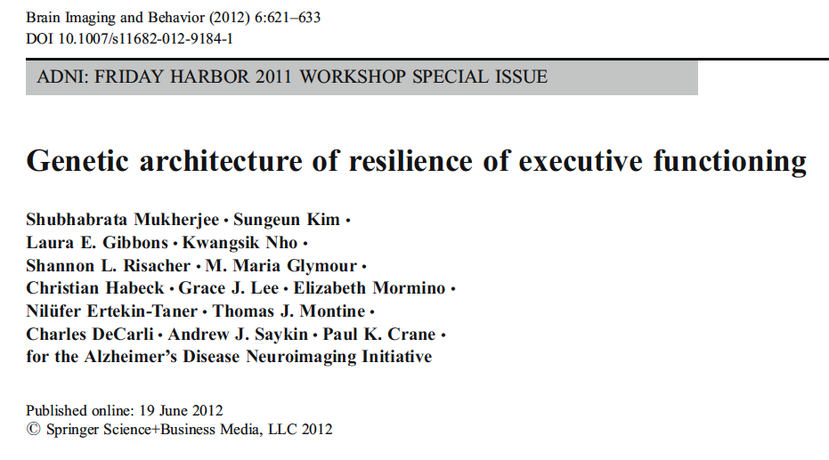
Resilience

Slide 88
Rationale for phenotype
Several demographic and imaging-derived factors are associated with EF
  Age, education, atrophy, lacunes, WMH
Regression model to predict EF
Standardized residuals of that are our phenotype
  EF beyond that predicted by independent variables
  At one extreme: resilient people with Swiss cheese for brains but intact EF

Slide 89
Important consideration: AD
Is the goal to look at an AD endophenotype or at a phenotype orthogonal to AD?
If incorporating data from multiple disease stages, need to ensure no relationship between phenotype and disease stage

Slide 90
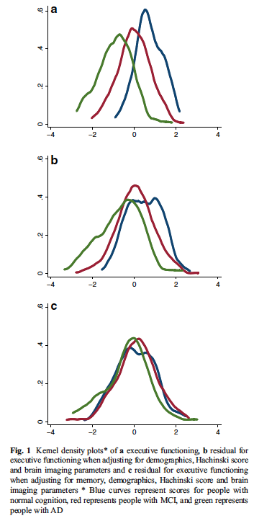

Slide 92
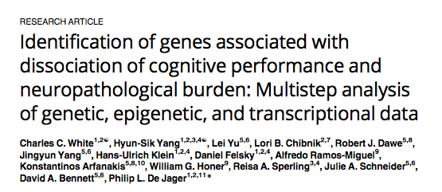

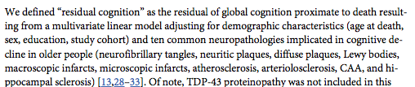
Others do this too
April 2017

Slide 93
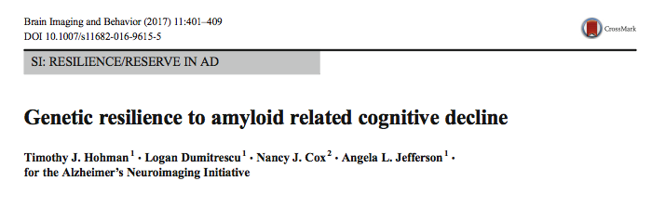
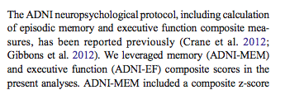
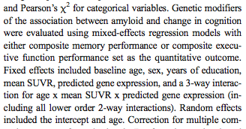

Slide 94
Cognitive AD endophenotypes
AD is one factor influencing global cognitive scores (or memory scores or any other cognitive domain)
… But there are many others
  Other neurodegenerative conditions
And premorbid intelligence / familiarity with cognitive tests / education / educational quality / SES / etc. etc. etc.
  It’s a mess!
  But we can clean it up! And the residual is really interesting and important!

Slide 95
Objectives
Understand the case-control AD phenotype
  And some really cool extensions!
Moving beyond the case-control AD phenotype
  Endophenotypes
  Phenotypes orthogonal to AD
    Subtypes
    Resilience

Slide 96
Conclusions
Tremendous opportunities to apply clinical intuition and understanding to further scientific understanding of underlying mechanisms
The cleaner the phenotype, the stronger the genetic signals
Or, in a nutshell, “It’s the phenotype, stupid!”

Slide 97

Thank you!!!
Phenotyping
  Andrew Saykin, PsychD
  Emily Trittschuh, PhD
  Jesse Mez, MD MS
Data management
  Elizabeth Sanders, BA
Psychometric Modeling
  Shubhabrata Mukherjee, PhD
  Alden Gross, PhD
  Laura E. Gibbons, PhD
  Seo-Eun Choi, PhD
Epidemiology
  Maria Glymour, PhD
  Juliana Bauman*
  Mackenzie Moore*
Genetics
  Shubhabrata Mukherjee, PhD
  Madeline Wessels*
  David Fardo, PhD
  John “Keoni” Kauwe, PhD
  Adam Naj, PhD
  Rick Sherva, PhD
  Gary Beecham, PhD
  Tim Thornton, PhD
  Kwangsik Nho, PhD
Data sources
  ROS/MAP
    David Bennett, MD
    Greg Klein
    Sue Leurgans, PhD
    Julie Schneider, MD
    Lisa Barnes, PhD
    Bryan James, PhD
  Pittsburgh
    Beth Snitz, PhD
    M. Ilyas Kamboh, PhD
  ACT
    Eric Larson, MD MPH
    KatieRose Richmire
    Bill Lee, PhD
    Steven Balch
  ADNI
    Danielle Harvey, PhD
    Mike Weiner, MD
Funding: NIA

