Slide 1
Disclaimers for all talks
Friday Harbor 2017

Slide 2
Disclaimer
This conference is supported by a grant from the National Institute on Aging (NIA) of the National Institutes of Health (NIH)
Any views expressed are the personal views of the speaker and do not imply endorsement by the NIA, the NIH, or the United States Department of Health and Human Services

Slide 3
GWAS Tutorial
Shubhabrata “Joey” Mukherjee, PhD
Laura E. Gibbons, PhD
Elizabeth Sanders
(Paul K. Crane, MD MPH)

Slide 4
Stuff Joey said to tell you about the GWAS
Software: R and PLINK installer/binary files are provided for people who have not installed them
SNP data: what we have are genotyped (not imputed) data from people with appropriate consent and European ethnicity from ADNI1 (not ADNIGO, ADNI2, or ADNI3).
Conscious choices to avoid crashing your computer (about 550,000 SNPs)
Many thanks to Kwangsik Nho for his assistance
The plan will be to perform QC and perform a GWAS with a phenotype / covariate file

Slide 5
Phenotypes in the GWAS
What is in there: ADNI-Mem, ADNI-Exec, WMH
Note that WMH is non-normally distributed, which may be an issue

Slide 6
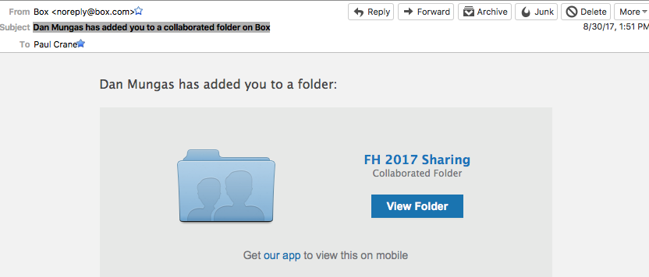
Stuff Joey said to tell you beyond the GWAS
On Box there is a file with ADNI data.
I received an email called “Dan Mungas has added you to a collaborated folder on Box”

Slide 7
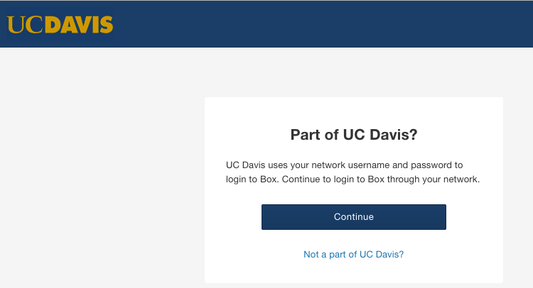

Slide 8
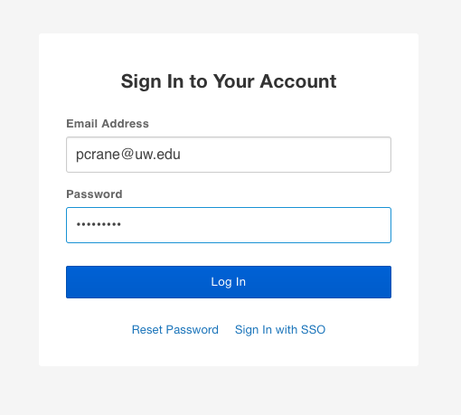

Slide 9
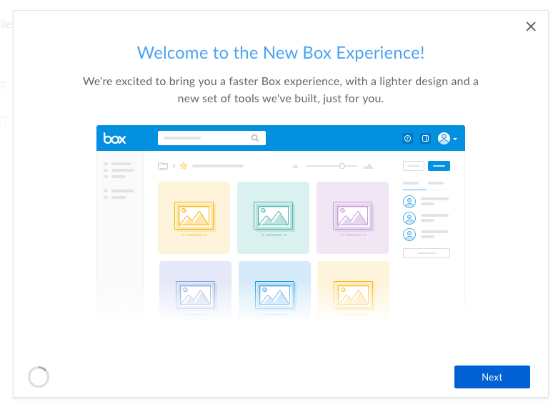

Slide 10
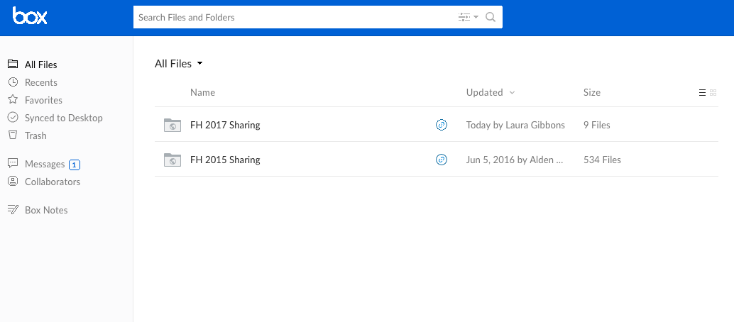

Slide 12
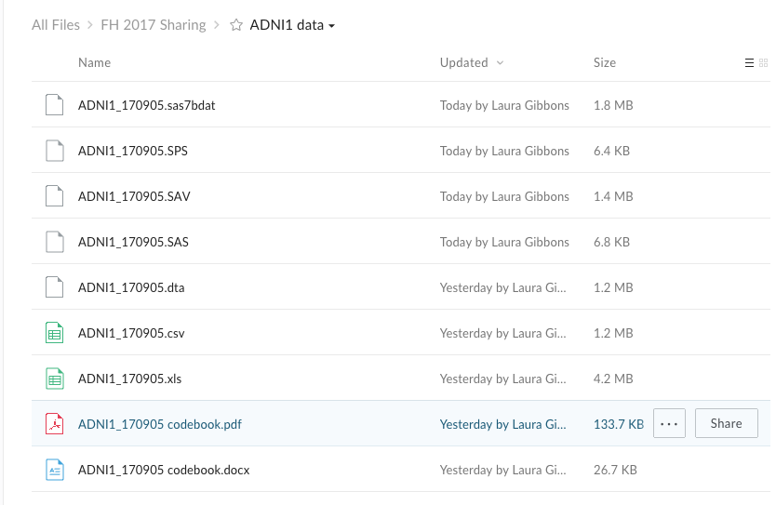

Slide 13
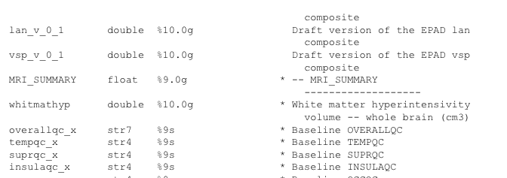

Slide 14
Notes
It should be straightforward to create a new phenotype file to go along with the genetic data that are in the tutorial
Elizabeth, Laura, and Joey spoil me tremendously (and you too!)
Note that imaging data may be profoundly not normally distributed and you may want to consider that in genetic analyses
Have fun!!!

