Slide 1
From clinical care to an epidemiological study: dealing with sporadically collected data
Paul K. Crane, MD MPH
Laura Gibbons, PhD
With much thanks to Rod Walker, MS
And Rebecca Hubbard, PhD

Slide 2
Acknowledgements
Funded in part by Grant R13 AG030995 from the National Institute on Aging
The views expressed in written conference materials or publications and by speakers and moderators do not necessarily reflect the official policies of the Department of Health and Human Services; nor does mention by trade names, commercial practices, or organizations imply endorsement by the U.S. Government.

Slide 3
Please note
I stole at least 90% of this talk from several sources
Rebecca and Rod’s work with glycemia
Notes that Laura developed
The Kullo paper
My minimal understanding of Mendelian randomization as gleaned from working with Maria, Stefan, and Joey
My minimal understanding of adjustments for frequency of follow-up gleaned from working with Chris Delaney
Many thanks to those people
Errors are mine

Slide 4
Typical prospective cohort study design
Collect exposure data at baseline, perhaps with blood samples or other data collection; baseline measure of outcomes or confirm that people don’t have a prevalent condition of interest
Follow-up visits to identify incident outcomes or measure outcomes
Analyze data evaluating associations between exposure from baseline and hazard of an outcome, or associations between exposure and trajectories of longitudinal outcomes

Slide 5
Characteristics of data collected in clinical care
Collected for a reason
Present not at random, so therefore not missing at random
Some vital signs or clinical labs are fairly routine; perhaps focus primarily on those
Others rarely obtained except in particular circumstances; those likely will have smaller numbers and have an odd cohort
Not necessarily collected when you’d like them to be for an epidemiological study
Windows of time with possible values, not each of which will have a value
Sometimes there will be lots of values in a window of time

Slide 6
Complicated example: Glycemia

Slide 8
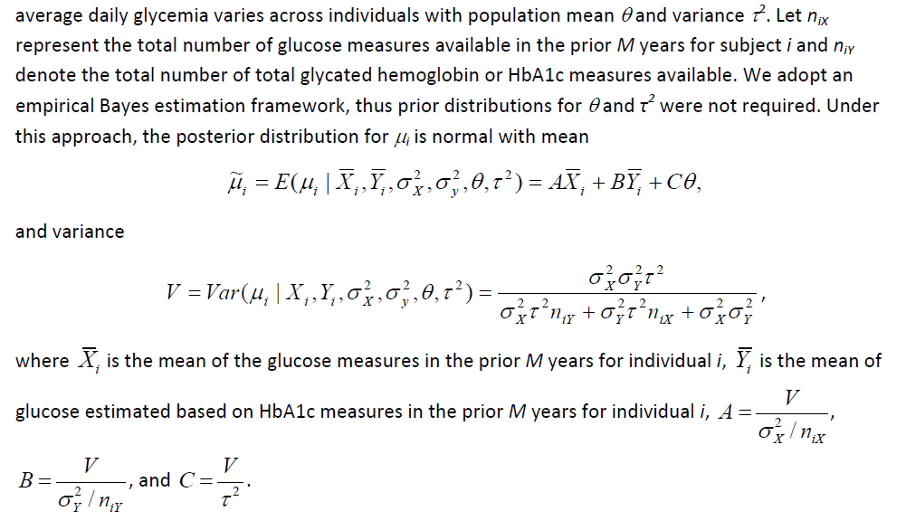

Slide 10
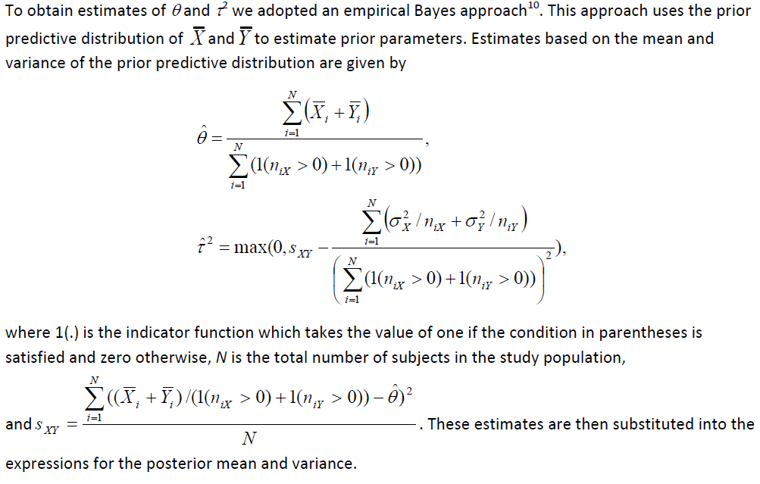

Slide 12
Summary of hard example
Two indicators of underlying thing we hope to measure, each with different amount of variability and precision
Incorporate information from each of those for each person
For time periods with sparse data, incorporate population averages (“shrinkage”)
Sensitivity analyses in which variances estimated from other sources are varied; determine impact on findings

Slide 13
Not everything is that hard
In many cases there will be only a single indicator of the thing trying to be estimated
Choice of models in that case can be broader
Three general outcomes for ACT
Time to dementia
Trajectories (cognitive functioning, depression, physical performance, …)
Neuropathology findings or other phenotypes at death (resilience)
Different considerations for each one

Slide 14
Change over time analyses (e.g. trajectories of IRT CASI score)
Think of it as a multi-level model.
Rebecca Hubbard recommends using a Restricted (aka Residual) Maximum Likelihood (REML) mixed model. Predictions will be "stabilized" in the sense that those that are based on fewer observations will be shrunk towards the population average.
From Stata: “The basic idea behind REML is that you can form a set of linear contrasts of the response that do not depend in the fixed effects…” (i.e. based on residuals after estimating fixed effects)
For some hypotheses, time-series models may be more appropriate (e.g. autoregressive integrated moving-average (ARIMA) models).

Slide 15
Autopsy models
You might want to bootstrap (drawing from the observations available for each person) to get estimates that account for the uncertainty in the exposure.
If we randomly sample one value/person, we’re assuming that the number of labs/person and the order of the labs is not informative.
You might want to calculate the mean lab value and weight the analysis based on the number of labs in those years.
Or maybe you don't want to weight. Think carefully, is having more labs a risk factor or does it just provide greater precision?
Be careful how your software handles weighting. In Stata, use “aweights”
Maybe you just want the most recent lab. Choice Depends on your hypothesis.

Slide 16
Bootstrapping in Stata
bootstrap, reps(1000) strata(rep) size(1) seed(130530): ///
reg latvent hb ageatdeath
(Note that you don't have exact age at death for this workshop, but you can estimate it by subtracting the year of death from year of birth.)

Slide 17
Failure time models (e.g. time to dementia)
Similar issues in deciding what the appropriate exposure is, and similar options for analysis.
If you bootstrap, there is a technical difficulty, at least in Stata. You can't use the bootstrap command directly (or at least Laura hasn't figured it out yet) because you need to set up the data for survival analysis (-stset-) AFTER it's been sampled. This may not be an issue in other stat programs.
In Stata, you can use the -bsample- command first,
bsample 1,strata(repos)
and then stset your data and fit the model. Put all this in a loop and post each estimate of your coefficient of interest to a file.
Note that in general the mean of the estimates using -bsample- will NOT be the mean that the corresponding -bootstrap- procedure would report.
-bootstrap- reports the coefficient in the original data, and only uses the sampling to obtain the SE of the coefficient.

Slide 18
Model adjustments and exclusions
Careful consideration of whether every value of your exposure is relevant
Values close to time of diagnosis may be caused in part by the diagnosis, leading to reverse causation
Causal pathways and diagrams to consider role of each exposure
Is the exposure directly causing the outcome?
Or is it on the causal pathway towards the outcome?
Answers to these questions may vary, depending on the scientific question

Slide 19
Consider hemoglobin
Kullo and colleagues: interested in genetic variants associated with set point of hemoglobin levels
Crane workgroup (2014, forthcoming): interested in possibility that oxygen carrying capacity may provide a mechanism for resilience
Other things being equal, having more oxygen available to your brain may enable you to resist the effects of plaques and tangles and “other badness”

Slide 20
Kullo and colleagues
For them, any value of hemoglobin that was not reflecting typical / setpoint / baseline level of hemoglobin could potentially be misleading
Say for example that an individual was in a car accident and had a major bleed, requiring transfusion of 10 units of blood
The nadir hemoglobin level reflects both the genetic hemoglobin set point AND the effects of blood loss
For them, they want to exclude that nadir hemoglobin level
Similar thinking led to the diagram on the next slide

Slide 21
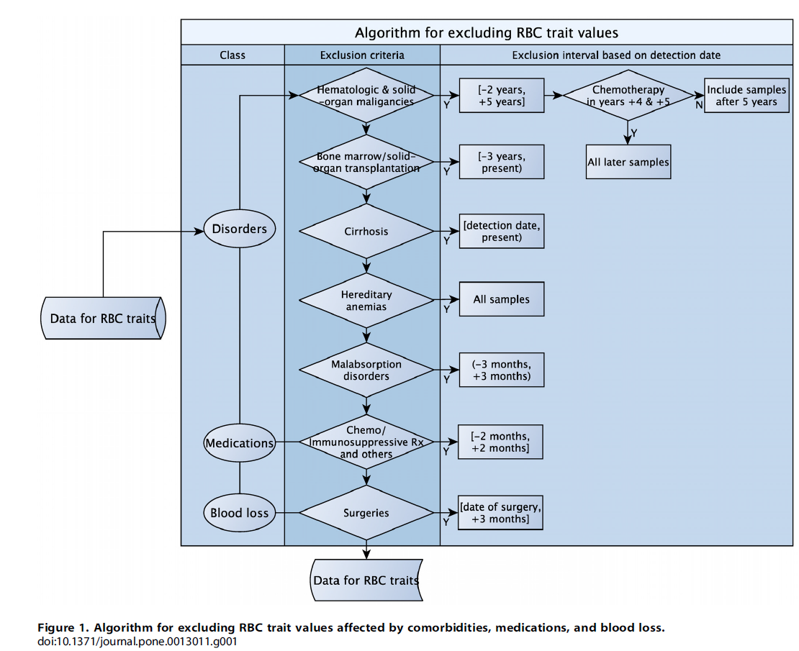

Slide 22
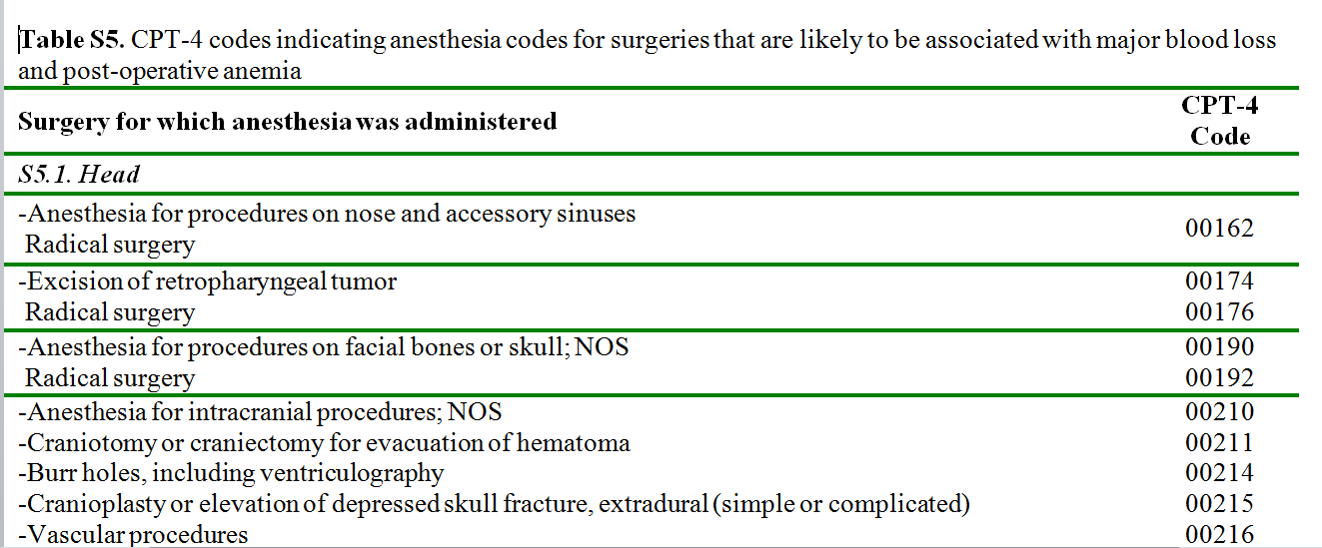
Just one of the appendices – surgeries associated with major blood loss

Slide 23
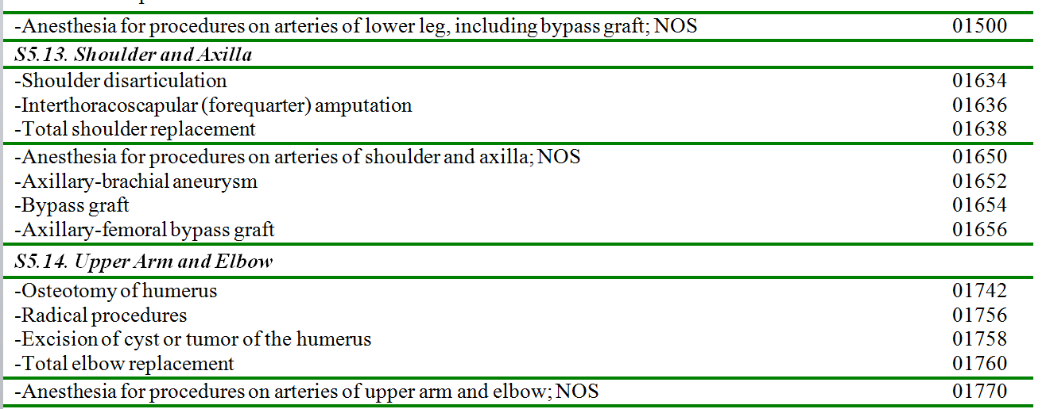
And so on
…
(bottom of page 3)

Slide 24
We have all of these data
Due to the extraordinary data availability from Group Health, we have all of the sources of data Kullo et al. considered, including dates in that second column (I’ll show that slide again in a second)
If we wanted to isolate setpoint hemoglobin levels, we could do that

Slide 26
For us, though, hemoglobin level is an exposure, not the outcome
One possible underlying biological model is that oxygen carrying capacity may act as a buffer
In that model, it’s the oxygen carrying capacity itself, not the setpoint for oxygen carrying capacity, that may impact brain outcomes
But at the same time might want to exclude really weird things
Hemoglobinopathies / congenital weirdness / sickle cell

Slide 27
Newer tricks: Mendelian randomization / gene scores
If there is a good genetic study of your exposure of interest, data from that study and genetic data from participants can be used to generate gene scores
Those gene scores reflect genetically-predicted values for your exposure of interest
May be helpful in disentangling questions of lifelong values vs. relatively acute exposures during late life

Slide 28
Frequency of follow-up not unrelated to exposure
More opportunities to measure exposure data among sicker people
Weights to account for probability of observations during the follow-up period
Could include some sort of model of frequency of any lab, or frequency of the lab you are looking at, or frequency of clinical visits
Then incorporate weights based on probability of having a relevant visit
This sort of thinking may be most important for clinical values rarely obtained (furthest away from MAR)

Slide 29
Conclusions / summary
Vast wealth of data from Group Health derived from clinical care of a cohort of people
Appropriate use requires careful thinking
Why were data generated?
What factors may influence the clinical data?
How does each of those factors relate to outcomes of interest?
Unique opportunities to pair very rich clinical data with research-quality outcomes to further our understanding of aging brains in aging bodies.

Slide 30
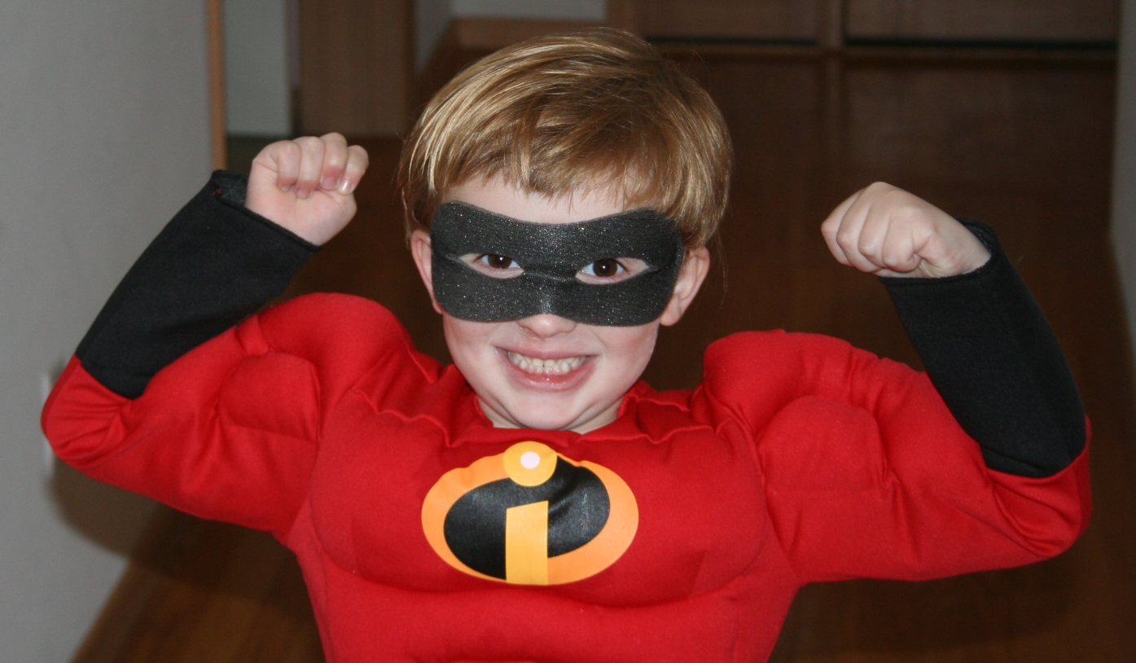
Thank you!
Laura, Rod, Rebecca, Maria, Stefan, Joey, and Chris
Group Health: Bill, Steve, Darlene, Anne, KatieRose, Erin, Eric
Laura (again) and Elizabeth

