Slide 1
Comments on the low education → dementia link
Paul K. Crane, MD MPH

Slide 2
The argument
Jen’s slides and Bruce’s slides both talked about lack of education as a known and potent risk factor for dementia
Cognitive reserve hypothesis has many proponents, including Yaakov Stern, who has done many important and good studies to buttress it
I’m probably a believer, to some extent
BUT…

Slide 3
DIF and 2-stage sampling
Paper under review took data from the Granarolo Study from Italy
  Region with high SES despite low education
MMSE (Italian translation) used as an initial screen
Those with scores of 28 or lower referred for neuropsych testing and eligible for diagnosis of dementia
Those with 29 or 30 were assumed to be free of dementia and no neuropsych testing done
No educational adjustments of the cutpoint
  EURODEM, ACT, HAAS, CSHA, Kame….

Slide 4
Findings
MMSE coded in 10 bundles, not item-level
We found DIF related to education in I think 8 of the bundles
  All with lower ed group disadvantaged
Determined the “difficulty” of the dichotomous bundles
  Pentagons right at 28
Wrote a thought experiment in the discussion section

Slide 5
Thought experiment
Imagine 2 mildly demented individuals who somehow got a score of 28 points on the other 9 item bundles
Their performance on the 10th item bundle will determine whether these mildly demented people screen positive or not
  Only if they screen positive will their mild dementia be detected; if they screen negative they will be assumed to be dementia free

Slide 6
More thought experiment
The person with less education has a smaller chance of getting the item correct than the person with high education (we did the math in the paper)
The person with high education is more likely to get the pentagons item correct and escape detection
  Thus, the problem with 2-stage sampling and DIF related to education in the first stage is under-diagnosis of people with more education
Remember these people had equal true ability levels

Slide 7
Yet more thought experiment
More argument from paper: the scenario is actually unlikely
  8 (or was it 7 or 9) bundles with DIF related to education, all in favor of those with higher levels of education
  Thus two hypothetical people with identical actual levels of cognitive functioning but different educational levels will have very different scores going into that last item bundle
A score of 28 for 9 bundles for someone with more education may be equal to a score of 24 or 25 for someone with less education
A score of 28 for someone with low education may be equal to a score of 33 for someone with high education

Slide 8
Risk factor analysis in the face of this problem
EURODEM, Granarolo, etc. etc. etc. used to study relationship between educational level and incident dementia used a 2-stage sampling design with no adjustment for DIF
There may be some relationship to education, but I am not very convinced by this particular study design
  Need at least some sampling above the line, or, ideally, no screening at all; everyone gets neuropsych tests

Slide 9
What about cognitive change over time
Sure, you say, I can buy that, but why do people with lesser amounts of education appear to have steeper declines of cognitive functioning over time?
(apply Paul’s hammer to nail here): This could be a measurement issue
Especially cognitive screening instruments (3MS, MMSE, CASI, CSI ‘D’) do not have items evenly spaced

Slide 10
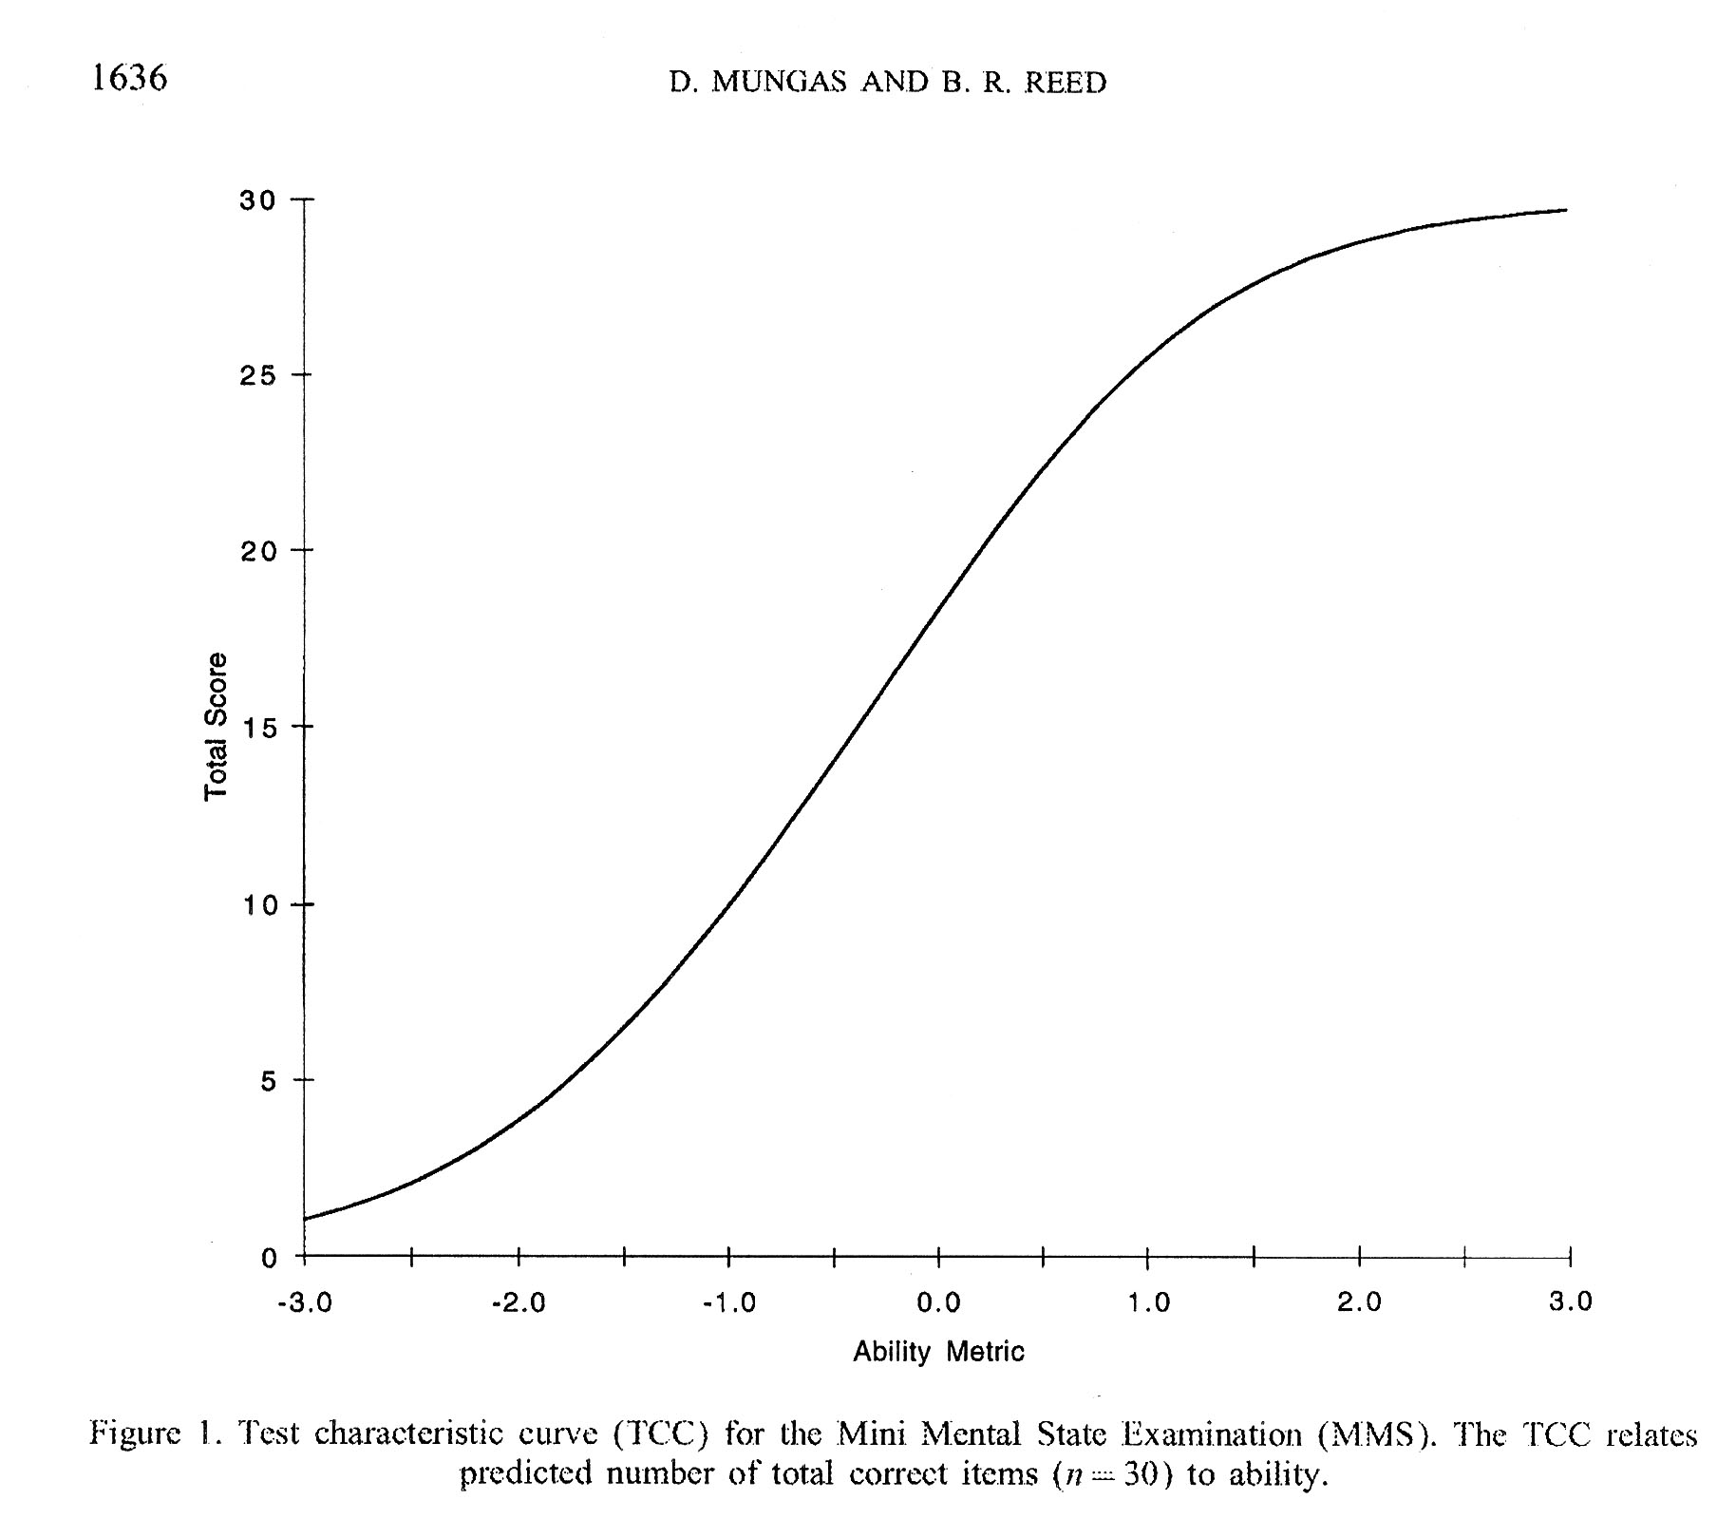
Test characteristic curve
Figure from Mungas D, Reed BR, Statist Med 2000; 19:1631-1644. n=1207.

Slide 11
Conclusions
Relationship between education and cognitive functioning measures is very tight
I’m less sure that the relationship between education and cognitive functioning itself is very tight
  DIF is everywhere, and under-acknowledged

