Slide 1
Leveraging Existing Aging Research Networks: LEARN TBI-AD Kristen Dams-O'Connor, Ph.D. Jesse Mez, MD MPH Director, Brain Injury Research Center Clinical Core Director, BU ADRC Associate Professor of Rehabilitation Medicine and Neurology Associate Professor of Neurology Icahn School of Medicine at Mount Sinai Boston University
Grant # 1 R01 AG061028-01
National Institutes of Health (NIH)/National Institute on Aging (NIA)
Grant # 1 U01 NS086625-01
National Institutes of Health (NIH)/National Institute of Neurological Disorders and Stroke (NINDS)
Grant #90DPTB0009-01-00
National Institute on Disability Independent Living and Rehabilitation Research (NIDILRR)
Grant #PCS-1604-35115
Patient Centered Outcome Research Institute (PCORI)
Grant # W81XWH-17-1-0330 Epidemiology of Military Risk Factors Award
Department of Defense CDMRP Peer Reviewed Alzheimer’s Research Program
Grant # DVBIC-W91YTZ-13-C-0015
Department of Defense – Defense and Veterans Brain Injury Center (DVBIC)
Grant #1K01HD074651-01A1
National Institutes of Health (NIH)/National Institute of Child Health and Development (NICHD)
Grant # AZ170038 Research Partnership Award
Department of Defense CDMRP Peer Reviewed Alzheimer’s Research Program

Slide 2
?

Slide 3
TBI and Dementia (2007 – present)
Type of Study | Primary Author | Publication Year | TBI → Dementia | APOE ε4 Interaction | Type of Dementia
Retrospective | Barnes | 2018 | Yes | N/A | ACD
Retrospective | Fann | 2018 | Yes | N/A | ACD, AD
Retrospective | Barnes | 2104 | Yes | N/A | ACD, AD
Retrospective | Gardner | 2014 | Yes | N/A | ACD
Retrospective | Lee | 2014 | Yes | N/A | ACD, AD
Case control | Wang | 2012 | Yes | N/A | AD, VaD, ACD
Case control | Suhanov | 2006 | Yes | N/A | AD
Prospective | Abner | 2014 | Conditional | N/A | AD
Prospective | Nordstrom | 2014 | Conditional | N/A | YOD/ACD
Prospective | Sundstrom | 2007 | Conditional | N/A | ACD
Case control | Sayed | 2013 | Conditional | N/A | AD, LBD, VaD, FTD
Prospective w. Autopsy | Crane | 2016 | No | No | ACD, AD LBD, PD
Prospective | Dams-O’Connor | 2013 | No | No | ACD, AD
Prospective | Helmes | 2011 | No | N/A | ACD

Slide 5
Methodological Challenges
Exposure ascertainment
Outcome ascertainment
Selection bias
Causal inference
Notes:
A lifetime history of TBI was not associated with elevated risk for developing subsequent incident dementia or incident possible or probable AD.
Evaluated dementia risk by age at injury: no increased risk regardless of age at TBI w LOC
HR ranged 1.02-1.06 (95% CI = 0.78-1.39)
No interaction between the APOE ε4 allele and history of TBI in increasing the risk for developing dementia or AD
Likelihood ratio test p=0.6.

Slide 6
How to measure TBI exposure?
X
Medical Records
ICD-9/10
Chart abstraction
Claims data
MISSING:
TBIs treated by PCP, outside of health system, etc.
Unreported TBIs (domestic violence, gang violence, etc.)
TBI in context of severe extracranial trauma
Self Report
Single-item screener
Structured Interview (e.g., BISQ, OSU-TBI-ID, BAT-L)
Other Report
Medical Record
Other Report
Self Report
Notes:
*Even in prospective studies of hospitalized TBI pts (injury well characterized), still want to measure prior exposure and re-injury.
Missing ex/ CDC estimates omit TBIs treated at PCP offices, urgent care, military or VA hospitals, untreated TBI, and TBIs that aren’t entered into medical record).
BAT-L = Boston Assessment of TBI-Lifetime

Slide 7
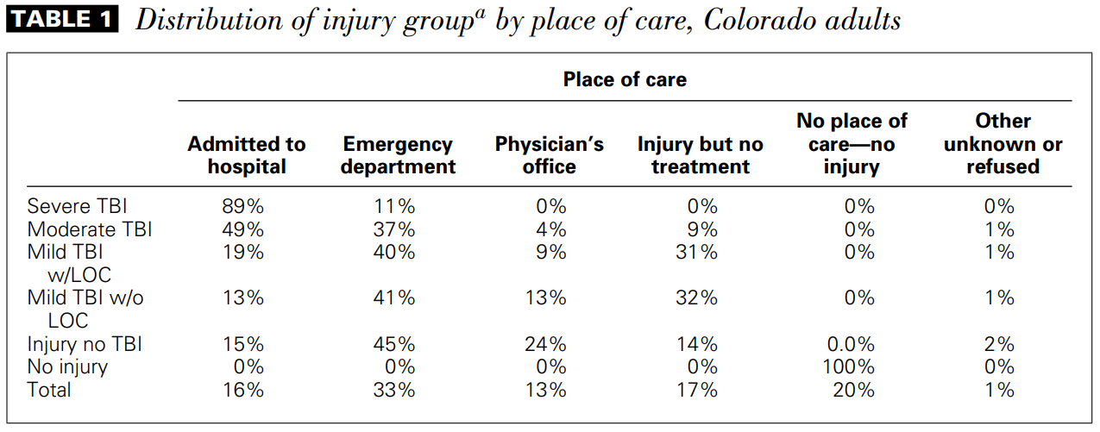
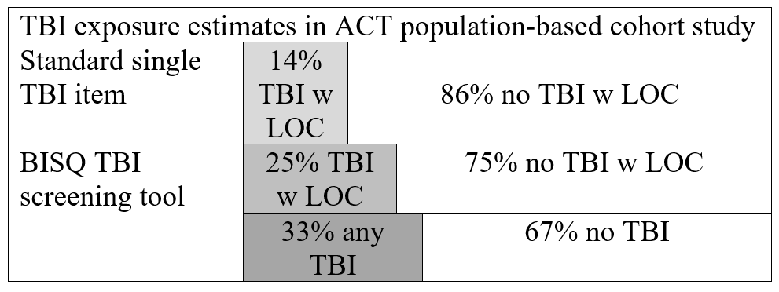
Non-hospitalized TBI: greater disability (Whiteneck 2016 JHTR)
Population-based study:
42% report TBI
Whiteneck 2016 JHTR
Notes:
43% of Coloradoans reported a lifetime history of TBI. (18% reported most severe was mTBI w no LOC, 18% had mTBI w LOC). A full 28% didn’t seek tx.
Those who didn’t seek tx had worse outcomes (?) – implications for what ‘not seeking tx’ may be proxy for

Slide 8
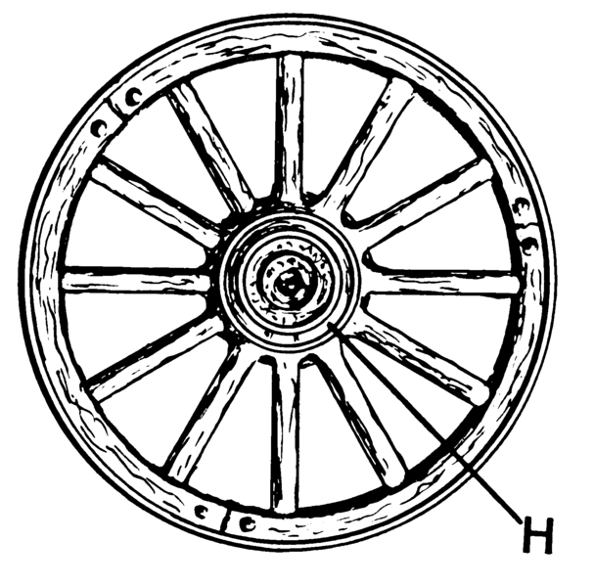
Self-report measurement of lifetime TBI exposure
Brain Injury Screening Questionnaire *
(Gordon 2000; Dams-O’Connor 2014)
Ohio State University TBI Identification Method *
(Corrigan 2007; Bogner 2009)
Consistent Methodology

Slide 9
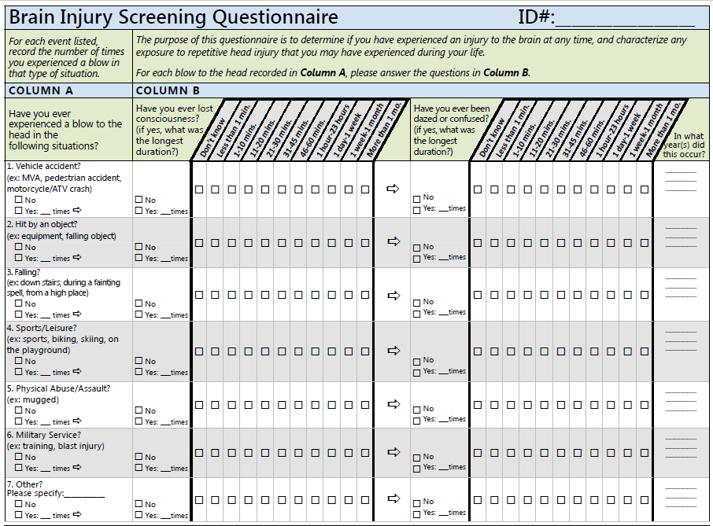

Slide 10
How to capture dementia diagnosis?
Autopsy-confirmed Diagnosis
Alzheimer’s disease: NIA/AA guidelines (Hyman et al, 2012; Montine et al, 2012)
Parkinson's disease (Braak et al., 2003; Dickson et al., 2009)
FTLD (Cairns et al., 2007)
Consensus-based Diagnosis
NINCDS/ADRDA (McKhann et al., 1984)
American Psychiatric Association DSM-IV/V
CERAD (Morris et al.,1989)
Claims data
ICD-9 codes, Defense and Veterans Brain Injury Center (DVBIC) and the Armed Forces Health Surveillance Branch (AFHSB)
ICD-9 codes, VA Dementia Steering Committee
ICD-9 CM codes, National Center for Injury Prevention and Control, Centers for Disease Control and Prevention (Marr et al., 2002).
Payment and service implications
Medical record abstraction
Trained data abstractor, local SOPs
Natural language processing
Notes:
(these are in hierarchical order I guess? Abstraction prob better than claims).

Slide 11
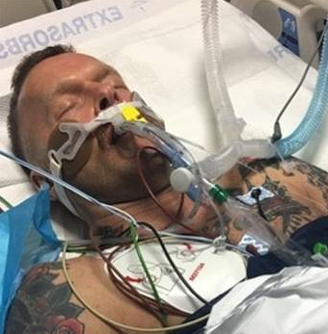
Selection Bias in TBI-ADRD Research
Death (20%)**
Autopsy
Research Study
. . . . . . . . . . . . . . . . . . . . . . . . . . . . . . . . . . . . . . . . . . . . . . . . . . . . . . . . . . . . . . . . . . . . . . . . . . . . . . . . . . . . . . .
Year 1 | Year 2 | Year 3 | Year 4 | Year 5 | Year 6 | Yea 7 | Year 8 | Year 9 | Year 10 | Year 11 | Year 12 | Year 13 | Year 14 | Year 15
Injury Severity
Age
Pre-existing cond
Complications
Inclusion/Excl. Criteria
Survival to eligibility
Capacity
Access to care
Identification w TBI
Financial incentive
Altruism
Boredom
Higher education
White
Better rehab outcomes***
Stable housing
??
Risk behavior
Substance use
Depression*
IADL difficulty*
*Dams-O’Connor 2016
**TBI Model Systems National Database
***Krellman 2014

Slide 12
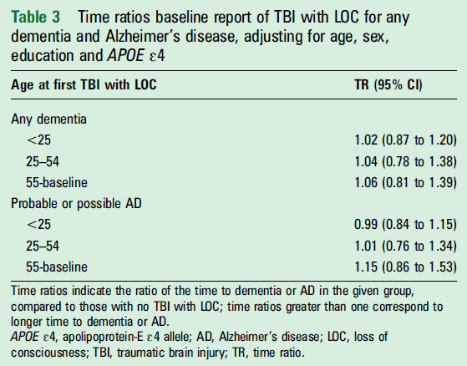
Parent study inclusion criteria:
Enrolled in health plan
Age 65+
Dementia-free at baseline
1 K01 HD074651-01A1 (NIH-NICHD)
Notes:
***TWO EXAMPLES of how selection into a study may bias research on TBI-ADRD associations (KDOC/ACT and Mez/McKee papers)
→ This study: can interpret findings as suggesting a model of diminishing risk?
A lifetime history of TBI was not associated with elevated risk for developing subsequent incident dementia or incident possible or probable AD.
Evaluated dementia risk by age at injury: no increased risk regardless of age at TBI w LOC
HR ranged 1.02-1.06 (95% CI = 0.78-1.39)
No interaction between the APOE ε4 allele and history of TBI in increasing the risk for developing dementia or AD
Likelihood ratio test p=0.6.

Slide 13
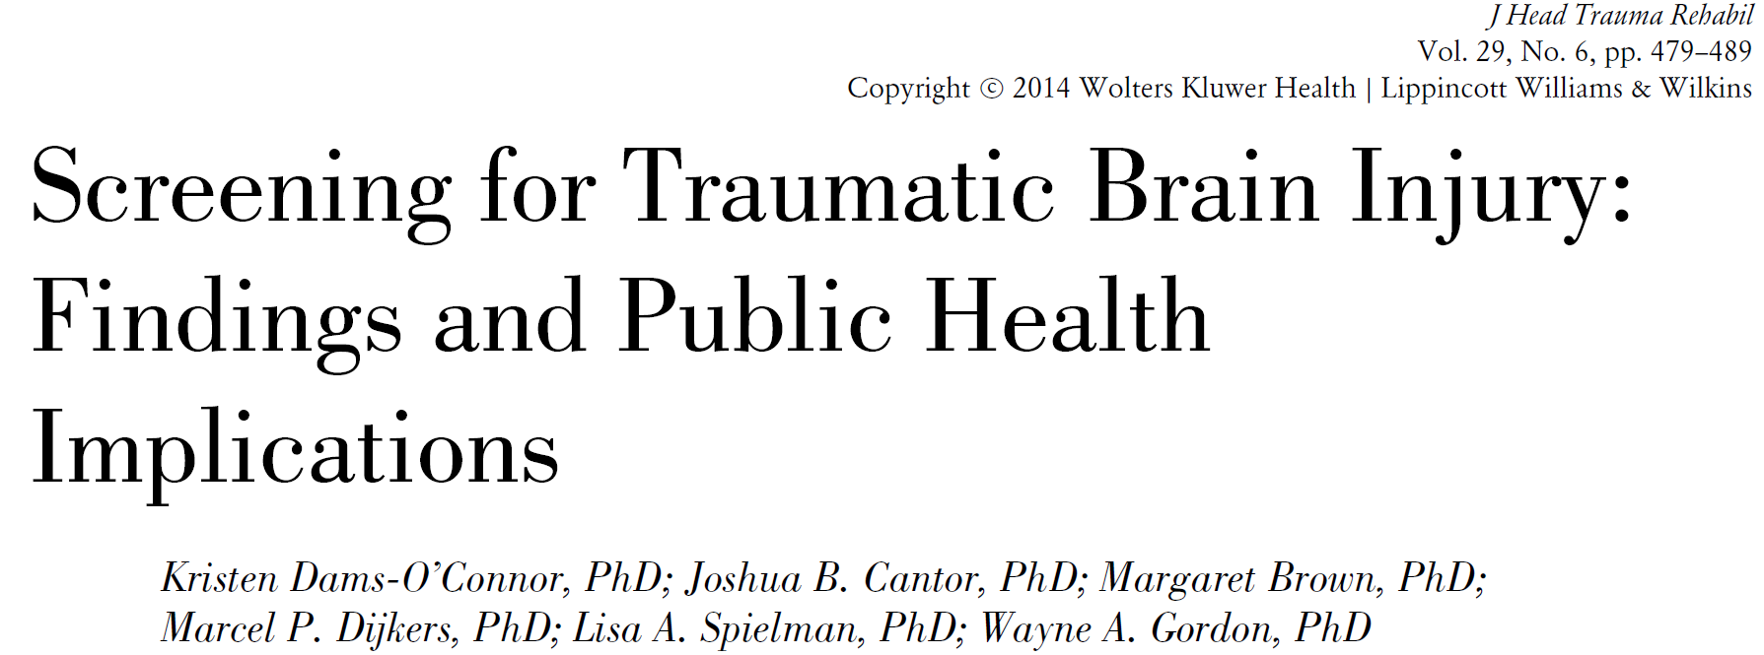
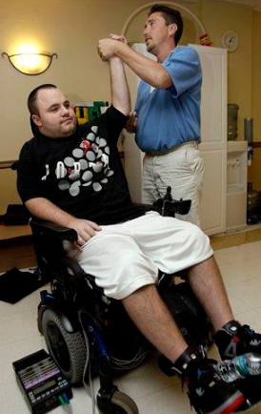
~70%
~75%
Research participants
~50%
40-60%
~10%**
. . . . . . . . . . . . . . . . . . . . . . . . . . . . . . . . . . . . . . . . . . . . . . . . . . . . . . . . . . . . . . . . . . . . . . . . . . . . . . . . . . . . . . .
Year 1 | Year 2 | Year 3 | Year 4 | Year 5 | Year 6 | Yea 7 | Year 8 | Year 9 | Year 10 | Year 11 | Year 12 | Year 13 | Year 14 | Year 15
Notes:
Need to recruit from the community, NOT just the clinic
Well demonstrated in dementia research (ADC cohorts are often clinic based, those recruited in community are different)

Slide 14
Age at injury influences dementia risk after TBI
Victoria Johnson and Willie Stewart, Nature Reviews Neurology 2015
Notes:
Many of the neurodegenerative pathologies described in TBI survivors might also arise through ‘normal’ ageing (green line). The data presented by Gardner et al.1 support the hypothesis of an accelerated accumulation of neurodegenerative pathology following a single moderate or severe TBI regardless of age at time of injury (pink line), so crossing a threshold to clinical symptoms (dotted line) at an earlier age. By contrast, increased dementia risk after mild TBI was only present in patients aged ≥65 (orange line), implying no meaningful acceleration in neurodegenerative pathologies in patients aged <65 (blue line). Arrows indicate the occurrence of a TBI.
Some evidence suggests early life TBI may confer increased risk for neuropathology later in life. In any case: prob not sufficient to consider age at injury as a covariate, may need to consider possibility that exposure-outcome relationships may differ depending on age at exposure.

Slide 15
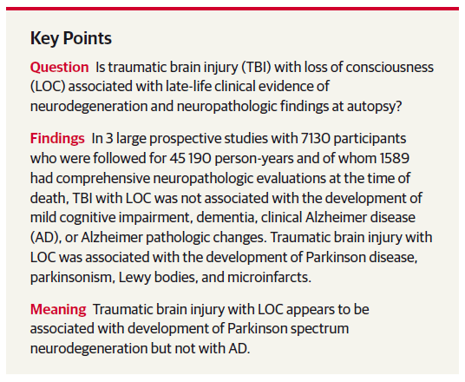
Notes:
ROS started in 1994, enrolled older religious clergy from >40 groups across US
MAP started in 1997, enrolled older residents from Chicago-area retirement facilities, subsidized housing, church groups & social service agencies
Annual battery of 21 cognitive tests (19 in common)
Computer-scored results reviewed by a neuropsychologist to diagnose cognitive impairment
Participants evaluated by a clinician who used cognitive and clinical data to identify AD and dementia
MCI defined as cognitive impairment without dementia
PD: self-report (“Has a doctor ever told you you have….”), mUPDRS every study visit
Detailed methods for both studies have been published (extensively)
Methods are similar; data were combined for analysis.

Slide 16
Pooled results

Slide 17
Exposure younger than Age 25 results
Notes:
Sensitivity Analyses:
Most people with TBI with LOC>1 hour sustained their TBI at age <25
Repeated analyses looking at people with TBI with LOC younger than age 25 compared to those who never had a TBI with LOC
Censored people who had a TBI with LOC after age 25 for these analyses

Slide 18
Circulatory diseases: >40%
Respiratory diseases: 9%
Mental/behavioral Dx: 28%
Nervous System Dx: 25%
Endocrine diseases: 19%
Any of above: 70%*
Life course context
Prior TBI: 40%**
. . . . . . . . . . . . . . . . . . . . . . . . . . . . . . . . . . . . . . . . . . . . . . . . . . . .
Childhood | Adolescence | Adulthood
. . . . . . . . . . . . . . . . . . . . . . . . . . . . . . . . . . . . . . . . . . . . . . . . . . . . . . . . . . . . . . . . . . . . . . . . . . . . . . . . . . . . . . .
Year 1 | Year 2 | Year 3 | Year 4 | Year 5 | Year 6 | Yea 7 | Year 8 | Year 9 | Year 10 | Year 11 | Year 12 | Year 13 | Year 14 | Year 15
*Isokuortti 2013
**Corrigan 2013
Notes:
Considering TBI in a life course context elucidates the complexity of relevant causal relationships in studying TBI-ADRD risk
Ppl w TBI have high(er?) rates of other health conditions. Many have prior TBI (past TBI increases risk for subseq TBI).
Highlight one in particular: early life advantage

Slide 19
Childhood
Environment
TBI
Dementia
Unmeasured confounding
Notes:
When an exposure isn’t assigned randomly (e.g., tx in RCT), need to account for confounding to obtain an unbiased estimate of the relationship of interest.
Confounding occurs when a factor is associated with (or causes) both Exposure and Outcome, and is not on the causal path bw Exposure (Tx) and Outcome.
Standard approaches: remove influence of confounders on the relationship of interest to isolate true effects by means of propensity score methods or regression analysis.
Mentioning early life advantage bc it’s a perfect example of a relevant confounder, and it is often not included in TBI-ADRD studies.

Slide 20
. . . . . . . . . . . . . . . . . . . . . . . . . . . . . . . . . . . . . . . . . . . . . . . . . . . . . . . . . . . . . . . . . . . . . . . . . . . . . . . . . . . . . . .
Year 1 | Year 2 | Year 3 | Year 4 | Year 5 | Year 6 | Yea 7 | Year 8 | Year 9 | Year 10 | Year 11 | Year 12 | Year 13 | Year 14 | Year 15
Seizures
Metabolic Dx
Endocrine Dx
Substance use Dx
Inflamatory Dx
Cardiovascular
Cerebrovascular
Diabetes
Sedentary
Notes:
TBI→ disease process. Earlier onset of diseases, greater burden w age, premature mortality.

Slide 21
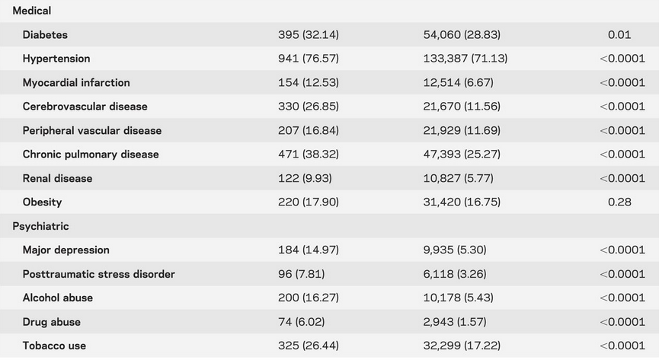

Slide 22
Disease
Burden
m
TBI
Dementia
Quantify mediation
Notes:
A mediator = 3rd variable that mediates (partially or fully) the relationship bw Exp and Outcome.
Standard approaches: mediation analysis (m) to estimate the components of the total effect of exposure on outcome
This is just one of zillions of factors affecting relationship bw TBI and ADRD.
There is some controversy over whether/how to incorporate factors that are “downstream” of the exposure into models testing associations…

Slide 23
Uniform Measurement
Adjust for selection
Test for Mediation
. . . . . . . . . . . . . . . . . . . . . . . . . . . . . . . . . . . . . . . . . . . . . . . . . . . . . . . . . . . . . . . . . . . . . . . . . . . . . . . . . . . . . . .
Year 1 | Year 2 | Year 3 | Year 4 | Year 5 | Year 6 | Yea 7 | Year 8 | Year 9 | Year 10 | Year 11 | Year 12 | Year 13 | Year 14 | Year 15
Marginal Structural Models?
Model competing risks
Notes:
Ideal = study what happens to a person w TBI and what happens to that person wo TBI (counterfactual) Only way to estimate causal effects is to compare 2 groups that are ID in every way EXCEPT that 1 had TBI 1 didn’t. Approximate: marginal structural models attempt to fully adjust for measured confounders to enhance group comparability and estimate causal effects in a similar way. (Only RCT can balance measured AND unmeasured confounders)

Slide 24
Leveraging Existing Aging Research Networks to investigate TBI and AD/ADRD risk (LEARN TBI & AD)
Combined dataset of up to 24 years of longitudinal data
>19,700 individuals
Comprehensive investigation of TBI-AD/ADRD relationships
Notes:
Traumatic brain injury (TBI) has long been considered one of the strongest environmental risk factors for dementia, though the strength and stability of this association is inconsistent across studies.^{1,2} Rates of TBI have increased as TBI-related deaths decreased,⁵ which means a growing number of individuals are living (and aging) after TBI. Due to differences in study design and analytic strategy, inconsistent definitions of exposures and outcomes, and limited sample sizes of individual studies, it remains unclear whether and under what circumstances TBI may be associated with increased risk for AD/ADRD. There is also growing evidence that repetitive head impacts (RHI),⁶⁻⁸ and perhaps single TBI,⁹⁻¹¹ are associated with an apparently distinct pathological disease, chronic traumatic encephalopathy (CTE).¹² The relationship of CTE with well-established AD/ADRDs and their clinical phenotypes remains unclear. RHI has primarily been studied in selected groups of athletes, so the CTE frequency and risk factors in community cohorts remain unknown. Identification of environmental and genetic risk factors, risk indicators, and effect modifiers using highly informative multi-level models requires very large samples. We will apply individual patient data meta analysis (IPDMA)^{3,4} using IPD from 5 ongoing longitudinal cohort studies with clinical and neuropathological dementia endpoints to conduct the most comprehensive evaluation of the relationships of TBI and RHI with AD/ADRD to date.

Slide 25
LEARN TBI & AD
We will test the association of TBI and RHI on clinical AD/ADRD outcomes.
- Dementia, AD, PD and dementia with Lewy bodies (DLB); and
- Decline in AD/ADRD clinical endophenoptypes, including cognition, activities of daily living (ADLs), mood and motor function.
We will test the association of TBI and RHI on neuropathological AD/ADRD outcomes. We will use autopsy data to test associations of:
- TBI and RHI with pathologically confirmed AD, PD and DLB
- TBI and RHI with other ADRD semi-quantitative and quantitative neuropathological indices including NFTs, diffuse and neuritic plaques, Lewy bodies, TDP-43 and vascular pathology.
We will determine if genetic risk loci associated with brain
function/disease modify these associations.
We will investigate CTE neuropathology in community-based cohorts. We will apply consensus-derived CTE neuropathological diagnostic criteria:
- To estimate lifetime the cumulative incidence of CTE in the community,
- To test associations of TBI and RHI and other risk factors (e.g., APOE ε4 genotype) with CTE pathology, and
- To measure the variance in AD/ADRD clinical outcomes accounted for by CTE pathology, independent of other pathologies.

Slide 26
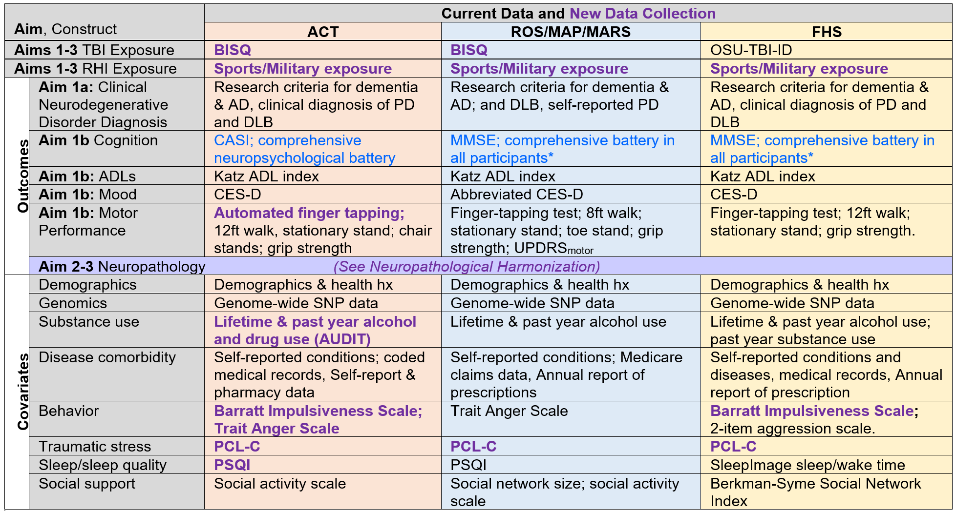
LEARN TBI & AD

Slide 27
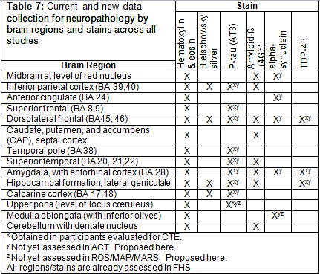
LEARN TBI & AD
Notes:
New ACT neuropath for LEARN project involve additional tissue sampling and immunohistochemistry:
- IHC stains for alpha-synuclein and TDP-43 (to harmonize the ACT neuropathology data with other cohorts)
Additional sampling and pTau IHC will be performed to assess for CTE according to consensus guidelines.
Thal phase scores will be calculated using existing and new amyloid beta immunohistochemistry.

Slide 28
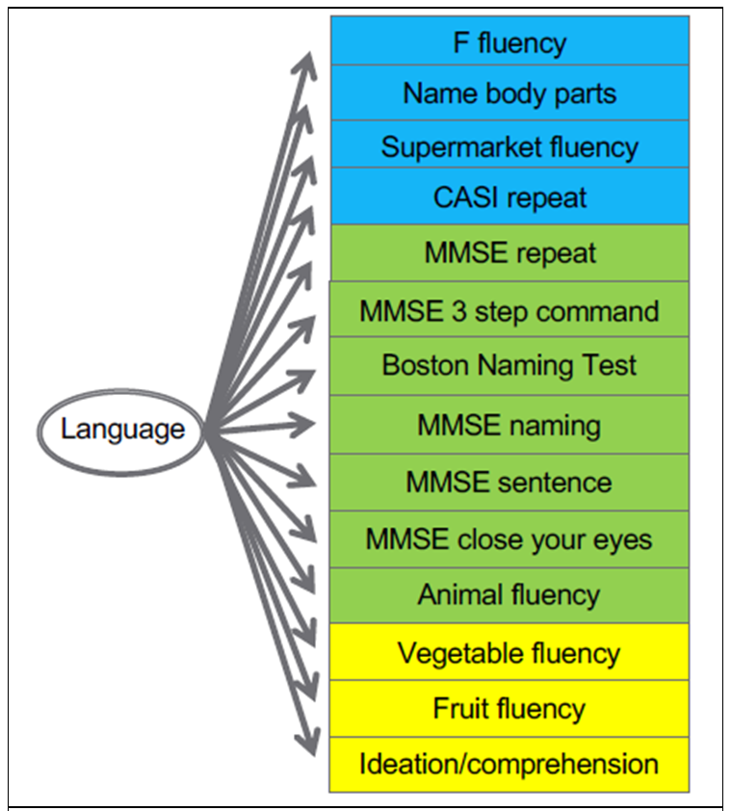
Integrative Data Analysis/Individual Patient Data Meta Analysis (IPDMA)
= Pool raw data from 2+ individual studies
Like traditional MA, useful when outcome-exposure relationships differ across studies
Increased sample heterogeneity, greater representation of low-frequency outcomes
Directly model sources of between-study/between-subject variability
Broader psychometric assessment of key constructs
Increased statistical power to test complex models
Identify sources of between-study heterogeneity and model their effects on IV-DV assoc
Uniform data coding
Unified definition of TBI
Harmonize covariates and outcomes (= construct, ≠ measure)
Pool data, analyze
Plan B: Coordinated analysis of IPDMA
Notes:
4.7.6 Psychometric harmonization of clinical outcomes. When the same construct is measured differently across studies, advanced psychometric methods provide an empirical framework to ensure that the same construct is measured in a psychometrically equivalent way across studies and maximizes precision. Although IPDMA does not require that the same measures are used across studies,^{73, 183, 191} there are important advantages to psychometric harmonization.^{73, 183, 191} This approach places all the items measuring a given construct across all studies on a uniform metric, which facilitates interpretation of results and maximizes the precision with which the upper and lower ranges of the construct can be measured.¹⁹¹ We will use IRT-based approaches to develop uniform measures of key constructs (see Table 5) as described in our prior NIH-funded work (see Figure 1). We will use IRT-based methods to place CES-D scores from different test versions on a uniform metric, and to co-calibrate cognitive screening tests (CASI, MMSE) as done previously.²⁰⁷ We will create a motor composite as done in previous work.²⁰⁸ We will use overlapping items to co-calibrate measures of behavioral aggression and of sleep quality. We will use SEM and IRT to co-calibrate cognitive test items to produce harmonized scores for memory, executive functioning, language, and visuospatial ability (see Fig 1). UW will lead IRT-based analyses with input from content experts via regular teleconferences.
Single factor model of language domain in ACT and ROS/MAP/MARS. Blue items are obtained in ACT only, yellow items are obtained in ROS/MAP only and green “anchor” items are obtained across the studies.

Slide 29
Leveraging Existing Aging Research Networks to investigate TBI and AD/ADRD risk (LEARN TBI & AD)
Individual Patient Data Meta Analysis (IPDMA)
Notes:
Traumatic brain injury (TBI) has long been considered one of the strongest environmental risk factors for dementia, though the strength and stability of this association is inconsistent across studies.^{1,2} Rates of TBI have increased as TBI-related deaths decreased,⁵ which means a growing number of individuals are living (and aging) after TBI. Due to differences in study design and analytic strategy, inconsistent definitions of exposures and outcomes, and limited sample sizes of individual studies, it remains unclear whether and under what circumstances TBI may be associated with increased risk for AD/ADRD. There is also growing evidence that repetitive head impacts (RHI),⁶⁻⁸ and perhaps single TBI,⁹⁻¹¹ are associated with an apparently distinct pathological disease, chronic traumatic encephalopathy (CTE).¹² The relationship of CTE with well-established AD/ADRDs and their clinical phenotypes remains unclear. RHI has primarily been studied in selected groups of athletes, so the CTE frequency and risk factors in community cohorts remain unknown. Identification of environmental and genetic risk factors, risk indicators, and effect modifiers using highly informative multi-level models requires very large samples. We will apply individual patient data meta analysis (IPDMA)^{3,4} using IPD from 5 ongoing longitudinal cohort studies with clinical and neuropathological dementia endpoints to conduct the most comprehensive evaluation of the relationships of TBI and RHI with AD/ADRD to date.

Slide 30
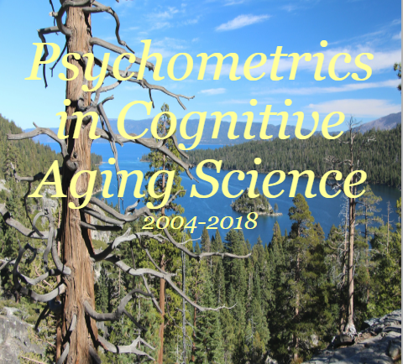

Slide 31
Thank You kristen.dams-o’connor@mountsinai.org
University of Washington Uniformed Services University
Paul Crane MD MPH of Health Sciences/CNRM
Laura Gibbons PhD C. Dirk Keene MD Dan Perl MD
Christine Mac Donald PhD Dara Dickstein PhD
Jeanne Hoffman PhD
New York Medical Examiner’s Office
KPW Health Research Institute Rebecca Folkerth MD
Eric Larson MD MPH
Rod Walker, MPH George Washington University
Melinda Power, PhD
Massachusetts General Hospital/Harvard
Brian Edlow MD Bruce Fischl PhD Rush University Medical Center
Ona Wu PhD Lilla Zollei David Bennett MD Julie Schneider MD Lisa Barnes PhD Sue Leurgans PhD
TBIMS Data and Statistical Center
Jessie Ketchum, PhD Dave Mellick, MA Boston University
Ann McKee MD Jesse Mez MD
University of Pennsylvania
Ramon Diaz-Arrastia, MD PhD Icahn School of Medicine at Mount Sinai
Sam Gandy MD PhD John Crary MD PhD

Slide 32
Thank You kristen.dams-o’connor@mountsinai.org
@SinaiTBI @BrainInjuryResearchCenter

Slide 33
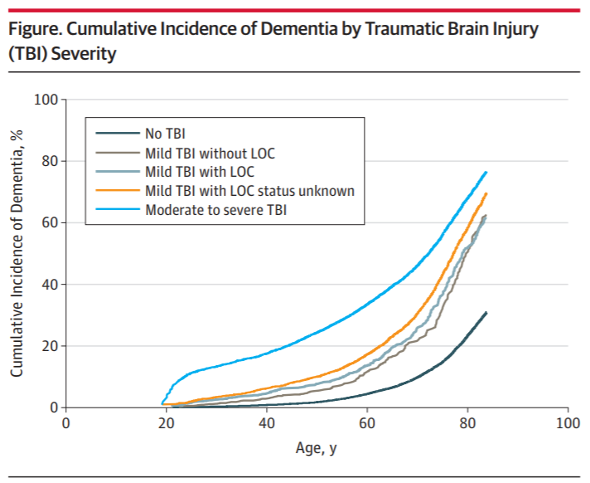
Danish National Registry study:
after clinical review, 58% vs 86% dementia cases correctly classified in those <60y vs 60+
(Salem et al., 2014)
Notes:
Danish administrative data study found only 58% of EOD diagnoses were correctly classified after clinical record review, compared to 86% in older adults. (Salem LC, Andersen BB, Nielsen TR, Stokholm J, J�rgensen MB, Waldemar G. Inadequate Diagnostic Evaluation in Young Patients Registered with a Diagnosis of Dementia: A Nationwide Register-Based Study. Dementia and Geriatric Cognitive Disorders Extra. 2014;4(1):31-44. doi:10.1159/000358050)
Pugh et al: review of ICD-9 codes used by VA (Barnes et al) - only 26% actually had evidence of cognitive dysfunction based on the medical record, few of whom would meet clinical criteria for dementia

Slide 34
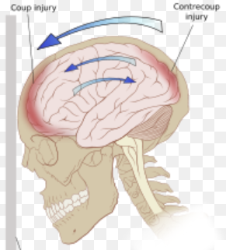
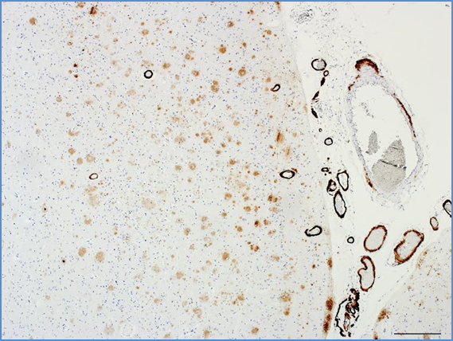
Where does the TBI end and the Dementia begin?
Slowed processing speed * Memory problems
Apathy * Irritability * Executive dysfunction
ADL problems * Gait disturbance * Motor slowing
Unified definition of Post-Traumatic Dementia
Notes:
**With respect to defining the outcome: prospective studies (ideally w autopsy endpoints) are needed to validate a unified definition. Til then, we honor a hierarchy: autopsy confirmed, consensus based, etc etc. Exercise caution when basing study on medical record data.

Slide 35
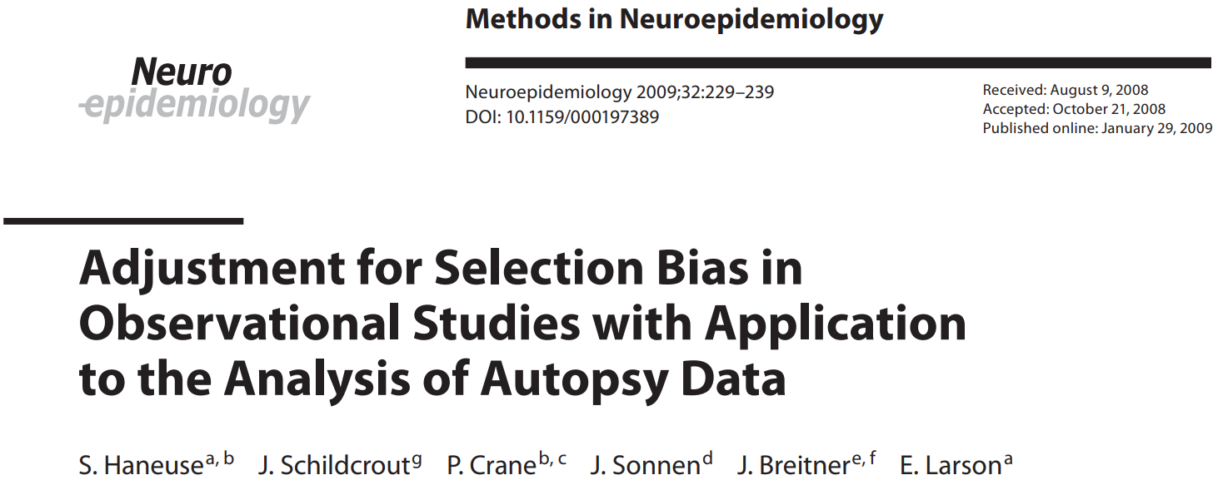
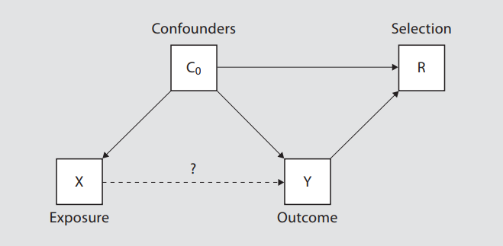
Competing risks
Notes:
Haneuse et al: When information is available on factors that govern selection, inverse-probability weighting provides an analytic approach to adjust for selection bias
Adjustment for potential selection bias yields substantially strengthened association between neuro-pathological outcomes and dementia status at death.
Confounders of the NP risk factor-dementia association can be separated into two groups; those that further act as predictors of the selection mechanism denoted C 0 , and those that do not, denoted C 1 . When there are ALSO covariates that are risk factors for selection but not for dementia, there is risk for selection bias.
Conclusions: Armed with analytic techniques to adjust for selection bias and to ensure generalizability of results from population-based neuropathological studies, researchers should consider incorporating information related to selection into their data collection schemes.
(figure 4 in this paper provides a directed acyclic graph indicating various relationships between variables associated with dementia and selection. For clarity, confounders of the NP risk factor-dementia association have been separated into two groups; those that further act as predictors of the selection mechanism denoted C 0 , and those that do not, denoted C 1 . Finally, Z denotes covariates that are risk factors for selection but not for dementia. From figure 4 we see that L = (Y, C 0 , Z); it is clear that both of the Hernán et al. [6] criteria apply, indicating potential selection bias.)
**IPW not necessarily appropriate for investigating impact of attrition-due-to-death on Exp-outcome relationships (essentially upweights dead ppl and pretends they are not different – when they obviously and fundamentally are).

