Slide 1
Friday Harbor 2017
Power and Heritability
Sept 7 2017
David Fardo

Slide 2
OUTLINE
Goal: be able to answer the following questions
What is statistical power?
What is unique about genetic association studies?
How can I conduct a power analysis for an association study?
What is heritability?
What is heritability not?
Notes:
Some slides are included more for later reference.

Slide 3
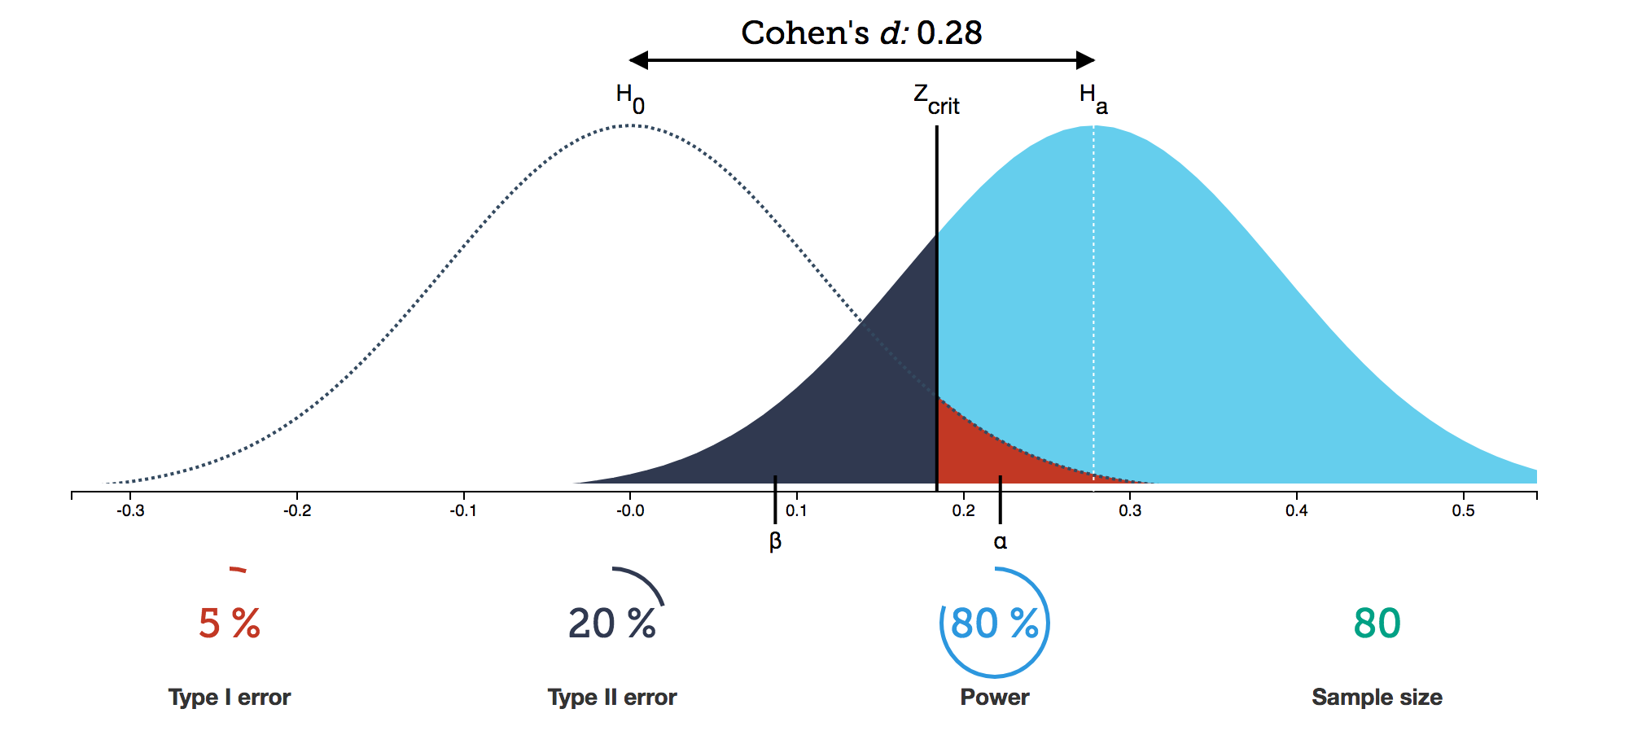
POWER
http://rpsychologist.com/d3/NHST/

Slide 4
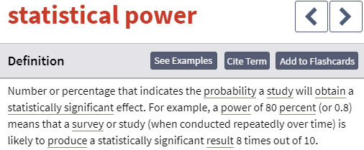
What is Statistical Power ?
From BusinessDictionary.com
http://www.businessdictionary.com/definition/statistical-power.html

Slide 6
What is Statistical Power ?
I like to say (simply):
“Statistical power is the chance of conducting a statistical test and finding something that is there”
This is still a little loose, so let’s define it as:
“The probability of rejecting the null hypothesis when the alternative hypothesis is true”

Slide 7
What affects power ?
(ignoring frequentist / hypothesis testing /
p-value controversies)

Slide 8
POWER
http://rpsychologist.com/d3/NHST/
Notes:
INTERACTIVE power lesson…

Slide 9
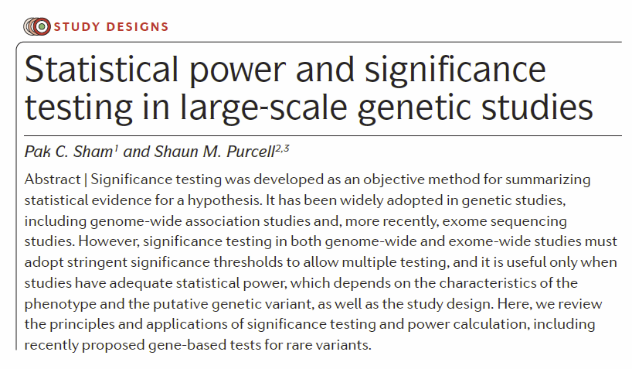

Slide 10
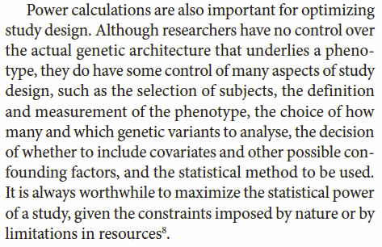
No control over genetic architecture BUT…
Subject selection
Definition/measurement of phenotype
How many / which variants
Covariate adjustment
Statistical method
…

Slide 11
There are many quality programs for power calculation
GPC: http://zzz.bwh.harvard.edu/gpc/
CaTS: http://csg.sph.umich.edu/abecasis/cats/
GAS: http://csg.sph.umich.edu/abecasis/cats/gas_power_calculator/index.html
PGA: http://dceg.cancer.gov/bb/tools/pga
R- powerGWASinteraction (GE/GG), GAP, GWAS.PC, Bioconductor/GeneticDesign
GWASPower[/QT]
Others for other models, e.g., gene-based, meta analysis, simulation, SurvivalGWAS_Power, …

Slide 12
QUANTO

Slide 13
About QUANTO
Authors: Jim Gauderman, John Morrison
http://biostats.usc.edu/Quanto.html
Association studies
Gene or environment effects
Gene-environment interaction
Gene-gene interaction
Study designs
Case-control (matched and unmatched)
Case-sibling
Case-parent
Case-only
Continuous Traits

Slide 15
Example 1
Testing the main effect of a gene for a disease
Assumptions:
Disease prevalence (K_{p}) estimated at 10%
Two alleles (A, a),and only those with AA are thought at risk (recessive model)
AA genotype estimated at 40%, and so prevalence of A allele is about 63% (assuming HWE)
Desired power of 80%, at significance 0.05, for a two-sided test
Matched case-control design

Slide 16
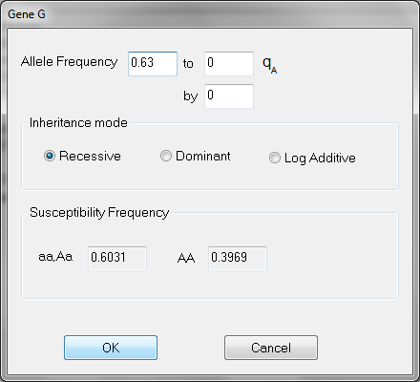
Example 1
Under “Parameters”
Select Outcome/Design-> Disease-> Case-control (matched)
Select Gene.
Input the following:

Slide 17
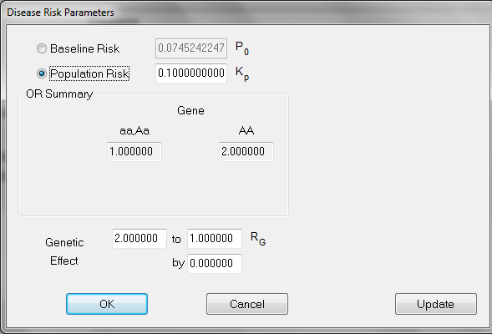
Example 1
Under “Parameters”
Select Hypothesis -> Gene Only
Select Outcome Model
Input:
The calculation is for an odds ratio of 2.0, with no range of possible values (by = 0)

Slide 18
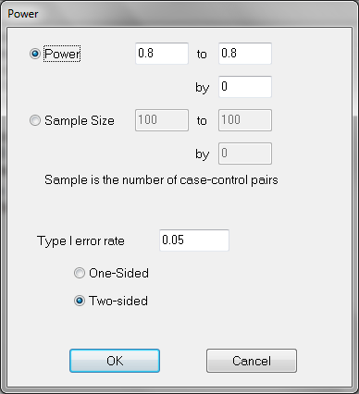
Example 1
Under “Parameters”
Select Power
Input:

Slide 19
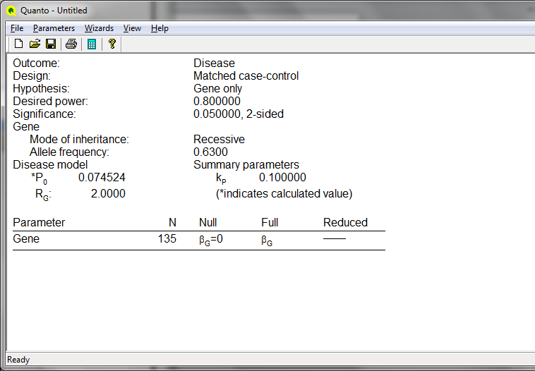
Example 1
Calculate!
135 experimental units (matched pairs) are suggested for the described study

Slide 20
Example 1
Note that different designs have different inputs and unknowns
You can see this when changing the design to:
Case-parent trio
Unmatched case-control
The study settings and calculation can be saved by QUANTO as a .qpp file for later use
Alternatively, you can save a .txt log file
Notes:
The solution: 119, 133

Slide 21
Example 2
Testing Gene x Environment interaction for a quantitative outcome
Motivation: Does GSTM1 interact with environmental tobacco smoke to produce an effect on lung function (forced expiratory volume in the first second, FEV₁) in a sample of 10 year old children?

Slide 22
Example 2
Assumptions:
GSTM1 is recessive with allele frequency 0.63
ETS is binary, with 30% of children exposed
The mean FEV₁ in 10 year olds is 2,000 mL, with SD of 300 mL.
Independent individuals used for the study.

Slide 23
Example 2
Assumptions (cont):
In the general population, GSTM1 carriers have 50mL lower FEV₁.
In the general population, ETS exposed 10 year olds have an FEV₁ that is 75mL lower.
The interaction effect for those with GSTM1 and exposed to ETS is estimated to produce an additional deficit of 100mL in FEV₁.

Slide 24
Example 2
Under “Parameters”
Select Outcome/Design -> Continuous -> Independent Individuals
Select Hypothesis -> Gene-Environment Interaction

Slide 25
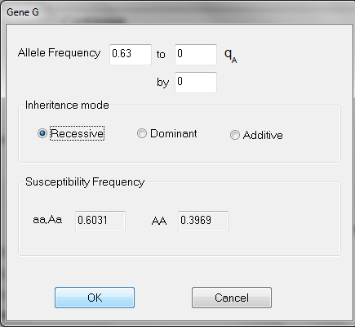
Example 2
Under “Parameters”
Select Gene
Input:

Slide 26
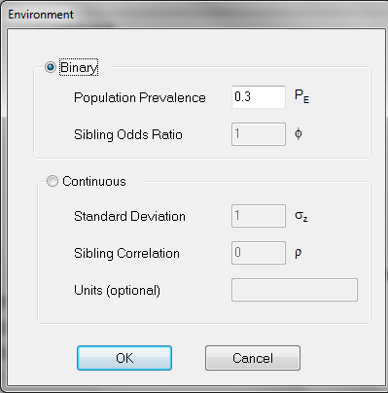
Example 2
Under “Parameters”
Select Environment
Input:

Slide 27
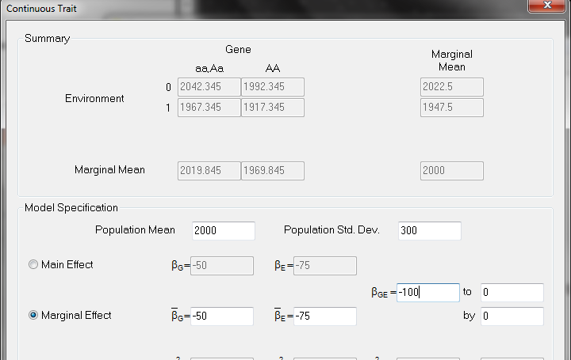
Example 2
Under “Parameters”
Select Outcome Model
Input:
100 mL interaction
75 mL ETS effect
50 mL gene effect

Slide 28
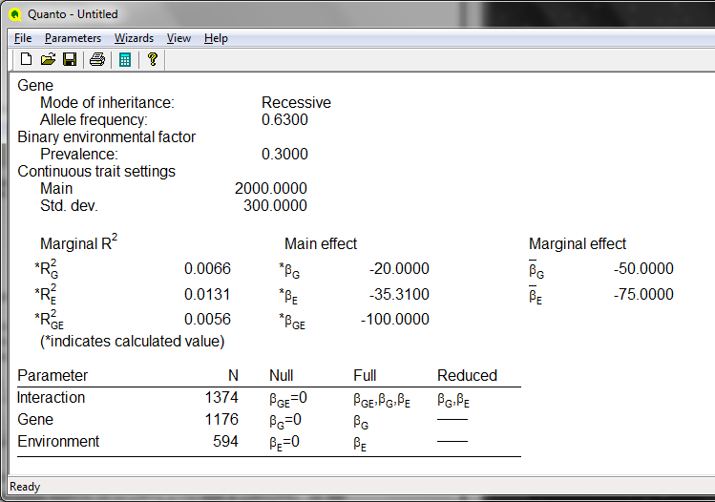
Example 2
Calculate!

Slide 29
QUANTO Acknowledgements
Examples derived from QUANTO’s help documentation which is available to you now
WJ Gauderman (2002), "Sample size requirements for matched case-control studies of gene-environment interaction", Stat Med 21:35-50.
WJ Gauderman (2002), "Sample size requirements for association studies of gene-gene interaction", American Journal of Epidemiology, 155:478-484.
WJ Gauderman (2003), "Candidate gene association studies for a quantitative trait, using parent-offspring trios", Genetic Epidemiology, 25:327-338.

Slide 30
Multiple Testing

Slide 31
Hypothesis Testing
Alpha-level (e.g. 0.05) is for ONE test
If you ran 100 experiments
~5% would have p < 0.05
Which of the 5 p-values < 0.05 are “real”?
If you ran 100,000 experiments
~5% would have p < 0.05
Which of the 5000 (!) p-values < 0.05 are “real”?

Slide 32
Methods to Adjust
Bonferroni
Adjust for the number of tests directly
Threshold = alpha / N
0.05 / 100
This constrains the family-wise error rate (FWER)
False-Discovery Rate (FDR)
Related to finding the “trues” within the rejected H₀
Bayesian
Involve placing ‘prior’ information on genomic locations
Permutation

Slide 33
Heritability
RECALL from yesterday

Slide 34
Polygenic Theory
Heritability
Bad question: To what extent is a given trait genetic?
Correct question: How much of the differences in a given trait between people in a particular country at a particular time is caused by their genetic differences, and how much by their different environments and life histories?
As environmental factors are reduced or equalized, the contributions of genetics to the observed variation will increase
V_{p} = V_{G} + V_{E}
V_{G} = V_{Additive} + V_{Dominant} + V_{Interaction}

Slide 35
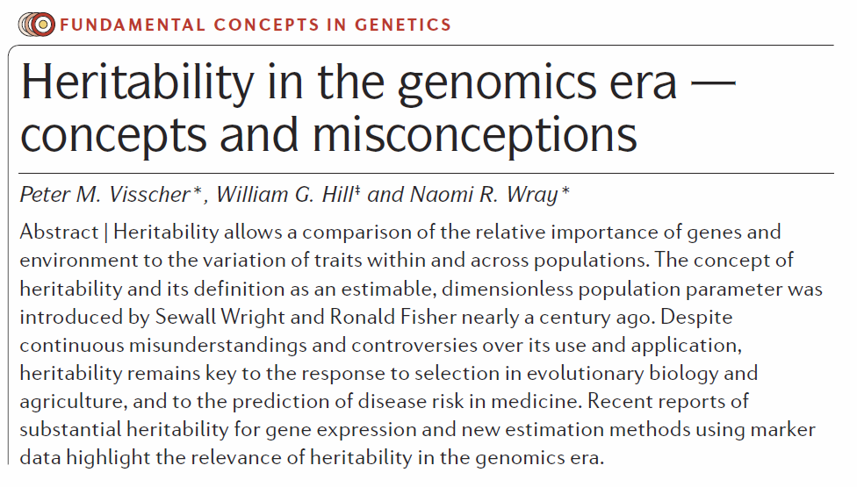

Slide 36
Components of Phenotypic Variance
The difference between the value of a trait in an individual and the mean of the population…
P = G + E
we can decompose G into…
G = A + D + I
therefore…
P = A + D + I + E
P=Phenotype
G=Genotype
A=Additive Genotype
D=Dominant Genotype
E=Environment
(I=Interaction) - typically ignored

Slide 37
Components of Phenotypic Variance
Now if we square the deviations in the phenotypic value…
P² = (A + D + E)²
we can express this as…
V_{P} = V_{A} + V_{D} + V_{E}
note that…
Cov(A,D) = 0 (additive and dominant effects are independent)
Cov(G,E) = 0 (assumption of no GxE interaction or I=0)
Genetic Variance
V_{G} = V_{A} + V_{D}

Slide 38
Misconceptions
Heritability is the proportion of a phenotype that is passed on to the next generation
High heritability implies genetic determination
Low heritability implies no additive genetic variance
Heritability is informative about the nature of between-group differences
A large heritability implies genes of large effect
Notes:
Heritability is the proportion of a phenotype that is passed on to the next generation
This is a commonly held misconception; phenotypes are not passed on but genes are. The definition of narrow-sense
heritability (BOX 1) contains the variation in additive genetic effects (A). Half of these effects are passed on from each
parent, but the actual half is unique to each offspring.
High heritability implies genetic determination
A high heritability means that most of the variation that is observed in the present population is caused by variation in
genotypes. It means that, in the current population, the phenotype of an individual is a good predictor of the genotype.
However, it does not mean that the phenotype is determined once we know the genotype, because the environment can
change or can be manipulated to alter the phenotype. For example, the well-documented secular rise in height in many
human populations77,78 is not at odds with reported heritabilities of about 0.8, but is likely to reflect changes in the
environment resulting from improved nutrition and medical care. Genetic determination is sometimes implied when
making predictions about the phenotype of offspring given the parental phenotypes for traits with a high heritability.
What this ignores is the segregation of genes within families: in a non-inbred population, half of the additive genetic
variance is between families and half is within families. This implies that for a trait such as adult height in human
populations, with a heritability of 0.8 and a standard deviation of approximately 7 cm in the population, the standard
deviation of height in adult offspring around the mean value of the parents is 5.4 cm (=√[72 (1 – .*0.8)]), which is not
much smaller than the standard deviation in the entire population. Hence, tall parents have on average tall children, but
with a considerable variation around the parental mean.
Low heritability implies no additive genetic variance
A low heritability means that of all observed variation, a small proportion is caused by variation in genotypes. It does
not mean that the additive genetic variance is small. This difference matters because the response to natural or artificial
selection depends on the amount of genetic variation in the population. Many phenotypes relating to fitness in natural
populations have a large amount of additive genetic variation relative to the mean79–81. Egg number in farmed chickens
has responded dramatically to artificial selection82. These observations are surprising because theory predicts that
additive variation for fitness should be small because of natural selection. These observations led Houle to propose
the additive genetic coefficient of variation (CVA = σA/mean) to measure ‘evolvability’79. He showed that, for natural
populations, fitness-related traits tend to have a larger value of CVA than morphological traits. Nevertheless, the
response to natural or artificial directional selection on the phenotype is proportional to hσA, so both the heritability
and genetic variance are important. In addition, a coefficient of variance (CV) can only be used to compare traits if the
mean has an intrinsic biological meaning. Many traits in human populations have an artificial scale (for example,
intelligence quotient (IQ)), so their CV is not informative.
Heritability is informative about the nature of between-group differences
This misconception comes in two forms, and in both cases height and IQ in human populations are good examples. The
first misconception is that when the heritability is high, groups that differ greatly in the mean of the trait in question must
do so because of genetic differences. The second misconception is that the observation of a shift in the mean of a
character over time (when we can discount changes in gene frequencies) for a trait with high heritability is a paradox. For
IQ, a large increase in the mean has been observed in numerous populations, and this phenomenon is called the Flynn
effect, after its discoverer83. The problem with this suggested paradox is that heritability should not be used to make
predictions about mean changes in the population over time or about differences between groups, because in each
individual calculation the heritability is defined for a particular population and says nothing about environments in other
populations. White males born in the United States were the tallest in the world in the mid-19th century and about 9 cm
taller than Dutch males78. At the end of the 20th century, although the height of males in the United States had
increased, many European countries had overtaken them and Dutch males are now approximately 5 cm taller than white
US males78, a trend that is likely to be environmental rather than genetic in origin.
A large heritability implies genes of large effect
In many gene-mapping experiments, the probability of detecting a gene of large effect increases with heritability.
However, this does not by itself imply that there is a relationship between heritability and the number or size of genes
affecting the trait. Mendelian single-gene traits have a broad-sense heritability of 1.0 but these seem to be exceptions.
Morphological traits usually have high heritability, but are polygenic, for although a few individual genes have been
identified that have a large effect84,85, these do not explain a high proportion of the genetic variance86.

Slide 39
Estimation
Twin studies
Think about comparing sib-pairs or MZ/DZ twins
Utilizing varied familial relationships

Slide 40
Deriving h²
Monozygotic twins reared together
Monozygotic twins reared apart
Dizygotic twins or full siblings reared together
Dizygotic twins or full siblings reared apart
Chapter 6, Ziegler & Konig
Notes:
Genotyping is not required to compute h2, because it can be derived by comparing the phenotypic similarity between relatives sharing genes and the environment to different degrees.
Twin studies are preferable to sibling studies when e2 is decomposed into c2 and e2: equal environments assumption. Same-sex DZ twins are more likely to have a truly common environment than opposite-sex DZ twins or siblings (because of differences in gender and age). Still, this assumption may not entirely hold even for MZ twins.

Slide 41
GCTA
Notes:
*GCTA provides the proportion, not the heritability. Adjustment for prediction errors and the relationship between SNPs and causal variants is required to estimate an unbiased heritability (details are in Nat Genet. 2010 Jul;42(7):565-9)
Proportion of phenotypic variance explained by all SNPs

Slide 42
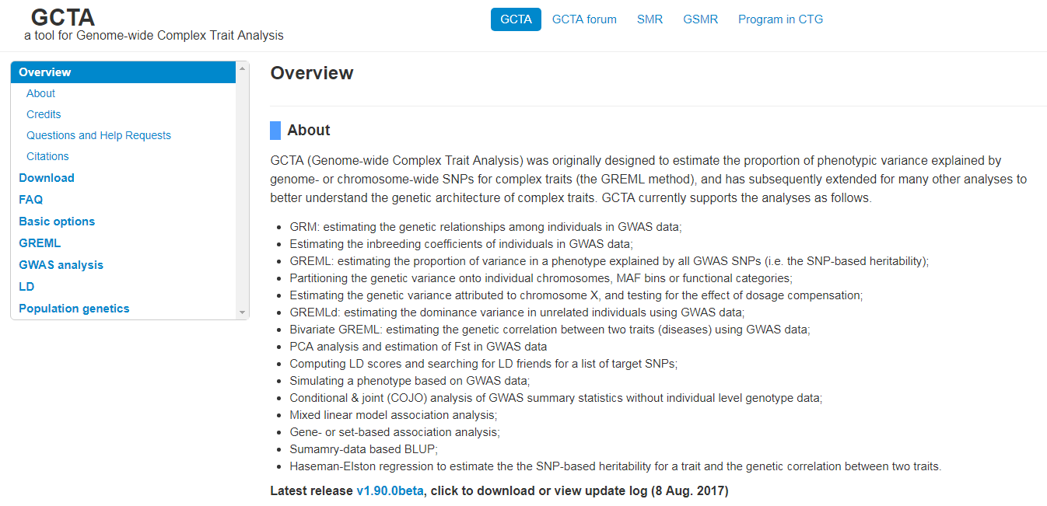
http://cnsgenomics.com/software/gcta/

Slide 43
Phenotypic variance can be expressed as a sum of genetic and non-genetic variances(including environmental variance)
Heritability
Our goal
What proportion of the total phenotypic variance is explained by genetic effects?
We need to estimate
and
Genetic variance
Non-genetic variance
Nat Rev Genet. 2008 Apr;9(4):255-66.

Slide 44
Thank you !
Questions ?

Slide 45
Acknowledgements
Harvard T. F. Chan School of Public Health
Christoph Lange
Pete Kraft
University of Colorado
Matt McQueen
University of Kentucky
Yuri Katsumata
Jennifer Daddysman
Suzanne Segerstrom
University of Florida
Tyler Smith
University of Washington
Paul Crane
Joey Mukherjee
University of Southern California
Jim Gauderman
National Institute of Aging
R01 AG042437
K25 AG043546
R01 AG057187
P30 AG028383
R01 AG054060

Slide 46
Extra slides

Slide 47
We have p covariates and m SNPs
Model used in GCTA
Covariate terms
Genetic terms
error
Phenotype for ith individual
Standardized genotypes
Genetic effects
Non-genetic effects

Slide 48
Standardized genotypes
Standardize
# of the reference allele
Frequency of
the reference allele

Slide 49
Genetic effects
We assume that genetic effects are identically and independently normal-distributed with mean 0 and variance
Genetic variance of single SNP
Total genetic variance

Slide 50
Non-genetic effects
We assume that non-genetic effects are identically and independently normal-distributed with mean 0 and variance
Non-genetic variance
Non-genetic variance
= environmental variance + error variance

Slide 51
Model used in GCTA
For all individuals

Slide 52
The variance of phenotype is

Slide 53
Define
Standardized
genotype matrix
# of SNPs
Genetic relationship matrix (GRM)
between individuals
Estimated by GCTA
Element of A =
Genetic relationship between two individuals

Slide 54
The variance of phenotype is
Rewrite the model
Total genetic effects

Slide 55
To estimate the variance explained by all autosomal SNPs
All SNPs effects
Estimated by GCTA
Proportion of phenotypic variance explained by all SNPs
*GCTA provides the proportion, not the heritability. Adjustment for prediction errors and the relationship between SNPs and causal variants is required to estimate an unbiased heritability (details are in Nat Genet. 2010 Jul;42(7):565-9)

