Slide 1
Survey of alternative uses of ACTIVE data, review of completed work and lessons learned Friday Harbor Advanced Psychometrics Workshop June 9-13, 2014
Presenter: Alden L. Gross, PhD MHS

Slide 2
Acknowledgements
Funded in part by Grant R13 AG030995 from the National Institute on Aging
The views expressed in written conference materials or publications and by speakers and moderators do not necessarily reflect the official policies of the Department of Health and Human Services; nor does mention by trade names, commercial practices, or organizations imply endorsement by the U.S. Government.

Slide 3
Acknowledgements
Funded in part by Grant R13 AG030995 from the National Institute on Aging
The views expressed in written conference materials or publications and by speakers and moderators do not necessarily reflect the official policies of the Department of Health and Human Services; nor does mention by trade names, commercial practices, or organizations imply endorsement by the U.S. Government.

Slide 4
Outline
Review of existing ACTIVE publications
Lessons learned
Representativeness of the data
Training outcomes
Subjective cognition
Nonequivalence of memory tests
Some conclusions

Slide 5
Review of existing publications
65 publications as of February, 2014
7 overviews
52 feature some flavor of longitudinal analysis
Usually latent growth models
56 studies with easily discernible exposure and outcome

Slide 6
Review of existing publications
Common exposures
Cognitive training (22 studies)
Cognitive performance (11 studies)
Other (race, other demographic characteristics, neighborhood, depression)

Slide 7
Review of existing publications
Common outcomes
Cognitive performance (26 studies)
Driving behaviors (accidents, cessation) (7 studies)
Primary ACTIVE outcomes of everyday functioning/impairment (8 studies)
Health-related quality of life (4 studies)
Everyday speed (2 studies)
Other

Slide 8
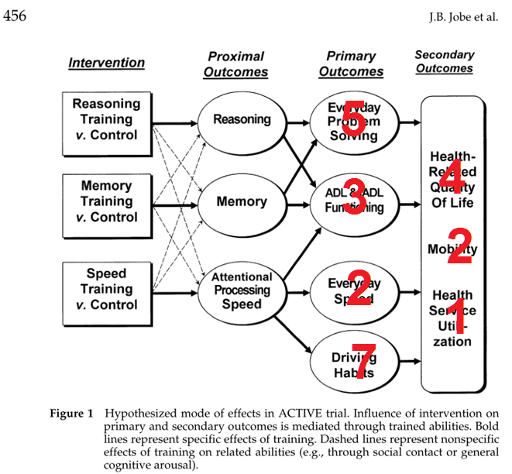
Why would ACTIVE impact Depression and Quality of Life Outcomes?
Review of existing publications
Jobe et al., Control. Clin. Trials 22, 453 (2001).

Slide 9
Review of existing publications
Conclusions from ACTIVE publications
ACTIVE held to its initial conceptual diagram
Health care utilization data are potentially underutilized
Few hospitalizations or nursing home admissions
We only observe a nursing home admission if a participant was released and comes back for an interview
Medication data rarely used

Slide 10
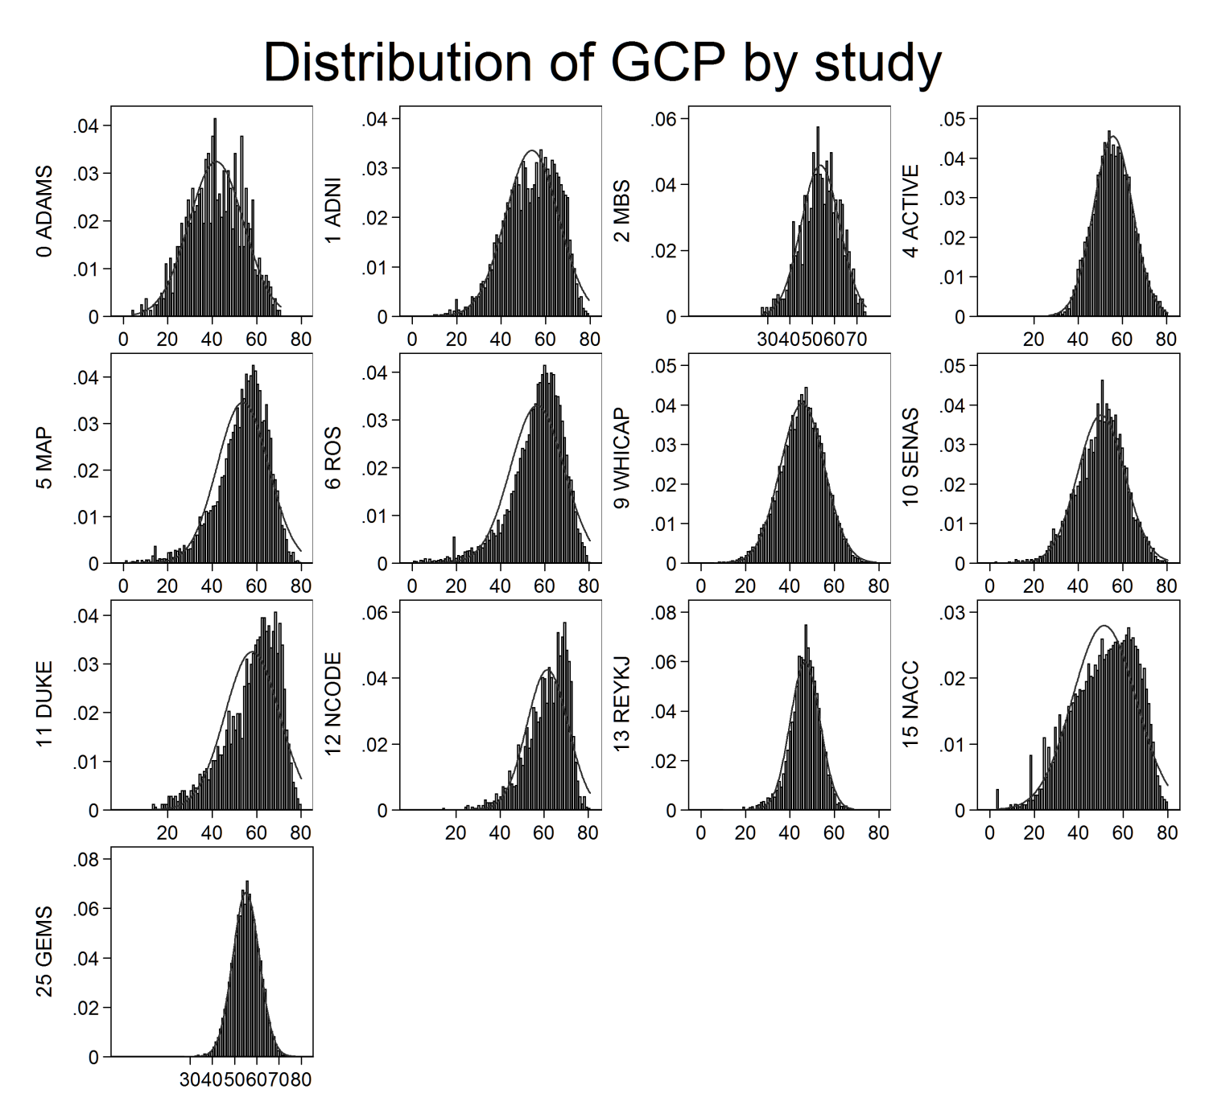
Concern: Generalizability of training effects

Slide 11
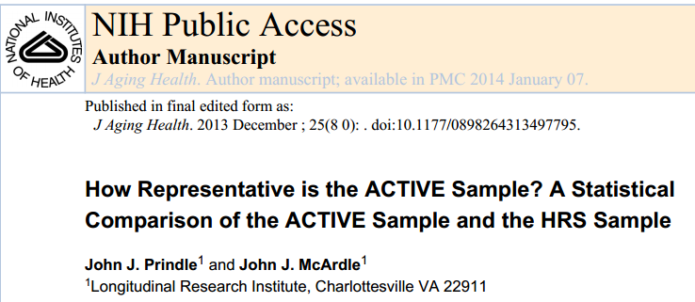
Concern: Generalizability of training effects

Slide 12
Concern: Generalizability of training effects
Prindle & McArdle (2013)
Constructed sampling weights to scale to HRS using 3 approaches: logistic regression, decision tree analysis, post-stratification weighting
Adjusted for age, education, sex, race/ethnicity
Using the weights, ACTIVE analyses may be considered nationally representative based on HRS demographics

Slide 13
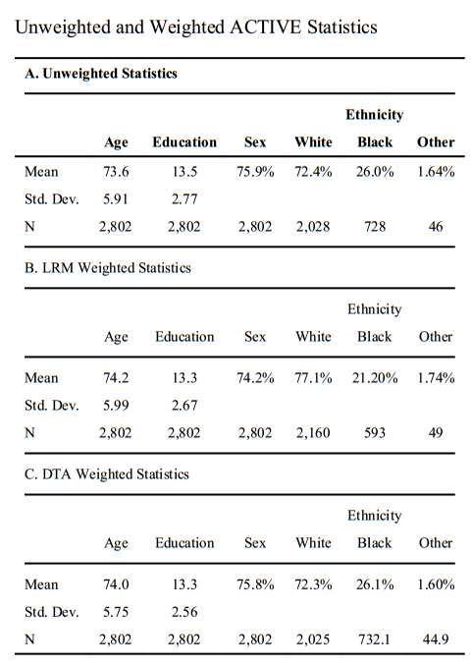
Concern: Generalizability of training effects
Weights may be used to scale associations to a nationally representative sample based on HRS
Weights are not in the FHL dataset, but can be easily constructed following Prindle & McArdle (2013)

Slide 14
Lessons learned: Training outcomes
If you write a paper with ACTIVE, test for differences by intervention group
Reviewers always ask
Test association in control group first (intgrp==4, N=698), then test intervention effect with interactions
ACTIVE’s advantage is the randomization to training, not representativeness

Slide 15
Lessons learned: Perceptions about memory

Slide 16
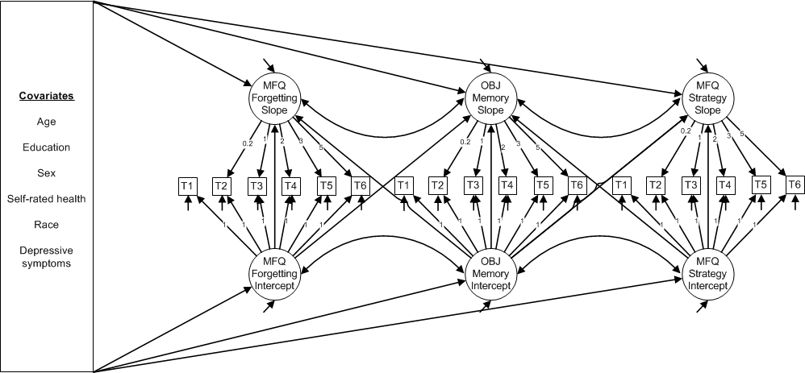
Lessons learned: Perceptions about memory
Parisi et al. (2011). Modeling Change in Memory Performance and Memory Perceptions: Findings from the ACTIVE Study. Psychology & Aging.
(change in MFQ associated with change in memory)

Slide 17
Lessons learned: Perceptions about memory
Application: Personality in Cognition (R03 Parisi)
Goal: Associate PIC (intellectual self-efficacy and concerns about intellectual aging) with objective cognitive performance
7 steps
Unconditional LGM, control group only
Conditional LGM, control group only
Unconditional LGM, full sample
Conditional LGM, full sample
Unconditional GMM, full sample
Unconditional parallel process models of PIC, cognition
Conditional parallel process models of PIC, cognition

Slide 18
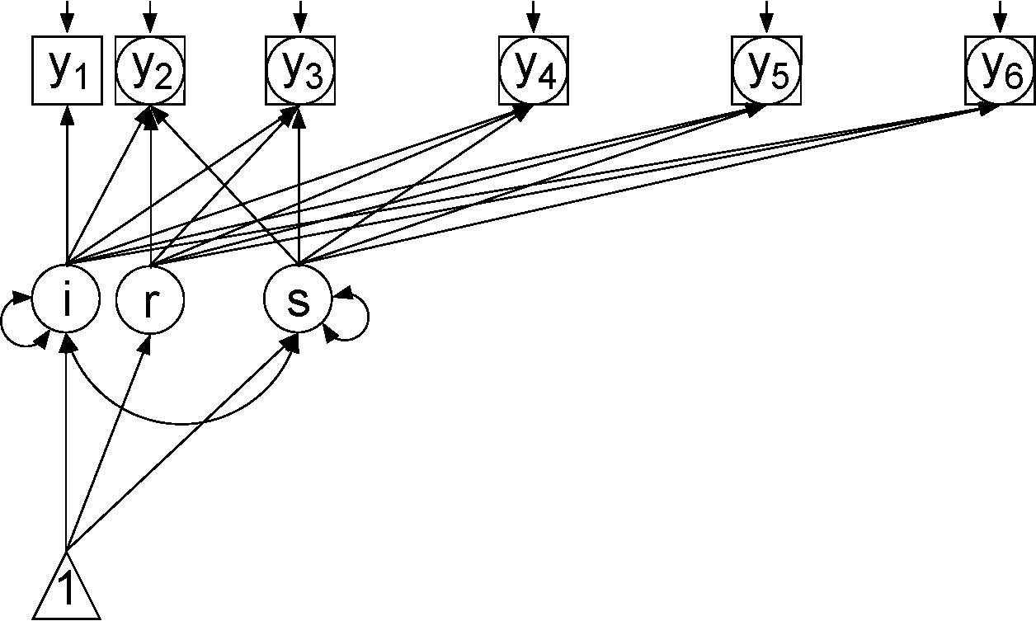
Latent growth curve model

Slide 19
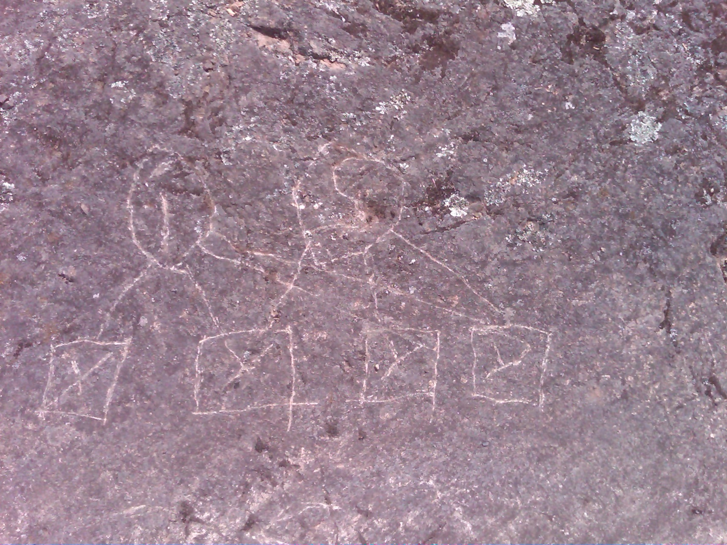
Latent growth curve model

Slide 20
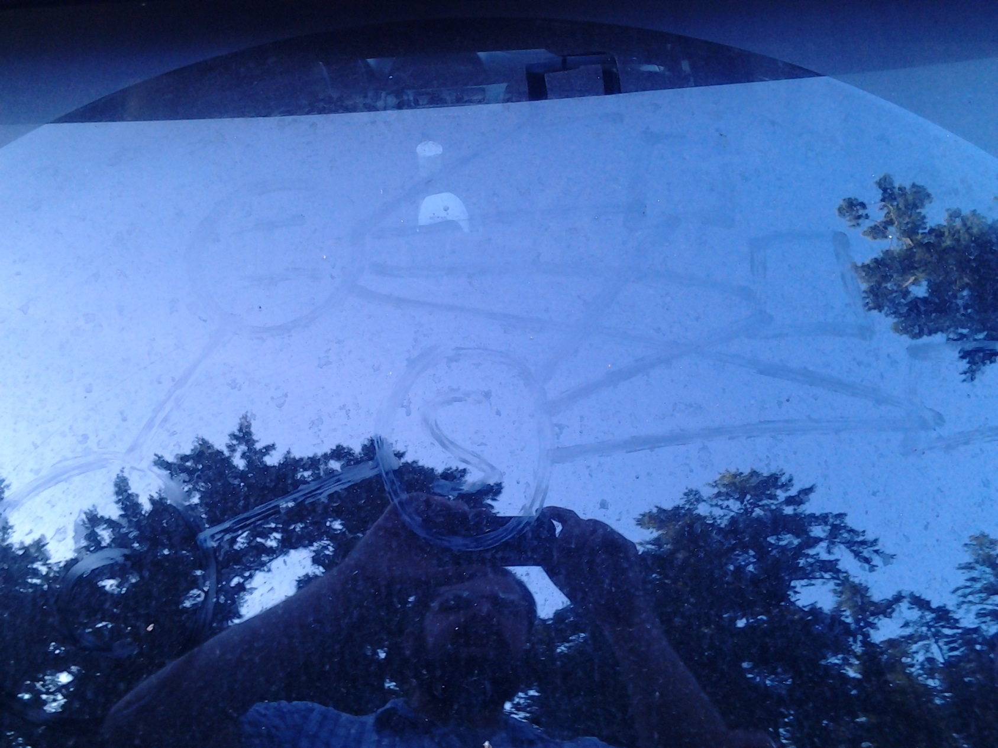
Latent growth curve model

Slide 21
Latent growth curve model

Slide 22
Next challenge: Nonequivalence of memory tests

Slide 23
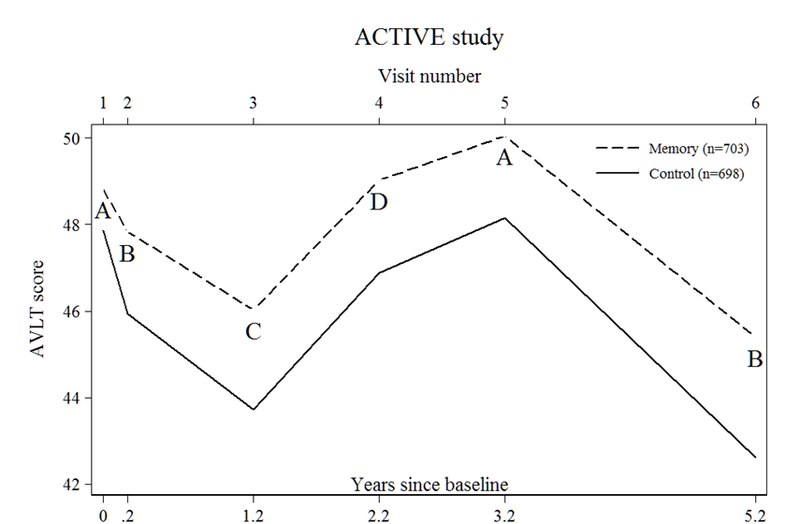
Nonequivalence of memory tests

Slide 24
Nonequivalence of memory tests
Assessment of change requires repeated measures
Alternate forms for neuropsychological tests are common, especially for memory
They are frequently used to minimize practice effects under the assumption that forms are equivalent and practice effects are mostly attributable to memory for content

Slide 25
Nonequivalence of memory tests
In reality, forms are rarely equivalent
Why? Word length, lexical frequency, novelty
Introducing a new form complicates analyses of within-person trajectories
Several equating methods offer solutions

Slide 26
Nonequivalence of memory tests
Equipercentile equating
Goal is to define a non-parametric transformation of response variable B that returns the same cumulative probability plot as variable A.
Equating methods can equate test scores but do not address qualitative differences in behaviors, such as different strategies used on more difficult tests.

Slide 27
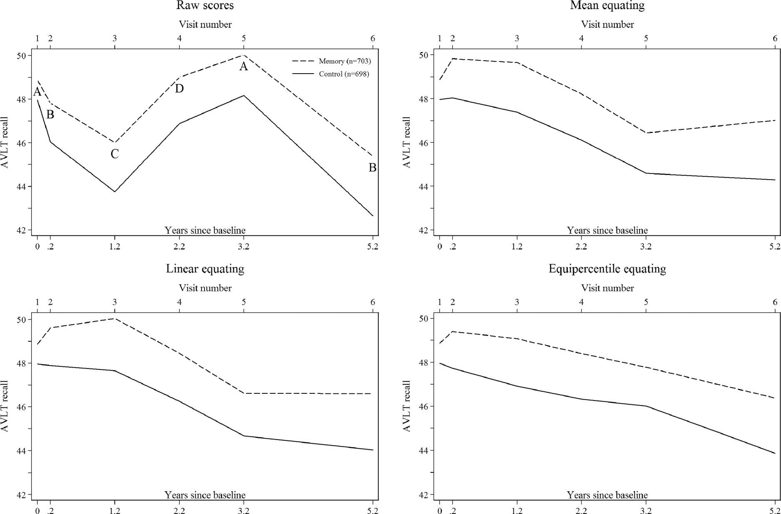
Nonequivalence of memory tests

Slide 28
Nonequivalence of memory tests
Equipercentile equating
eeavlt
eehvlt
mem: factor score constructed using these variables

Slide 29
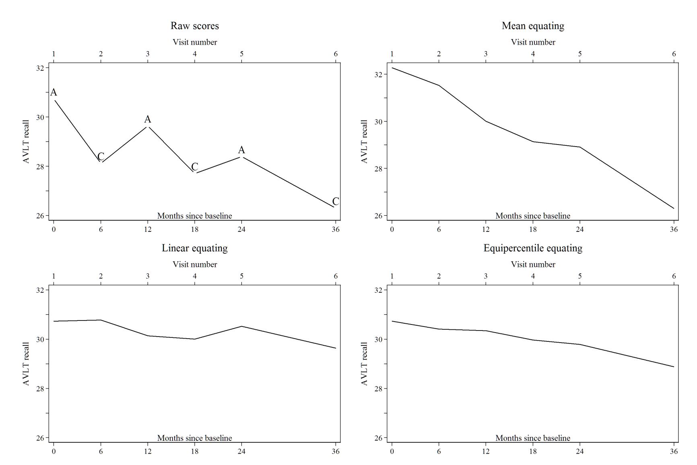
Nonequivalence of memory tests
Does equipercentile equating work in another dataset? ADNI

Slide 30
Some conclusions
Review of existing ACTIVE publications
Most exposures are intervention group
Most outcomes are cognitive
Wealth of primary/secondary ACTIVE outcomes
Need for examination of perceptions about cognition
Lessons learned
Representativeness of the data
Training outcomes
Be careful about nonequivalence of memory tests

Slide 31
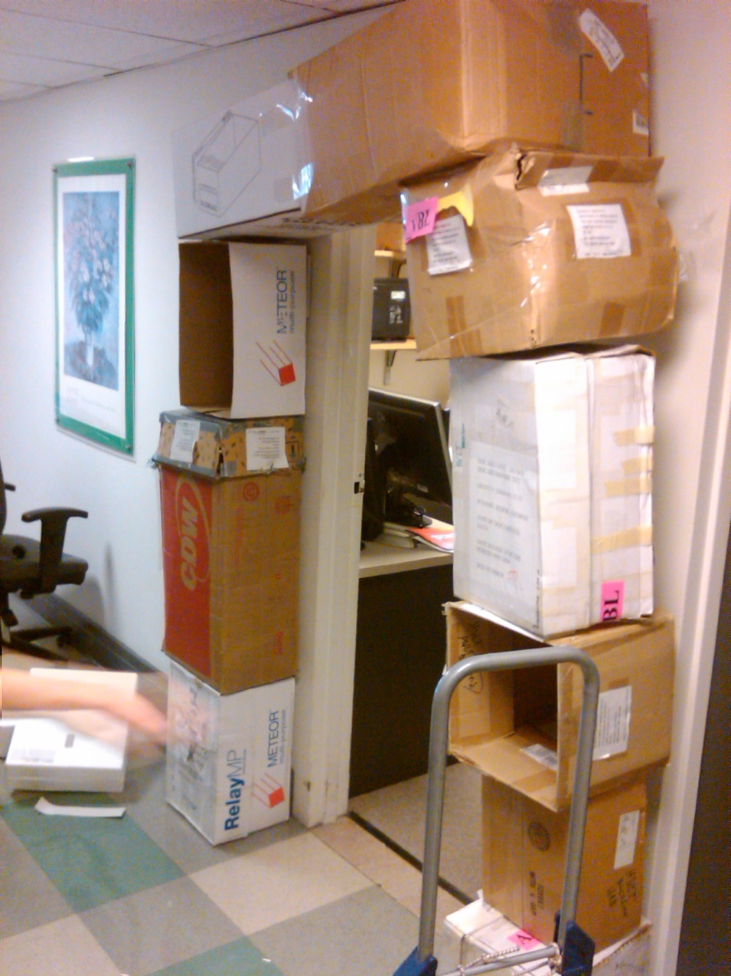
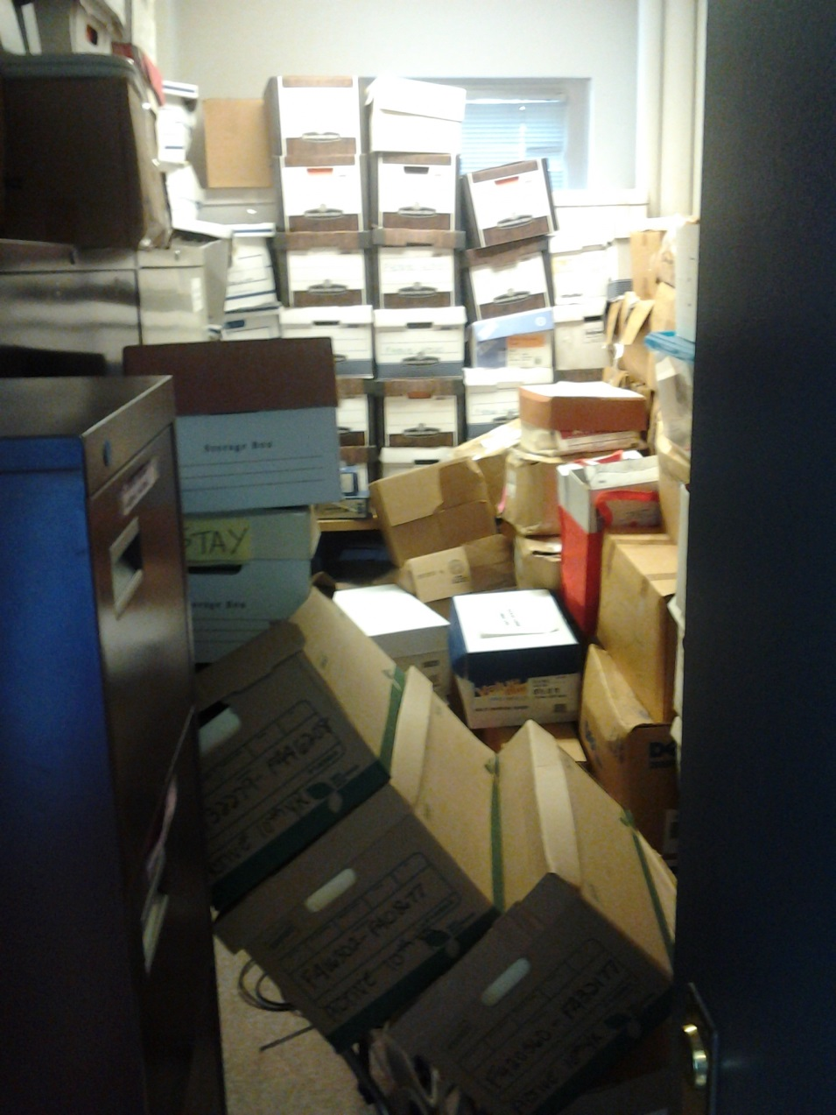
Best advice? Dig into data

Slide 32
Secondary outcome: Falls
Speed training protects against falls
This has not been published yet
Who wants to write the paper?

