Slide 1
Some Methods for Statistical Harmonization
A fantastically brief introduction
ΨMCA - Psychometrics and Measurement in CognitΙve Aging
Lake Tahoe, CA
Alden Gross
Dept. Epidemiology, Johns Hopkins Bloomberg School of Public Health

Slide 2
Outline
ΨMCA
What is harmonization?
What are the goals of harmonization?
Approaches for statistical harmonization
  Latent variables
  Without latent variables
Some general issues

Slide 3

What is statistical harmonization?
ΨMCA
“Harmonization” is a broad term
  Qualitative assessments of the comparability of measures
  Aspects of study design
  Statistical approaches to link measurement scales or tests
Harmonization can help synthesize information across different sources, either to have bigger samples or to address novel questions
What we’re doing this week is “statistical co-calibration”
  With latent variables
  Without latent variables
Notes:
Different studies on the same topic often implement different measures due to:
Developmental differences in the target population
Investigator proclivities
Logistical issues

Slide 4
What is our goal?
ΨMCA
To compare level of cognitive performance across studies (or time) when test items differ
To meet this goal, we either need to assume we have (some) common items or exchangeable people with respect to cognition

Slide 5
Broad steps to statistical harmonization (Briceno et al., in progress; Griffith et al., AHRQ report 2012)
ΨMCA
Prestatistical harmonization
  Accounting work
  Gather available test data
  Test and test item characteristics
    Administration, scoring procedures, score ranges
  Understand the cohort characteristics
    selection procedures, demographic factors
Statistical harmonization approaches
for test equating
Diagnostics

Slide 6
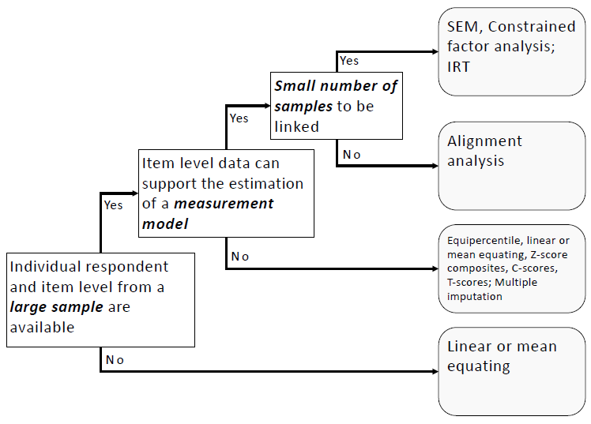
Approaches for statistical harmonization
ΨMCA

Slide 7
Approaches for statistical harmonization
ΨMCA
Item-based
  Goal: define a transformation of a test that places it on the same metric as another
  Item response theory/latent variables
Distribution-based standardization methods
  Goal: define a transformation of a test that returns the same cumulative probability plot as the other variable being compared
  Mean equating
  Linear equating
  Equipercentile equating

Slide 8
Item response theory
ΨMCA
A latent variable describes the probability of responding to an indicator
  Indicator responses are dependent upon ability (and item characteristics) only
There is no natural scale in latent variable space
  By convention, we scale F to mean 0, variance 1 for model identification
  There’s more footwork in harmonization approaches
U₁
δ₁
F
U₂
δ₂
U₃
δ₃
Model:
f BY u1* u2 u3;
f@1; [f@0];

Slide 9
Some terminology
(Markus & Borsboom, 2013, Frontiers of Test Validity)
ΨMCA
Target of measurement
  construct: theoretical attribute
  latent variable: operationalization of a construct that underlies a set of indicators. Presumed to exist, and cause observable responses
  index: sum or average score; indicators syntactically "cause" the construct of interest
Items and indicators
  item: stimulus designed to get a response. e.g., serial 7's task
  item response: person's response to the item. e.g., 93, 87, 80, 73, 85
  item score: coding of responses into numbers. e.g., 3 points
  indicator: items used in models. Often recoded item scores. e.g., score=3. Or recode 0={0,1,2,3,4} 1=5
Notes:
Testing vs assessing
testing: systematic observation and scoring of elicited responses (e.g., administer a neuropsych battery)
assessing: Broader term; testing in a systematic or non-systematic way (e.g., leveraging IQCODES/informants alongside objective testing to inform cognitive status)

Slide 10
Items vs indicators
ΨMCA
Word list recall examples are ubiquitous
Constructional praxis from LASI-DAD:

Slide 11
Steps in harmonization using latent variables/IRT: Item banking approach
ΨMCA
Identify all items across all studies
Find common items to serve as anchors
  The best anchors are highly correlated with other tests in each study and average difficulty (Dorans, 2010)
Convert items to indicators as necessary

Slide 12
What could the data structure look like?
ΨMCA

Slide 13
Steps in harmonization using latent variables/IRT: Item banking approach
ΨMCA
Estimate IRT model in each sample separately
  Freely estimate parameters in the first “reference” sample, fixing only the mean/variance initially
  In later samples, restrict parameters for items you’ve seen before to what they were in previous samples; free the mean/variance
  The final model should not estimate a score and parameters simultaneously
Concerned about items that function differentially by study? Save that for DIF testing later

Slide 14
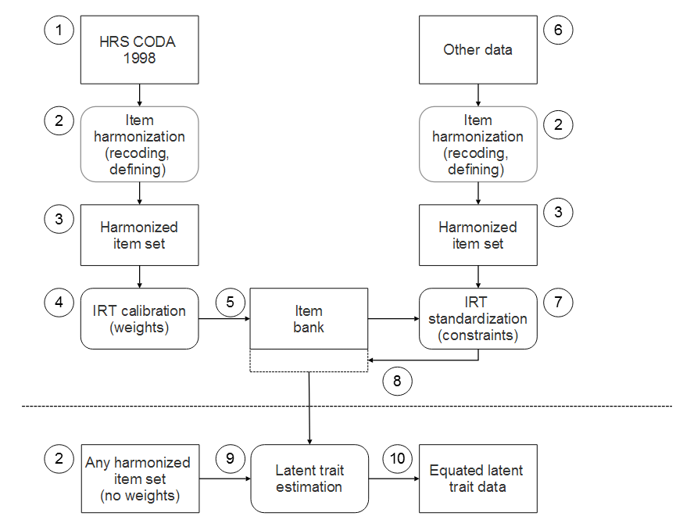
PITCH Project: Harmonization across studies, then across time
ΨMCA

Slide 15
Example syntax for Mplus
ΨMCA
e.g., fix all parameters (loadings, thresholds) to correspondent values from step 1; freely estimate means/variances of latent variables because we placed constraints on item loadings and thresholds
Factor is now scaled to a particular dataset or reference group

Slide 16
What happens if we were to pool the samples (studies; timepoints) and run a single IRT model?
ΨMCA
Item parameters would reflect an average between the characteristics of the samples
  The larger of the three samples contributes more to the co-calibration
  Could apply weights, restriction, matching, or some other approach to balance the samples in different ways

Slide 17
Issues with harmonization using IRT
ΨMCA
Selecting an estimator
Check for differential precision / ceiling effects
Is the metric the same across studies?
  Are some indicators performing differently in some datasets or in subgroups?

Slide 18
(1) Selecting an estimator: WLSMV
ΨMCA
Mplus default is WLSMV
  Works from the observed covariance matrix of indicators
  Thus, uses pairwise complete data (pairs of variables must overlap)
  Fast, but inappropriate when MCAR (missing completely at random) assumptions are not viable
  Infeasible for harmonization methods that capitalize on missing data handling because covariance coverage is 0
Use ANALYSIS: PARAMETERIZATION=THETA to match parameter estimates from a Bayesian estimator and MLR PROBIT

Slide 19
(1) Selecting an estimator: MLR
ΨMCA
Maximum likelihood (MLR)
  All records are used, not just the covariance matrix
    Except records that are 100% missing on all dependent variables
    Thus relies on MAR for missing data
  Use ANALYSIS: LINK=PROBIT to match parameter estimates from a Bayesian estimator

Slide 20
(1) Selecting an estimator: BAYES
ΨMCA
Bayesian plausible values
  Based on a mean of k individual plausible values drawn from the posterior distribution
  As number of draws from the posterior increase, we should reach MLR regression-based factor score estimates
If the goal is to estimate population parameters (e.g., epidemiological inference), then plausible values are desirable because they retain some imprecision in estimates
See Asparouhov & Muthen (2010). Plausible values for Latent Variables Using Mplus. https://www.statmodel.com/download/Plausible.pdf

Slide 21
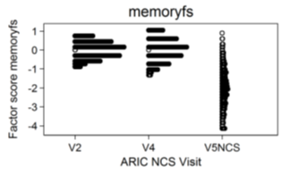
(2) Check for differential precision
ΨMCA
Example: ARIC study
We see differences in floors based on the precision of information available
  With MLR, every response pattern has a unique estimated level of the latent trait.
  If one sample does not have all the items with parameters at the extreme ends of the scale, then people in that sample cannot score as low (or high) as people from another sample with a different battery
These dropped floors can cause biases in estimated associations with decline IF people with low levels of the exposure have low cognition at baseline

Slide 22
(3) Is the metric the same across studies?
ΨMCA
Indicators should measure the latent trait in the same way among different subgroups of a population
  characteristics like age, race, sex, etc.
To the extent that indicators do not measure the same latent trait across groups, we say the items show DIF (differential item functioning)
Group 2 will address this

Slide 23
DIF as a special case of measurement noninvariance
ΨMCA
Levels of measurement invariance
  Configural
  Metric
  Scalar (strong)
  Strict

Slide 24
Approaches for statistical harmonization
ΨMCA
Item-based
  Goal: define a transformation of a test that places it on the same metric as another
  Item response theory
Distribution-based standardization methods
  Goal: define a transformation of a test that returns the same cumulative probability plot as the other variable being compared
  Mean equating
  Linear equating
  Equipercentile equating

Slide 25
Approaches for statistical harmonization
ΨMCA

Slide 26
Mean equating
ΨMCA
Make means the same
Relative position is defined by the absolute difference from the sample mean of a test, and each individual’s score is changed by the same amount to equate the sample mean to that of a reference test
Notes:
dd

Slide 27
Linear equating
ΨMCA
Make means, SDs the same
Relative position is defined in terms of standard deviations from the group mean.
Linear equating is accomplished by adjusting scores from the new form to be within the same number of standard deviations of the mean of the original form.

Slide 28
Equipercentile equating
ΨMCA
Make means, SDs, skews, kurtoses the same
Defines relative position by a score’s percentile rank in the group.
Accomplished by identifying percentiles for scores on a reference test and transforming each score on a new test to the score on the reference with the same percentile rank

Slide 29
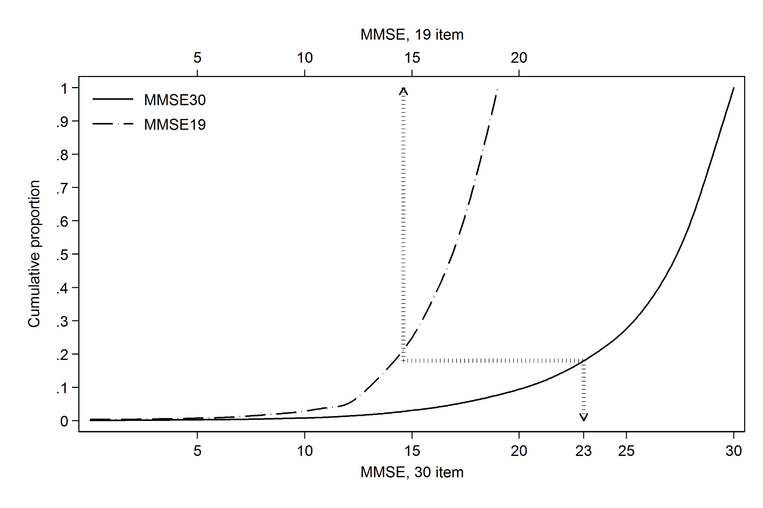
Cumulative probability plots
ΨMCA
Each score on one test (non-30 point MMSE version) is transformed to the score on the reference test (30-point MMSE) with the same percentile rank

Slide 30
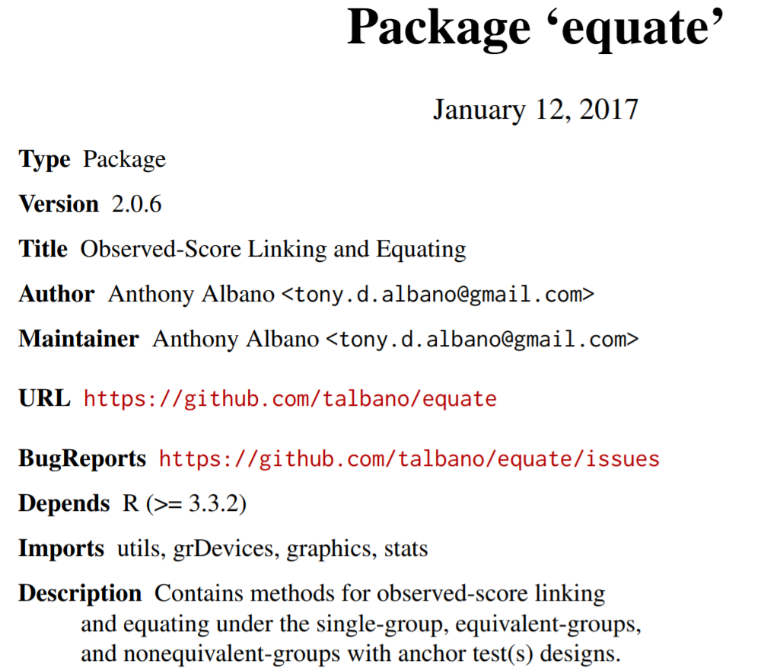
How are these done?
ΨMCA
Mean equating
  Score2= Score1 - (MeanScore2 – MeanScore1)
Linear equating
  Score2 = MeanScore1 +(Score1- MeanScore2)/(SDtest1/SDtest2)
Equipercentile equating
  R package: r_equate
  https://cran.r-project.org/web/
  packages/equate/equate.pdf

Slide 31
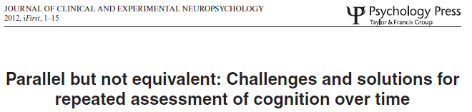
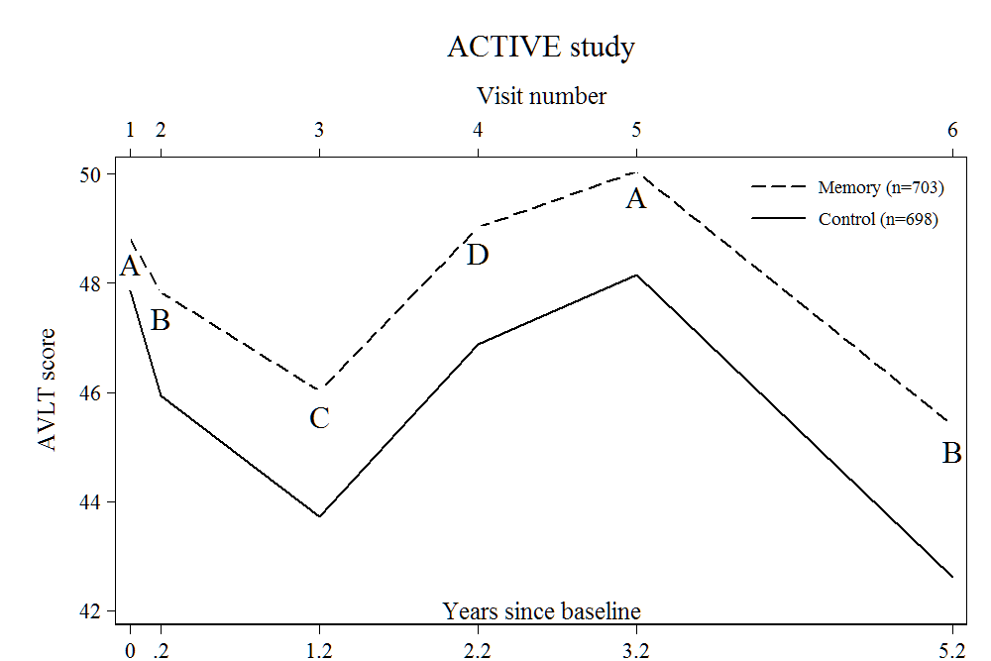
ΨMCA
Raw AVLT sum of trial recall from the ACTIVE study
Notes:
Raw AVLT sum of trial recall from the ACTIVE study

Slide 32
Results: ACTIVE AVLT
ΨMCA

Slide 33
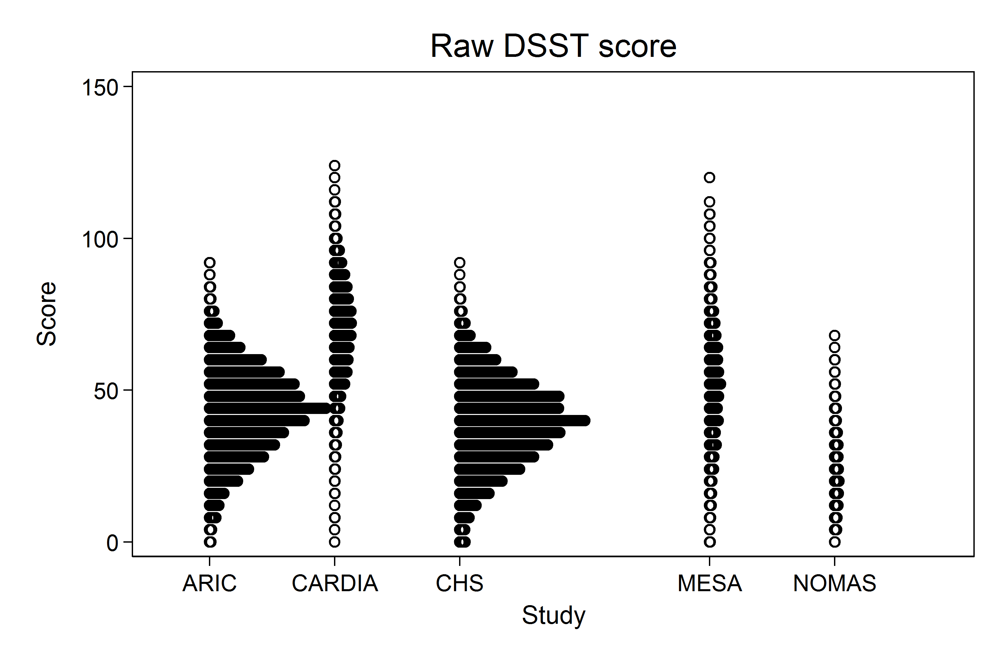
BPCOG Harmonization: Versions of the DSST can be equated
ΨMCA
WAIS-III
WAIS-III
SDMT
WAIS-R
WAIS-R
Notes:
NOMAS: SDMT
WAIS-III

Slide 34
Dangers of distribution-based methods
ΨMCA
Blunt force tools: they not only erase form/version differences, but also obliterate age differences, demographic differences that we may wish to preserve
Think carefully about what you equate
  Is there sufficient variability to support the relative position? Variables need variability to be equipercentile-equated
  Same construct? Measures should not be equated that have different meanings

Slide 35
Shoe size and MMSE
(Mobilize Boston Study, N=807)
ΨMCA
Think carefully about what you equate!
Among persons with an observed MMSE of <24, the maximum equated shoe size is 7. So, to screen for dementia using shoe size, flag as possibly demented persons with a shoe size of less than 7.

Slide 36
Outline
ΨMCA
What is harmonization?
What are the goals of harmonization?
Approaches for statistical harmonization
  Latent variables
  Without latent variables
Some general issues

Slide 37
What to do with highly skewed items?
ΨMCA
Return to the prestatistical harmonization; consider transformation from item score to the indicator

Slide 38
Differences in sampling strategies across studies?
ΨMCA
e.g., some HCAPs oversampled people with impairment, and some did not
This is not a problem for harmonizing test scores
It is a problem for substantive interpretations about study differences in cognitive ability
Notes:
This is a question for substantive interpretations, not strictly for harmonization as a method
We don’t need equivalent people to conduct harmonization because the IRT model adjusts for the construct being equated (cognition)

Slide 39
Approaches for statistical harmonization
ΨMCA

Slide 40

Spock on measurement
ΨMCA
“Instruments only measure what they’re designed to measure. There are a lot of unknowns in space.”
  Spock, The Animated Series
For a more thorough explanation and applied example, see Rich’s:
Jones-2019-DUMP-Statistical-harmonization
Notes:
For a more thorough explanation, see Rich’s “harmonization example.pdf”

