Slide 1
Polygenic Scores and Mendelian Randomization
Amal Harrati
Friday Harbor Workshop
Sept. 7, 2017

Slide 2
Objectives for this Talk
Polygenic Scores
-- Construction
-- Use of / examples
-- Caveats and challenges
Mendelian Randomization
-- Theory and assumptions
-- Us of / examples
-- Caveats and challenges

Slide 3
Background
Perspective of a social scientist
Genetics can be tools we incorporate into work we do
When/How/Do we agnostic can we remain to biology?
When/How/Do we wrangle with (social) environment?

Slide 4
In other words…

Slide 5
Objectives of this Talk
Polygenic Scores
-- Construction
-- Use of / examples
-- Caveats and challenges
Mendelian Randomization
-- Theory and assumptions
-- Use of / examples
-- Caveats and challenges

Slide 6
Taking a step back
Let’s take a (rapid) tour through the last century of human genetics and try to make sense of where we are at the present.

Slide 10
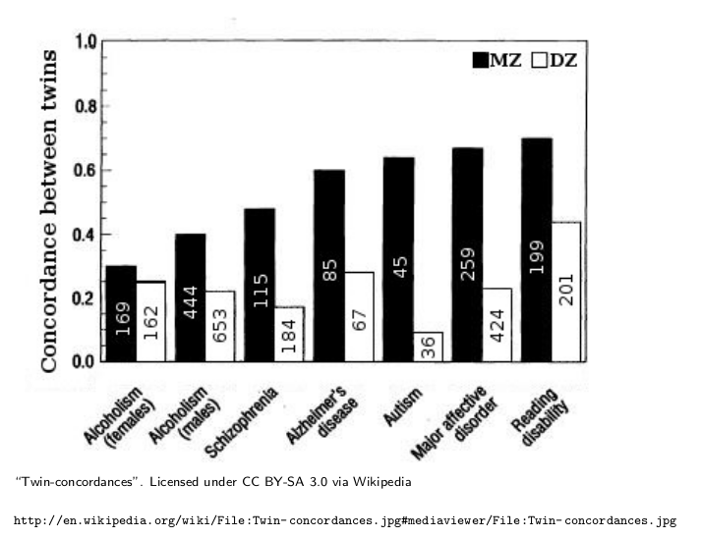
Increased genetic similarity → Increased Phenotypic Similarity

Slide 11
Moving past pedigree studies
Human Genome Project completed in 2003. Three big aims:
determining the order, or ”sequence,” of all the bases in our genome’s DNA
making maps that show the locations of genes for major sections of all our chromosomes
producing what are called linkage maps

Slide 12
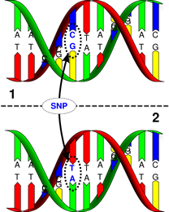
Single Nucleotide Polymorphisms (SNPs)
Simplest form of genetic variation.
Others exist (e.g., CNVs)
SNPs occur ~1/300 base pairs

Slide 13
Single Nucleotide Polymorphisms (SNPs)
Two flavors of a SNP are “alleles”.
Major and minor alleles.
Reference Allelle.
We inherit two pieces of genetic information, one from mom and one from dad.
Focus is on number (0,1,2) of reference alleles at a SNP.

Slide 14
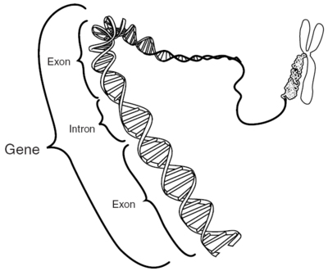
SNPs are not genes
We have ~25,000 genes.
SNPs may be embedded within genes. Or not.

Slide 15
Genome-wide data is not sequence data
Genome-wide data will look at just SNPs (and even just a sample of those).
Sequence data contains information about EVERY base pair.
Of interest for study of rare variants and de novo mutations.

Slide 16
SNP data (aka genome-wide data)

Slide 17
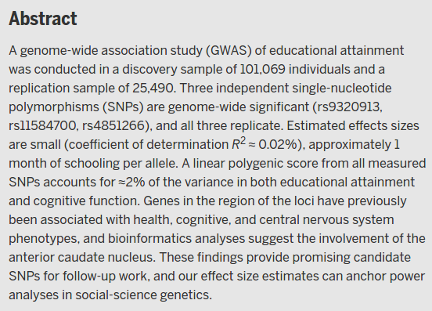
Individual SNPs are weak predictors
Weak prediction of individual genetic variants.
Some exceptions (APOE)
A typical human behavioral trait is associated with very many genetic variants, each of which accounts for a very small percentage of the behavioral variability.

Slide 18
One solution: aggregate information across SNPs Polygenic scores!

Slide 19
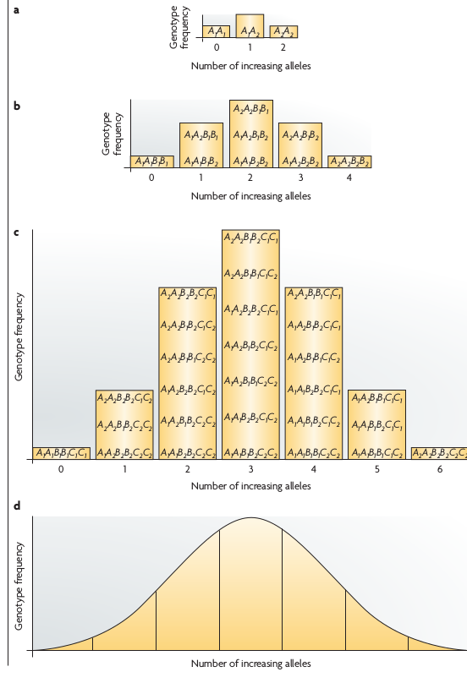
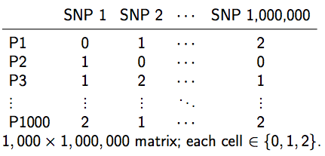
Score Construction

Slide 20
Polygenic scores are weighted sums
(person-i, SNP-j)
General idea is to take “weights” from a GWAS performed by someone else and apply them to your sample.

Slide 22
Where to get GWAS results?
IGAP
Chouraki et al. (2016)
Marden et al. (2015)
Desikan et al. (2017)

Slide 23
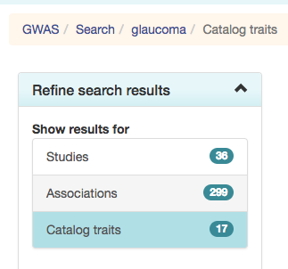
GWAS catalog: http://www.ebi.ac.uk/gwas/

Slide 24
LD Hub

Slide 25
Score Construction: Key Considerations
Which j’s? (Which SNPs to include?)
Strand Ambiguity
P-value thresholds
Independence of SNPs
Genotyped or imputed?
What are beta-weights?
Which i’s? (For whom should they apply?)

Slide 26
Mechanical Problem: Strand ambiguity
Identifying the allele that predisposes towards an outcome can be trickier than it would seem at first blush.

Slide 27
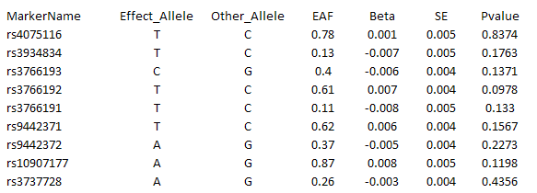
GWAS Results

Slide 28
GWAS Results
Empirical Data
1 rs3934834 0 1005806 A G

Slide 29
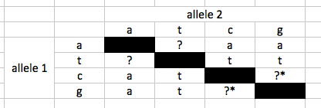
Strand issues
Paired bases: A-T, C-G
Fwd strand A/C implies reverse strand T/G
Suppose GWAS identifies A as risk allele. [note: they may not give you other allele.]
Your data:

Slide 30
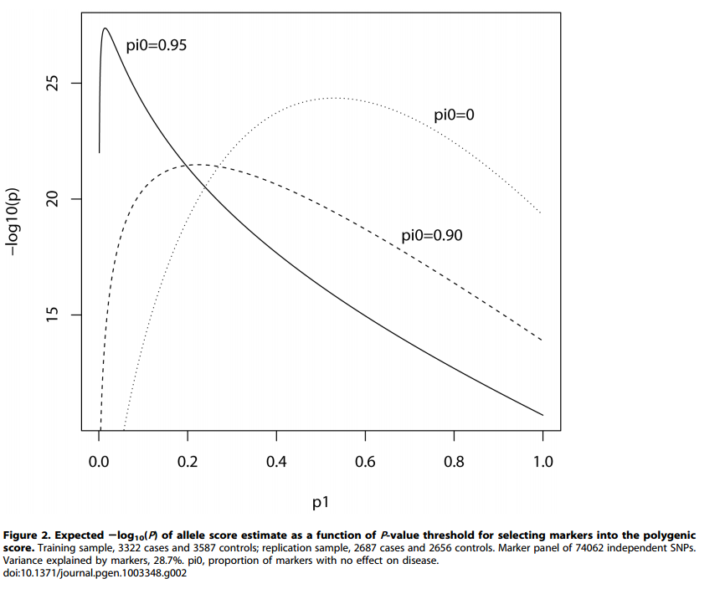
Choice of p-value
There is a theoretical optimum
It depends on knowledge of trait’s genetic architecture we don’t generally have.

Slide 31
P-value threshold
General rule: More genetic information yields better prediction.
Most research use lenient p-value threshold.
Low weights for low p-values

Slide 32
P-value threshold

Slide 33
Two points re p-values
Top hits scores
Scores constructed using only genome-wide significant hits.
Useful when you might be interested in understanding the relevant biology.
Mendelian randomization?
Beware overfitting!
Optimization of p-value threshold should not take place in your analytic sample.

Slide 34
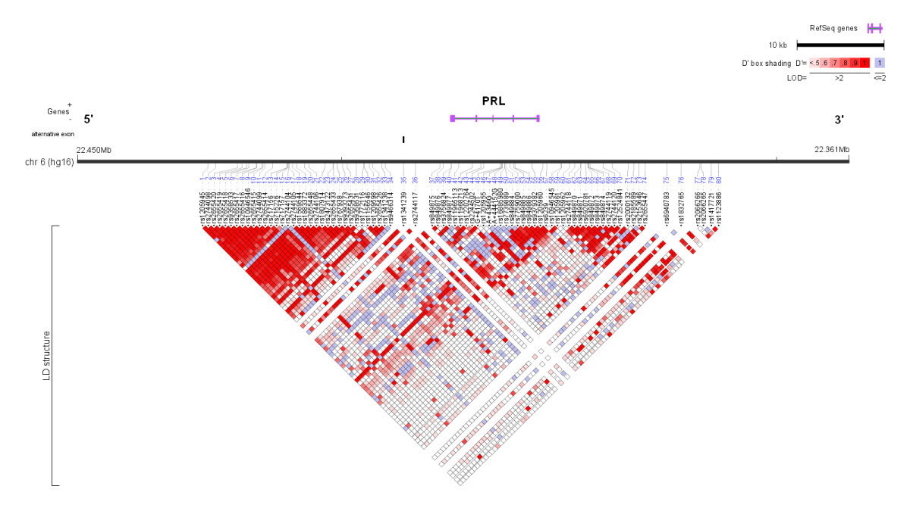
Linkage

Slide 35
Why is linkage relevant here?
What do we want out of PGS?
Create a proxy that captures biological predisposition or risk.
If too many SNPs in linkage with a causal locus are included, we might overemphasize that locus in score.
Chip design
Tricky problem
Removing non-causal (but associated) SNPs necessitates knowledge of causal SNPs which we don’t have.

Slide 36
Many options
Use all SNPs [aka do nothing]
Pruning
Traditional approach to identifying independent markers involved random selection.
Clumping
Select variants in LD blocks that are most highly associated with outcome.

Slide 37
Imputed or Genotyped SNPs
Imputation quality may vary as a function of ancestry
Probably worth knowing whether key results are sensitive to this choice re score construction.

Slide 38
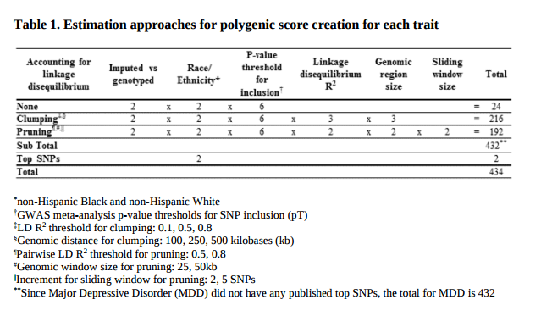

Slide 39
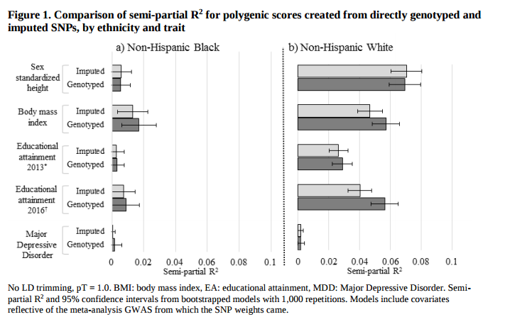
How sensitive are scores to this set of choices?

Slide 40
Weights
Each SNP will be weighted by the magnitude of its effect.
For continuous traits, the estimated coefficient.
For dichotomous traits, log of the OR.
If you’re doing a top-hits score, then may not need to weight.
You probably need big samples to get reasonable weights
Use consortia-led GWAS rather than doing yourself.

Slide 41
Final result: A PGS!
One consolidated measure of genetic risk
Useful in reducing complexity, particularly when studying complex questions
Individual-level assignment, like a credit score

Slide 42
How to get PGS in practice
Software Options
PRSice, http://prsice.info/
plink, https://www.cog-genomics.org/plink2
LDpred, https://github.com/bvilhjal/ldpred
Some are now available.
HRS, https://hrs.isr.umich.edu/data-products/genetic-data/products/pgs-list

Slide 43
Objectives for this Talk
Polygenic Scores
-- Construction
-- Use of / examples
-- Caveats and challenges
Mendelian Randomization
-- Theory and assumptions
-- Us of / examples
-- Caveats and challenges

Slide 44
Uses of PGS
Predictive Tool
“Genes”/PGS as Modifiers in social environments
PGS as a way to understand social complexities
“Genes”/PGS as instruments

Slide 46
Uses of PGS
Predictive Tool
“Genes”/PGS as Modifiers in social environments
PGS as a way to understand social complexities
“Genes”/PGS as instruments

Slide 47
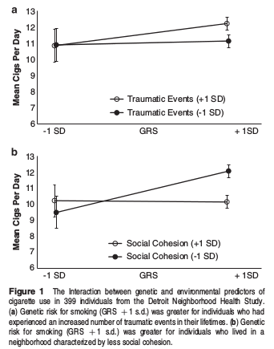

Slide 48
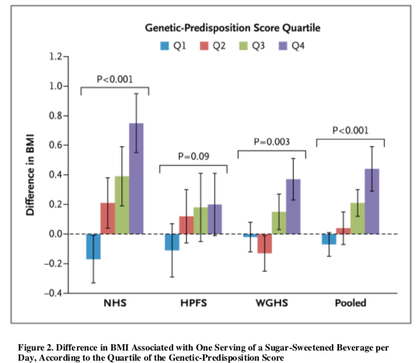

Slide 49
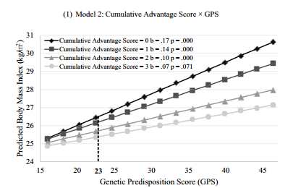
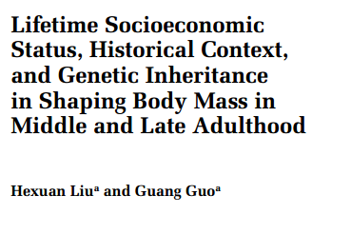

Slide 50
Uses of PGS
Predictive Tool
“Genes”/PGS as Modifiers in social environments
PGS as a way to understand social complexities
“Genes”/PGS as instruments

Slide 51
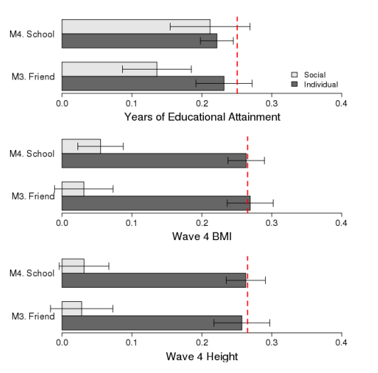
Social genome, as measured by educational attainment PGS, predicts own educational attainment.
Social genome, as measured by height/BMI PGS, irrelevant for own phenotype.

Slide 52
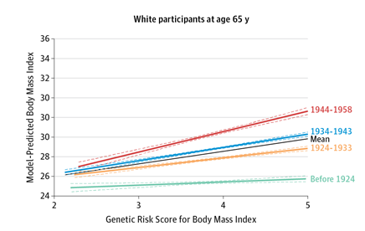
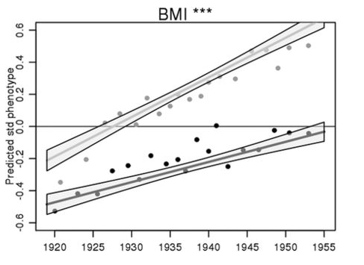
BMI

Slide 53
Uses of PGS
Predictive Tool
“Genes”/PGS as Modifiers in social environments
PGS as a way to understand social complexities
“Genes”/PGS as instruments (To be continued)

Slide 54
Objectives for this Talk
Polygenic Scores
-- Construction
-- Use of / examples
-- Caveats and challenges
Mendelian Randomization
-- Theory and assumptions
-- Us of / examples
-- Caveats and challenges

Slide 55
Caveats and Challenges
Decisions in score construction
Selection
Population Stratification/ancestry
Environmental sensitivity (or lack thereof)

Slide 56
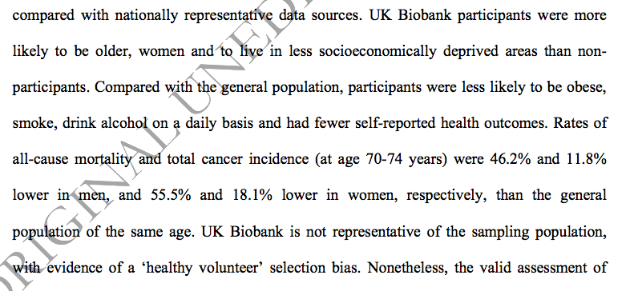

Slide 57
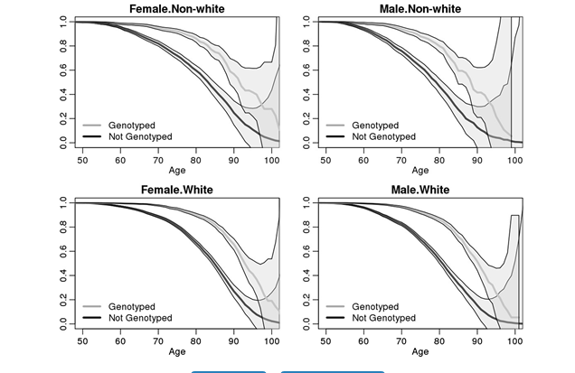

Slide 58
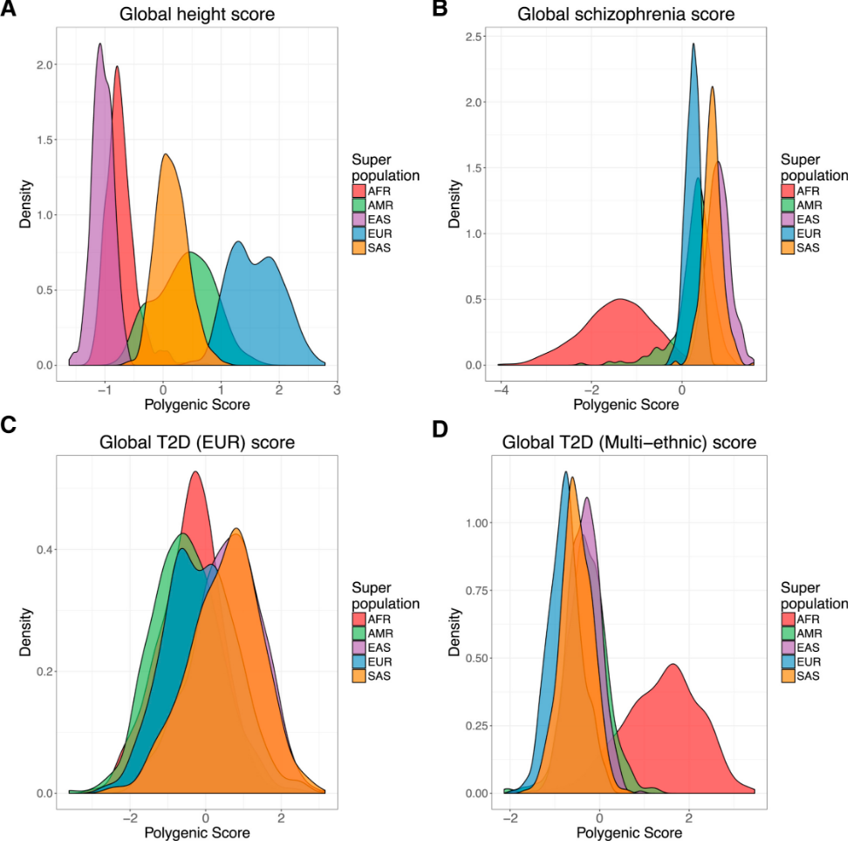

Slide 59
Caveats and Challenges
Decisions in score construction
Selection
Population Stratification/ancestry
Environmental sensitivity (or lack thereof)

Slide 60
Objectives for this Talk
Polygenic Scores
-- Construction
-- Use of / examples
-- Caveats and challenges
Mendelian Randomization
-- Theory and assumptions
-- Us of / examples
-- Caveats and challenges

Slide 61
Introduction
The IV approach refers to a set of methods that allow one to recover, under certain assumptions, a causal effect of an exposure in the presence of unmeasured confounding.
The IV approach has a longstanding tradition in econometrics going back to the original work of Wright (1928) and Golderberger (1972) who initially developed the approach in the context of linear structural equation modeling.
More recently been formalized using potential outcomes or counterfactual variables, by Angrist (1994), Robins (1994), Angrist, Imbens and Rubin (1996) and Heckman (1997).
A key contribution of the counterfactual language to the IV approach is that it allows one to formally define the causal effect of interest and to clearly articulate assumptions needed to identify this effect.

Slide 62
Causal inference: Randomized Control Trial
Confounds
Randomly
Allocated
Treatment
Disease/
Outcome
Received
Treatment

Slide 63
Mendelian Randomization: Basic Framework
Disease/
Outcome
Phenotype

Slide 64
Mendelian Randomization: Basic Framework
Confounds
Disease/
Outcome
Phenotype

Slide 65
Mendelian Randomization: Basic Framework
Confounds
Randomly
Allocated
Allele(s)
Disease/
Outcome
Intermediate
Phenotype

Slide 66
Genes as Instruments: Mendelian Randomization
Mendel’s First Law: Genes segregate randomly and independently of environmental factors
Mendel’s Second Law: Genes segregate independently of other traits
Little individual knowledge of genetic makeup
Notes:
Hence, as genes are randomly assigned during meiosis (cell division for reproduction), individuals of different genotypes are expected not to differ systematically in any other respect.
As stated by Mendel’s first law (the law of segregation), genetic variants segregate randomly and independently of environmental factors, and Mendel’s second law (the law of independent assortment) suggests that genetic variants should also segregate independently of other traits (although with some exceptions—see below) (79). There is empirical evidence that this is indeed the case (subject to certain qualifications, described below). For example, one study showed that although 96 nongenetic characteristics showed substantial intercorrelation with one another, 23 genetic variants were associated with the same traits only at the level expected by chance (37).

Slide 67
Assumptions for Mendelian Randomization
Assumption 1:
Instrument must be associated with exposure
Assumption 2:
Instrument not associated with confounders
Assumption 3:
Instrument not associated with outcome except through exposure

Slide 68
Assumption 1: Instrument must be associated with exposure
Confounds
PGS
Disease/
Outcome
Phenotype

Slide 69
Assumption 2: Instrument not associated with confounders
Confounds
PGS
Disease/
Outcome
Phenotype

Slide 70
Assumption 3: Instrument not associated with outcome
Confounds
PGS
Disease/
Outcome
Phenotype

Slide 71
Objectives for this Talk
Polygenic Scores
-- Construction
-- Use of / examples
-- Caveats and challenges
Mendelian Randomization
-- Theory and assumptions
-- Use of / examples
-- Caveats and challenges

Slide 72
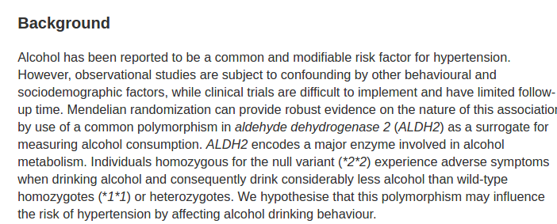

Slide 73
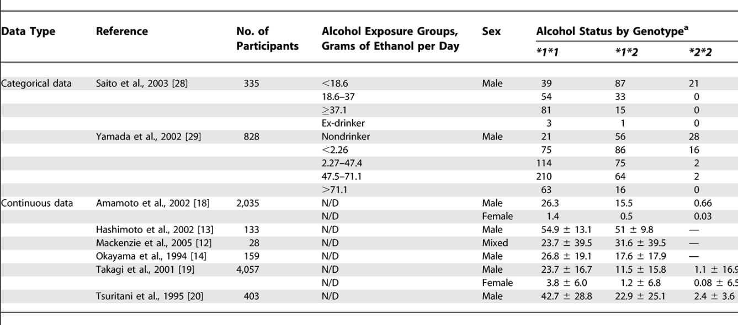

Slide 74
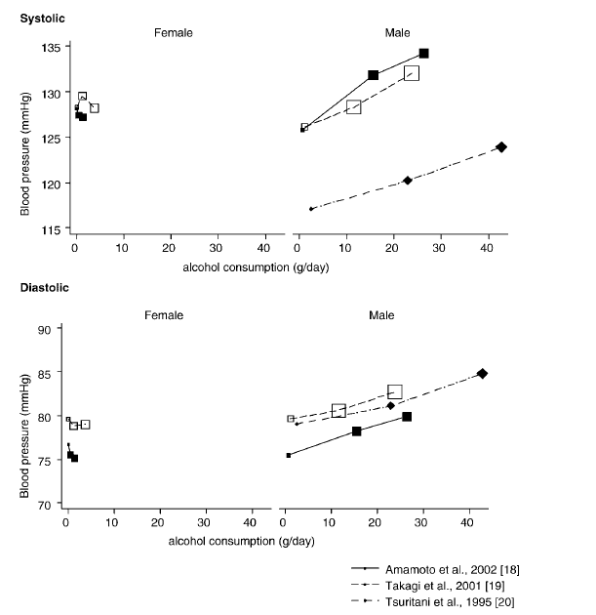

Slide 75
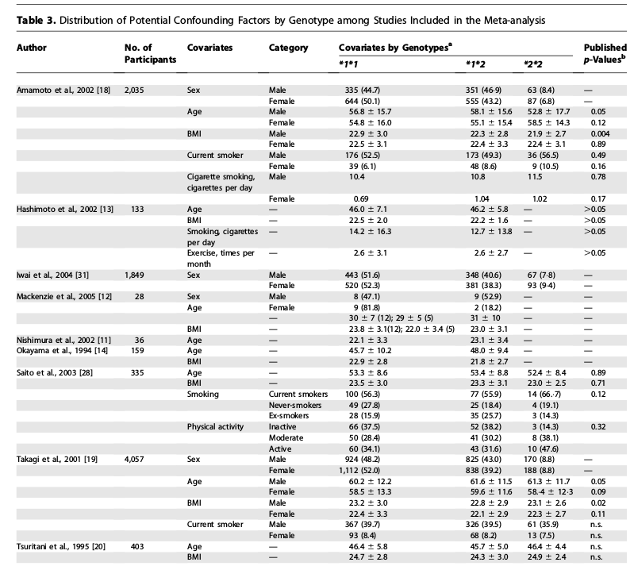

Slide 76
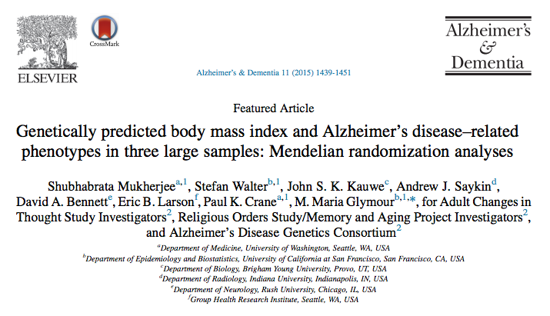
BMI as an example

Slide 77
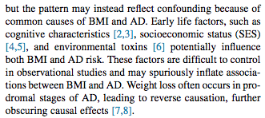
Confounding
Common cause of BMI and AD
AD causes BMI change
(reverse causation)
Bottom line: confusing to study!

Slide 78
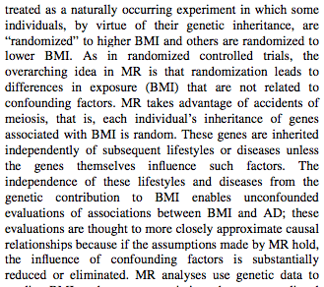
Natural experiments
Genes inherited randomly
Genetic inheritance not impacted
By SES, environment, etc.

Slide 79
Objectives for this Talk
Polygenic Scores
-- Construction
-- Use of / examples
-- Caveats and challenges
Mendelian Randomization
-- Theory and assumptions
-- Use of / examples
-- Caveats and challenges

Slide 80
Challenges with MR
Suitable genetic variants
Power/large sample sizes
Pleiotropy
Population Stratification
LD
Epigenetics (must assume random distribution of epigenetic changes as well)
Assortative mating (Panmixia)

Slide 81
Genetic Predictors
(Predictive) Power/Mechanisms trade-off
Always important to think about the trade-off when incorporating a genetic predictor.

Slide 82
Evaluating MR Studies: leverage prior assumptions about confounding
Often, field is only interested in knowing if a conventional effect estimate is biased up
Other direction of bias not of interest, or not considered plausible
Compare IV effect estimate to conventional effect estimate: if conventional effect estimate is positively confounded, IV<conventional
4 equivalent versions of this test: no more convincing to show all 4.
Relies on assumption regarding the direction of confounding: if you don’t know the direction, the test is not informative
Not guaranteed to be consistent in non-linear causal structures (but doesn’t completely rely on linearity).

Slide 83
Evaluating MR Studies: Over-identification tests
Use multiple instrumental variables to conduct over-identification tests.
Other genes or even polymorphisms of the same gene might provide additional instruments.
Cannot detect violations of the IV assumptions if all instruments have identical biasing pathways.
May also reject even when all instruments are valid if the model is incorrectly assumed to be linear or the phenotype is composite. These tests generally have low statistical power.

Slide 84
Evaluating MR Studies: Modifying factors
Identify factors that modify the genotype-phenotype association.
Compare the IV effect estimate across groups in which the population association between the instrument and the phenotype is either silenced or reversed.
This test could identify a biased instrument if the biasing pathway is active in both subgroups.

Slide 85
Evaluating MR Studies: Negative controls (theoretically based)
Identify situations (types of people, particular locations) in which the phenotype should not affect the outcome
Identify outcomes that would be associated with similar pleiotropic pathways but not causal pathways

Slide 86
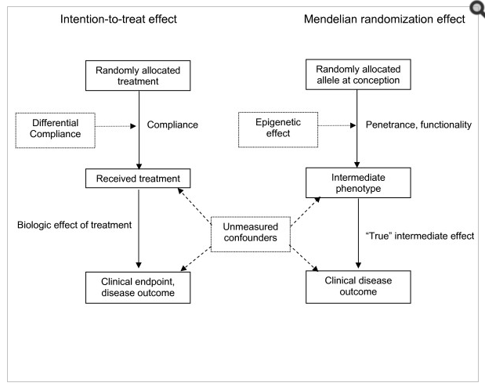
Challenges: Epigenetics
Adapted from Nitsch D, et al.

Slide 87
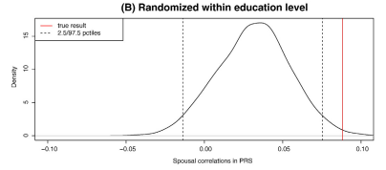
Challenges: Positive Assortative Mating

Slide 88
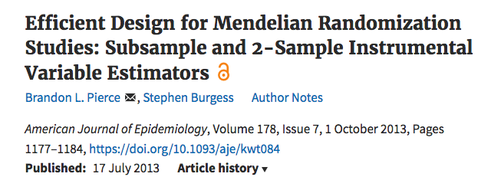
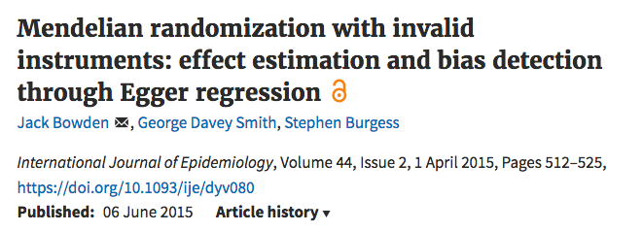
Additional Methods

Slide 89
Additional Methods

Slide 90
Summary
GWAS results can be used in informative ways for non-geneticists
Polygenic scores provide a useful to simplify complexity and provide a tool for analysis, including MR
MR can recover causal estimates, provided assumptions are met
Many challenges exist: be careful, be thoughtful, limit interpretation

Slide 91
Thank you!
aharrati@stanford.edu

Slide 92
Cognitive Age
Based on Immediate Recall, Delayed Recall, Serial 7s and Backwards Counting
Chronological Age – Cognitive Age
Harrati, Levine and Crimmins (in progress)
Cognitive Age
Notes:
Positive values are better, negative values are worse

Slide 93
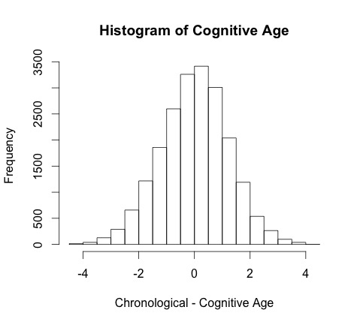

Slide 94
The Instrument: Genetic Risk Score (GSR)
Compilation of 19 SNPs that are associated with cognitive decline and memory loss, including APOE.
Risk Score is created for each individual by creating a weighted sum of risk alleles (Lambert et al., 2013)
Demonstrated to be associated with memory loss in the HRS population (Marden et al., 2016)
Notes:
Meta-Analysis of 74,046 individuals for AD

Slide 95
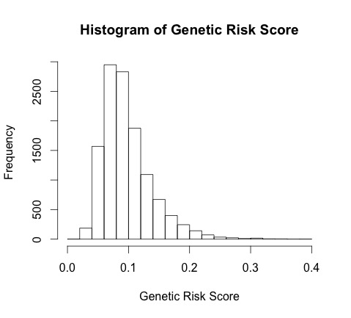

Slide 96
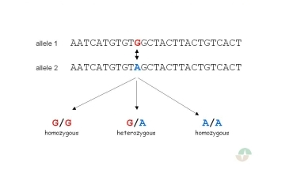
Genome-wide data

Slide 97
SNPs are not Genes
Genes are protein-coding regions.
25k genes in human genome.
SNPs may lie within genes.
Most traits are “massively polygenic” meaning individual genes have small effects.

