Slide 1
Pathways and Interactions
Timothy J Hohman, PhD
Assistant Professor of Neurology
Vanderbilt Memory & Alzheimer’s Center
Friday Harbor September 8, 2017

Slide 2
Outline
Gene Level Analysis
Pathway Analysis
Gene Interactions

Slide 3
Advantage of Gene Level Analysis
Reduce multiple comparisons
GWAS: 1 million independent loci, α = 5x10⁻⁸
Gene level: 20,000 genes, α = 2.5x10⁻⁶
Interpretation
Most functions at gene level rather than SNP level
Non-coding and intergenic SNPs less of an issue
Increased power?
Multiple causative loci in single gene could be summarized to increase power

Slide 4
Challenges to Gene Level Analysis
Annotation
What SNPs should be annotated to a given gene?
Gene Size
How do you compare genes of 2,300,000 bases (PTPRD) to a gene of 6,000 bases (RAG2)?
Linkage Disequilibrium
Account for covariance among SNPs

Slide 5
Plink Set-Based Analysis
Select a set (see annotation issue previously)
Often we’ll use gene region +/- 50kb
Step 1: univariate analysis for all SNPs
Step 2: LD prune to remove correlated SNPs (optional)
Step 3: Select up to five SNPs with lowest p-values
Step 4: Assign score based on average chi-square
Step 5: Permute phenotype
Step 6: Calculate permutation p-value for score
Step 7: Correct for total number of sets evaluated (genes)

Slide 6
Burden Tests and SKAT
Same basic premise (summarize effects across SNPs)
Weighting scheme allows integration of rare variants
Burden test places a larger weight on rare variants
At level of raw analysis (sum minor allele counts)
Combine rare variants weighted based on minor allele frequency
Direction has to be the same (because of summing)
SKAT balances weighting scheme across rare and common variants, and uses square to take care of direction
Sum of weighted square of test statistic
Can also be thought of as variants modeled as random effects within mixed effects model, pvalue is whether random component differs from 0
SKAT-O: Optimized linear combination of burden test and SKAT test

Slide 7
VEGAS
Basically set-based analysis applied directly from GWAS p-values
Convert p-values to χ² statistic with 1df
Calculate gene level statistic
Adjust for LD using 1,000 genomes
Run simulations to calculate an empirical p-value
Can be run directly online
https://vegas2.qimrberghofer.edu.au/

Slide 8
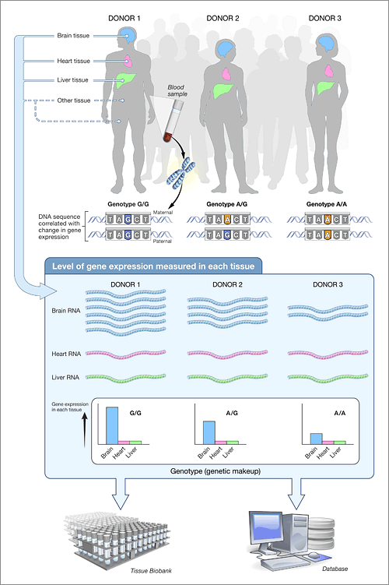
PrediXcan
https://commonfund.nih.gov/GTEx/index

Slide 9
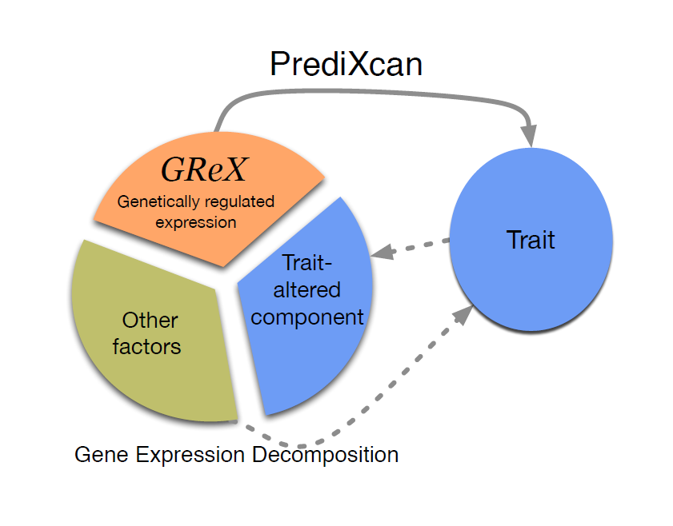
PrediXcan
SNP → Gene Expression
Is my identified SNP associated with gene expression in the brain?
Impute gene expression!
Build multi-SNP prediction models in GTEx
Use the SNP prediction estimates to impute

Slide 10
Other Resources for eQTL and Lookup
SNP lookup: https://www.ncbi.nlm.nih.gov/SNP/
Brain eQTL: http://www.braineac.org/
Regulation: http://archive.broadinstitute.org/mammals/haploreg/haploreg.php
LD: http://archive.broadinstitute.org/mpg/snap/ldsearchpw.php
Protein atlas: http://www.proteinatlas.org/
Other relevant tools: http://www.sanger.ac.uk/science/tools#guide

Slide 11
Outline
Gene Level Analysis
Pathway Analysis
Gene Interactions

Slide 12
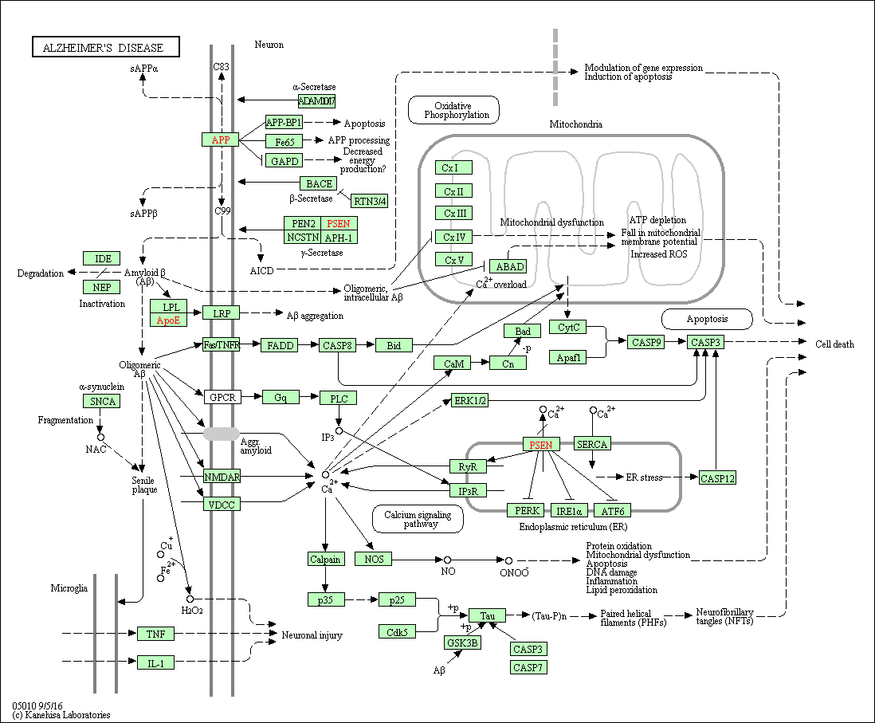
KEGG Pathway Analysis

Slide 13
Pathway Enrichment
Define genes (50 kb window) and get gene score (see previous section)
Decide what is a “high score” (95% of gene score we’ll say)
Ask does a given pathway have more genes in the “high score” than expected
Comparison is 10,000 randomly selected “gene sets” the same size as the pathway

Slide 14
Example Results

Slide 15
Outline
Gene Level Analysis
Pathway Analysis
Gene Interactions

Slide 16
Gene Interaction Challenges
Statistical power
Single marker GWAS: 1,000,000 Tests, α=0.00000005
Genome-wide Interaction: 499,999,500,000 Tests, α=0.0000000000001
Computational
GWAS: 1,000,000 tests at .0001 seconds each = 1 minute
GWI: 499,999,500,000 tests at .0001 seconds = 578 days

Slide 17
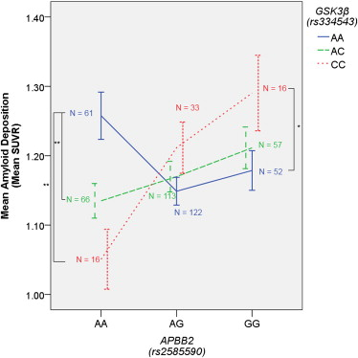
Gene Interaction Challenges
Interpretation

Slide 18
Genetic Resilience: Gene x Gene Interactions
Microglial Phagocytosis
Plaques
↑ APP
Normal APP
Aβ
γ-secretase
Proinflammatory Response
AICD
Fe65
GSK-3
↑ APP
↑ GSK-3
Notes:
GSK-3 Promotes both production of Abeta, through facilitating gamma secretase cleavage via an unknown mechanism (GSK-3 blocker lithium actually reduces Abeta in mouse models), and also promotes pro-inflammatory response.
Lithium (a GSK-3 blocker) inhibits the gamma secretase clevage step
APBB@ - Amyloid Beta Precursor Protein-Binding Family B, Mmeber 2 → codes the Fe65 protein

Slide 19
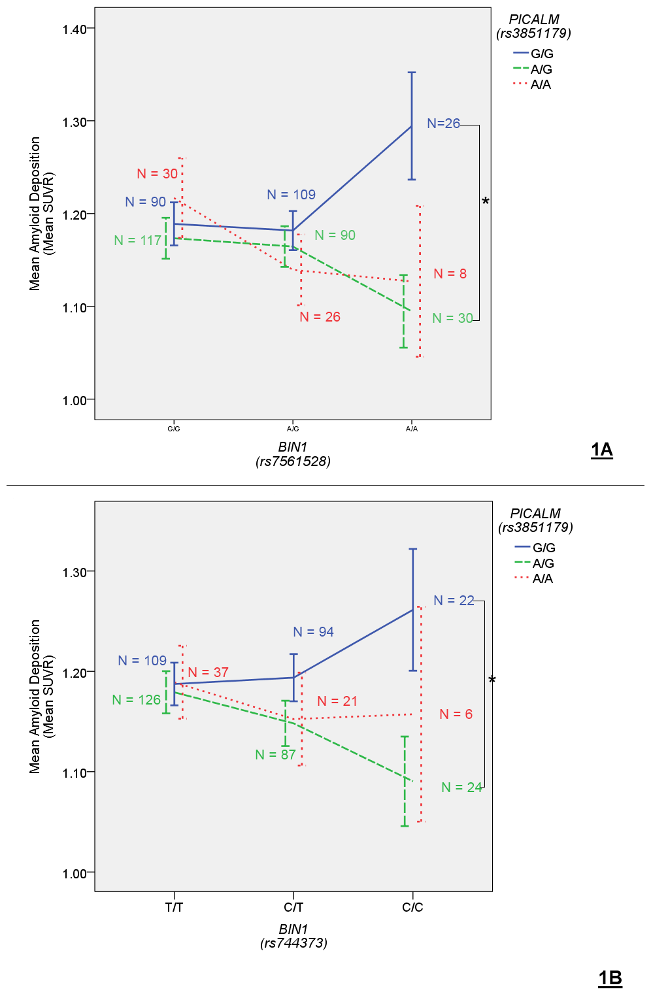
Candidate Gene Approach

Slide 20
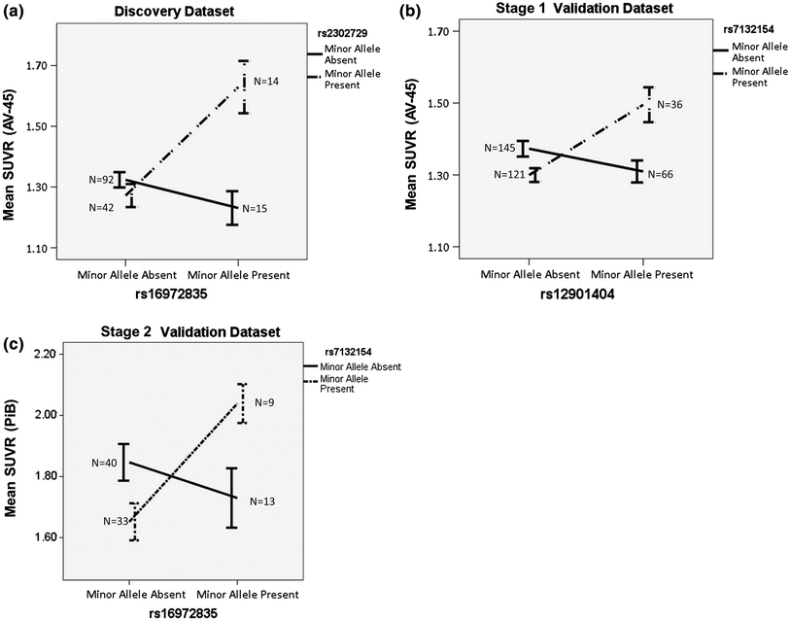
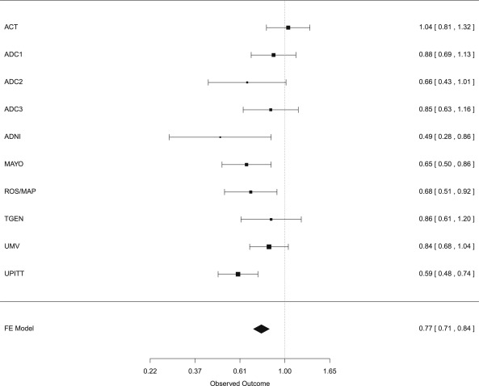
Informed Pathway Approach
GRIN2B (rs1805474) x ADRA1A (rs2466176)

Slide 21
Acknowledgements
Vanderbilt Memory & Alzheimer’s Center
Brigham Young University
John (Keoni) Kauwe, PhD
University of Washington
Paul Crane, MD
Joey Mukherjee, PhD
University of Kentucky
David Fardo, PhD
Case Western University
Jonathan Haines, PhD
William Bush, PhD
University of Miami
Margaret Pericak-Vance, PhD
Eden Martin, PhD
Brian Kunkle, PhD
Pennsylvania State University
Marylyn Ritchie, PhD
Alzheimer’s Disease Genetics Consortium
Angela Jefferson, PhD
Katherine Gifford, PsyD
Logan Dumitrescu, PhD
Vanderbilt Genetics Institute
Nancy Cox, PhD
Collaborators
Novartis Institute for Biomedical Research
Tricia Thornton-Wells, PhD
Funding:
K01-AG049164
K12-HD043483
NIA HHSN311201600276P

