Slide 1
Introduction to Genetics for the Non-Geneticist
Timothy J Hohman, PhD
Assistant Professor of Neurology
Vanderbilt Memory & Alzheimer’s Center
Friday Harbor September 6, 2017

Slide 2
Outline
DNA and the Cell Cycle
Mendelian Genetics
Molecular Genetics

Slide 3
DNA and Cell Cycle
Goals
Overview of Cell Cycle
Demonstrate how cell division contributes to genetic variation

Slide 4
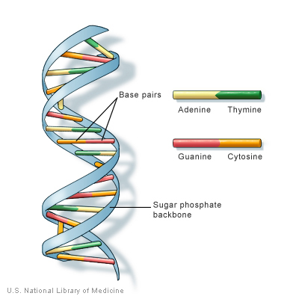
DNA
DNA: Deoxyribonucleic acid
Stable molecule that can be copied and transmitted to daughter cells
Contains “blueprints” for making RNA
DNA Structure
Sugar-phosphate backbone
Adenine, Cytosine, Guanine, Thymine
Double helix with complementary base pairs
A always pairs with T, G always pairs with C

Slide 5
Human Chromosomes
Human DNA is arranged in 24 Chromosomes
22 Autosomes, 2 Allosomes (X and Y)
Most cells are diploid (23 pairs of chromosomes)
Sperm and egg cells are haploid
All cells derive from a single diploid cell (zygote)
The division of cells and the passing of genetic information is an essential component of our basic biology

Slide 6
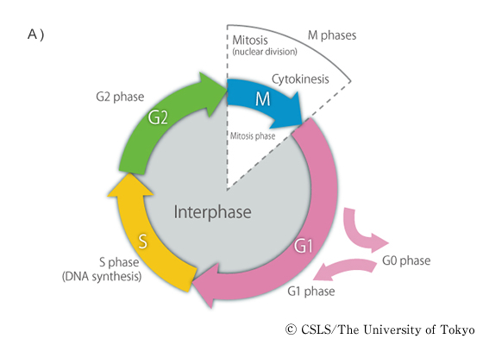
Cell Cycle
The process of cellular growth and reproduction

Slide 7
Cell Cycle
Decision time!
G0, S phase, apoptosis, senescence, meiosis, differentiation
Notes:
G1 “decisions” based on signals from the extracellular environment (presence of nutrients). Following G1, the nucleus is capable of initiating DNA replication
G0 is resting phase

Slide 8
Cell Cycle
DNA replication (only occurs once)
Notes:
Cell regulators can differentiate between replicated DNA and DNA that has not replicated.

Slide 9
Cell Cycle
Prepare for division: Growth, protein translation

Slide 10
Cell Cycle
Will expand on this in a second

Slide 11
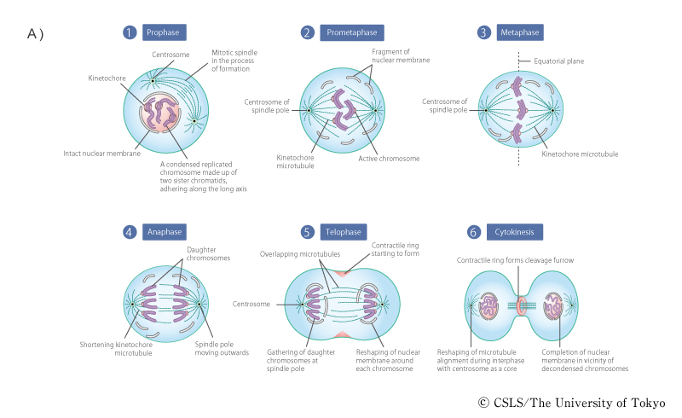
Mitosis
Results in two identical cells
Notes:
Two centrosomes move to opposite ends of cells
Nuclear membrane breaks down
Chromosomes connect to microtubules and move to equatorial plane
Centromere cohesions removed
Free chromosomes pulled to opposite poles

Slide 12
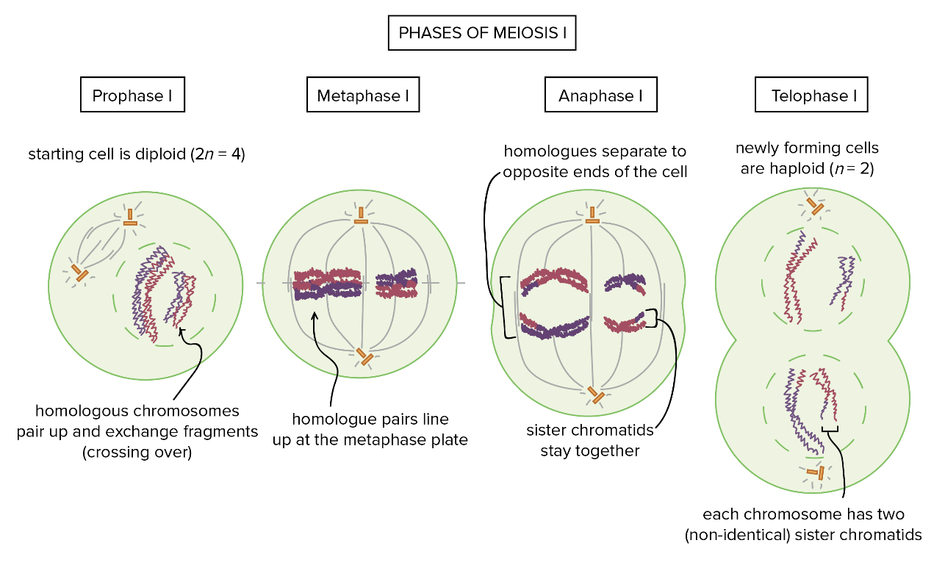
Meiosis
Meiosis – Special type of cell division resulting in 4 haploid gamete cells (rather than two diploid cells)
Follows after DNA replication in S phase

Slide 13
Meiosis – Prophase I
Synapsis: Homologous chromosomes join
Synaptonemal complex holds them together and enables cross over
Mechanisms of Genetic Diversity:
Independent Assortment
Recombination (cross over)
Notes:
Chromsomes are actually on top of each other, not next to each other.

Slide 14
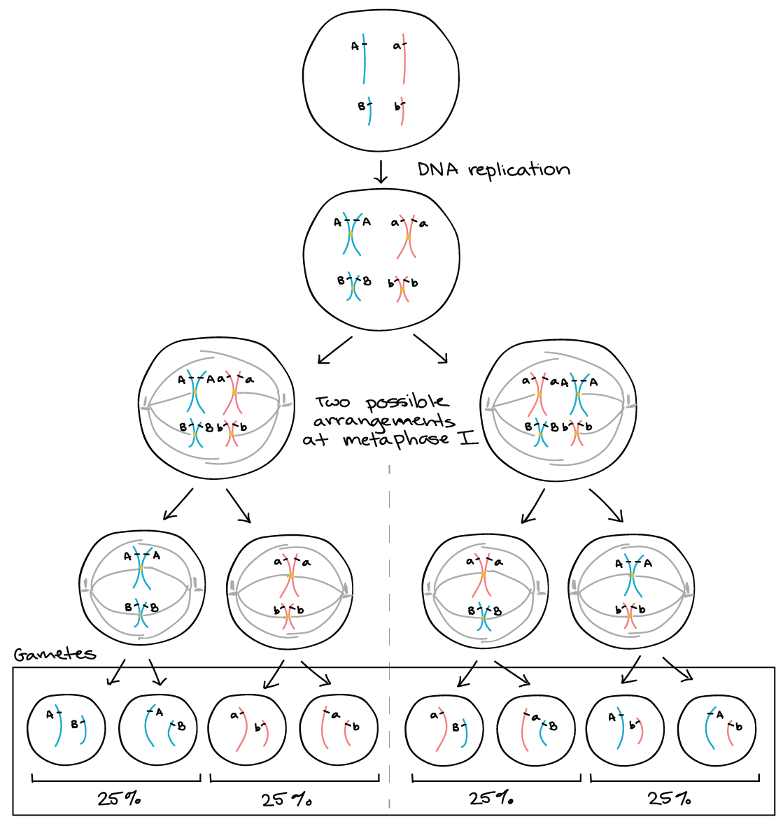
Meiosis – Independent Assortment
2²³ = 48,388,608 unique assortments are possible
Notes:
Start with your diploid cell, DNA is replicated (46 chromosomes present, 96 chromatids)
Synapsis takes place, homologous chromosomes are aligned, but which is on top/bottom is random. That random “assortment” will dictate which chromatid (from mom or dad) will be pulled into gamete

Slide 15
Meiosis – Recombination
Cross over includes breaking and rejoining one paternal and one maternal chromatid
Recombined homologs joined at chiasmata
Facilitated by recombination nodules along the synaptonemal complex
Notes:
X and Y are joined vertically rather than sandwiched, joined at one small region of homology

Slide 16
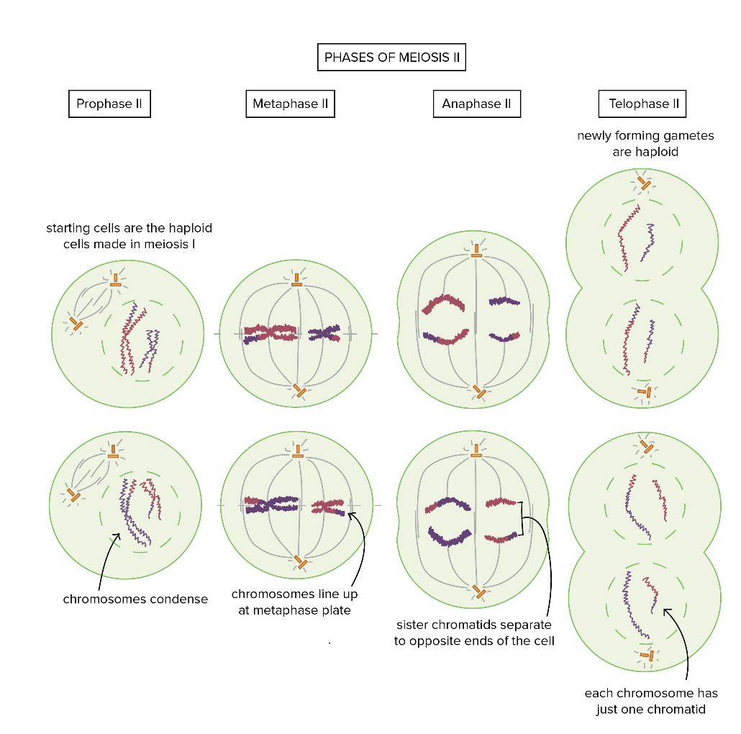
Meiosis
Mitosis of haploid cells

Slide 17
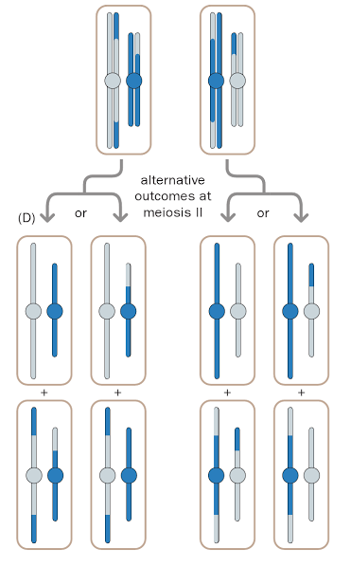
Meiosis

Slide 18
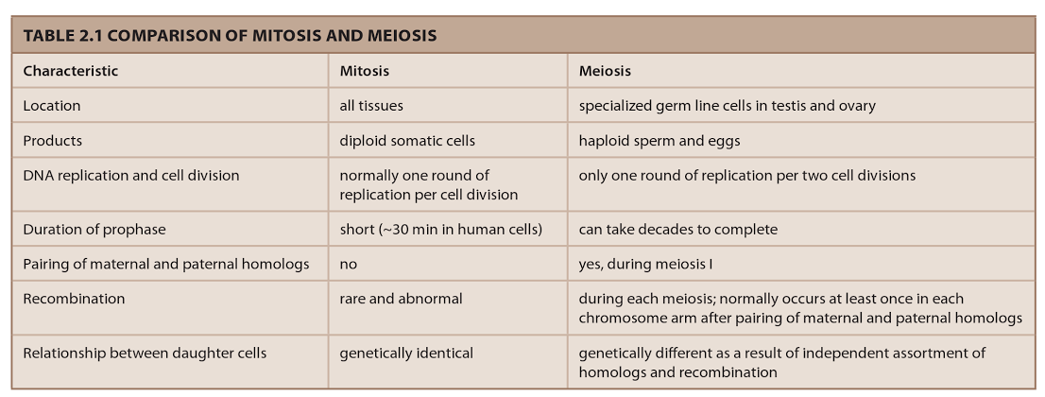
Summary

Slide 19
Outline
DNA and the Cell Cycle
Mendelian Genetics
Molecular Genetics

Slide 20
Mendelian Genetics
Goals:
Mendel’s laws
Inheritance
Segregation
Independent Assortment
Pedigrees and Extensions to Human Genetics

Slide 21
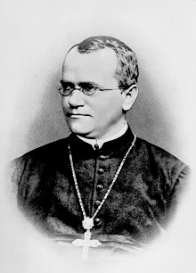
Mendelian Genetics
Heredity: The passing of traits from one generation to another
Gregor Mendel
Studied the Pea Plant
Dominant alleles hide recessive alleles

Slide 22
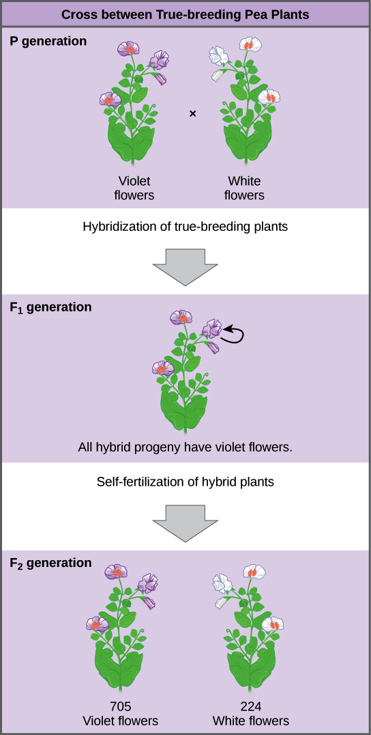
Mendelian Genetics: Example
Always resulted in a 3/1 ratio
http://cnx.org/contents/24nI-KJ8@24.18:NjE8d7G4@7 /Mendels-Experiments

Slide 23
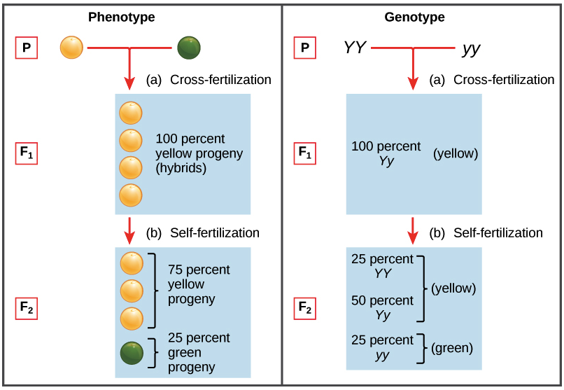
Mendelian Model of Inheritance
http://cnx.org/contents/24nI-KJ8@24.18:gvXF8Dni@4/Laws-of-Inheritance

Slide 24
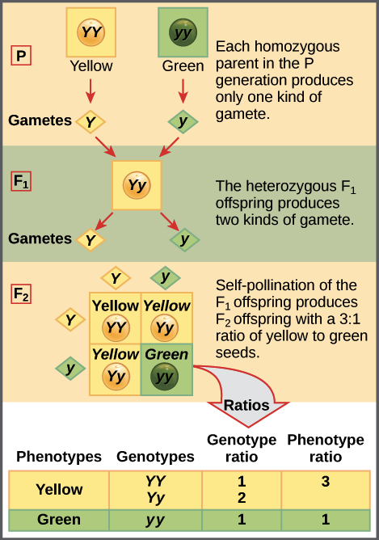
Mendelian Law of Segregation
Punnett Square!
http://cnx.org/contents/24nI-KJ8@24.18:gvXF8Dni@4/Laws-of-Inheritance

Slide 25
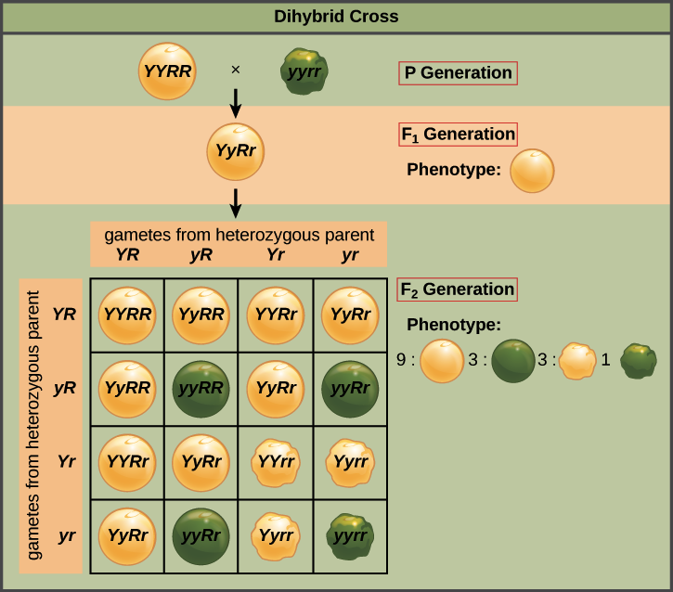
Mendelian Law of Independent Assortment
http://cnx.org/contents/GFy_h8cu@10.8:cUeevuaC@3/Laws-of-Inheritance

Slide 26
Mendelian Extensions
Mendelian Pedigree Patterns
Autosomal Dominant
Autosomal Recessive
X-linked Dominant
X-linked Recessive
Y-linked

Slide 27
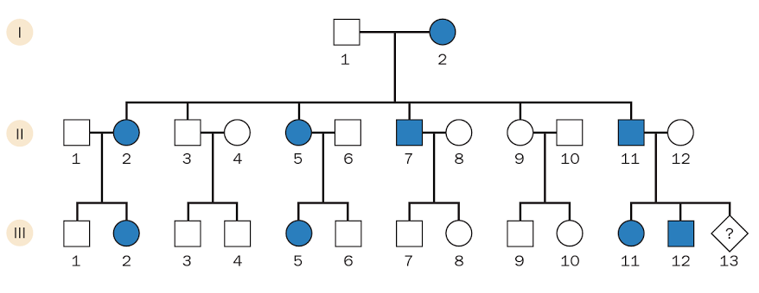
Pedigree Example: Autosomal Dominant
What is the risk for the individual marked with ?
Notes:
½
F2 is hybrid because 1 allele came from unaffected parent, can only be unaffected if homozygous for non risk allele
Therefore F3 is a Punnett square of Heterozygote with homozygote non-carrier: Aa x aa

Slide 28
Other important concepts
Co-dominance: Heterozygote presents with intermediate phenotype
Penetrance: probability that person with genotype will manifest the character
Non-penetrance complicates the interpretation of pedigrees
Imprinting: Some conditions (e.g., glomus body tumors) only manifest when passed from one sex (e.g., father)

Slide 29
Extending Mendelian Analysis
Quantitative Traits: Can traits that are observed on a Gaussian distribution be genetically determined in a Mendelian fashion?
Polygenic theory
If a given character depends on a large number of small, independent causes, the distribution of the character in a population will approximate a normal distribution

Slide 30
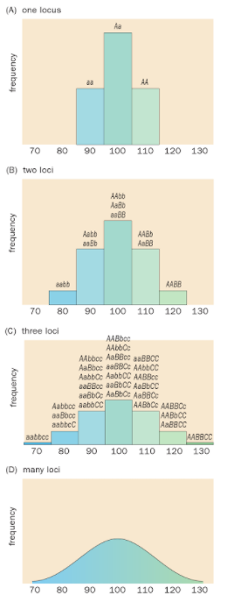
Polygenic Theory

Slide 31
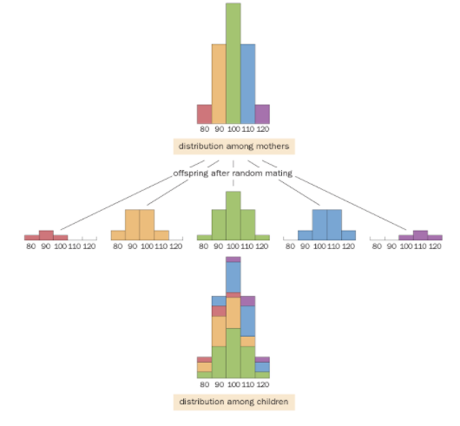
Polygenic Theory
Regression to the Mean
Offspring halfway between mothers and population mean
Simplified, one locus model with random mating and no dominance effects

Slide 32
Polygenic Theory
Heritability
Bad question: To what extent is a given trait genetic?
Correct question: How much of the differences in a given trait between people in a particular country at a particular time is caused by their genetic differences, and how much by their different environments and life histories?
As environmental factors are reduced or equalized, the contributions of genetics to the observed variation will increase
V_{p} = V_{G} + V_{E}
V_{G} = V_{Additive} + V_{Dominant} + V_{Interaction}

Slide 33
Outline
DNA and the Cell Cycle
Mendelian Genetics
Molecular Genetics

Slide 34
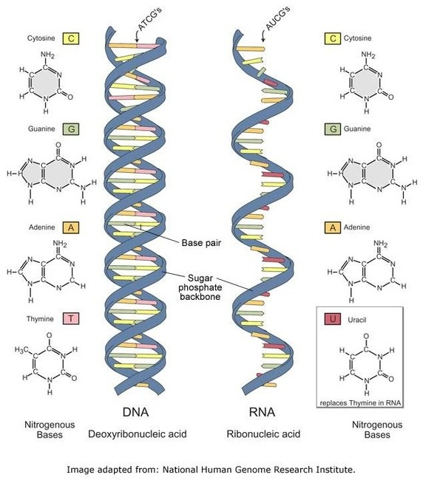
Molecular Genetics
The Central Dogma of Molecular Biology
One direction pass of information
DNA polymerase, RNA polymerase, Ribosomes
Special Cases
Reverse transcription, RNA replication
Proteins don’t code other proteins, RNA, or DNA
Genotype (DNA)
Transcription
Gene Expression (RNA)
Translation
Protein
Notes:
Some potential exceptions: Posttranslational modifications, Methylation, Prions

Slide 35
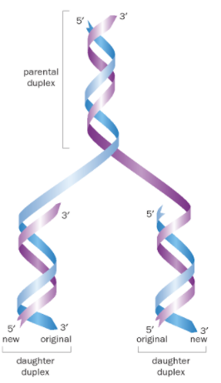
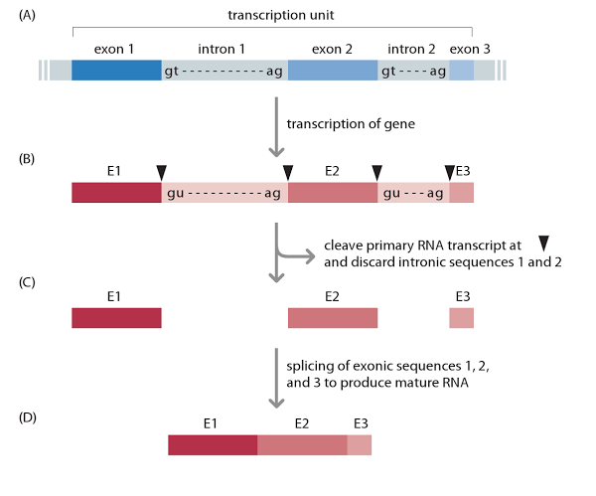
Molecular Genetics
DNA Replication
One half of the double helix can be used to infer the other half (because of complementary pairs)
Transcription
Transcription factors form preinitiation site
RNA polymerase transcribe, Thymine replaced by Uracil

Slide 36
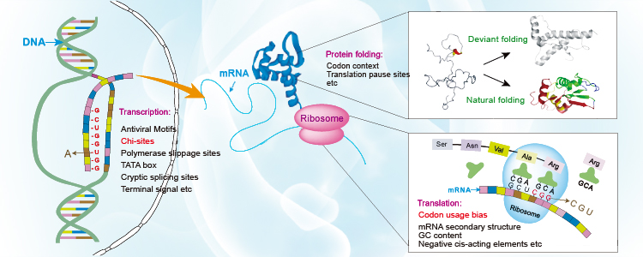
Molecular Genetics
Translation
Every 3 nucleotides forms a “codon”
Each codon codes a single amino acid

Slide 37
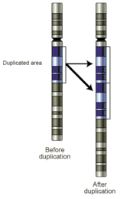
Molecular Genetics
Single Nucleotide Polymorphisms (SNPs)
Common, single variants across the genome
Single base pair sequence alternatives
Typically bi-allelic (2 options)
99.9% of DNA sequence will be identical across individuals
80% of the .1% difference is SNPs
Copy Number Variants
Section of the genome is repeated to a variable degree across the population
Short and long repeats

Slide 38
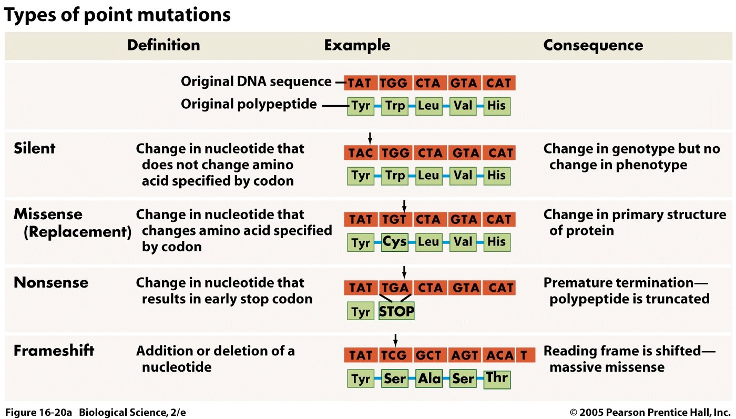
Molecular Genetics
SNP location matters
Coding v. non coding region
Intergenic, Intronic
Notes:
Missense: Tryptophan changed to cystein
Nonsense: Tryptophan changed to STOP (termination)
Frame shift: added nulceotide results in dramatic change in protein structure

Slide 39
References
Khanacademy.org
https://creativecommons.org/licenses/by-nc-sa/4.0/
Human Molecular Genetics, 4th Edition
Strachan & Read (2011). Garland Science, Taylor & Francis Group, New York, NY.

Slide 40
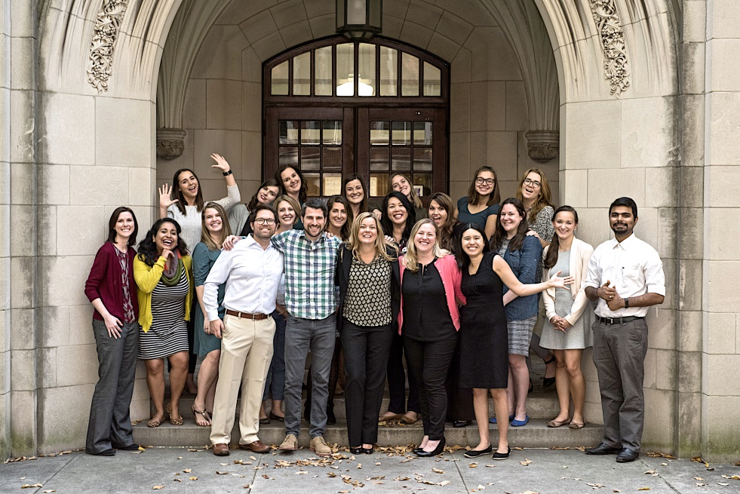
Acknowledgements
Vanderbilt Memory & Alzheimer’s Center
Brigham Young University
John (Keoni) Kauwe, PhD
University of Washington
Paul Crane, MD
Joey Mukherjee, PhD
University of Kentucky
David Fardo, PhD
Case Western University
Jonathan Haines, PhD
William Bush, PhD
University of Miami
Margaret Pericak-Vance, PhD
Eden Martin, PhD
Brian Kunkle, PhD
Pennsylvania State University
Marylyn Ritchie, PhD
Alzheimer’s Disease Genetics Consortium
Logan Dumitrescu, PhD
Angela Jefferson, PhD
Katherine Gifford, PsyD
Vanderbilt Genetics Institute
Nancy Cox, PhD
Collaborators
Novartis Institute for Biomedical Research
Tricia Thornton-Wells, PhD
Jackson Laboratories
Catherine Kaczorowski, PhD
Funding:
K01-AG049164
K12-HD043483
NIA HHSN311201600276P

