Slide 1
REGARDS Overview
George Howard, Virginia Wadley and Virginia (Ginny) Howard
for the REGARDS investigators

Slide 2
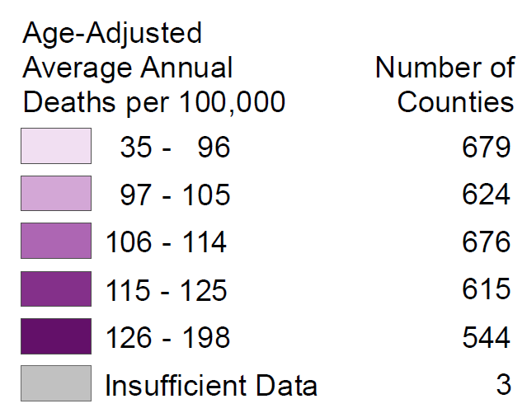
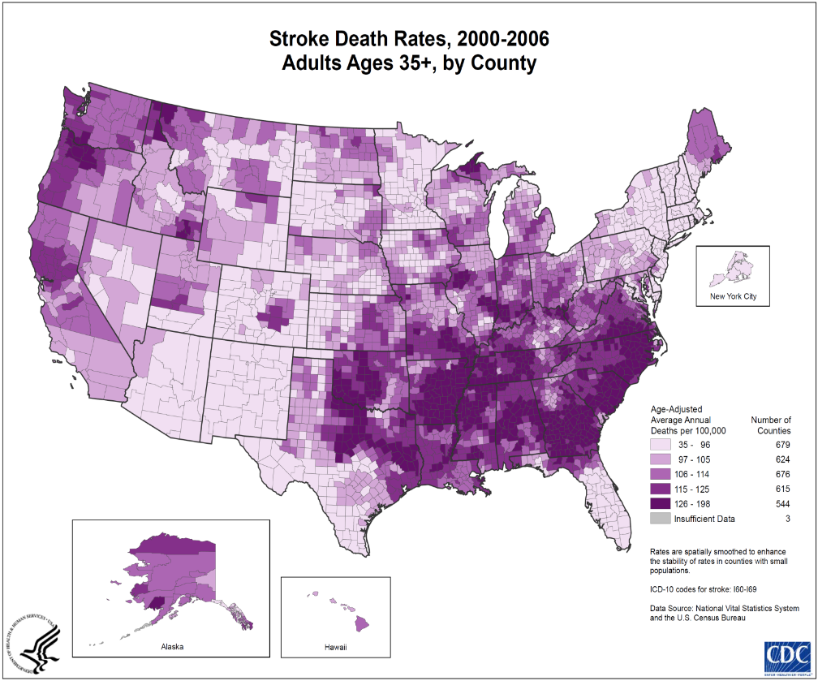
Two Great Mysteries of Stroke Epidemiology
≈ $2.3 Billion in “Extra”
Costs Annually
≈ $2.2 Billion in “Extra”
Costs Annually

Slide 3
REGARDS
Overview of a Novel Study Design to Meet Study Needs
Central participant recruitment using mail and telephone
Central computer-assisted telephone interview
In-home evaluation for physical, venipuncture and ECG: EMSI: Examination Management Services, Inc
Central facilities
  Laboratory and repository for serum and urine samples: University of Vermont
  ECG Reading Center: Wake Forest University
Central follow-up for detection of suspected stroke events (+ MI, VTE and fractures; plus cognitive change)
Physician adjudication of stroke events

Slide 4
REasons for Geographic And Racial Differences in Stroke (REGARDS)
Study Population
Longitudinal population-based cohort of 30,239 volunteers age 45 and older
Simple random sampling with geographic representation
  56% from the stroke belt (goal was 50%)
  44% from the rest of the contiguous US (goal 50%)
Racial representation: 42% African American / 58% white (goal was 50/50%)
Sex representation: 45% male / 55% female (goal was 50/50%)

Slide 5
REGARDS Participants
White
African American
N = 30,239

Slide 6
Types of Data Available in REGARDS
Examples of “Expected” data
  Questionnaire data on major CVD risk factors, HRQoL, depression, stress, etc.
  Lab data: lipids, glucose, insulin, CRP, creatinine, albumin, cystatin C, etc.
  ECG for MI, atrial fibrillation, LVH
  Self administered data for diet, family history
  Follow-up data for incident stroke/MI events
  Repository with frozen specimens
Examples of “Novel” data
  Remarkable geographic heterogeneity
  Longitudinal cognitive assessments
  Residential history
  Occupational history
  Direct measures of physical activity
  Childhood assessment of SES
  (if you don’t see it … ask … >60 ancillary studies have greatly enriched cohort characterization)
Examples of data not present
  Some interview data
  Anything requiring complex equipment (carotid ultrasound, coronary calcium, etc)

Slide 7
Example of Ancillary Study Childhood SES
(Howard VJ, Wadley, Crowe, Glymour, Manly)
Questionnaire data
  Early life factors (birth weight)
  Educational history
  Childhood health
  Family SES
  Important events
  Retrospective report of subjective social standing
Historical Census data
  Linked to birth year and childhood residential history
    Community amenities (medical facilities, etc.)
    Community SES (home ownership, etc)
    Community environment (urban/rural, environmental hazard, etc.)
    Social norms (marital rates, etc.)
    Education (literacy, etc.)
Historical quality of education
  Average number of days in school term
  Student/teacher ratio
  Average teacher salary
  Attendance rates

Slide 8
Baseline Age Distribution of REGARDS Participants
14,857
5,171
591

Slide 9
Second Risk Factor Assessment
Started May 2013
Every active participant will be invited for 2nd evaluation consisting of the CATI, in-home physical exam, and self-administered questionnaires
Approximately 10 years since 1st assessment
Most data variables, protocol same as 1st
New in-home: chair stand, timed walk, REALM, digit symbol substitution
New self-administered: neighborhood perception, discrimination, life space, social support, PA
Current status: goal to assess 15,000 participants and we are just passing 14,000 completed

Slide 10
REGARDS Cognitive Assessment
 | Measure | Score | Occasions
Global Cognitive Status | Six-item Screener | Number correct (0-6) Dichotomous categorization (intact, impaired) | Measured yearly (months 12, 24, 36 …)
Short Battery Cognitive Domains
Learning | Word List Learning (WLL) | Sum of 3 learning trials (0-30) | Measured every two years (months 18, 42, 66...)
 | NINDS-CSN 5-item Registration | Number correct (0-5)
Memory | Word List Delayed Recall (WLD) | Number correct (0-10)
 | NINDS-CSN 5-item Recall | Number correct (0-5)
 | NINDS-CSN Orientation | Number correct (0-6)
Executive | Animal Fluency | Number correct in 60 secs, Number of intrusions
 | NINDS-CSN Letter Fluency | Number correct in 60 secs, Number of intrusions
Overall Cognitive Composite (Short Battery) | WLL + WLD + Animal Fluency + NINDS-CSN Registration + NINDS-CSN Orientation + NINDS-CSN Recall + NINDS-CSN Letter Fluency | z-transformed composite of domain scores
Callahan C et al. Medical Care 2002; 40:771-781; Morris JC et al. Neurology 1989;39:1159-1165; Hachinski V et al. Stroke 2006; 37: 2220-2241

Slide 11
Six-item Screener (SIS)
Cognitive impairment is a score of 0-4 (of 6).
Incident cognitive impairment is a change from score of 5-6 to score of 0-4
  To date, most recent score used to classify incidence of impairment
  Recommended sensitivity analyses
Callahan C et al. Medical Care 2002; 40:771-781

Slide 12
Approaches to Incident Impairment on SIS as a Dichotomous Outcome
Logistic regression, examining association between predictor and likelihood of being impaired at last observed assessment
Survival analysis, examining association between predictor and time to first impairment
Generalized Estimating Equations (GEEs), examining association between predictor and impairment over time

Slide 13
Short BatteryTests
CERAD Word List Learning
CERAD Word List Delayed Recall
NINDS-CSN MOCA 5-minute protocol
  Includes Letter Fluency (F)
Semantic Fluency (Animals)
  WLL and WLD administered via recording
  Fluency tests recorded and later scored by trained techs
Morris JC et al. Neurology 1989;39:1159-1165; Hachinski Vet al. Stroke 2006; 37: 2220-2241

Slide 14
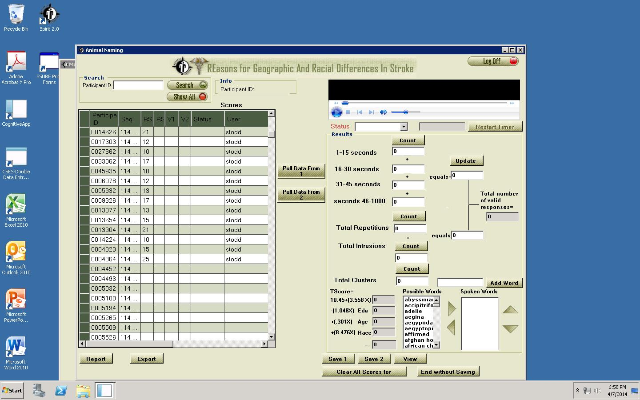

Slide 15
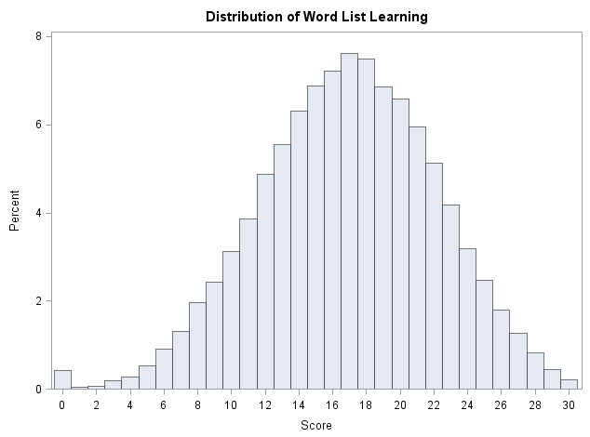
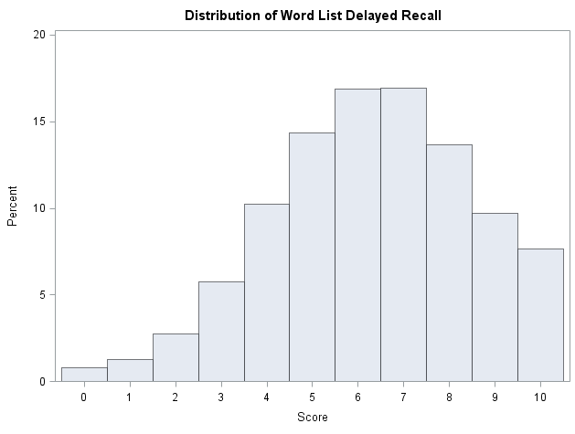
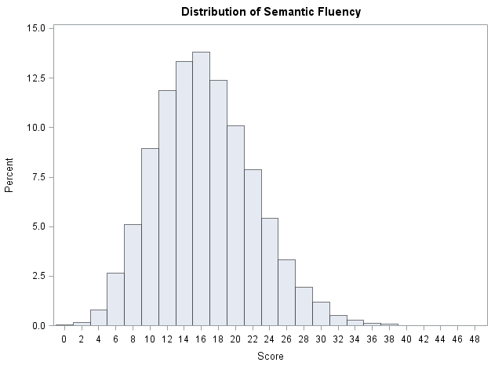
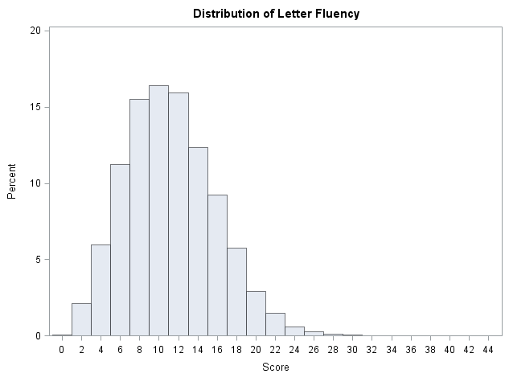
Distribution of Cognitive Scores
Word List Learning
N = 23,355; Mean = 16.90, SD = 5.21
Word List Delayed Recall
N = 23,105; Mean = 6.30, SD = 2.20
Semantic Fluency
N = 24,175; Mean = 15.89; SD = 5.74
Letter Fluency
N = 20,169; Mean = 10.66, SD = 4.65

Slide 16
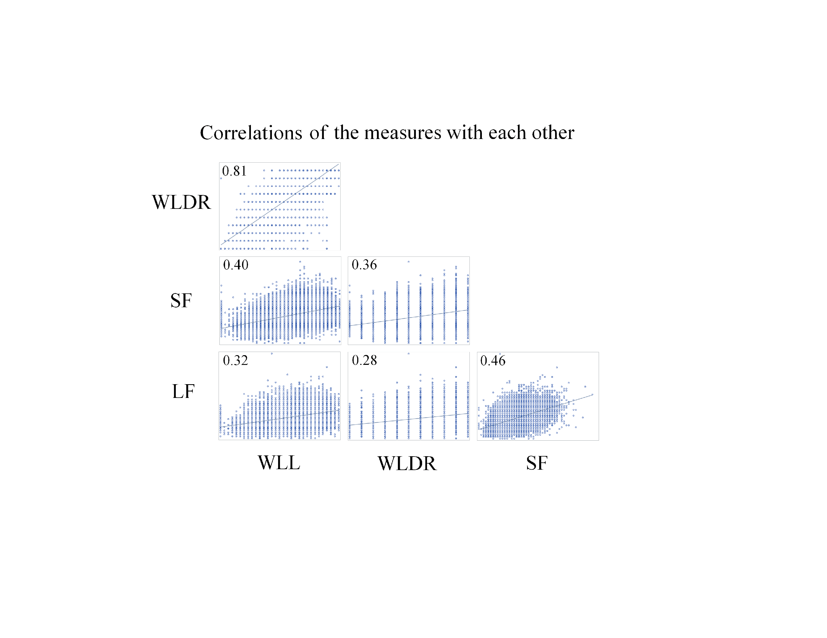

Correlations of the measures
with each other

Slide 17
Acknowledgements
REGARDS: NINDS U01 NS0411588
Funding for the Childhood SES REGARDS ancillary study provided by NIA
    NIH RO1 AG039588

