Slide 1
​The PITCH Project Cross-National Harmonization of Mental Status and Cognitive Performance Data: Suitability for Comparative Epidemiologic Research
Richard N. Jones​, ScD
Brown University, Providence, RI, United States
rich_jones@brown.edu
#ΨMCA19

Slide 2
PITCH Project Team
Brown University
Richard N. Jones, ScD
Douglas Tommet, MS
University of Washington
Paul K Crane, MD MPH
Laura E Gibbons, PhD
Joey Mukherjee, PhD
Elizabeth Saunders, MS
Johns Hopkins University
Alden E Gross, PhD
University of California, Davis
Dan Mungas, PhD
University of California, San Francisco
M Maria Glymour, ScD
Carole Dufouil, PhD (INSERM)
Columbia University
Jennifer Manly, PhD
University of Michigan
Lindsay Kobayashi, PhD
Conference on Advanced Psychometric Methods in Cognitive Aging Research; R13-AG030995 (Mungas PI) 2008 - 2023
http://alzheimer.ucdavis.edu/fhpsych/

Slide 3
The PITCH project: Psychometric Integrative Technology for Cognitive Health Research
In response to RFA-AG-15-015 Enhancing Cross-National Research within the Health and Retirement Study Family of Studies
Harmonization, equating and validating cognitive assessments used in HRS and international sister studies
Suggesting alternative measures for good measurement of cognition
All secondary data analysis

Slide 4
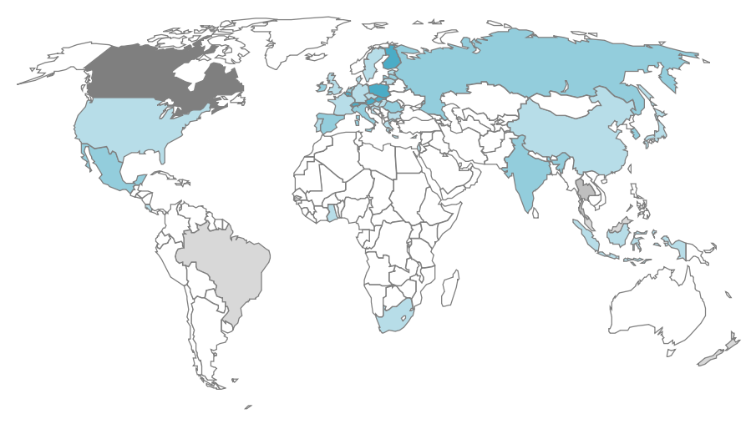

Slide 5
--- Studies with public data available ---
CHARLS - China Health, Aging, and Retirement Longitudinal Study
CRELES - Costa Rican Longevity and Healthy Aging Study
ELSA - English Longitudinal Study of Ageing
MHAS - Mexican Health and Ageing Study
HAALSI - The Health and Aging in Africa in three INDEPTH Communities
IFLS - Indonesia Family Life Survey
JSTAR - Japanese Study on Aging and Retirement
KLoSA - Korean Longitudinal Study on Aging
LASI - Longitudinal Aging Study in India
SAGE - Study on Global Ageing and Adult Health
SHARE - Survey of Health, Ageing, and Retirement in Europe
TILDA - The Irish Longitudinal Study on Ageing

Slide 6
--- Studies with limited data availability ---
CLSA - Canadian Longitudinal Study on Aging
NZHART - New Zealand Health and Aging Research Team
--- Studies in development ---
ELSI - Estudo Longitudinal da Saúde e Bem-Estar dos Idosos Brasileiros [The Brazilian Longitudinal Study of Aging (ELSI-BRASIL)]
HAGIS - Healthy Ageing in Scotland
HART - Panel Survey and Study on Health Aging and Retirement in Thailand
MARS - Malaysia Ageing and Retirement Survey
NICOLA - Northern Ireland Cohort for the Longitudinal Study of Ageing
THSLS - The Scottish Longitudinal Survey of Ageing

Slide 7
End goal

Slide 8
Linked cognition scores non-specialists can use in applied research
Tools (software) for linking
Transparent methods
Some evidence on limits of reliability and validity of these scores

Slide 9
Preliminary results

Slide 10
Detailed protocol document
Why did we make the choices we did?
What alternatives were considered?
How do we know our modeling assumptions and data analysis procedures are reasonable?

Slide 11
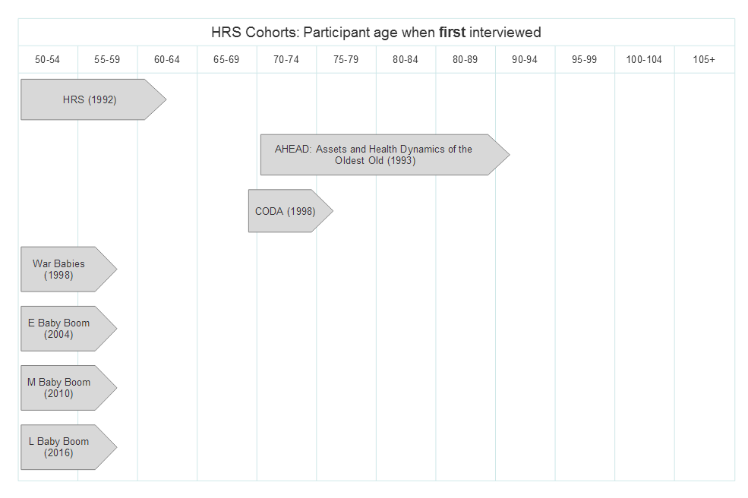

Slide 12
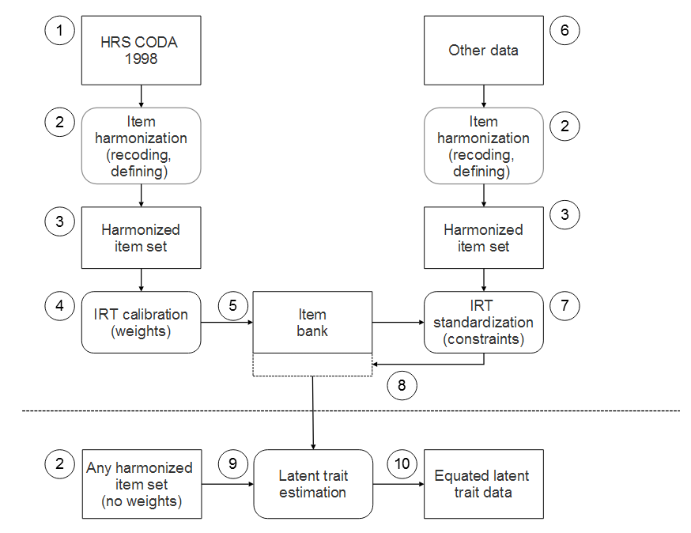
Protocol

Slide 13
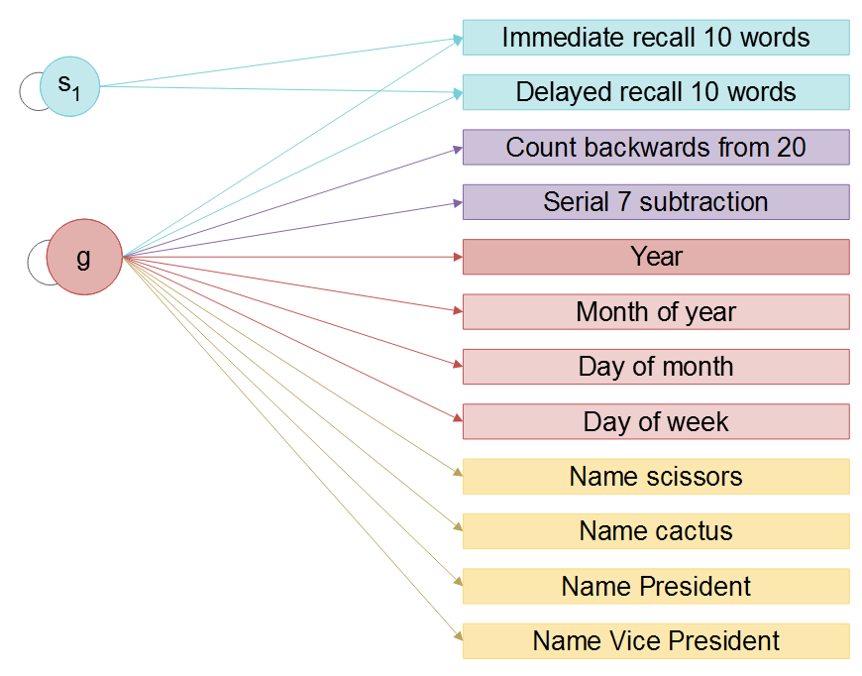
HRS 1998
CODA Sample (N = 2,187)
Model fits
CFI = 0.992
RMSEA = 0.024
McDonald’s Omega (g) = 0.871

Slide 14
NEAT Linking
NEAT (Non-equivalent anchor test [item]) design
Population | Test 1 | Test 2 | Test 3
A | y₁ | y₂ | NA
B | NA | y₂ | y₃

Slide 15
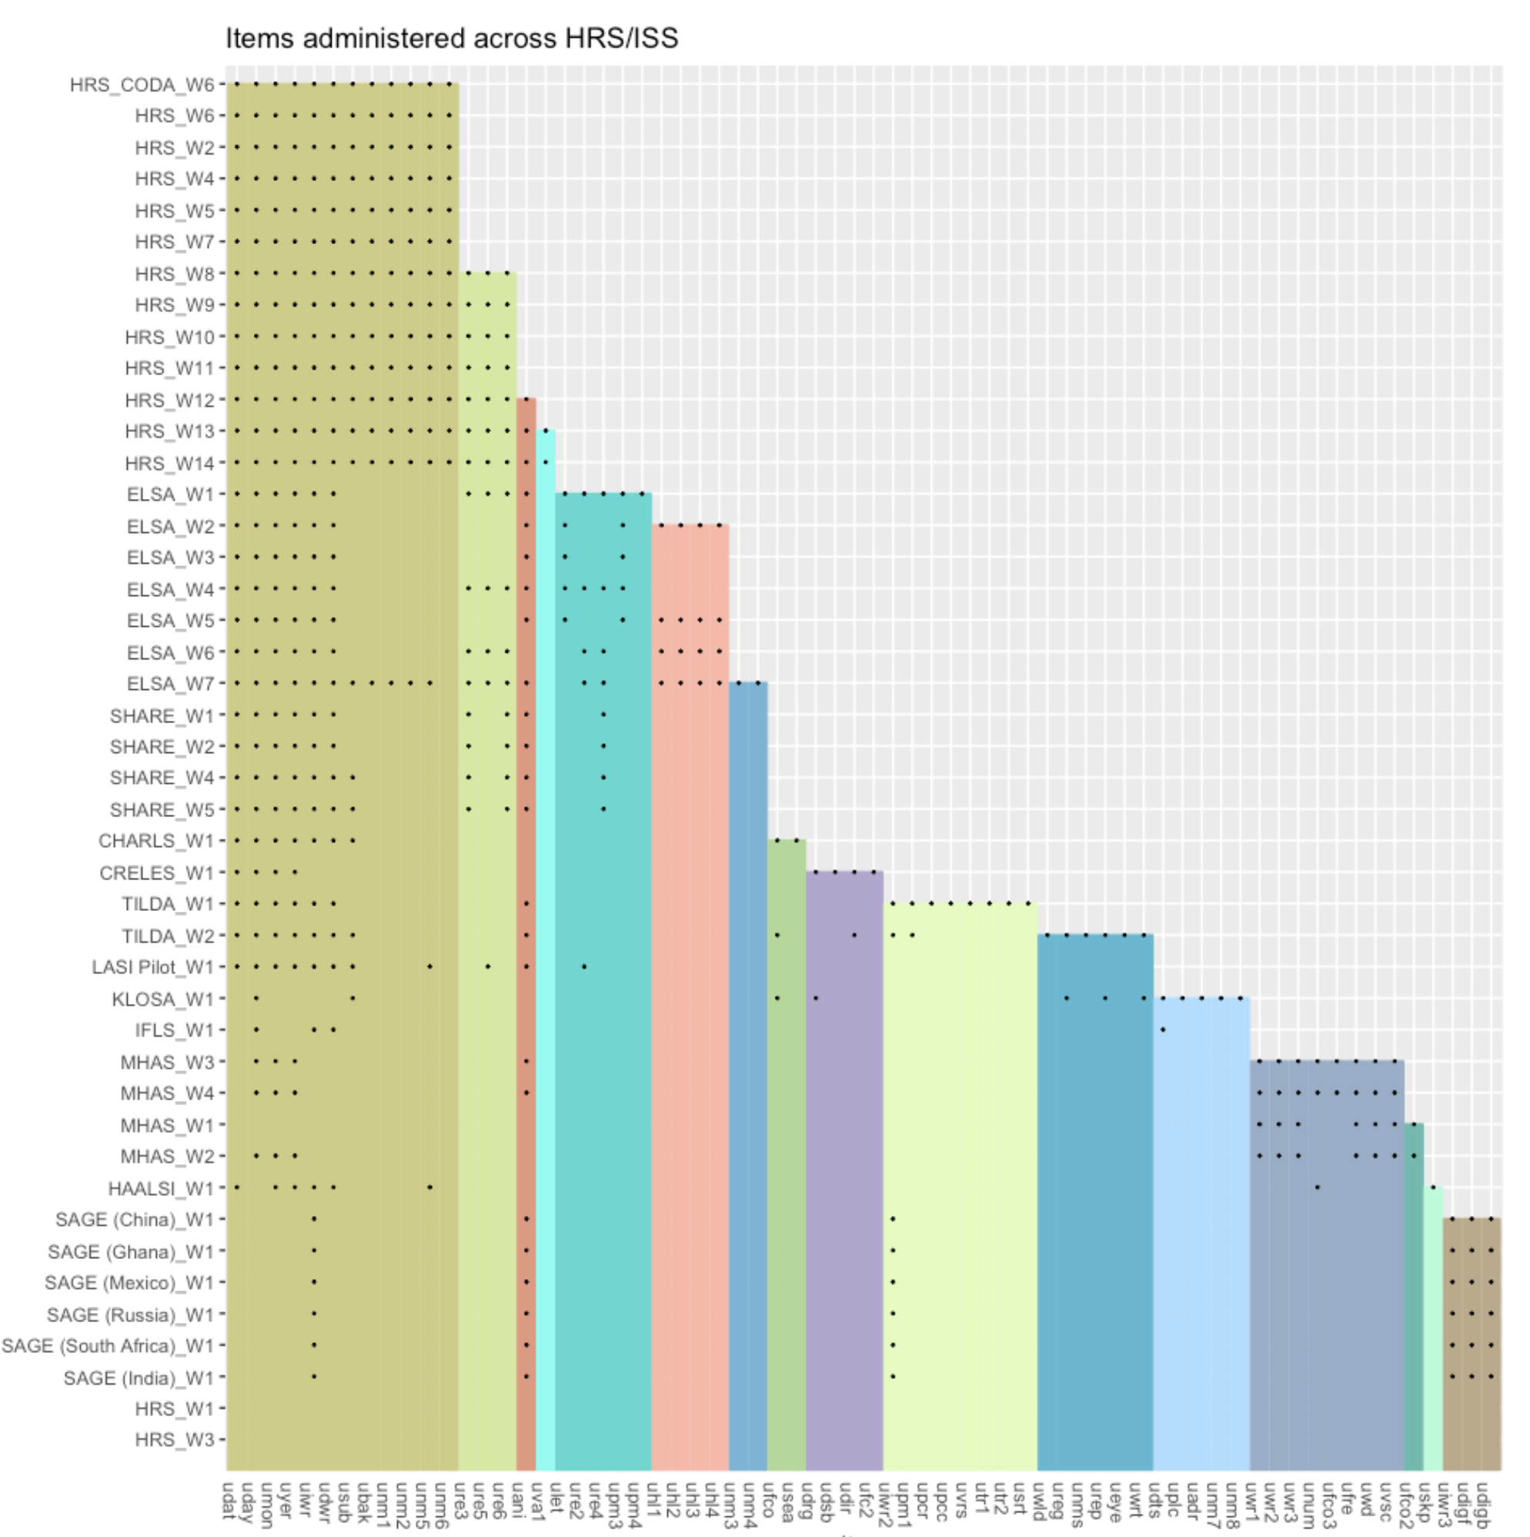
43 countries/studies/waves
69 items

Slide 16
Good news and areas for further investigation
Of 43 studies/waves, most reasonably fit well
given unmodeled bifactor structure
Some countries/waves need further investigation
China (CHARLS)
Ghana (SAGE)
Mexico (MHAS waves 1-4)
India (LASI)
Ireland (TILDA)
South Africa (HAALSI)
South Africa (SAGE)
USA (HRS Waves 2 [AHEAD] and 8)

Slide 17
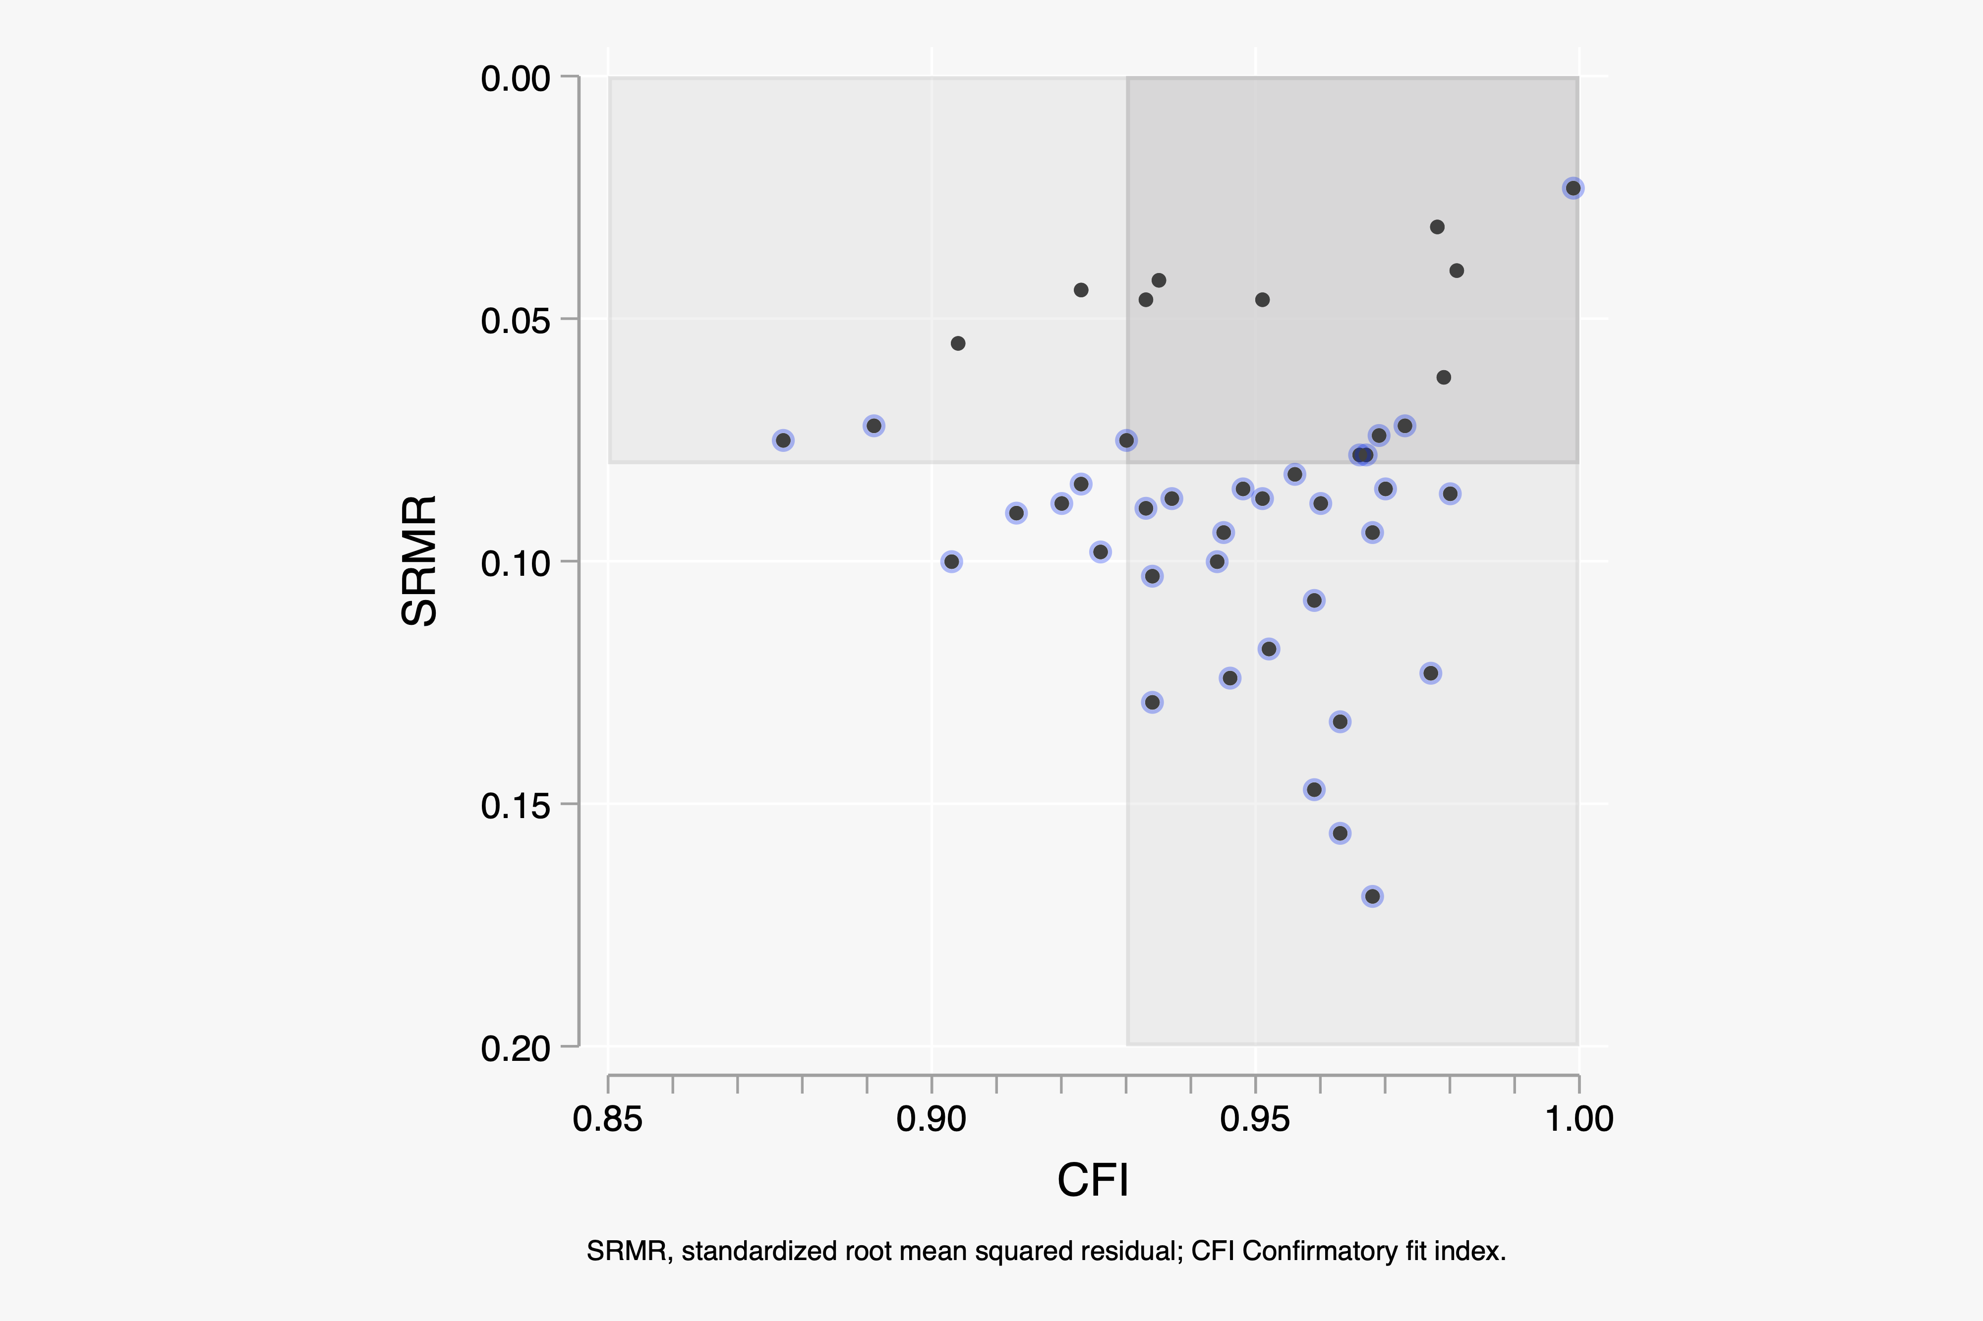

Slide 19
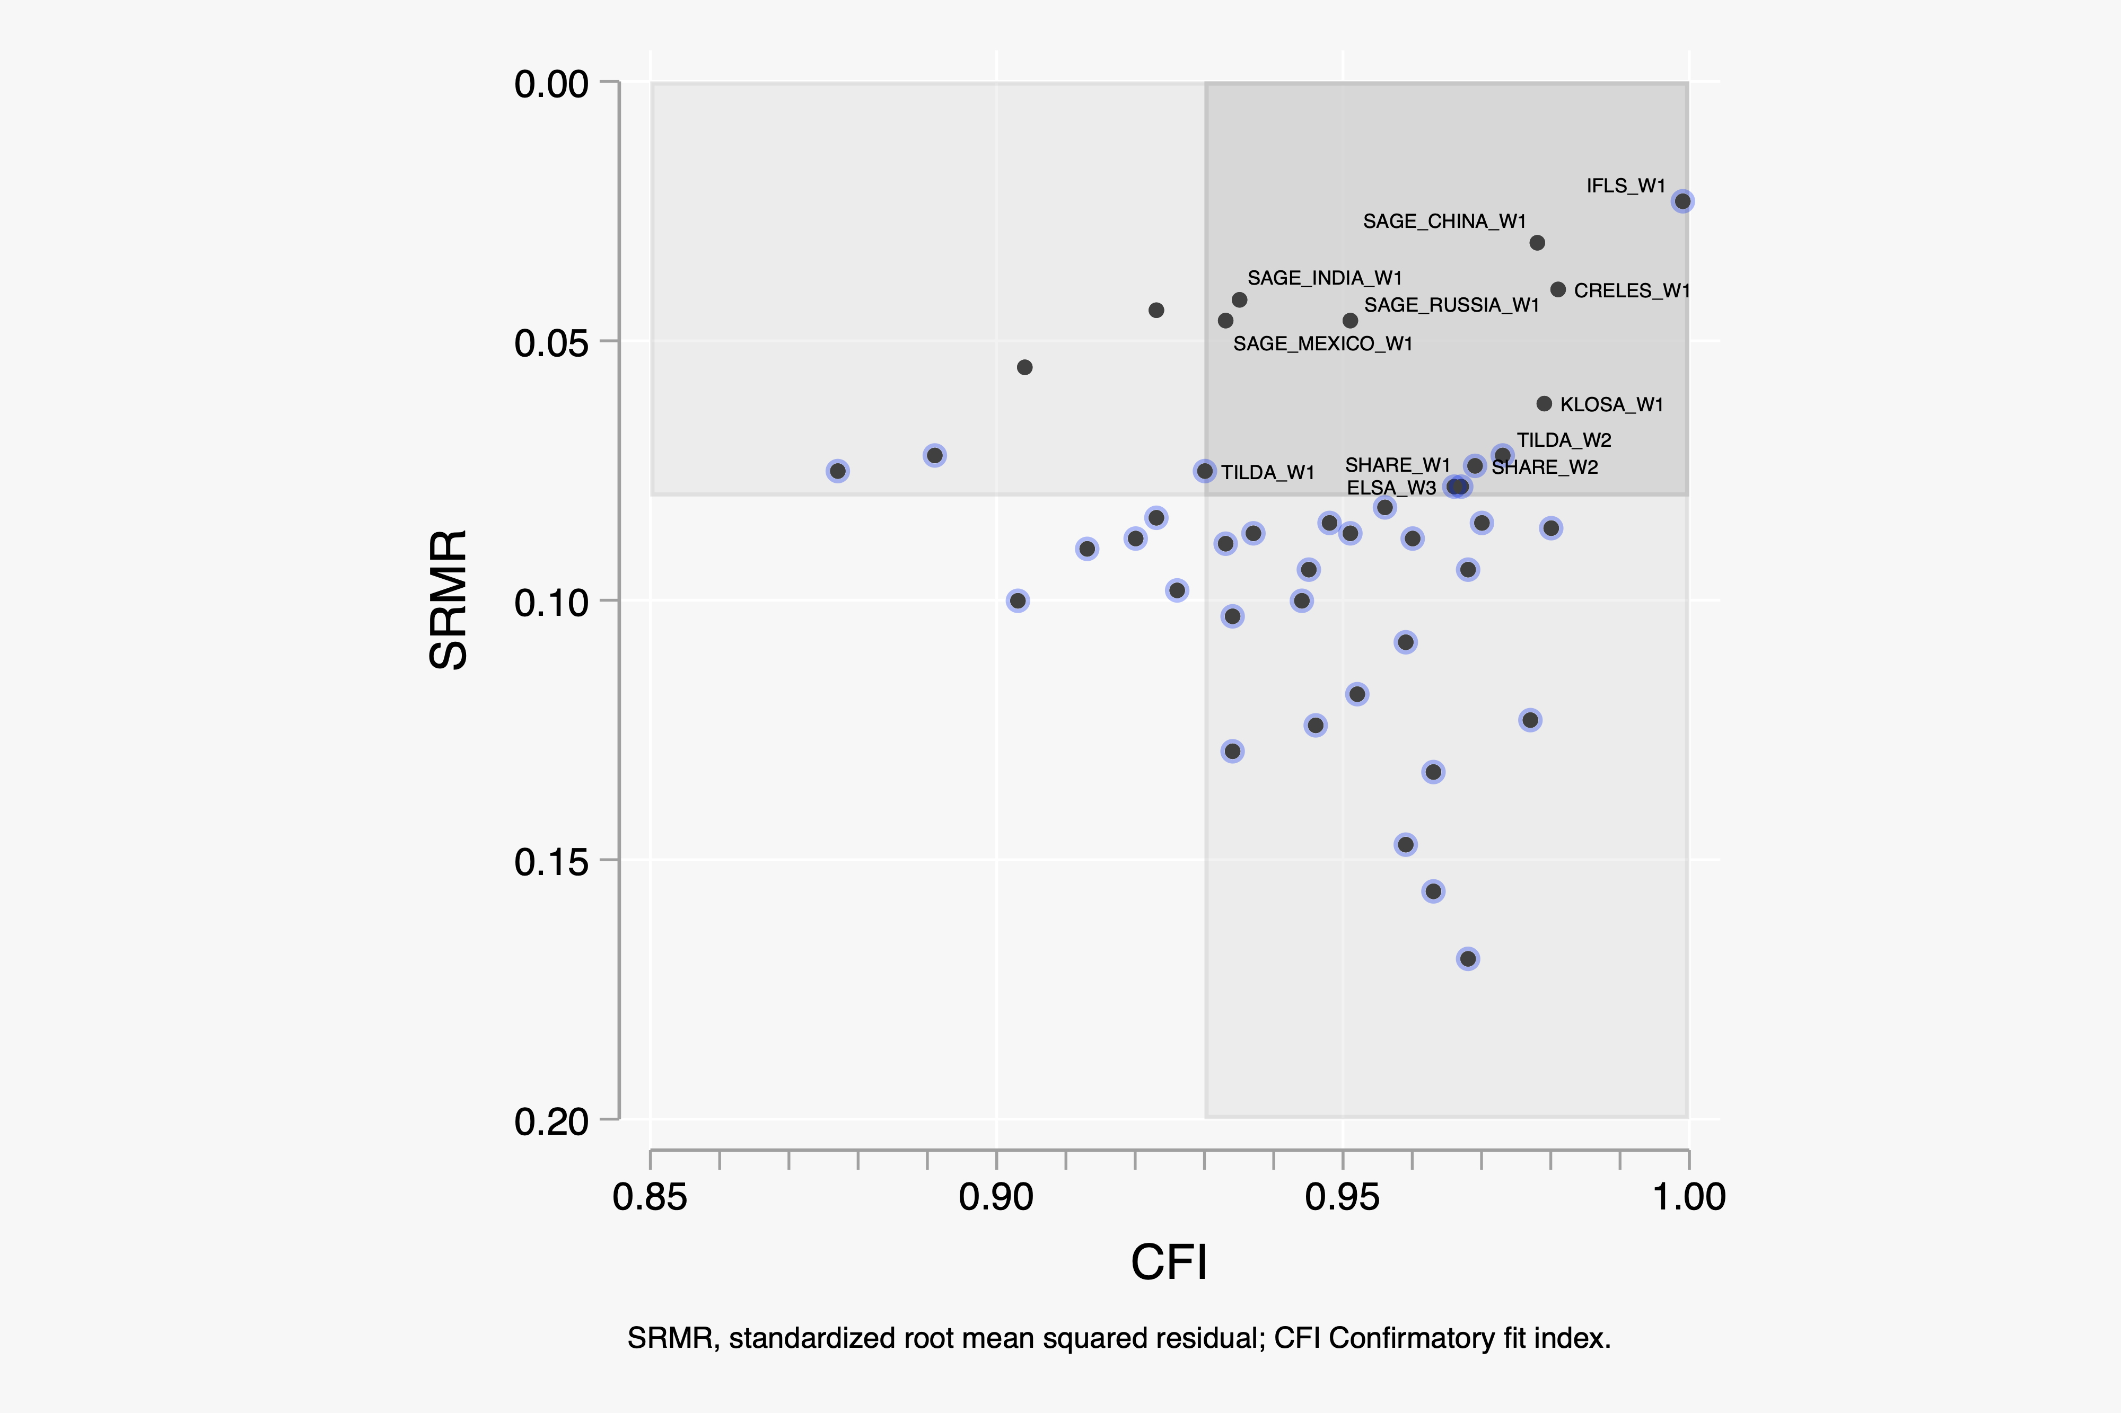

Slide 20
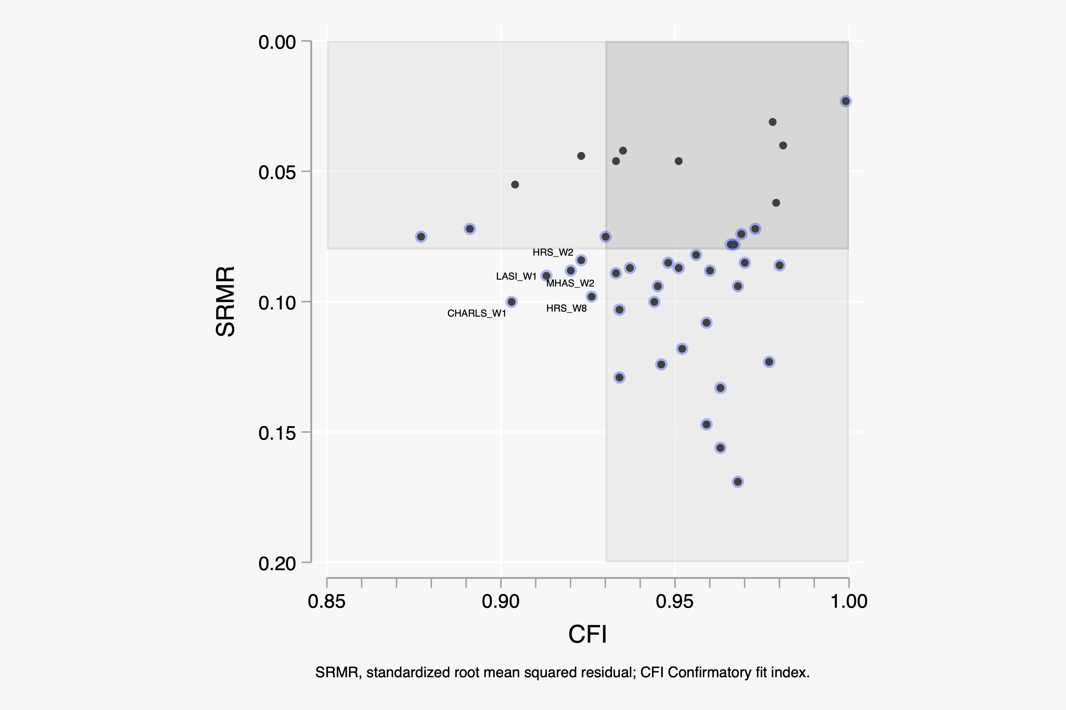

Slide 21
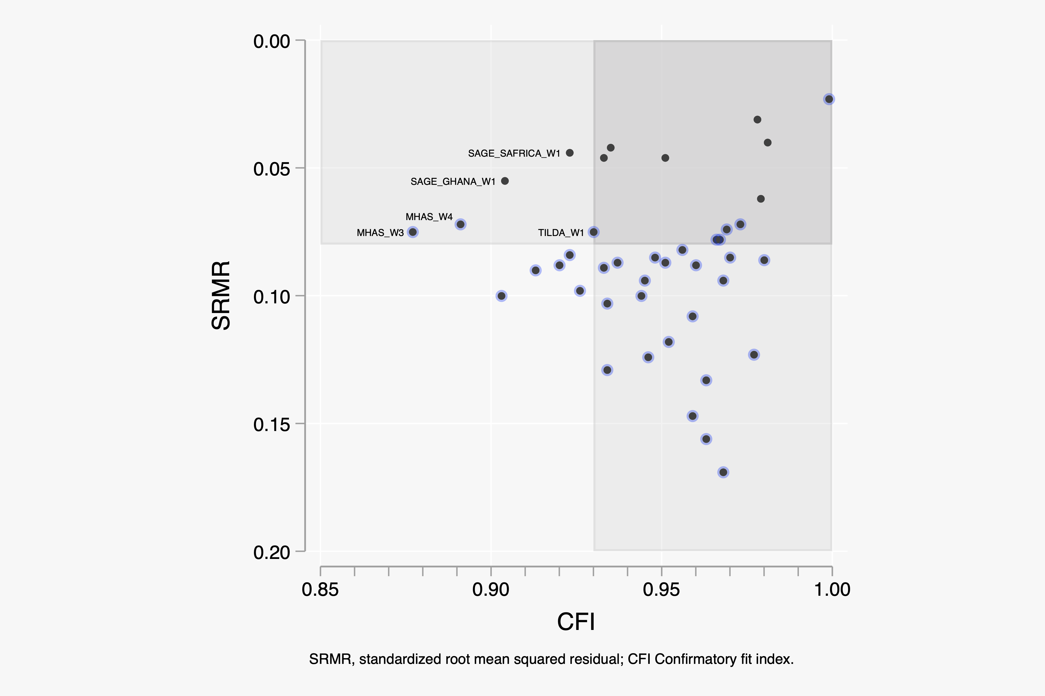

Slide 22
Ongoing work

Slide 23
Misfit & differential item functioning
Reliability & validity description
Dissemination
Harmonized Cognitive Assessment Protocol (HCAP) *New*

Slide 24
Suitability for Comparative Epidemiologic Research

Slide 25
Validation Plan
Idea: identify the limits to the validity of the harmonized HRS/ISS cog measure
Use data from external cross-national studies; studies other than HRS/ISS
Link external study’s cognitive assessment to harmonized HRS/ISS cognition measure
Demonstrate relationship of linked HRS/ISS cognition measure to
Cognitive decline (change over time)
Clinical, consensus dementia ratings
Neuropathological findings on brain autopsy
Cortical atrophy and other MRI findings
Compare effects to those generated using longer neuropsychological assessment batteries

Slide 26
3C | Three cities study (France) | MMSE & Neuropsyc battery Cognitive decline, dementia ratings, MRI
ACT | Adult changes in thought (US [Seattle]) | CASI Cognitive decline, dementia, neuropathology
ADAMS | Aging, Demographics and Memory Study (US) | Link HRS/ISS to Neuropsyc battery Dementia ratings
ADNI | Alzheimer’s Disease Neuroimaging Initiative (US) | MMSE, ADAS-Cog, Neuropsyc battery Dementia ratings, cognitive decline, MRI
MAP/MARS | Memory and Aging Project, Minority Aging Research Study (US [Chicago]) | MMSE, Neuropsyc battery Cognitive decline, dementia, neuropathology
SENAS | Spanish and English Assessment Scales project (US [Sacramento]) | MMSE, Neuropsyc battery Cognitive decline, limit setting on differential item functioning amelioration effects
WHICAP | Washington Heights, Hamilton Heights, Inwood Columbia Aging Project (US [New York]) | MMSE, Neuropsyc battery Cognitive decline, dementia, MRI
SOS | Some other study | We’re open

Slide 27
Dissemination
There already exists a well-established platform for sharing harmonized data from HRS-ISS: g2aging.org
We will prepare dissemination materials that are similar to be distributed on that platform; also GitHub
Technical documents
Code
Data

Slide 28
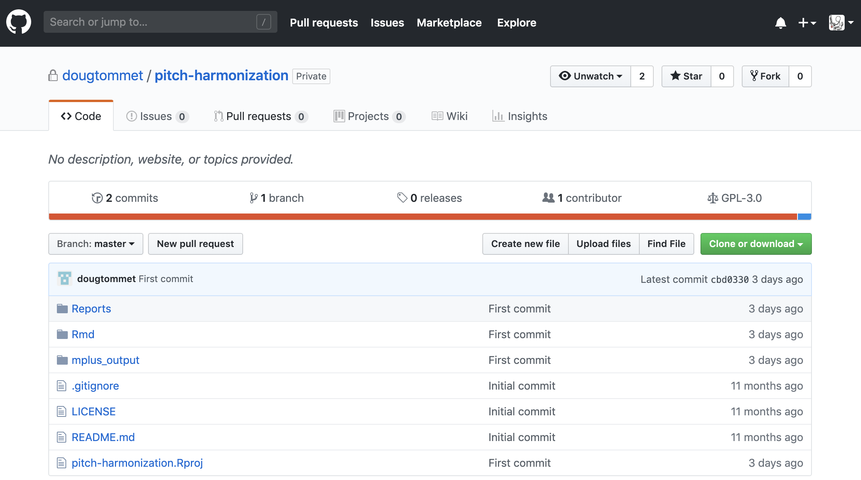

Slide 29
What is available for #ΨMCA19

Slide 30
Data available for many countries from PITCH on box
Harmonized* cognition indicators
Linked or aligned measures of overall cognition
Select demographics (age, sex)
Original study unique identifier
* In the sense of pre-statistical harmonization

Slide 31
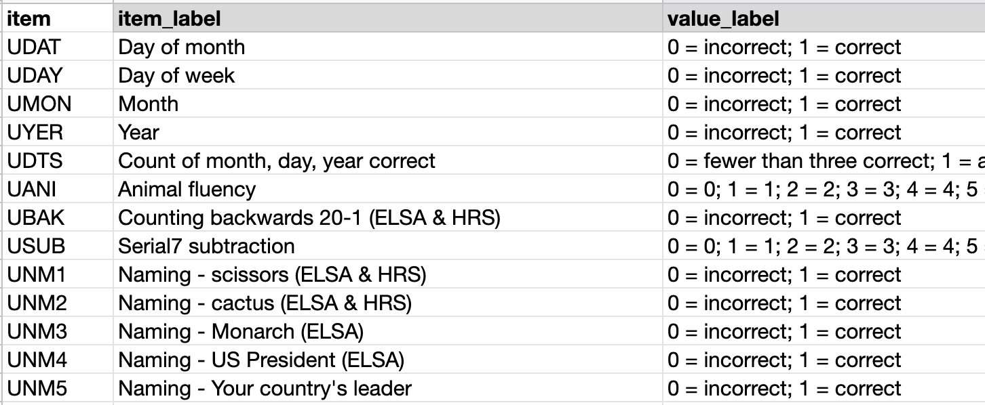

Slide 32
Key references

Slide 33
Harmonization Griffith, L., van den Heuvel, E., Fortier, I., Hofer, S., Raina, P., Sohel, N., . . . Belleville, S. (2013). Harmonization of Cognitive Measures in Individual Participant Data and Aggregate Data Meta-Analysis: Agency for Healthcare Research and Quality. https://www.ncbi.nlm.nih.gov/books/NBK132553/ | Dorans, N. J. (2007). Linking scores from multiple health outcome instruments. Quality of Life Research, 16(1), 85-94. https://www.jstor.org/stable/40212575?seq=1#metadata_info_tab_contents Jones, R. N., & Fonda, S. J. (2004). Use of an IRT-based latent variable model to link different forms of the CES-D from the Health and Retirement Study. Social Psychiatry and Psychiatric Epidemiology, 39(10), 828-835. https://link.springer.com/content/pdf/10.1007/s00127-004-0815-8.pdf
Plausible Values | Asparouhov, T., & Muthén, B. (2010). Plausible values for latent variables using Mplus. Retrieved from http://www.statmodel.com/download/Plausible.pdf

Slide 34
Item response theory | Mellenbergh, G. J. (1994). Generalized linear item response theory. Psychological Bulletin, 115, 300-300.
Alternative approaches | Muthén, B., & Asparouhov, T. (2014). IRT studies of many groups: the alignment method. Frontiers in Psychology, 5, 978. https://doi.org/10.3389/fpsyg.2014.00978
Cognition | Lezak, M., Howieson, D., & Loring, D. (2012). Neuropsychological assessment (5 ed.). New York: Oxford University Press. Weir, D. R., Langa, K. M., & Ryan, L. H. (2019). Health and retirement study: 2016 harmonized cognitive assessment protocol (HCAP) study protocol summary. Retrieved from http://hrsonline.isr.umich.edu/modules/meta/hcap/2016/HRS_2016_HCAP_Protocol_Summary_011619.pdf Weir, D., McCammon, R., Ryan, L., & Langa, K. (2014). Cognitive test selection for the harmonized cognitive assessment protocol. Retrieved from https://hrs.isr.umich.edu/sites/default/files/biblio/HCAP_testselection.pdf

