Slide 1
ACTIVE Design
Sites, Sampling, Replicates, and Follow-up

Slide 2
Acknowledgements
Funded in part by Grant R13 AG030995 from the National Institute on Aging
The views expressed in written conference materials or publications and by speakers and moderators do not necessarily reflect the official policies of the Department of Health and Human Services; nor does mention by trade names, commercial practices, or organizations imply endorsement by the U.S. Government.

Slide 3
Design Sites
Recruitment began in March 1998 and ended in October 1999
2,832 persons were enrolled in the trial
30 persons incorrectly randomized
Variable name in data files: site

Slide 4
Recruitment Strategy
Each of the 6 field centers had a specific study sample and recruitment strategy
University of Alabama at Birmingham
Hebrew Rehabilitation Center for the Aged in Boston
Indiana University
Johns Hopkins University
Pennsylvania State University
Wayne State University

Slide 5
University of Alabama - Birmingham
Recruited participants from two sources:
residents of Jefferson County, Alabama, who were licensed to drive or who had non-driver identification cards through the Alabama Department of Public Safety; and
patients of UAB eye clinics

Slide 6
Indiana University
Recruited participants from two sources:
Clients of the Community Centers of Indianapolis, a network of 14 facilities that provide activities and social services for older adults.
Local churches and senior citizens organizations.

Slide 7
Hebrew Rehabilitation Center
Recruited residents from congregate and senior housing sites, from senior centers, and from a registry of volunteers interested in participating in aging research at the Harvard Cooperative Program on Aging in Massachusetts

Slide 8
Johns Hopkins University
Recruited participants from two sources:
recruited participants from senior centers, churches, senior housing, and senior community organizations in the Baltimore metropolitan area and in Cumberland, Maryland.
Wellness and service programs offered by the Urban Medical Institute in Baltimore and in partnership with the Commission on Aging and Retirement Education, an organization that coordinates and funds services in Baltimore.

Slide 9
Wayne State University
Recruited from a large range of community organizations, churches, hospital-based senior assessment centers, and senior housing sites in metropolitan Detroit as well as from driver registration lists.

Slide 10
Penn State University
Recruited from the enrollment files of a state-funded pharmaceutical assistance program for low-income elders, called PACE.

Slide 11
Demographics by site
 | UAB | IU | Hebrew | JHU | WSU | PSU
Age, M (SD) Range | 72.2 (5.3) 65-88 | 73.6 (6.0) 65-91 | 77.1 (6.6) 65-94 | 72.4 (5.2) 65-89 | 73.1 (5.4) 65-89 | 73.8 (5.4) 65-91
Female, % | 61.6 | 77.1 | 73.1 | 86.7 | 75.4 | 84.1
White, % | 92.6 | 59.1 | 95.3 | 67.3 | 35.9 | 94.3
Yrs education, M(SD) Range | 13.9 (2.7) 4-20 | 13.6 (2.8) 5-20 | 14.6 (2.7) 7-20 | 13.1 (2.6) 5-20 | 13.9 (2.7) 6-20 | 12.1 (1.9) 5-18
Notes:
Minority elders coming from the Indian & WSU
76% female, 24% Black

Slide 12
Replicates
Due to logistical considerations field work was conducted in six replicates of approximately 8-week duration.
Variable name in data files: replcode
Replicates are important for (at least) 2 reasons
Minorities in earlier replicates tended to have lower SES, particularly from Indiana site, as recruitment strategies varied over time
Replicate 1: At baseline, participants were given more time on the HVLT and AVLT differed; therefore, data is missing for these participants

Slide 13
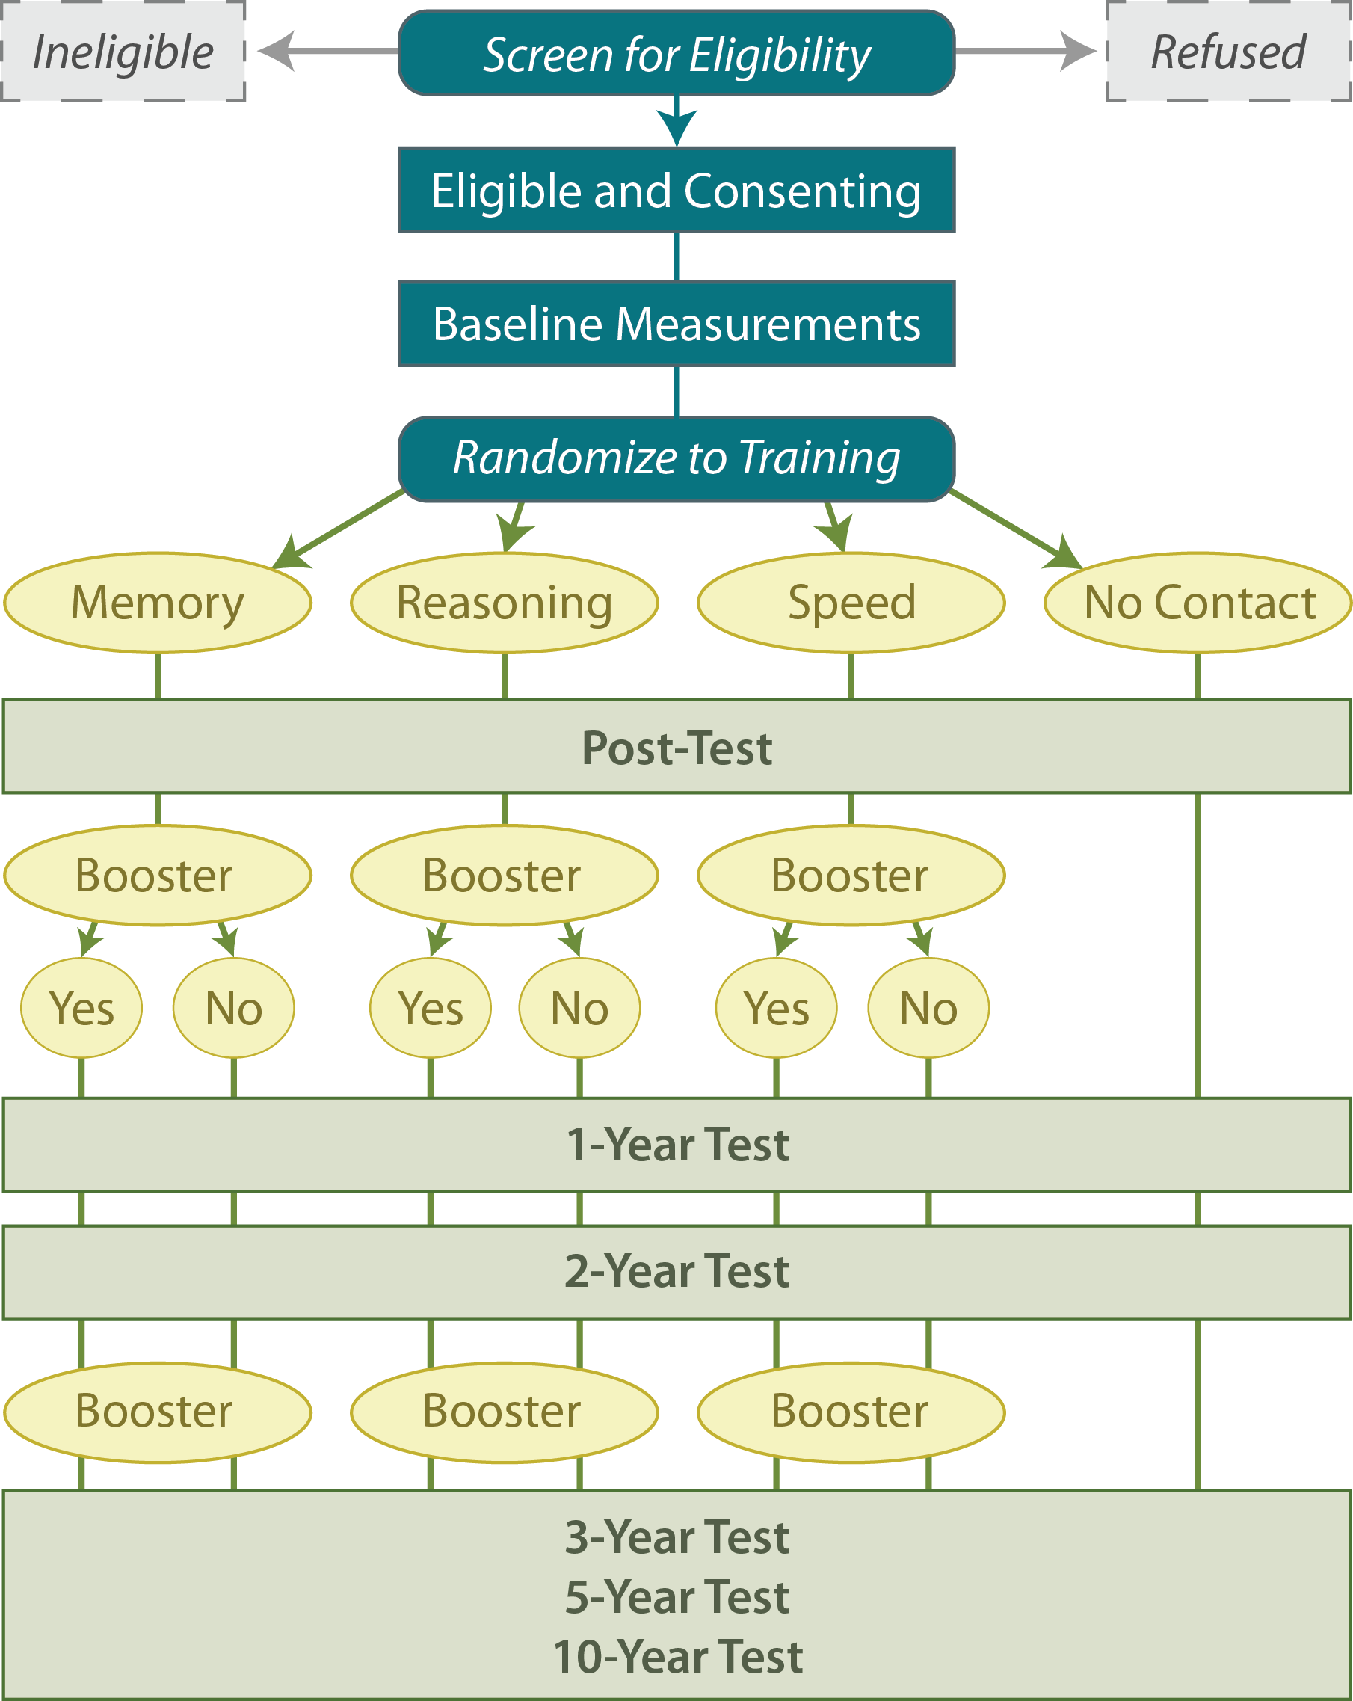
1998
2010

Slide 14
Booster Training
Booster training administered at 2 time points
Prior to 1st annual follow-up
Prior to 3rd annual follow-up
Eligibility for booster training conditional on participation in initial training sessions
Individuals who completed at least 8 of the 10 initial training sessions were randomized to additional training sessions
Booster training consisted of four 75-min refresher classes designed to reinforce strategies already taught during initial training sessions
Notes:
Prior to the first annual follow-up, a 60% random sample of persons who were compliant with baseline training completed 8 of 10 sessions) were randomized to a booster training arm
Because persons randomized to booster training had to be compliant with their initial training, the sample of persons who were initially randomized to training but not to booster is overrepresented by persons who were noncompliant with initial training
Roughly 200 persons per group (ie, memory, reasoning, speed, control)

Slide 15
Schedule of Test Administration
Differences across follow-up

Slide 16
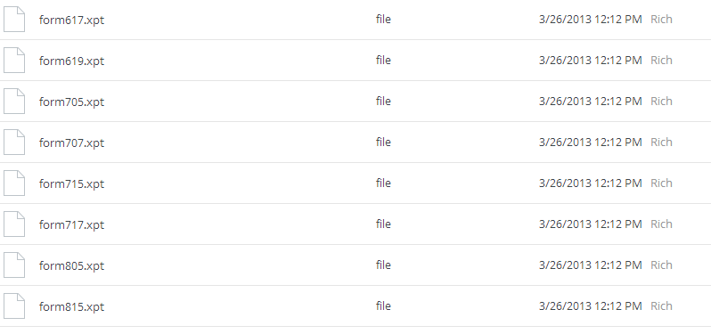
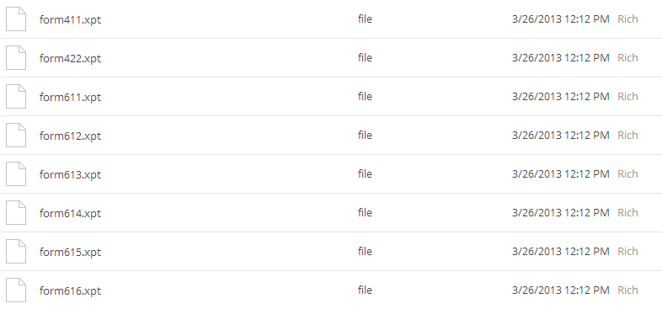
So many data files….

Slide 17
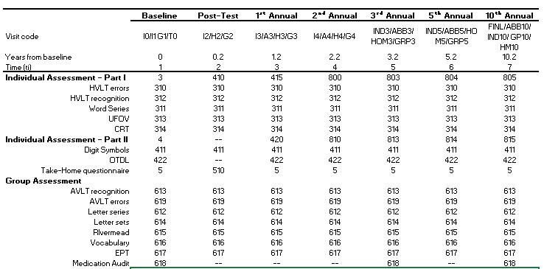
Documentation
Dropbox DOCUMENTATION ACTIVE Crib Sheet

Slide 18
A note on memory
At each follow-up (baseline – 10th annual), a different form was used for the
Hopkins Verbal Learning Test (HVLT)
Auditory Verbal Learning Test (AVLT)
Equipercentile-equated variables in data sets to handle form differences
eemem – equipercentile-equted memory composite

Slide 19
Visits
Individual Assessment – Part I
Individual Assessment – Part II
Group Assessment

Slide 20
Schedule of Test Administration
Notes:
MMSE and vision test were administered at the screening visit but not measured again until the 2nd annual

Slide 21
Schedule of Test Administration
Notes:
Height & weight, Grip, Turn 360 – NOT measured at post-test or 1st annual
BP & pulse / OTDL, driving, lifespace, # of falls, health conditions, utilization & insurance info were not collected at PT

Slide 22
Schedule of Test Administration
Notes:
SF-36 & CESD were not collected at PT
Medication audit not collected at PT or 1st annual

