Slide 1

WHICAP
Washington Heights/Hamilton Heights-Inwood Columbia Aging Project
Jennifer Manly
@ManlyEpic
jjm71@columbia.edu

Slide 2
Supported by
RF1 AG054023 (Mayeux)
R01 AG037212 (2010 – 2017)
P01 AG007232 (1992 – 2008)

Slide 3


Slide 4
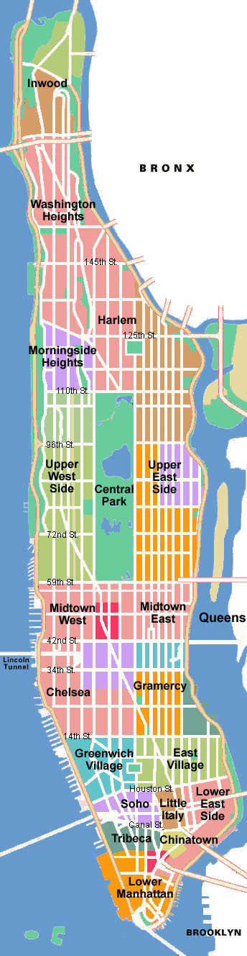
WHICAP
PI: Richard Mayeux
Washington Heights-Inwood Columbia Aging Project
N > 6,500 older adults
  Inclusion criteria: Medicare-eligible residents, age 65+, Spanish or English speaking
  Seen in home at 18-24 month intervals
  Women (68%) outnumber men (32%), consistent with age group
  Tested in Spanish (37%) or English (63%)
  Dx based on neuropsychological test battery, medical & functional interview
Proportion of sample

Slide 5
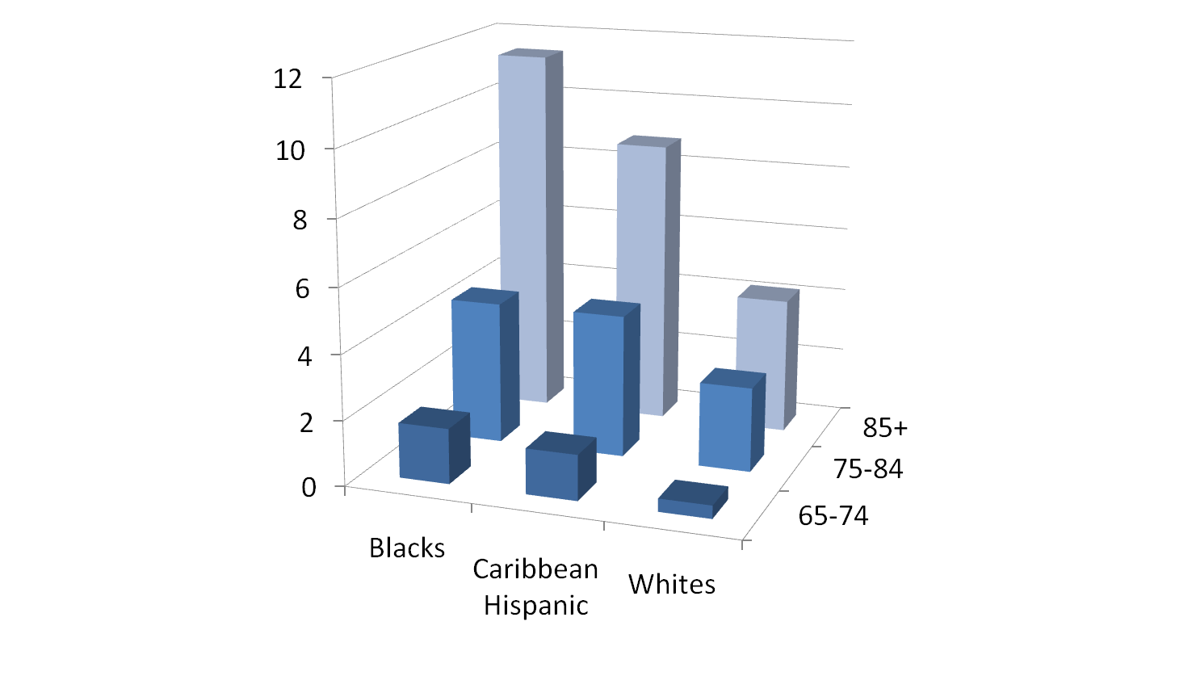
Age-Specific Incidence of Alzheimer’s Disease
Annual age-specific incidence
Tang et al., 2001; Neurology 56: 49-56

Slide 6

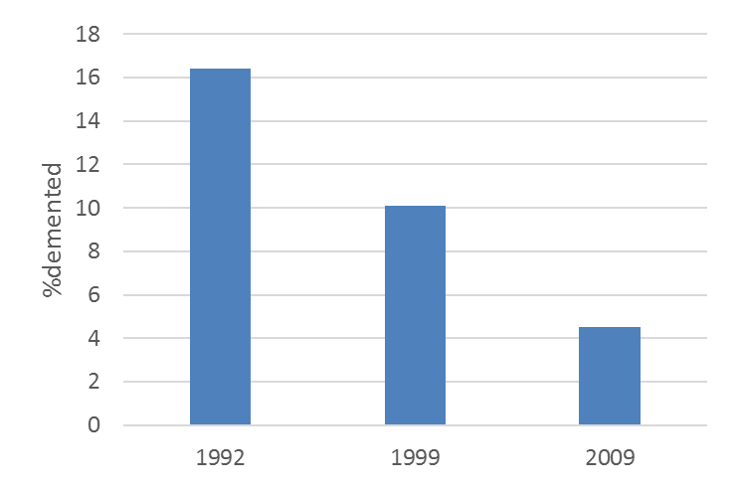
Recruitment across 3 cohorts
Consensus diagnosis of dementia at baseline
Inclusion/exclusion criteria
  1992: focus on prevalence in residents as is
  1999: focus on incidence in equal N ethnic groups, exclude for self-reported dementia diagnosis or serious memory complaints
  2009: + capacity to consent and willingness to give blood
  Recruitment method
  1992/1999: Medicare lists
  2009: Relevate consumer data
Neighborhood
    65.5% reduction in crime 1993 to 2007

Slide 7
N and availability of measures
Visit
 | 1 | 2 | 3 | 4 | 5 | 6 | 7 | 8 | 9 | 10
1992 | 2337 (1773) | 1388 | 1135 | 855 | 645 | 494 | 327 | 206 | 119 | 66
1999 |  |  |  | 2180 | 1615 | 1170 | 776 | 450 | 285 | 112
2009 |  |  |  |  |  |  | 2146 | 1391 | 585 | 73
Neuropsych as part of core visits
CESD
Education and literacy questions
PSES, Sleep
Color Trails
Structural MRI

Slide 8
Secular trends in cognitive decline
Vonk et al., in preparation
** use cohort variable in your analyses ****
Notes:
But secular trends for rate of change were robust in all three ethnic groups – Blacks Whites and Hispanics
the benefit of being born later was limited to the highest quartile of cognitive performers within each ethnic group, and this benefit was explained for by higher childhood or family SES and higher educational attainment.
Because these secular trends in educational attainment were due to policy changes requiring additional years of school, these results support a causal link between educational attainment and AD

Slide 9
Cognition
Siedlecki 2008
χ² = 1022.27
RMSEA = .04
CFI = .93

Slide 10

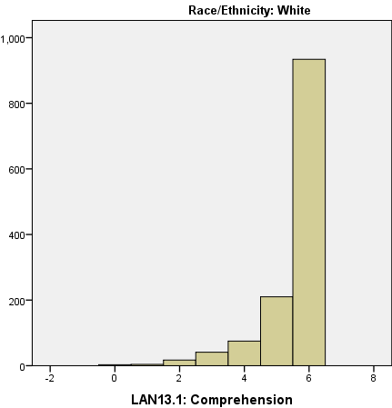
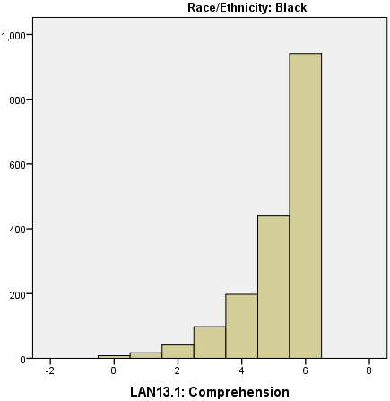
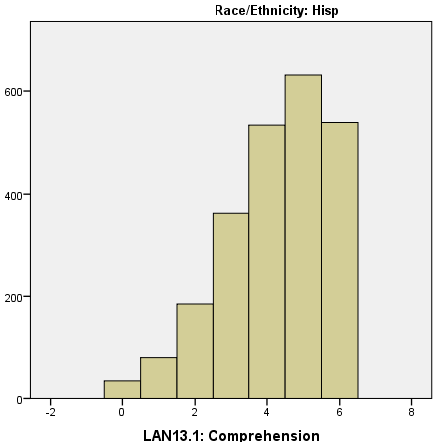
Measurement Invariance
MEMORY
LANGUAGE
VISUO-SPATIAL
SRT TOTAL
RECALL
SRT DELAY
RECALL
SRT DELAY
RECOG
BOSTON
NAMING
LETTER
FLUENCY
CATEGORY
FLUENCY
SIMILARITI
BDAE
REPETI
BDAE
COMPREH
BVRT
RECOG
BVRT
MATCHING
ROSEN
IDEN/
ODDITIES
Avila et al., in prep.
Notes:
Why these had metric invariance in which group
Add slide explaining types
Looking for inv across race/gend groups- it was bc of race and not gender.
why?
Put up bar graph to show distribution

Slide 11
Imaging variables
“Baseline” scans: N = 761
“Follow-up” scans: N = 334
Measures
  Brickman et al., 2008 https://www.ncbi.nlm.nih.gov/pmc/articles/PMC2692286/
    Brain volume, cranial volume, ventricular volume, hippocampus and entorhinal cortex (DeCarli).
    White matter hyperintensities quantified semi-automatically on FLAIR-weighted MRI
  Freesurfer – cross-sectional and longitudinal stream

Slide 12
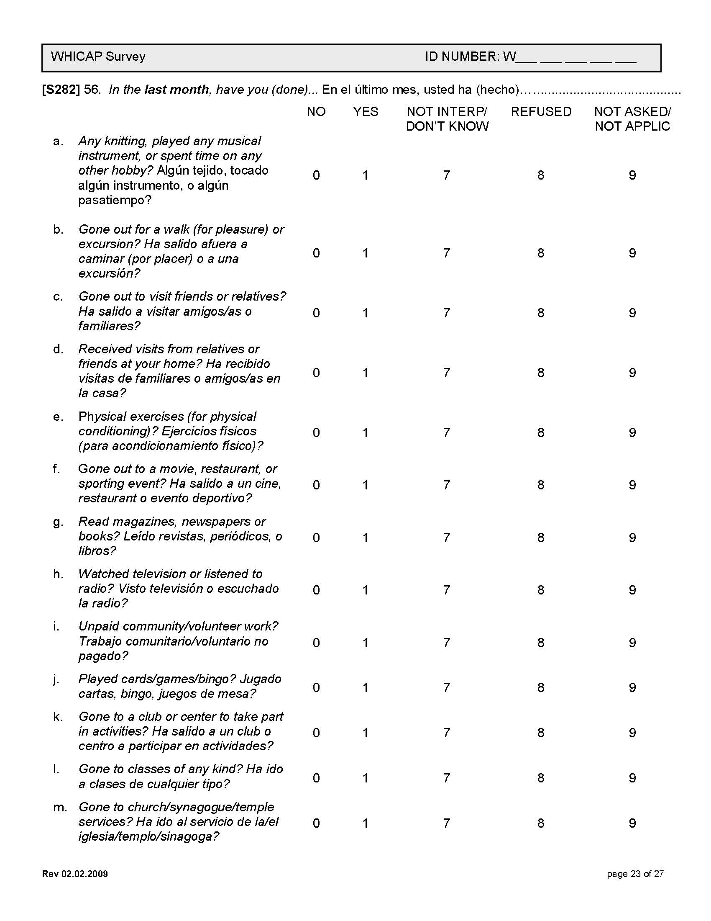
Activities

Slide 13
Activities

Slide 14
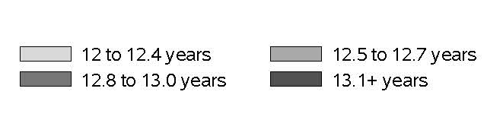
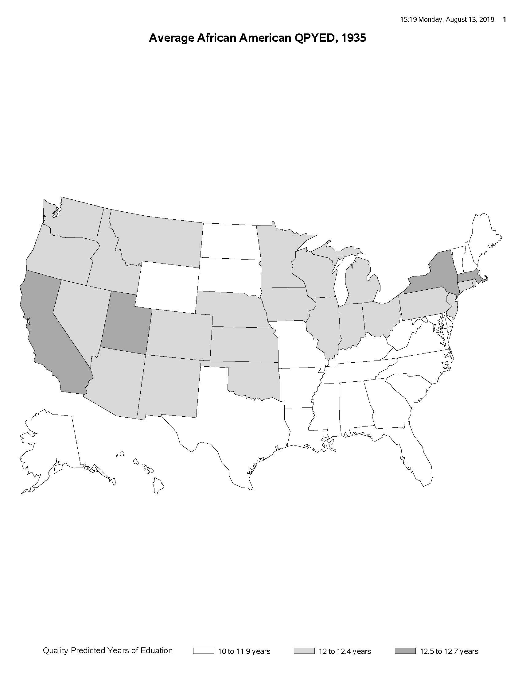
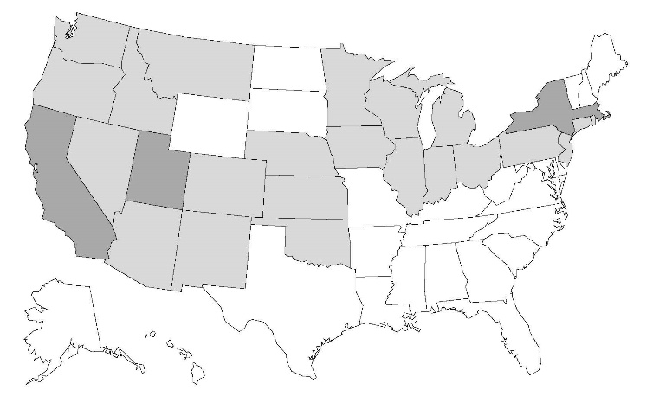
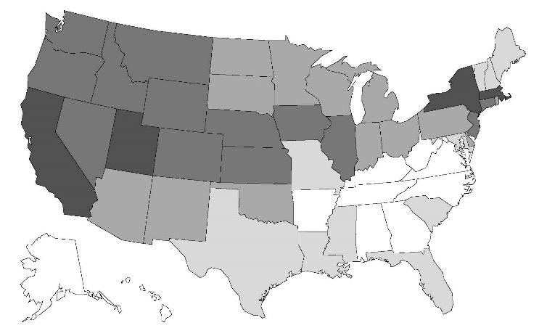
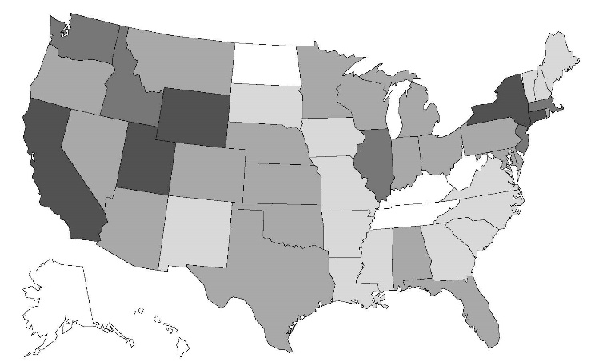

School quality predicted yrs of ed by state and race in 1935 and 1963
Darker shades correspond to longer term lengths
Blacks
Whites
1935
1960
Notes:
AM: Jen, not sure if “longer term length” is the correct phrase. Trying to think through this…difficult to think about what a “quality predicted year” actually menas.

Slide 15
Reading Level
English | Spanish
Wide Range Achievement Test - reading subtest I V Z J Q see red milk was between cliff stalk grunt clarify residence urge rancid conspiracy deny quarantine deteriorate regime beatify internecine regicidal puerile factitious lucubration epithalamion inefficacious synecdoche | Word Accentuation Test ACULLA ABOGACIA ANOMALO CELIBE ALELI RABI APATRIDA HUSAR LEGORIA MANCHU DIAMETRO MOARE CONCAVO AMBAR PUGIL POLIGAMO ACME SILICE GRISU ALBEDRIO CANON PIFANO TACTIL VOLATIL DESCORTES DISCOLO BULGARO BALADI ACOLITO CUPULA Identificacion de letras y palabras de ciudad la página es vertical uno zaramugullón por medicoquirúrgico niño corpóreo
Del Ser et al., 1997

Slide 16
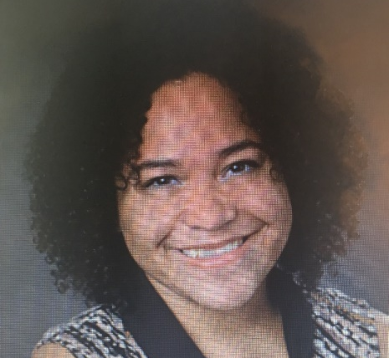

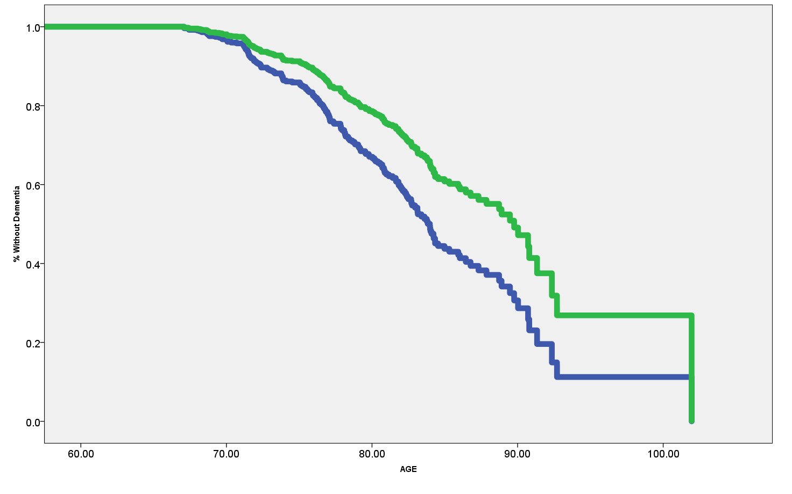
Cumulative AD incidence in literates and illiterates
Hazard Ratio = 1.66
95% CI = 1.15 - 2.39
p = .006
Literate
Illiterate
Arce et al., in preparation

Slide 17
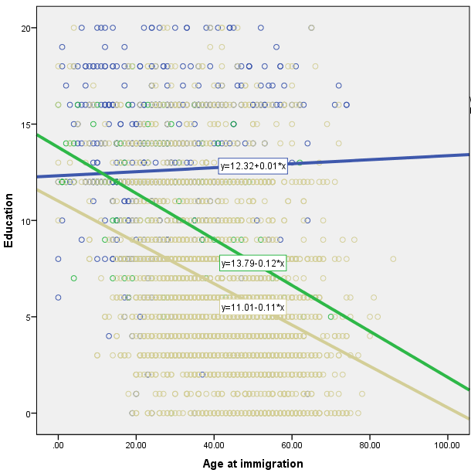
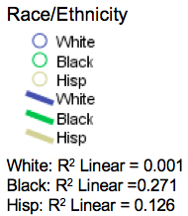
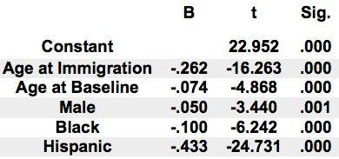
Relationship of Age at Immigration to Years of Schooling
Education (years)
Age at Immigration

Slide 18
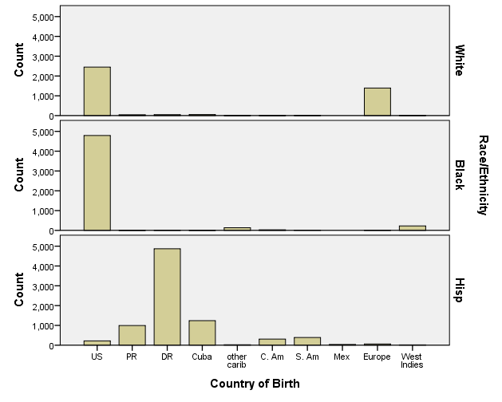
Birthplace

Slide 19
Childhood SES variables
Mother’s grade/credential
Father’s grade/credential
Mother’s occupation at age 16
Father’s occupation at age 16
Country and state of birth
Rural versus urban
Year of immigration
Number of siblings
Early death of parent

Slide 20
Education variables
Years of education
State of elementary & HS education
  Historical quality variables
Private vs. public
Rural vs. urban setting
Racial/ethnic breakdown of schools
Size (one room school vs. multi-room)

Slide 21
Adult SES variables
Years of education
Joint monthly income
Occupation during most of life
Own or rent home
Neighborhood (addresses)

Slide 22
Adult health variables
Self-reported medical diagnoses
  Hypertension
  Diabetes
  Heart disease
  Stroke
Medication categories
Head injury history
Blood pressure
Height, weight, BMI
Lipids, HBA1C, Cpeptide, (glucose)

Slide 23
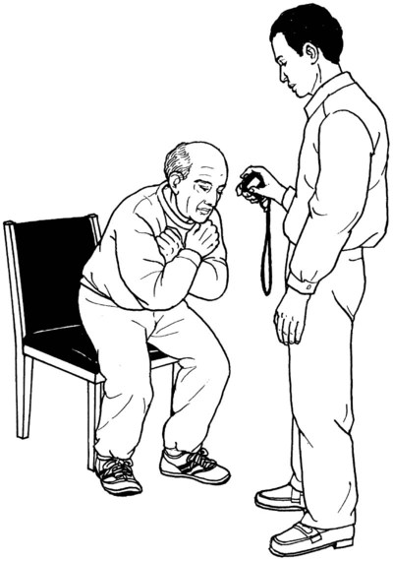
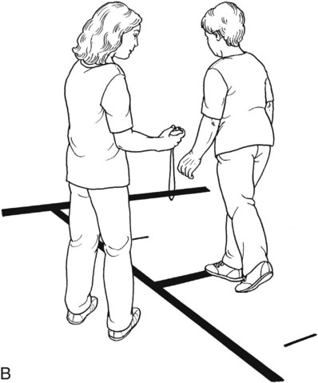
Subjective cognitive complaints
ADLs
IADLs
Blessed functional activities scale
Gurland CARE survey
Activities Limitations Scale (ALE)

Slide 24
Adult health behavior variables
Smoking
Alcohol
Sleep
Exercise questionnaire

Slide 25
Adult psychosocial variables
Marital status
Living status
DSM depression checklist
CES-D

Slide 26
Genetic variables
APOE genotype
GWAS

Slide 27
WHICAP data request
https://cumc.co1.qualtrics.com/jfe/form/SV_6x5rRy14B6vpoqN

