Slide 1



The ACTIVE Study (intro, overview, context, model, results, overview)
Michael Marsiske, PhD
Department of Clinical & Health Psychology
University of Florida

Slide 2
Acknowledgements
Funded in part by Grant R13 AG030995 from the National Institute on Aging
The views expressed in written conference materials or publications and by speakers and moderators do not necessarily reflect the official policies of the Department of Health and Human Services; nor does mention by trade names, commercial practices, or organizations imply endorsement by the U.S. Government.

Slide 3
Cognitive Training:
Results from the
ACTIVE Study at 10 Years
November 21, 2013

Slide 4
Proximal and Primary Outcomes at 10 Years
Presenter: George W. Rebok, MA, PhD
Supported By: U01 AG14260

Slide 5
Mobility Outcomes in ACTIVE
Presenters: Lesley A. Ross, PhD,
Jerri D. Edwards, PhD, & Karlene Ball, PhD
Supported By: U01 AG14289

Slide 6
Cognitive Training
Impact on Self-Rated Health and Depression: 10 Years Later
Presenters: Richard N. Jones, ScD
Frederick Unverzagt, PhD
Supported By: U01 NR04507, U01 NR04508

Slide 7
Generalizability of the ACTIVE findings – How representative is the ACTIVE sample?
Presenters: John Prindle, PhD
Jack McArdle, PhD
Supported By: U01 AG14282

Slide 8
Methodological Challenges and Lessons Learned
Presenters: Michael Marsiske, PhD
Sherry Willis, PhD
Supported By: U01 AG14263, U01 AG14276

Slide 9
ACTIVE Steering Committee
University of Alabama-Birmingham
Karlene Ball PhD
Hebrew SeniorLife Boston
John Morris PhD
Richard Jones ScD
Indiana University
Fredrick Unverzagt PhD
Johns Hopkins University
George Rebok PhD
Pennsylvania State University
Sherry Willis PhD
University of Florida/Wayne State University
Michael Marsiske PhD
New England Research Institutes, Coordinating Center
Sharon Tennstedt PhD
National Institute on Aging
Jonathan King PhD
National Institute of Nursing Research
Susan Marden PhD

Slide 10
Acknowledgements and Disclosures
ACTIVE is supported by grants from NIA and NINR to Hebrew Senior Life (U01 NR04507), Indiana University School of Medicine (U01NR04508), Johns Hopkins University (U01AG14260), New England Research Institutes (U01 AG14282), Pennsylvania State University (U01 AG14263), University of Alabama at Birmingham (U01 AG14289), University of Florida (U01AG14276).
Dr. Unverzagt has received research support from Posit Science, Inc., in the form of site licenses for cognitive training programs for investigator-initiated research projects.
Dr. Marsiske has received research support from Posit Science, Inc., in the form of site licenses for cognitive training programs for investigator-initiated research projects. Dr. Marsiske has received research support from Robert Wood Johnson Foundation and McKnight Brain Research Foundation. Dr. Marsiske has received payment for development of education presentations from the National Academy of Neuropsychology and the International Neuropsychological Society for workshops on cognitive interventions. Dr. Marsiske has received payment for development of education presentations from the National Institute on Aging and American Society on Aging for overview presentation on cognitive interventions.
Dr. Ball is a consultant and owns stock in the Visual Awareness Research Group and Posit Science, Inc., the companies that market the Useful Field of View Test (UFOV®) and speed of processing training software now called Insight (the Visual Awareness Research Group invented Insight and the UFOV®). Dr. Ball serves as a member of the Posit Science Scientific Advisory Board. Posit Science paid royalties to the Visual Awareness Research Group (unrelated to the study described). The Visual Awareness Research Group is an S Corp; all profits and losses flow to stockholders.
Dr. Rebok is an investigator with Compact Disc Incorporated for the development of an electronic version of the ACTIVE memory intervention.
Drs. Morris and Jones received support from the Edward Fein Foundation and Vicki and Arthur Loring for research activities.

Slide 11
Context

Slide 12
Precursors of ACTIVE
Reasoning
  Labouvie-Vief and Gonda
  Willis & Baltes
  Seattle Longitudinal Study
Memory
  Many studies
  Verhaeghen & Marcoens meta-analysis
  Greater variability in target of training, training approach

Slide 13
Precursors of ACTIVE
Speed, attention, working memory
  Many approaches, often practice-based
  Useful Field of View studies
Famous debates: Horn & Donaldson vs. Baltes & Schaie
Limitations of small samples, laboratory-specific training procedures, lack of sample diversity, lack of followup, lack of “real world” outcomes

Slide 14
Precursors of ACTIVE
RFA-AG-96-001
  Multi-site clinical trial
  Each proposal developed own protocol; funded sites to negotiate common approach and outcomes
  Mandated training at the level of basic abilities, to assess transfer to measures of functioning and independence

Slide 15
Intro

Slide 16
Distinguishing Features
Randomized trial
Community-based – Six Field Sites
Large, diverse sample
Focus on transfer of training effects on cognitive abilities to daily function

Slide 17
Strengths of the trial
Size and diversity are assets
Multiple intervention arms
Sample size and power
  2,802 adults at enrollment
Sample diversity (multi-site; racial/ethnic^{1,2})
  27% African American; large representation from disadvantaged areas
Maintenance of training for 10 years
  Longer followup and success than any prior trial
¹Ball et al, 2002
² Willis et al, 2006
Notes:
1 Ball, K., Berch, D. B., Helmers, K. F., Jobe, J. B., Leveck, M. D., Marsiske, M., ... & Willis, S. L. (2002). Effects of cognitive training interventions with older adults. JAMA: the journal of the American Medical Association, 288(18), 2271-2281.
2 Willis, S. L., Tennstedt, S. L., Marsiske, M., Ball, K., Elias, J., Koepke, K. M., ... & Wright, E. (2006). Long-term effects of cognitive training on everyday functional outcomes in older adults. JAMA: the journal of the American Medical Association, 296(23), 2805-2814.

Slide 18
Primary Aim
To test the efficacy of three cognitive
interventions
  Memory
  Reasoning
  Speed of processing
to improve or maintain the cognitively
demanding activities of daily living.

Slide 19
Overview

Slide 20
Interventions
Memory Verbal episodic memory
Reasoning Solving problems with a serial pattern
Speed of Processing Visual search and information processing

Slide 21
Cognitive Abilities
Reasoning
Word Series
Letter Series
Letter Sets
Speed of Processing
Useful Field of View
Memory
Auditory Verbal Learning Test
Hopkins Learning Test
Rivermead Paragraph Recall

Slide 22
Daily Function
Everyday Problem Solving
Observed Tasks of Daily Living
Everyday Problems Test
Everyday Speed
Complex Reaction Time
Timed IADL Test
IADL / ADL Functioning
Perceived IADL Performance
Perceived IADL Capacity
Perceived ADL Performance

Slide 23
Secondary Outcomes
Everyday Mobility
Life Space
Driving
Auto crashes: state driving records
Health
Self-reported health status
Depression: CES-D
HR-QOL: SF-36

Slide 24
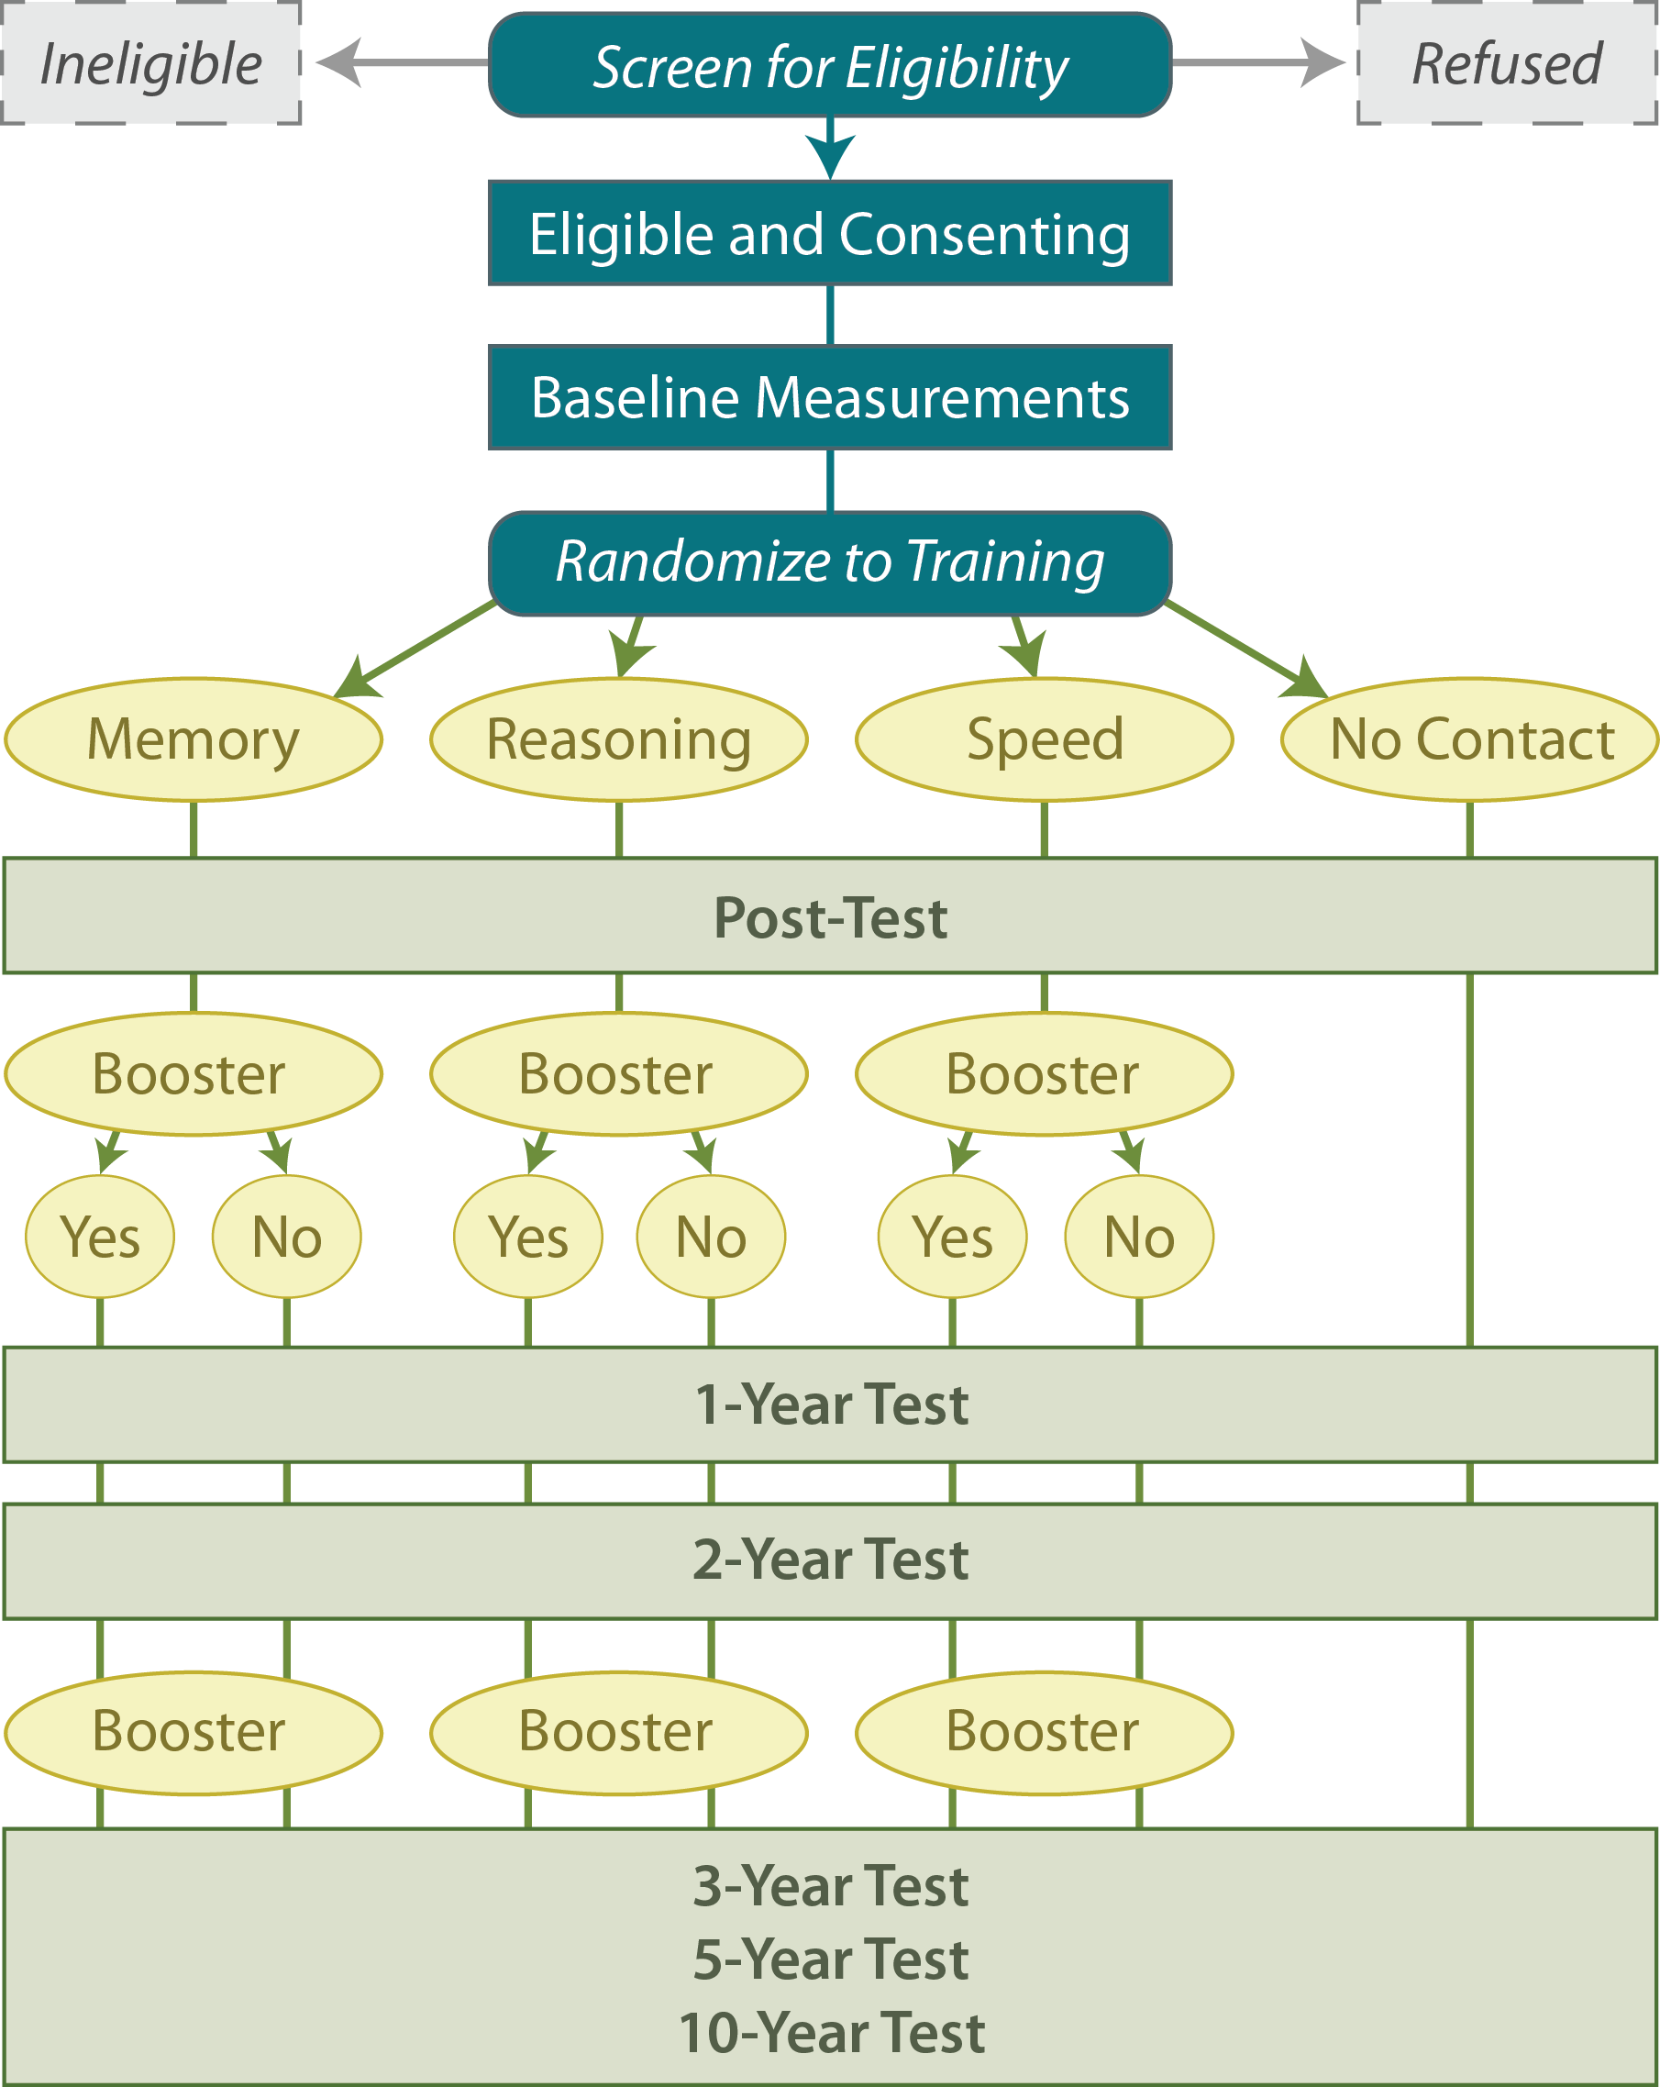
Study Design

Slide 25
Targeted Population
Diverse sample age ≥ 65 years
Living independently
At risk of loss of independence

Slide 26
Excluded
Age < 65 years
Substantial cognitive decline
  MMSE < 23
  Self-reported Alzheimer's disease
Substantial functional decline
  Assistance with dressing, personal hygiene, bathing
  Specified predisposing medical conditions (e.g., CVA)
Severe sensory losses
Communication difficulties
Similar cognitive training
Unlikely availability for study activities
Non-English speaking

Slide 27
Model

Slide 28
Simplified Conceptual Model
Participant
Characteristics
Training
Cognitive
Abilities
Daily
Function

Slide 29
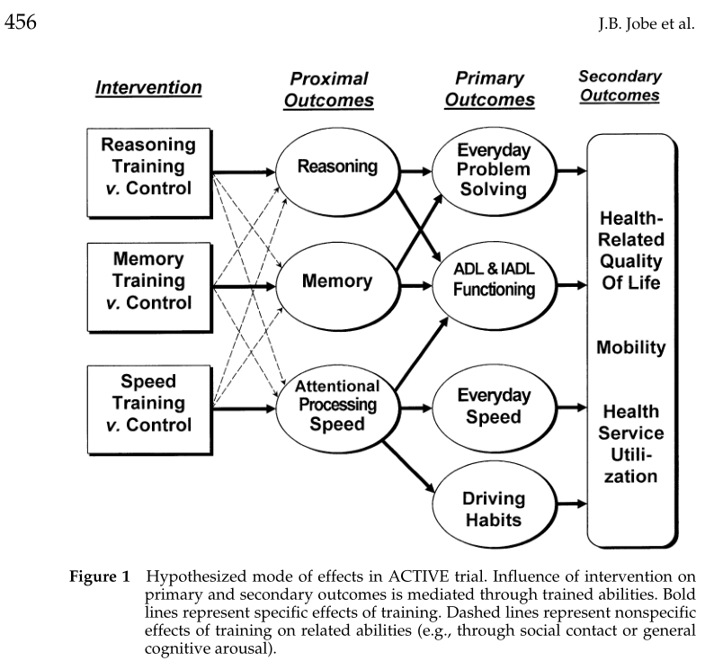
Why would ACTIVE impact Depression and Quality of Life Outcomes?
Jobe et al., Control. Clin. Trials 22, 453 (2001).

Slide 30
Results

Slide 31
Selectivity of Attrition at 10 Years
Retained 44% (n = 1220) of initial sample
  Death – primary reason
Attrition higher if:
  male
  older
  not married
  lower baseline MMSE
  lower baseline Memory and Reasoning scores
  less education
  more health problems
No differences across treatment groups

Slide 32
Proximal (Cognitive) and Primary (Functional) Outcomes at 10 Years

Slide 33
5-Year ACTIVE Results
  Cognitive outcomes
  Functional outcomes

Slide 34
Effect Sizes at 5 Years

Slide 35
Self-Reported IADL at 5 Years

Slide 36
10-Year ACTIVE Results
  Cognitive outcomes
  Functional outcomes

Slide 37
Memory
10-year Trajectory of Memory, Separately by Training Group

Slide 38
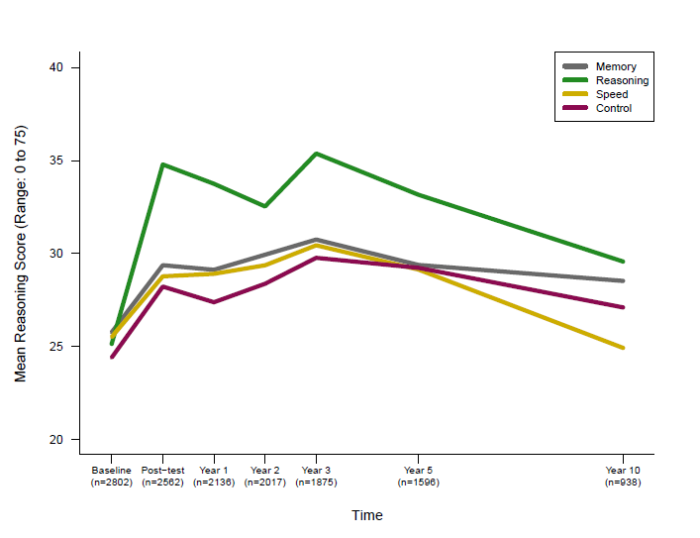
Reasoning
10-year Trajectory of Reasoning, Separately by Training Group

Slide 39
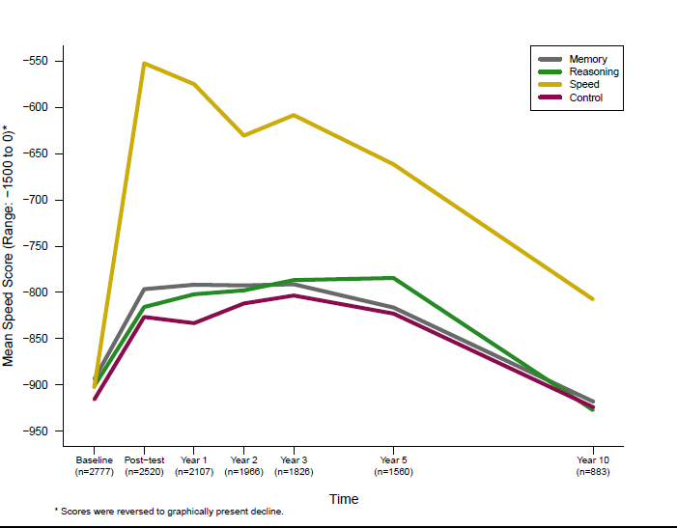
Speed of Processing
10-year Trajectory of Speed of Processing , Separately by Training Group

Slide 40
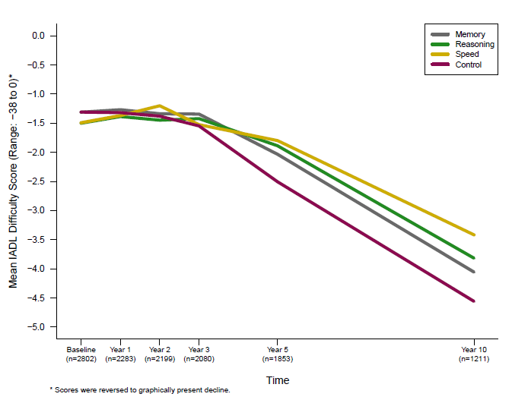
Self-Reported IADL Difficulty
10-year Trajectory of Self-Reported IADL Difficulty, Separately by Training Group

Slide 41
Summary and Conclusions
Main Findings
Participants in each intervention group reported less IADL difficulty
The reasoning and speed-of-processing interventions maintained their effects on their targeted cognitive abilities at 10 years
Memory training effects were no longer maintained for memory performance
Booster training produced additional and durable improvement for the reasoning intervention for reasoning performance and the speed-of-processing intervention for speed-of-processing performance

Slide 42
Summary and Conclusions
Implications
Results provide support for the development of other interventions, particularly those that target multiple cognitive abilities
Such interventions hold potential to delay onset of functional decline and possibly dementia
Even small delays in the onset of functional impairment may have a major public health impact

Slide 43
Mobility Outcomes in ACTIVE

Slide 44
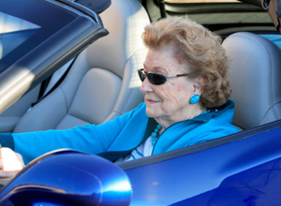
Mobility Measures in ACTIVE
Falls
Life Space
Driving Habits
Driving Cessation
Crash Risk
Focus will be on driving cessation and crash risk for this presentation.

Slide 45
Three years: Driving Cessation
Assessed the probability of driving cessation across the subsequent three years as a function of training, controlling for baseline driving status and vision
Cox Regression Model
  Time to driving cessation
  Speed Training
  Vision and Baseline Driving

Slide 46
Three years: Driving Cessation
At-risk older adults who completed 8 or more sessions of Speed of Processing Training were 40% less likely to cease driving over the next three years.
Those with better visual function were slightly less likely to quit driving
Those who drove more days per week were 37.5 % less likely to cease driving.
Edwards et al., 2009

Slide 47
Five Year Crash Results: Unadjusted
 | Control N=409 | Memory N=175 | Reasoning N=145 | Speed N=179
Person-time
Any crash | 1.00 ( - ) | 0.77 (0.52-1.16) | 0.73 (0.46-1.14) | 0.87 (0.59-1.29)
At-fault crash | 1.00 ( - ) | 0.86 (0.56-1.32) | 0.67 (0.40-1.12) | 0.55 (0.33-0.92)
Person-miles
Any crash | 1.00 ( - ) | 0.84 (0.56-1.27) | 0.81 (0.51-1.26) | 0.91 (0.62-1.35)
At-fault crash | 1.00 ( - ) | 0.93 (0.61-1.44) | 0.74 (0.44-1.24) | 0.58 (0.35-0.97)
Ball et al., 2010

Slide 48
Five Year Crash Results: Adjusted
 | Control N=409 | Memory N=175 | Reasoning N=145 | Speed N=179
Person-time
Any crash | 1.00 ( - ) | 0.73 (0.48-1.10) | 0.67 (0.43-1.05) | 0.79 (0.53-1.17)
At-fault crash | 1.00 ( - ) | 0.82 (0.53-1.27) | 0.44 (0.24-0.82) | 0.52 (0.31-0.87)
Person-mile
Any crash | 1.00 ( - ) | 0.80 (0.53-1.21) | 0.71 (0.45-1.11) | 0.82 (0.55-1.22)
At-fault crash | 1.00 ( - ) | 0.93 (0.60-1.45) | 0.50 (0.27-0.92) | 0.57 (0.34-0.96)
Ball et al., 2010
Notes:
*Adjusted for age, gender, race, education, MMSE score, self-rated health status, depression, vision, and site

Slide 49

What is the Impact of Training after Ten Years?

Slide 50
Participants
Participants at-risk at baseline for future driving cessation or crashes who received 8 or more training sessions (N=598)
  Age: 76 (5.98), 65-91
  27% male
  71% white
  Education: 13.2 (2.68), 4-20
  Health: 2.8 (.83), 1-5
  Days Driven per Week: 5.3 (1.90), 1-7
  Miles Driven per Week: 88.8 (97.4), 1-999

Slide 51
Methods
Outcomes
  Driving Cessation
  State-reported At-fault Crashes
Covariates
  Age, Gender, Study Site
  Baseline reported mileage, education and health
Cox-regression analyses with time censored at the event (driving cessation or crash), death, or last date in study

Slide 52
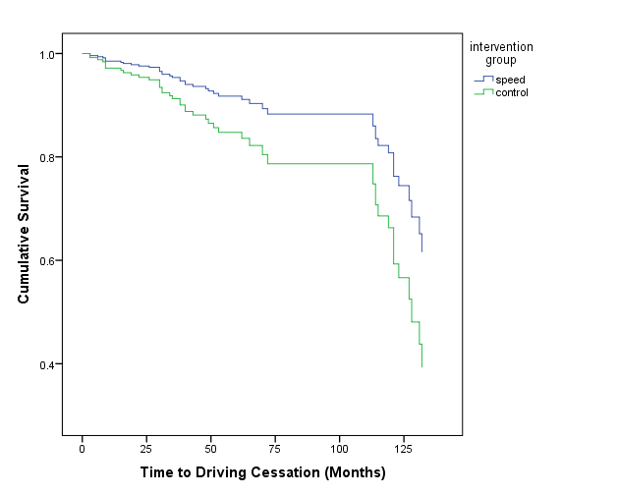
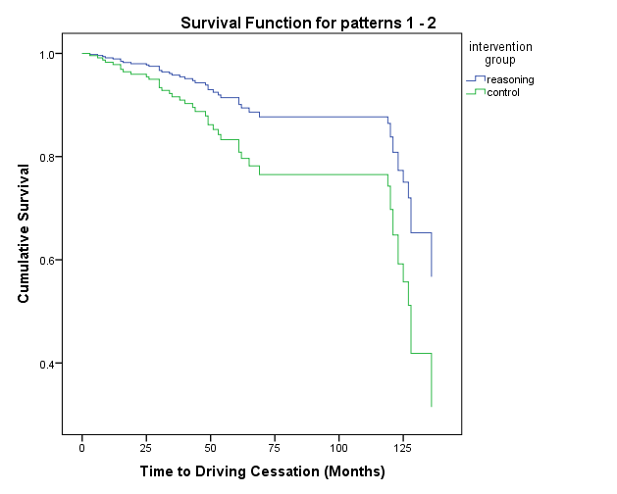
Results: Driving Cessation
Speed vs. Control
Reasoning vs. Control
HR=0.52, 95%CI=(0.28-0.95), p=.03
Adj. for education, gender and baseline mileage (n=263)
HR=0.49, 95%CI=(0.26-0.92), p=.03
Adj. for education, gender and baseline mileage (n=254)

Slide 53
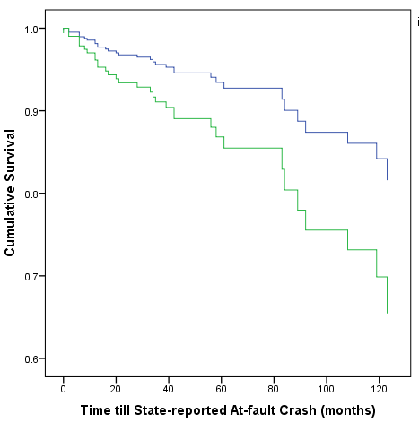
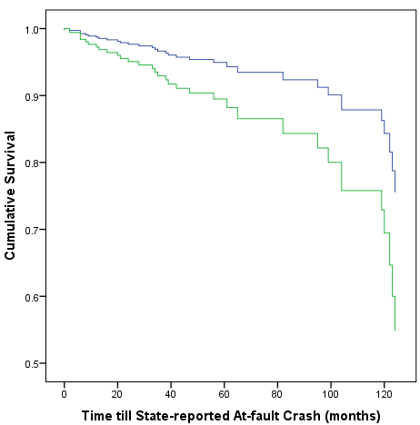
Results: State-reported Crashes
Speed vs. Control
Reasoning vs. Control
HR=0.48, 95%CI=(0.24-0.98), p=.04
Adj. for gender, study site, health and baseline mileage (n=270)
HR=0.47, 95%CI=(0.23-0.96), p=.04
Adj. for gender, study site, health and baseline mileage (n=263)

Slide 54
Cognitive Training
Impact on Self-Rated Health and Depression: 10 Years Later

Slide 55
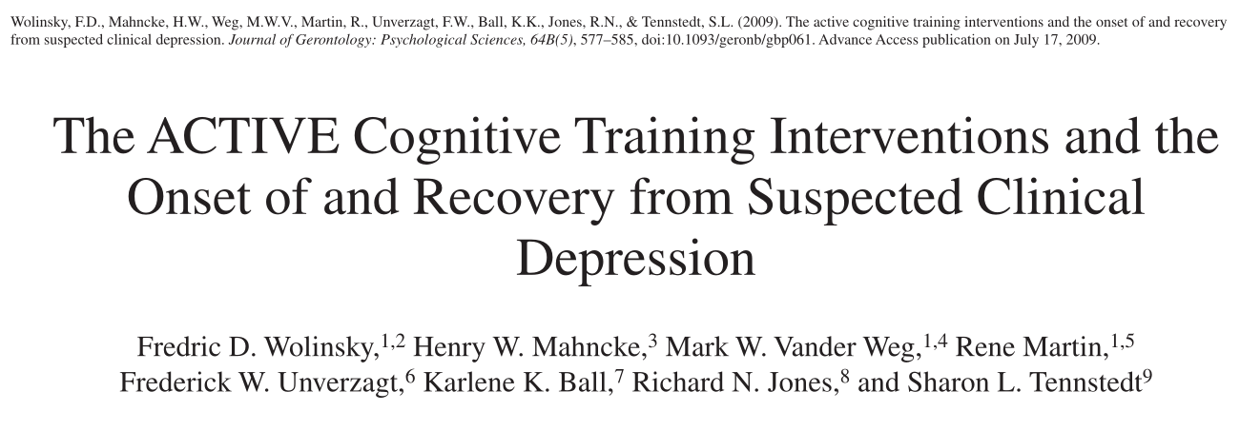
Only the speed of processing (vs. no-contact control) intervention had a significant effect, with its participants being 38% less likely to develop suspected clinical depression at 1 year (adjusted odds ratio = 0.62; p < .01).
None of the interventions had a significant effect on recovery from suspected clinical depression

Slide 56
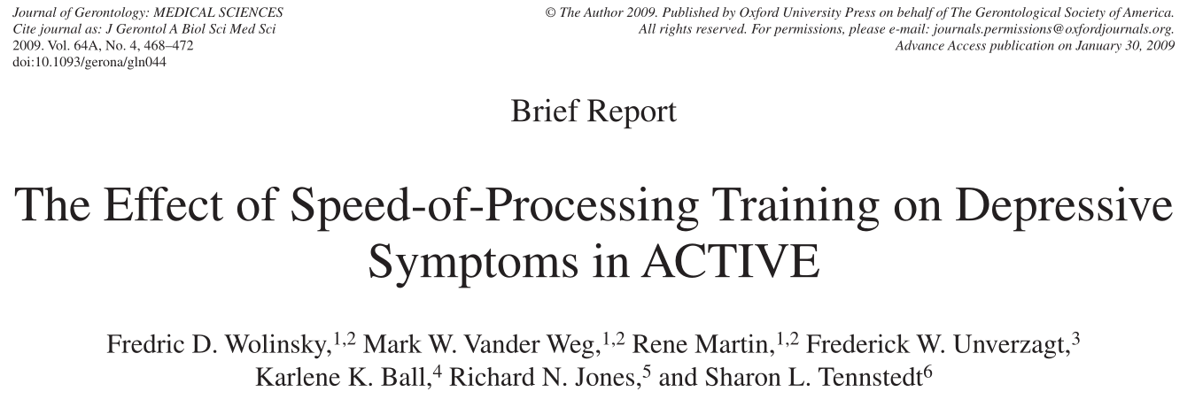
The speed-of-processing group (vs. the no-contact control group) was 30% less likely to experience clinically important increases in depressive symptoms at 1-year (adjusted odds ratio [AOR] = 0.70, p = .01) and 5-year (AOR = 0.70, p = .02)
No differences were observed among the control, memory, or reasoning groups at either time period

Slide 57
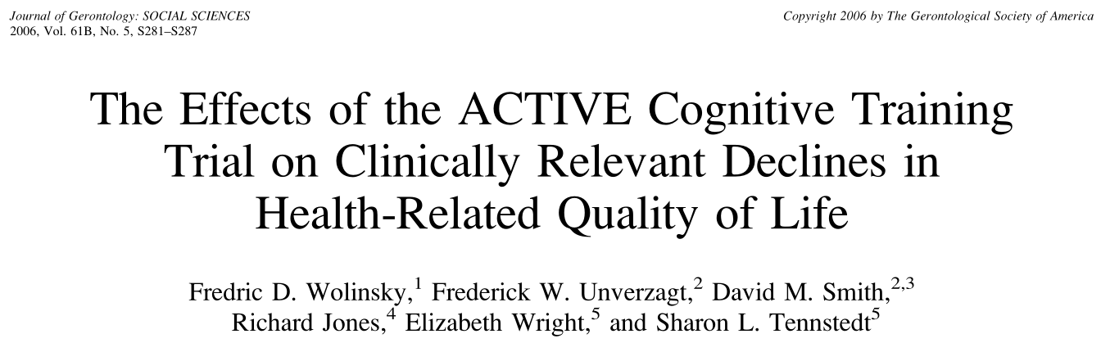
Previously, ACTIVE demonstrated…
Participants in the speed-of-processing intervention arm were less likely to have extensive HRQoL decline (adjusted odds ratio aOR = 0.64; p < .01) compared with controls, and
Participants in the memory and reasoning arms were equivalent to controls (adjusted odds ratios = 1.15 and 1.01, respectively; ps = .32 and .92, respectively)

Slide 58
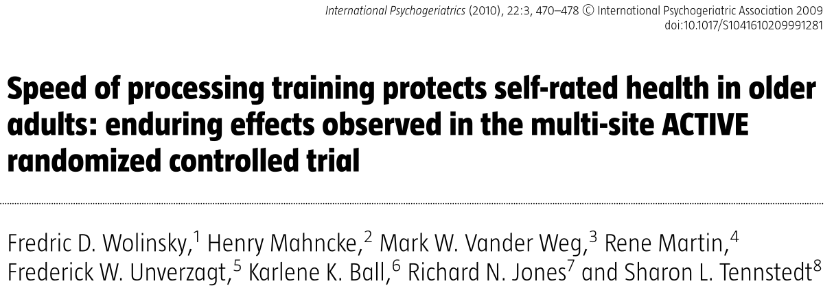
The speed of processing (vs. no-contact control) group had statistically significant improvements (or protective effects) on changes in self-rated health at the 2, 3 and 5 year follow-ups. The 5-year improvement was 2.8 points (p = 0.03).
No significant differences were observed in the memory or reasoning groups at any time

Slide 59
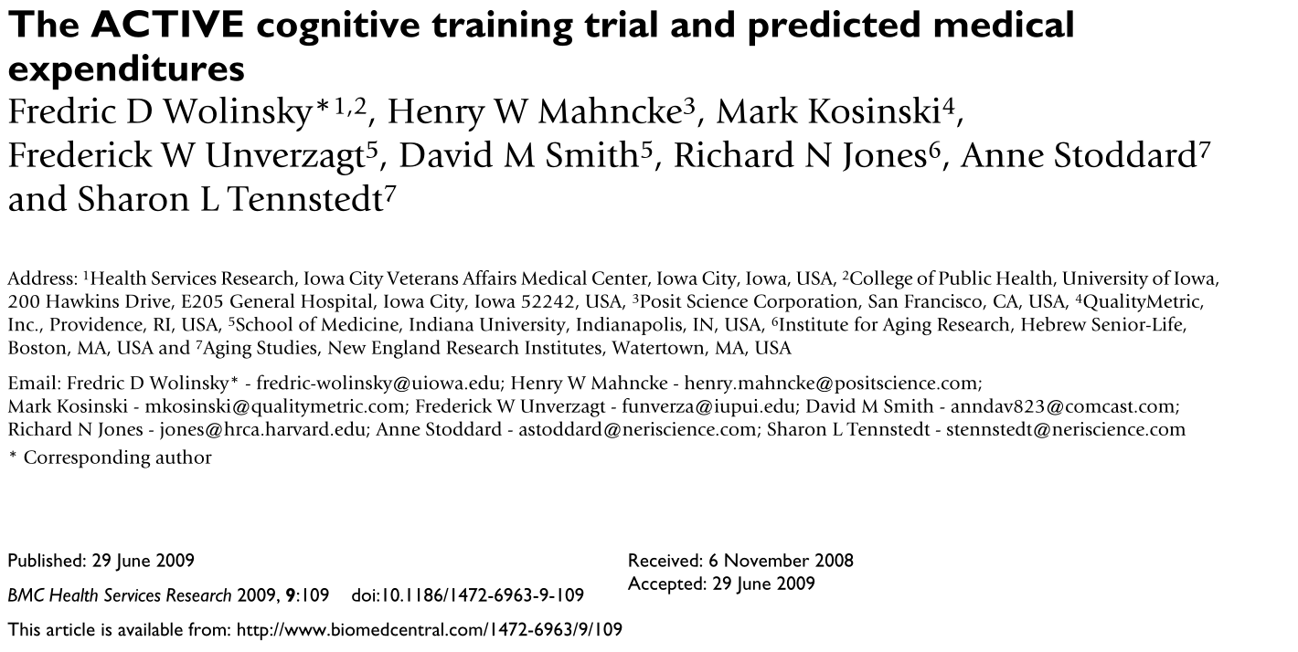
Changes in predicted annual medical expenditures were [derived from] functional status scores
At one and five years post-training, annual predicted expenditures declined by $223 (p = .024) and $128 (p = .309), respectively, in the speed of processing treatment group, but there were no statistically significant changes in the memory or reasoning treatment groups compared to the no-contact control group at either period

Slide 60
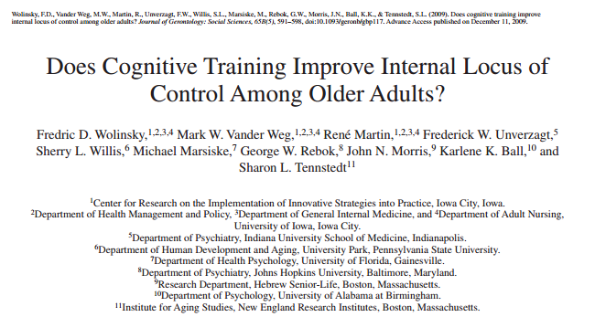
Multinomial regression predicted (1) > 0.5 SD decline in control from BL→A5, (2) >0.5 SD improvement in control vs. (3) reference group (no change).
Reasoning and speed of processing groups were 76% (p < .01) and 68% (p < .05) more likely, respectively, to improve than the no-contact control group.

Slide 61
New Analyses
Jones & colleagues: 10 year follow-up data
Growth modeling framework
Intent-to-treat principle …
…all participants included as randomized, and ML under MAR used for estimation
Two outcomes
  Depression
  Self-reported HRQOL

Slide 62
Main Results
By year 10, only a single point of evidence suggested benefit of training
  Memory training accelerates Depression improvement among those depressed at baseline (P < 0.01, net 3.3 CESD12 points at A10, 0.64 SD units)

Slide 63
Conclusion
Little evidence that ACTIVE training produces favorable outcome profiles for
  Depression
    Level, change
    Clinically important level of severity
  Self-rated health
  ten years after initial training
Suggests that, despite the durability of cognitive outcomes, ten years may be too long to expect residual affective/quality of life outcomes.

Slide 64
Impact

Slide 65

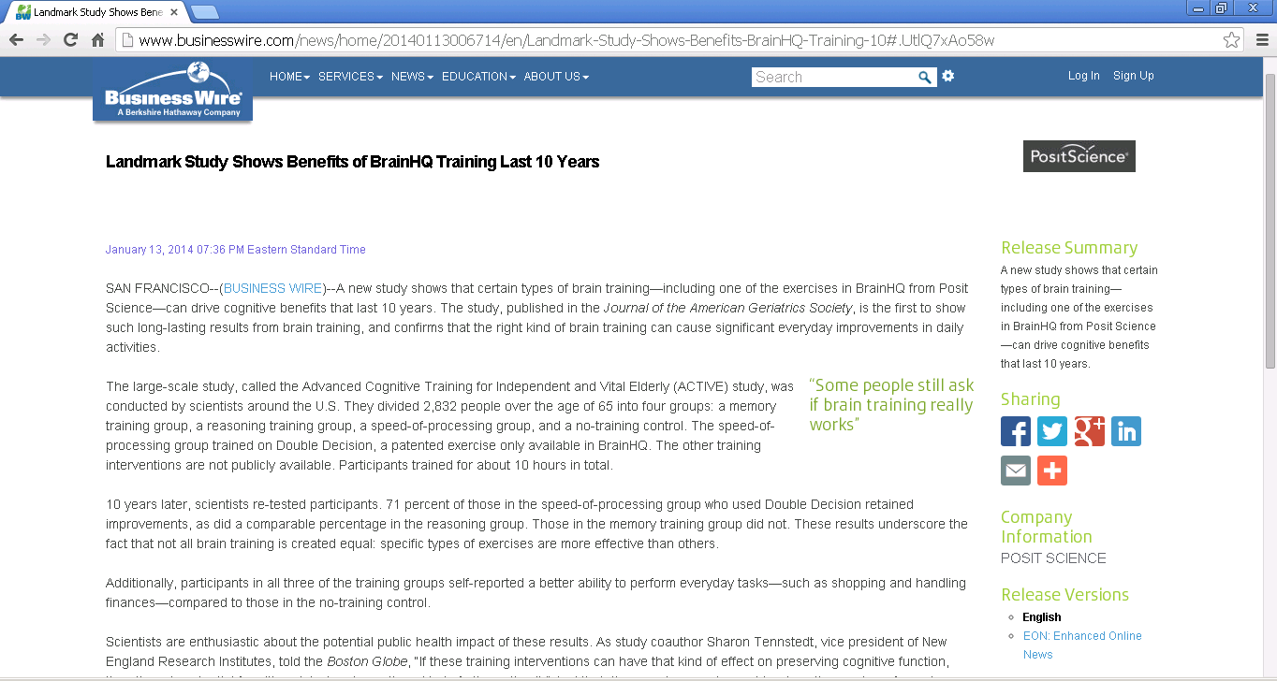

Cognitive Training in the News

Slide 66
How does the field respond?
Prevention of dementia consensus conference highlights lack of evidence
McKnight-NIA small-grant RFA on training and mechanisms
NIA 2014 RFA on mechanisms of cognitive training
Growing prevalence of intervention focused studies
Many draw on “lessons learned” from ACTIVE

Slide 67
Methodological challenges
Clinical trials or multivariate experiments
Clinical trials are generally powered to look at direct effects of treatment on single outcomes^{3,4}
RFA mandate to focus on functional outcomes⁵
  Underlying conceptual model was one of indirect effects
McArdle & Prindle applied this model to immediate reasoning outcomes⁶
Participant
Characteristics
Training
Cognitive
Abilities
Daily
Function
⇒
⇒
⇒
³Prentice, 1989 ⁵NIA, 1996
⁴ Schulz & Grimes, 2005 ⁶McArdle & Prindle, 2008
Notes:
3 Prentice, R. L. (1989). Surrogate endpoints in clinical trials: definition and operational criteria. Statistics in medicine, 8(4), 431-440.
4 Schulz, K. F., & Grimes, D. A. (2005). Multiplicity in randomised trials I: endpoints and treatments. The Lancet, 365(9470), 1591-1595.
5 National Institute on Aging, RFA-AG-96-001, Trial of a cognitive intervention for older adults, http://grants.nih.gov/Grants/guide/rfa-files/RFA-AG-96-001.html
6 McArdle, J. J., & Prindle, J. J. (2008). A latent change score analysis of a randomized clinical trial in reasoning training. Psychology and aging, 23(4), 702.

Slide 68
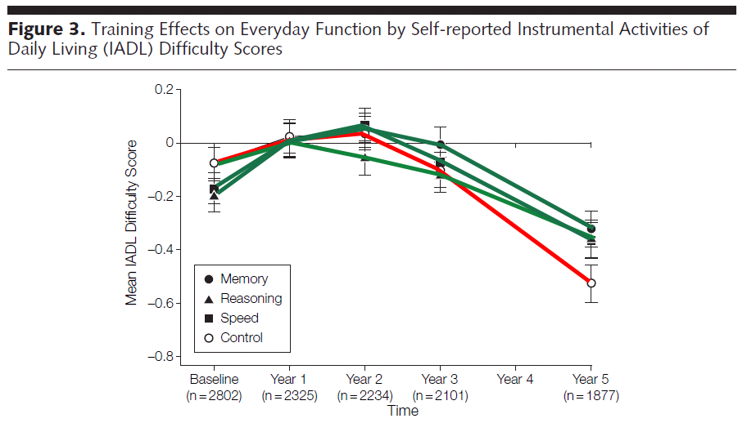
Methodological challenges
Objective versus subjective outcomes
ACTIVE chose, correctly, not to include a placebo control condition for cognitive outcomes
  Prior work showed it was not needed^{10,11}
  ACTIVE confirmed cognitive effects were intervention-specific^{1,2}
But for subjective outcomes, placebo is essential
¹⁰ Willis, Blieszner & Baltes 1981
¹¹ Blieszner, Willis & Baltes, 1981
¹Ball et al, 2002
²Willis et al, 2006
Notes:
10 Blieszner, R., Willis, S. L., & Baltes, P. B. (1981). Training research in aging on the fluid ability of inductive reasoning. Journal of applied developmental psychology, 2(3), 247-265.
11 Willis, S. L., Blieszner, R., & Baltes, P. B. (1981). Intellectual training research in aging: Modification of performance on the fluid ability of figural relations.Journal of Educational Psychology, 73(1), 41.

Slide 69
Methodological challenges
Optimal follow-up timing
Group differences on subjective outcomes did not emerge until fifth-annual follow-up
  This was likely the time needed for healthy, community dwelling elders to, on average, begin to experience functional decline
  If an intervention has protective rather than immediate effects, longer-term follow-up must be planned
  What is the best design for trials that build cognitive reserve?^{12,13}
¹² Valenzuela & Sachdev, 2009
¹³ Stern, 2002
Notes:
12 Valenzuela, M., & Sachdev, P. (2009). Can cognitive exercise prevent the onset of dementia? Systematic review of randomized clinical trials with longitudinal follow-up. American Journal of Geriatric Psych, 17(3), 179-187.
13 Stern, Y. (2002). What is cognitive reserve? Theory and research application of the reserve concept. Journal of the International Neuropsychological Society,8(03), 448-460.

Slide 70
Next steps

Slide 71
Next steps
Enrollment of a risk cohort
In the time since the 1996 RFA⁵, much scholarship has focused on the pre-clinical detection of incipient cognitive impairment
A growing body of research suggests that some cognitive gains can be achieved by this group^{15,16}
ACTIVE also found that memory impaired individuals gained in non-memory interventions¹⁷
Interventions must likely be tailored differently for this population
⁵ NIA, 1996 ¹⁶ Rapp, Brenes & Marsh, 2002
¹⁵ Belleville, 2008 ¹⁷ Unverzagt et al, 2007
Notes:
15 Belleville, S. (2008). Cognitive training for persons with mild cognitive impairment. International Psychogeriatrics, 20(01), 57-66.
16 Rapp, S., Brenes, G., & Marsh, A. P. (2002). Memory enhancement training for older adults with mild cognitive impairment: a preliminary study.
17 Unverzagt, F. W., Kasten, L., Johnson, K. E., Rebok, G. W., Marsiske, M., Koepke, K. M., ... & Tierney, W. M. (2007). Effect of memory impairment on training outcomes in ACTIVE. Journal of the International Neuropsychological Society, 13(6), 953.

Slide 72
Next steps
Multi-component interventions
Combined interventions were considered, but would have needed more preliminary data
  Distributed versus massed training
  What are appropriate comparison groups?
How ought strategy based interventions be combined with “restorative”¹⁸ information processing interventions (e.g., working memory), physical exercise¹⁹, cognitive restructuring²⁰, or pharmacology?
¹⁸ Sitzer, Twamley & Jeste, 2006 ²⁰ Hertzog & Dunlosky, 2011
¹⁹ Colcombe & Kramer, 2003
Notes:
18 Sitzer, D. I., Twamley, E. W., & Jeste, D. V. (2006). Cognitive training in Alzheimer's disease: a meta‐analysis of the literature. Acta Psychiatrica Scandinavica, 114(2), 75-90.
19 Colcombe, S., & Kramer, A. F. (2003). Fitness effects on the cognitive function of older adults A meta-analytic study. Psychological science, 14(2), 125-130.
20 Hertzog, C., & Dunlosky, J. (2011). Metacognition in Later Adulthood Spared Monitoring Can Benefit Older Adults' Self-Regulation. Current Directions in Psychological Science, 20(3), 167-173.

Slide 73
The arsenal
Arsenal
Educate
Brain Health
Spot-train
Mood
Engage

Slide 74
Next steps
Increasing dosage
Over a 5 week period, participants in original training spent up to 900 minutes in training
  That represents just 1.8% of the available time during that period.
  Over the ten year period, even those who received booster spent just 003% of time in training
Education²¹, rehabilitation science²², and physical exercise science²³ all tell us that dosages must be continuous, ongoing, protracted, and embedded into everyday life
Optimal delivery mechanism?
²¹ Ary et al, 2010 ²³ Paterson & Warburton, 2010
²² Whyte & Barrett, 2012
Notes:
21 Ary, D., Jacobs, L. C., Razavieh, A., & Sorensen, C. (2010). Introduction to research in education. CengageBrain. com.
22 Whyte, J., & Barrett, A. M. (2012). Advancing the evidence base of rehabilitation treatments: a developmental approach. Archives of physical medicine and rehabilitation, 93(8), S101-S110.
23 Paterson, D. H., & Warburton, D. E. (2010). Review Physical activity and functional limitations in older adults: a systematic review related to Canada's Physical Activity Guidelines.

Slide 75
Next steps
Tailored interventions
It is tempting to use technology (internet, computer-based training programs²⁴⁻²⁷) and increasingly available platforms (computers, tablets) to deliver longer, more adaptive, more multi-component interventions
  Technology access issues
  Appropriateness for cognitively frail elders?
  Same compliance issues as exercise interventions
  Absence of evidence regarding transfer
²⁴ Lumosity, http://www.lumosity.com/
²⁵ PositScience, http://www.positscience.com/
²⁶ Vigorous Mind, http://www.vigorousmind.com/
²⁷ Cogmed, http://www.cogmed.com/
Notes:
24 Lumosity, http://www.lumosity.com/
25 PositScience, http://www.positscience.com/
26 Vigorous Mind, http://www.vigorousmind.com/
27 Cogmed, http://www.cogmed.com/

Slide 76
Next steps
Biomarkers
Pre-training predictors
  measures of structural integrity (e.g., volumes, white matter burden, cortical thickness of hippocampus/entorhinal cortex)
  functional profile (DTI-tract integrity, patterns of activation at baseline to predict transfer^{28,29}
  Genetic (e.g., APOE4, BDNF-expressivity)
Pre-post assessment
  Changes in functional organization of tasks
²⁸ Lustig et al, 2009
²⁹ Lustig & Reuter-Lorenz, 2012
Notes:
28 Lustig C., Shah P., Seidler R., Reuter-Lorenz P. A. (2009). Aging, training, and the brain: A review and future directions. Neuropsychology Review, 19, 504–522.
29 Lustig C., Reuter-Lorenz P. A. (2012). Training working memory: Insights from neuroimaging. In Alloway T. P. (Ed.), Working memory: The new intelligence. New York, NY: Psychology Pres

Slide 77
Next steps
Reflecting on endpoints and training
The goal of ACTIVE was always to training functional abilities / IADLs
  The original RFA insisted that training be done at the cognitive level, but that seems at odds with the long-understood problem of specificity of training
  Implications for follow-up timing?
  Even recent promising basic interventions (working memory³⁰⁻³², dual task) do not show benefits at the level of complex everyday tasks
  Need direct interventions at the IADL level?
³⁰ Klingbert, 2010 ³² Colom et al, 2013
³¹ Jaeggi et al, 2010
Notes:
30 Klingberg, T. (2010). Training and plasticity of working memory. Trends in cognitive sciences, 14(7), 317-324.
31 Jaeggi, S. M., Studer-Luethi, B., Buschkuehl, M., Su, Y. F., Jonides, J., & Perrig, W. J. (2010). The relationship between n-back performance and matrix reasoning—Implications for training and transfer. Intelligence, 38(6), 625-635.
32 Colom, R., Román, F. J., Abad, F. J., Shih, P. C., Privado, J., Froufe, M., ... & Jaeggi, S. M. (2013). Adaptive n-back training does not improve fluid intelligence at the construct level: Gains on individual tests suggest that training may enhance visuospatial processing. Intelligence, 41(5), 712-727.

Slide 78
Take home
In a diverse (26% African American) population of elders aged 65+, training effects can last up to ten years! This is with as little as 10-18 sessions
Secondary benefits are seen in terms of
  health related quality of life/affect/control (up to 5 years later),
  performance-based tasks of daily living (in people receiving “booster” training, up to 5 years later)
  self-reported daily limitations of activity (up to 10 years later),
  driving/crash risk (up to 10 years later)
Next steps are to better understand the mechanisms, increase the dosage, explore combinations of treatments
Notes:
30 Klingberg, T. (2010). Training and plasticity of working memory. Trends in cognitive sciences, 14(7), 317-324.
31 Jaeggi, S. M., Studer-Luethi, B., Buschkuehl, M., Su, Y. F., Jonides, J., & Perrig, W. J. (2010). The relationship between n-back performance and matrix reasoning—Implications for training and transfer. Intelligence, 38(6), 625-635.
32 Colom, R., Román, F. J., Abad, F. J., Shih, P. C., Privado, J., Froufe, M., ... & Jaeggi, S. M. (2013). Adaptive n-back training does not improve fluid intelligence at the construct level: Gains on individual tests suggest that training may enhance visuospatial processing. Intelligence, 41(5), 712-727.

