Slide 1

Population-based
Neuropathology: classification of disease biomarker discovery tool
Thomas J. Montine, MD, PhD
Alvord Professor and Chair
Department of Pathology
University of Washington
Disclosures: Consultant to: Eisai, Amgen, BMS
No off-label medications
No medical devices

Slide 2
Neuropathology of Dementia
Classification of Disease
Risk of disease vs. Actual disease
Extent vs. Causes of functional impairment
Risk | Genetics Previous life events | Likelihood of initiation or progression disease in the future.
Actual | Clinical Data degree & character of functional impairment | Normal |  | Mild Impairment | Dementia or Parkinsonian
 | Laboratory Data disease type & burden | None | + | ++ | +++
Chronic Disease Model |  | No Disease | Latency | Prodrome | Full Expression
“Laboratory data” can be neuropath, lab med, and neuroimaging
“Clinical data” can be signs, symptoms, and neuropsych findings

Slide 3
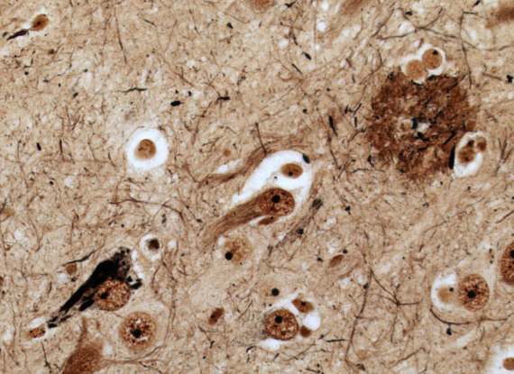
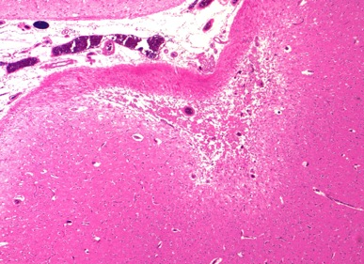
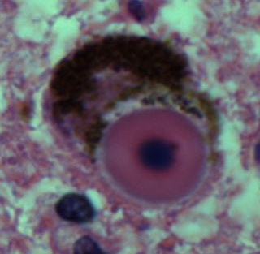
Neuropathology of Dementia
Classification of Disease
Chronic disease model of dementia
Aging, Genetics, Environment
COGNITIVELY NORMAL
P
R
O
D
R
O
M
E
D
E
M
E
N
T
I
A
AD
Injury &
Response to Injury
AD ≈45%
Proteinopathy
Mito Stress
Glial activation
Etc.
VBI
VBI ≈33%
Repair &
Functional
Compensa-tion
LBD
LBD ≈10%
LATENT DISEASE

Slide 4
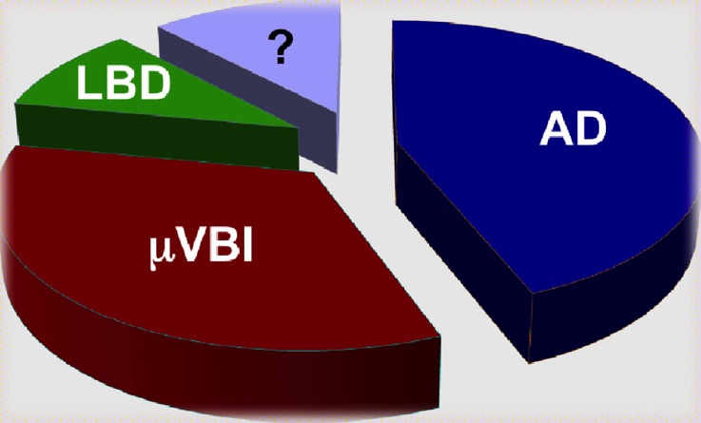
Neuropathology of Dementia
Classification of Disease
Dementia stage

Slide 5
Neuropathology of Dementia
Chronic disease model of dementia
Aging, Genetics, Environment
COGNITIVELY NORMAL
P
R
O
D
R
O
M
E
D
E
M
E
N
T
I
A
AD
Injury &
Response to Injury
AD ≈45%
Proteinopathy
Mito Stress
Glial activation
Etc.
VBI
VBI ≈33%
Repair &
Functional
Compensa-tion
LBD
LBD ≈10%
LATENT DISEASE

Slide 6
Neuropathology of Dementia
Chronic disease model of dementia
ACT
HAAS
Nun Study
OBAS
Aging, Genetics, Environment
COGNITIVELY NORMAL
P
R
O
D
R
O
M
E
D
E
M
E
N
T
I
A
AD
Injury &
Response to Injury
AD ≈45%
Proteinopathy
Mito Stress
Glial activation
Etc.
VBI
VBI ≈33%
Repair &
Functional
Compensa-tion
LBD
LBD ≈10%
LATENT DISEASE

Slide 7
Neuropathology of Dementia
Classification of Disease
Summary
Aging, Genetics, Environment
COGNITIVELY NORMAL
P
R
O
D
R
O
M
E
D
E
M
E
N
T
I
A
AD
Injury &
Response to Injury
AD ≈45%
Proteinopathy
Mito Stress
Glial activation
Etc.
VBI
VBI ≈33%
Repair &
Functional
Compensa-tion
LBD
3 chronic diseases account for vast majority of dementia
Idiosyncratic convergence at all stages of impairment
Progressive aggregate disease vs. functional impairment
Apparent resilience and hightened vulnerability
LBD ≈10%
LATENT DISEASE

Slide 8
Neuropathology of Dementia
Classification of Disease
2012 NIA-AA revised Guidelines for Neuropath Evaluation

Slide 10
Neuropathology of Dementia
Classification of Disease
2012 NIA-AA revised Guidelines for Neuropath Evaluation
Isssue | 1997 | 2012
Clinical Dx of dementia required for NP Dx of AD | Yes | No
NP assessment based on | Braak for NFTs & CERAD for Neuritic plaques | These plus Thal phase for Aβ regional accumulation
NP assessment of commonly co-morbid diseases | Little guidance | Explicit
Minimum regions to sample and stains to be used | Silent | Explicit
Reporting and CPC | Silent | Guidelines

Slide 11
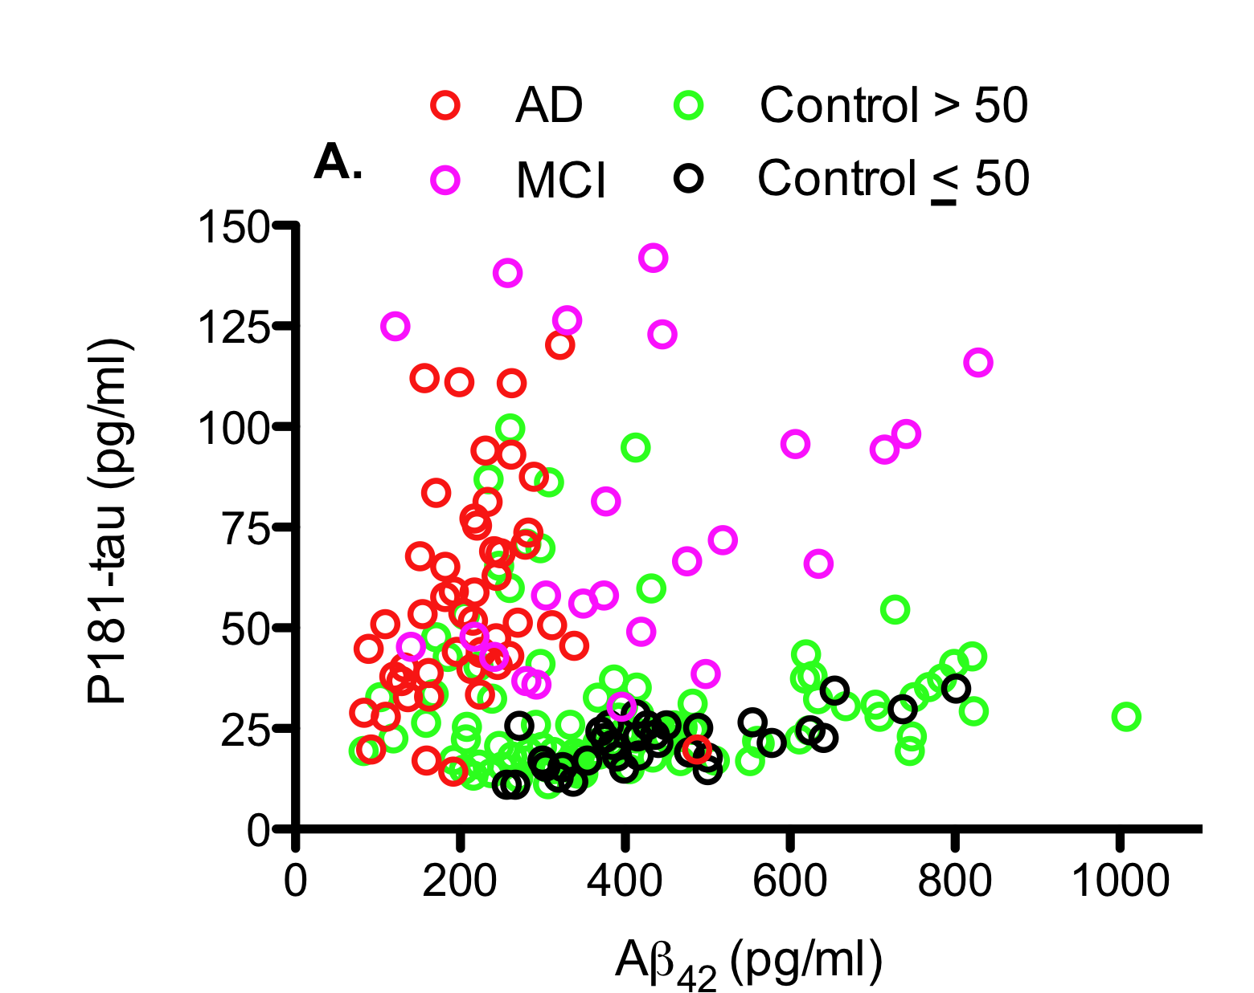
Neuropathology of Dementia
Biomarkers
CSF tau and Aβ₄₂
Volunteers for lumbar puncture: OHSU, UCSD, & UW ADC
Spectrum of Normal Cognition to Dementia
Clinical Lab evidence for AD is rare in cognitively normal volunteers younger than 50 yr-old
≈ 20% of cognitively normal volunteers > 50 yr-old have laboratory evidence of AD
Have poorer cognitive function at baseline
Have much greater risk of converting to MCI or AD in next 3 to 4 years
LP within 3 wk of cognitive testing

Slide 12
Neuropathology of Dementia
Discovery Tool
Histelide
Molecular-specific regional quantification
IHC

Slide 13
Neuropathology of Dementia
Discovery Tool
Histelide
Molecular-specific regional quantification
IHC

Slide 14
Neuropathology of Dementia
Discovery Tool
Histelide
Molecular-specific regional quantification
IHC

Slide 15
Neuropathology of Dementia
Discovery Tool
Histelide
Molecular-specific regional quantification
IHC

