Slide 1
Neurocognitive Outcomes of Depression in the Elderly (NCODE) Study
NIMH Grant R01 MH054846

Slide 2
Acknowledgements
Funded in part by Grant R13AG030995-01A1 from the National Institute on Aging
Dr. Potter is funded by Grant K23MH087741
The views expressed in written conference materials or publications and by speakers and moderators do not necessarily reflect the official policies of the Department of Health and Human Services; nor does mention by trade names, commercial practices, or organizations imply endorsement by the U.S. Government.

Slide 3
History of NCODE
R01 MH54846 awarded in 1995 to focus on biopsychosocial predictors of long-term geriatric depression course
  D. Steffens assumes PI role in 1998; cognitive battery included
Project named NCODE, refunded in
  2001 – focus on long-term cognitive outcomes
  2006 – inclusion of autopsy component
  2011 – emphasis on neuroimaging

Slide 4
NCODE study
Depressed patients (n = 527) and non-depressed controls (n = 180), age 60 and older
MRI brain scans, annual neuropsychological testing, evaluation and guideline-based treatment by a geriatric psychiatrist
Followed clinically with active treatment
  Naturalistic treatment paradigm
Cognitive diagnoses by expert consensus panel (study geriatric psychiatrists, neuropsychologists and a neurologist)
Steffens et al. J Geriatr Psychiatry Neurol. 2004

Slide 5
Consensus diagnostic model
Model used in several epidemiological studies of dementia (e.g., Cache County Memory Study)
Expert panel reviews all available evidence on participants
  Panel: geropsychiatrists, neurologist, cognitive neuroscientist, neuropsychologists
  All available evidence includes: clinical & medical history, treatment notes, neuropsychological testing, neuroimaging
Methodology has shown good agreement (87%) with autopsy in diagnosis of AD in epidemiological samples

Slide 6
NCODE sample size w/ neuropsych
(n of African Americans in parentheses )
Year | Depressed |  | Control
Baseline | 390 (53) |  | 185 (28)
1 | 262 (35) |  | 143 (20)
2 | 202 (8) |  | 122 (14)
3 | 168 (15) |  | 113 (11)
4 | 135 (11) |  | 103 (11)
5 | 118 (7) |  | 92 (11)
6 | 91 (8) |  | 78 (7)
7 | 78 (7) |  | 60 (7)
8 | 58 (2) |  | 45 (3)

Slide 7
Research issues in late-life depression
Heterogeneity of depression symptoms
Depression and cognitive dysfunction
  Persistent cognitive dysfunction
  Depression and dementia
    Prodrome or risk factor?
Structural brain changes and depression
Vascular depression hypothesis
  Brain lesions
  Hippocampal volume
Psychosocial factors affecting longitudinal course of depression

Slide 8
Depression symptoms

Slide 9

What is depression?
DSM-IV classifications
Diagnosis of Major Depressive Episode (MDE):
  5 or more DSM-IV symptoms of depression during 2-week period; must include depressed mood or loss of interest
  Symptoms impaired social or occupational function
  Not directly due to drug, medication, or medical condition
  Not better diagnosed as Bereavement
Major Depressive Disorder (MDD): 1 or more major depressive episodes
Dysthymic Disorder: at least 2 years of depressed mood and other symptoms not meeting criteria for MDE

Slide 10
What is depression?
Symptoms of Depression (DSM-IV)
Persistent sad, anxious, or “empty” mood
Loss of interest or pleasure in hobbies and activities
Significant weight loss
Significant weight gain
Insomnia
Hypersomnia (oversleeping)
Psychomotor agitation
Psychomotor retardation
Decreased energy, increased fatigue
Feelings of worthlessness and guilt
Reduced ability think, concentrate, or make decisions
Recurrent thoughts of death or suicide
Notes:
10

Slide 11
Problem of heterogeneity
“The use of the current classification schemas including DSM-IV… are based on clusters of symptoms and characteristics of clinical course that do not necessarily describe homogenous disorders, and rather reflect common final pathways of different pathophysiological processes. (Hasler et al. Neuropsychopharmacology. 2004)
Implications:
  Current scales may not assess a unitary depression construct
  Current scales unlikely consistent with each other
  Subsets of items may be related to subtypes of depression and depression outcome

Slide 12
Depression measures
Montgomery-Asberg Depression Rating Scale
  10 item clinician rated, standard NCODE measure
Hamilton Depression Rating Scale
  17 item clinician rated
Center for Epidemiologic Studies Depression Scale
  20 item self report

Slide 13
4 factors of depression
Low positive mood
  Felt sad (CES-D)
  Not happy (CES-D)
  Blues (CES-D)
  Depressed (CES-D)
Apathy
  Lassitude (MADRS)
  Low interest (HAM-D)
  Inability to feel (HAM-D)
  Sad affect (MADRS)
Appetitive
  GI symptoms (HAM-D)
  Reduced appetite (MADRS)
  Weight loss (HAM-D)
Sleep
  Reduced Sleep (MADRS)
  Middle Insomnia (HAM-D)
  Restless sleep (CES-D)
  Delayed Insom. (HAM-D)

Slide 14
Association to depression symptoms to other outcomes
Greater appetite disturbance is associated with greater neuopsychological impairment and higher odds of dementia
Greater sleep disturbance and greater endorsement of low positive affect associated with lower odds of dementia
Potter unpublished data

Slide 15
Depression and cognitive dysfunction

Slide 16
Cognition during acute depression and beyond
Older adults with depression have worse neuropsychological performance than elders w/o depression
Cognitive deficits often persist despite remission of depression (Bhalla, 2009; Lee, 2007)

Slide 17
Depression and Cognitive Impairment
Comorbidity of depression and cognitive impairment estimated 17-36%
Depression prevalence among individuals with cognitive impairment 3x higher than among age-matched peers w/o CI
22-54% of individuals with AD also have depression (Zubenko et al. 2003); high end of range in includes minor depression

Slide 18
Depression: Risk Factor or Prodrome?
Risk factor
Case-Control OR: 2.0
Prospective Cohort OR: 1.90
Recurrent episodes increase risk
Longer interval b/w MDD and Dem assoc w/ > risk
Prodrome
Baseline depression in elders assoc. w/2x risk of depression in ~3 yrs (Devanand, 1996)
2 studies found 50% conversion to dementia when there was depression and CI together (Reding 1985; Modrego 2004)

Slide 19
Depression: Risk Factor or Prodrome?
  Three likely hypotheses:
  Depression can be an early prodrome of dementia
  Depression brings forward the clinical manifestation of dementing diseases
  Depression leads to damage to the hippocampus through a glucocorticoid cascade
Jorm. J Aust N Zeal J Psychiatry 2001;35:776-781

Slide 20
Neuropsychological Measures
MMSE
CERAD Battery (Animal Naming, 15-item Boston Naming, Word List Learning, Praxis)
  Word list learning, delayed recall, recognition
  Constructional Praxis, Praxis recall, recognition
WMS-R Logical Memory
Benton Visual Retention
Trail Making Test
Symbol Digit Modalities Test
Digit Span
Word fluency (COWA)
Shipley Vocabulary Test

Slide 21
CERAD Total Score
Source: Chandler et al. (2005) Neurology 65: 102-106

Slide 22
CERAD/75
TP = 19
FP = 35
FN = 1
CERADTOT = 75
Sensitivity/Specificity = .95/0.75
MMSE/24
TP = 7
FP = 2
FN = 13
MMSE = 24
Sensitivity/Specificity = .35/0.98
MMSE = 29
Sensitivity/Specificity = .90/0.75
MMSE/29
TP = 18
FP 107
FN = 2

Slide 23
Percent concordance for AD from baseline assessment
 | Percent concordant
CERAD Delay** | 82.8
CERAD** | 88.9
MMSE** | 66.0
CERAD** + MMSE ^{(ns)} | 88.8
*p <0.05 **p <0.01 ns = non-significant

Slide 24
Comparison of NCODE groups to Chandler MCI & AD groups
Note: NCODE “non-convert” are depressed at time of testing; demographics are comparable between samples

Slide 25
Discriminant function analysis predicting dementia from baseline neuropsych
Dementia: Best Subset Model
Parameter | DF | Estimate | SE | Chi-Square | Pr > ChiSq
INTERCEPT | 1 | -17.19 | 4.75 | 13.08 | 0.0003
AGE | 1 | 0.15 | 0.05 | 9.72 | 0.0018
FEMALE | 1 | -0.20 | 0.65 | 0.10 | 0.7557
EDUCATION | 1 | 0.29 | 0.11 | 6.86 | 0.0088
MADRS | 1 | 0.02 | 0.03 | 0.38 | 0.5357
CERAD DELAYED RECALL | 1 | -0.50 | 0.16 | 9.52 | 0.0020
TRALB (SEC) | 1 | 0.02 | 0.01 | 16.45 | <.0001
 | Model Fit:
 | Max-rescaled R-Square = 0.6347
 | Concordance Index c = 0.927
Potter et al., Am J Ger Psych. 2011

Slide 26
Structural brain changes and depression

Slide 27
Brain structure measures
Brain MRI 1.5 T, later switch to 3.0 T
Variables include:
  White matter lesion volume (1.5 T)
  Whole brain lesion volume (3 T)
  Total brain volume (1.5 T, 3 T)
  L and R hippocampal volume (1.5 T, 3 T)
  Visual ratings of lesion severity/confluence (Coffey/Fazekas)
    deep white matter, periventricular, subcortical

Slide 28
Hippocampus, depression, & cognitive decline
Depressed individuals have smaller hippocampus that non-depressed individuals (Steffens 2000, Biol Psych)
Volume loss in hippocampus over 2 yrs associated with subsequent decline on MMSE (Steffens, 2011, Am J Geriatric Psych)
Age, baseline MMSE, total cerebral volume, and smaller left hippocampal volume were associated with incident dementia (Steffens 2002, Am J Geriatric Psych)

Slide 29
White matter lesions and cognition
White matter lesions are associated with cognitive deficits, which are greater in depression (Kramer-Ginsberg, Am J Psychiatry. 1999 Mar;156:438-44).
Group comparisons revealed that vascular depression associated with worse performance on most neuropsychological measures, but also with greater age, higher cardiac illness burden, and higher endorsement of apathy and concentration problems (Potter 2009, Int J Ger Psych)

Slide 30
Vascular depression hypothesis
Cerebrovascular pathology impairs mood-related circuits, leading to depression
  Seventy-five (54%) of the subjects met neuroimaging criteria for subcortical ischemic vascular depression (SIVD).
  Age has strongest association with SIVD
  History of hypertension was positively associated, family history of depression was negatively associated with SIVD
Krishnan et al. Biol Psychiatry 2004;55(4):390-7.

Slide 31
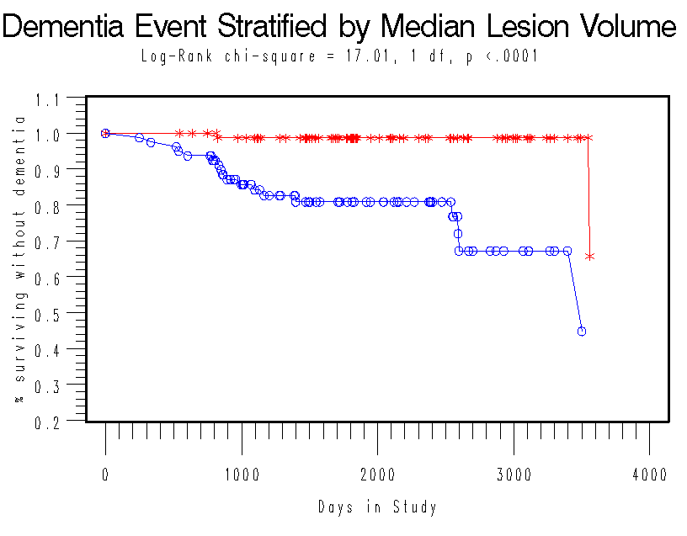
NCODE study: two-year change in white-matter lesion volumes and incident dementia among 161 depressed patients with two MRIs
Age, baseline MMSE score, and change in WMH volumes were significantly associated with time to dementia onset
Steffens et al. Am J Geriatr Psychiatry. 2007;15:839-849

Slide 32
Psychosocial factors affecting longitudinal course of depression

Slide 33
Psychosocial measures
Duke Social Support Index (Landerman, 1989):
  Subjective social support. (10 items) Instrumental social support. (12 items)
  Social network size (4 items)
  Social interaction (4 items)
  Stressful life events
Stressful life events
  Total stress, stress valence (negative impact), average stress rating

Slide 34
Stress, social support, and cognition
Decline in total number of stressors (baseline to Y1) was associated with a improvement on CERAD TS during subsequent year (Y1 – Y2).
Decreased social interaction and decreased instrumental social support predicted decline in cognitive performance.
Consistent with hypothesis that stress adversely affects hippocampus, but further study needed
Dickinson. Int J Ger Psych. 2011.

Slide 35
Other measures
Cumulative Illness Rating Scale
(CIRS, measure of medical burden)
Dementia Severity Rating Scale
(DSRS, informant report by mail, may have lower response rate)
ADL/IADL ratings
Various medical history by self report
APOE

Slide 36
Strengths of NCODE
Size/length of longitudinal cohort in late life depression
Clinical diagnosis of dementia and cognitive impairment subtypes
Multiple indicators over time: neuropsych, MRI, clinical and psychosocial variables
Possibility to define multidomain phenotypes of cognitive decline/dementia
Productive: >130 peer-reviewed papers over life of grant; however, few investigations utilizing modern psychometric/statistical methods

Slide 37
Limitations & challenges of NCODE
Evolution of research questions effects data structure
  Depression outcomes →→ neurocognitive outcomes
Clinical care supercedes data collection
  Variability in dates/visits
Naturalistic treatment = multiple medications

Slide 38
Limitations & challenges of NCODE
Decreasing sample size over time; also when combining elements (neuropsych, MRI, dementia dx)
# of dementia cases small by most standards, smaller when baseline neuropsych needed
Harmonization of MRI data (1.5 T vs. 3 T)
  MRI not annual after 2 years
Limited sample size for many race-based questions

