Slide 1
Racial differences in epidemiologically derived cognitive resilience from a population sample
Kumar B. Rajan, PhD
University of California at Davis

Slide 2
Acknowledgements
Investigators Grants
Denis Evans, MD R01AG11101
David Bennett, MD R01AG051635
Robert (Bob) Wilson, PhD RF1AG057532
Lisa Barnes, PhD
Patricia Boyle, PhD
Charlie DeCarli, MD

Slide 3
Background
Preserved cognitive functioning in the face of challenges
  Neuropathology of AD found at autopsy
  Neuroimaging features typical of AD
  Epidemiologically measured challenges through social, economic, psychological, and physical factors
    Can be derived in population studies without pathology
    Concordance with resilience based on pathology
    Identify lifestyle, cardiovascular, genetic, and other risk factors
Notes:
The literature on the association of BP with cognitive decline is generally mixed. Most previous works have focused on the increase in cognitive decline for linear increments in BP and on specific BP values such as 150 mmHg proposed by the JNC8 treatment guidelines.
Previous literature shows that both antihypertensive medications and the APOE E4 allele are associated with cognitive decline. However, it is not clear how antihypertensive medications and the APOE E4 allele influence the association of BP and cognitive decline
Also, it is not clear how these factors may influence cognitive decline at specific threshold values.

Slide 4
Cognitive Aging
Cognitively normal
Dementia threshold
Cognition
50
60
70
80
90

Slide 5
Alzheimer’s disease (AD)
AD is clinically defined by the presence of significant and progressive loss of memory and cognitive abilities and functional impairment
AD defined pathologically by the presence of plaques and tangles in the brain
AD pathology disrupts the ability of neurons to communicate with each other and function properly

Slide 6
Brain Pathology
99% had plaques or tangles
36% had 1+ macroscopic infarcta
28% had 1+ microinfarcts
10% had neocortical LB
90% concordance between clinical and pathological diagnosis
Reference: Bennett et al. Neurol. 2005

Slide 7
Pathology and Cognitive Decline
Pathology Estimate (SE) Variance
Global AD -0.084 (0.007) 22%
Amyloid -0.010 (0.001) 6%
Tangles -0.008 (0.001) 34%
Gross infarcts -0.034 (0.009) 2%
Neocortical LB -0.102 (0.014) 8%
41% of cognitive decline is explained by pathology
25% of variation in the onset of cognitive decline
Reference: Boyle et al. Annals Neurol. 2013

Slide 8
Going forward?
Less than half of the variation on the cognitive decline are explained by neuropathology
The variation in cognitive decline explained by neuropathology are similar to the variation explained by epidemiologic factors.

Slide 9
Objectives
Individuals who showed slow cognitive aging despite having challenges identified epidemiologically through social, economic, psychological, and physical factors
Examine the racial differences in the derived cognitive resilience measure

Slide 10
Chicago Health and Aging Project
Longitudinal Follow-up of Population Sample
Follow-up 1
N=7,569
1832 deceased
291 did not participate
854 lost to follow-up
283 end-of-study
Follow-up 2
N=4,973
1281 deceased
442 did not participate
440 lost to follow-up
405 end-of-study
Follow-up 3
N=3,275
802 deceased
328 did not participate
86 lost to follow-up
482 end-of-study
Follow-up 4
N=1,570
717 deceased
112 did not participate
135 lost to follow-up
741 end-of-study
Follow-up 5
N=1,133
425 deceased
124 did not participate
lost to follow-up
437 end-of-study
Baseline
N=10,801
Original Cohort
Successive Cohorts 1-4

Slide 11
Study Materials
Social and economic measures
  Childhood and adult SES and education
  Social engagement, network, and diversity
Psychological measures
  Depressive symptoms
  Perceived stress
  Perceived Discrimination
Physical function
  Physical functioning score – tandem walk, chair stand, and timed walk
  Functional limitations in activities of daily living
1990 US census-based race questions

Slide 12
Neuropsychological Tests
Individual tests of cognition
  Perceptual speed (SDMT)
  East Boston Memory tests (Immediate and Delayed Recall tests)
  Mini-mental state examination (MMSE)
Global composite cognitive function
  76% of variation explained by first factor
  Each test standardized and combined
Interpretation in standard deviation units

Slide 13
Demographic Characteristics
 | African Americans | European Americans | All Participants
 | Mean (SD) | Mean (SD) | Mean (SD)
Age, years | 71.2 (5.5) | 74.2 (7.0) | 72.3 (6.3)
Education, years | 11.5 (3.4) | 14.0 (3.3) | 12.4 (3.6)
Global cognition | 0.127 (.736) | 0.553 (.624) | 0.426 (.697)
Females, % | 3043, 62% | 1669, 63% | 4712, 62%
Notes:
The average age of CHAP cohort was about 72 years. White participants were generally older, more education and had higher cognition than Black participants. They also used lower antihypertensives and lower E4 alleles.

Slide 14
Approach
1. Use a multi-level multivariate linear mixed effects models with subject-specific intercept and slope
  Include demographic characteristics
  Social, economic, psychological, and physical factors
2. Estimate the subject-specific residuals from the linear model
  Residuals typically vary from -3 to 3
  Normalized marginal subject-specific residuals
  Resilience scores range between 0 and 100
  Use quartiles to split into four groups (low, medium, moderate, and high)
  About 40% variation explained in cognitive decline
3. Examine the differences in the cognitive resilience scores between the racial groups
Notes:
The association of systolic BP with cognitive decline will be studied using two different approaches.
First approach is based on linear association of systolic BP with cognitive decline.
Second approach is based on estimating threshold values where the association of systolic BP with cognitive decline may change.
Finally, compare the threshold values by antihypertensive and APOE E4 values.

Slide 15
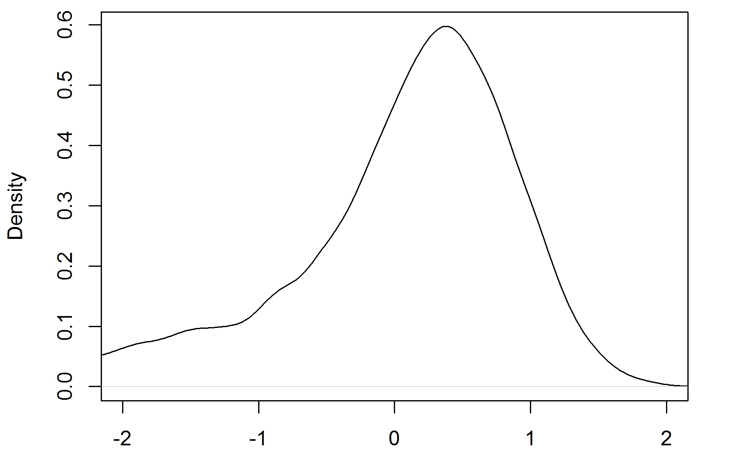
Cognitive Decline Residuals

Slide 16
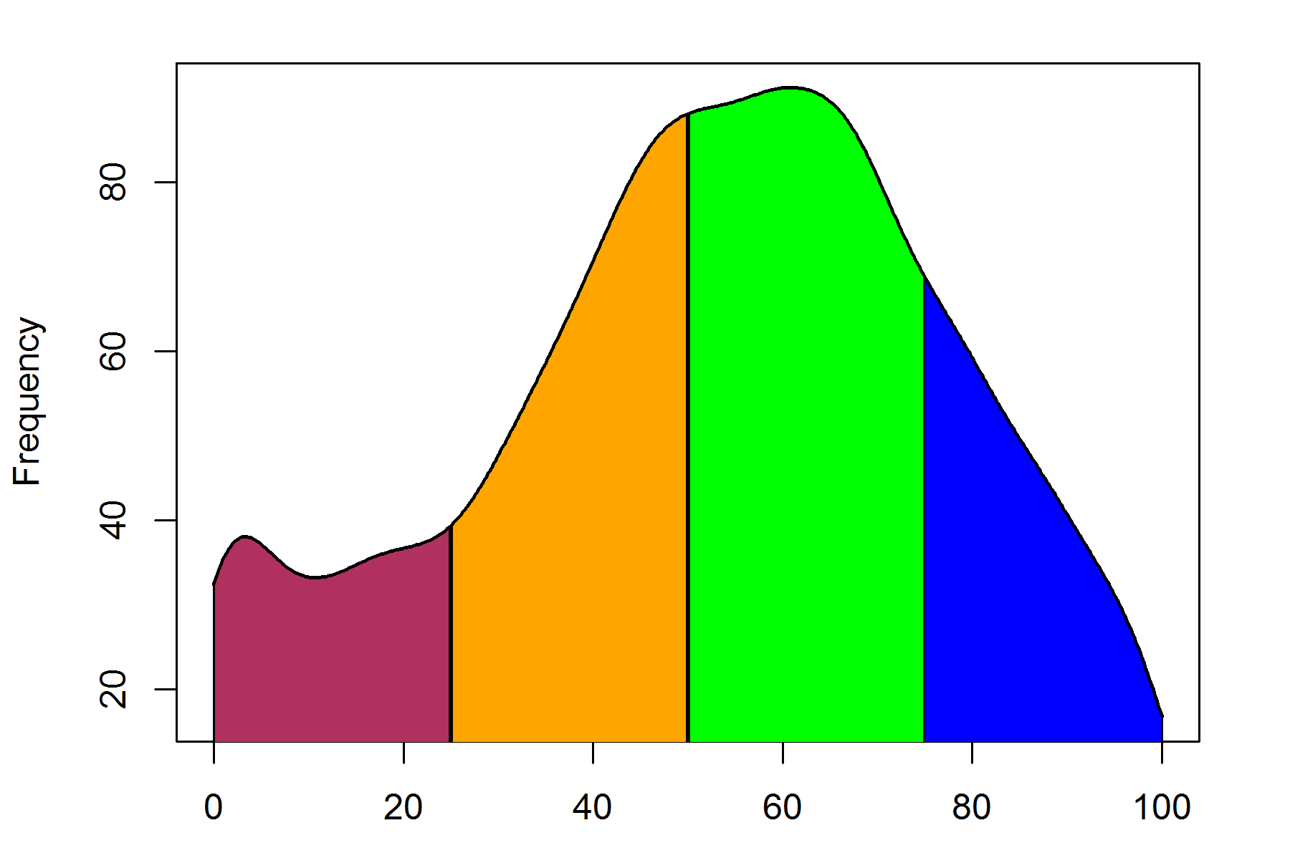
Normalized Cognitive Residuals

Slide 17
Global Cognition

Slide 18
Group Characteristics
 | Low | Medium | Moderate | High
 | N=1009 | N=1619 | N=2169 | N=1154
Age | 71.9 | 70.9 | 70.9 | 72.0
Education | 10.4 | 12.3 | 13.3 | 13.6
Global Cognition (GC) | -0.478 | 0.254 | 0.640 | 0.858
GC change | 0.081 | 0.038 | 0.036 | 0.028
Memory | -0.565 | 0.192 | 0.648 | 0.968
Speed score | -0.419 | 0.315 | 0.748 | 0.910
MMSE | -0.946 | 0.068 | 0.409 | 0.537
CES-D | 1.69 | 1.30 | 1.24 | 1.57
Physical Functioning | 10.3 | 11.4 | 11.4 | 10.2
ADL/IADL | 0.84 | 0.68 | 0.69 | 0.80
Females (%) | 54% | 57% | 66% | 75%
African Americans, % | 75% | 58% | 62% | 76%

Slide 19
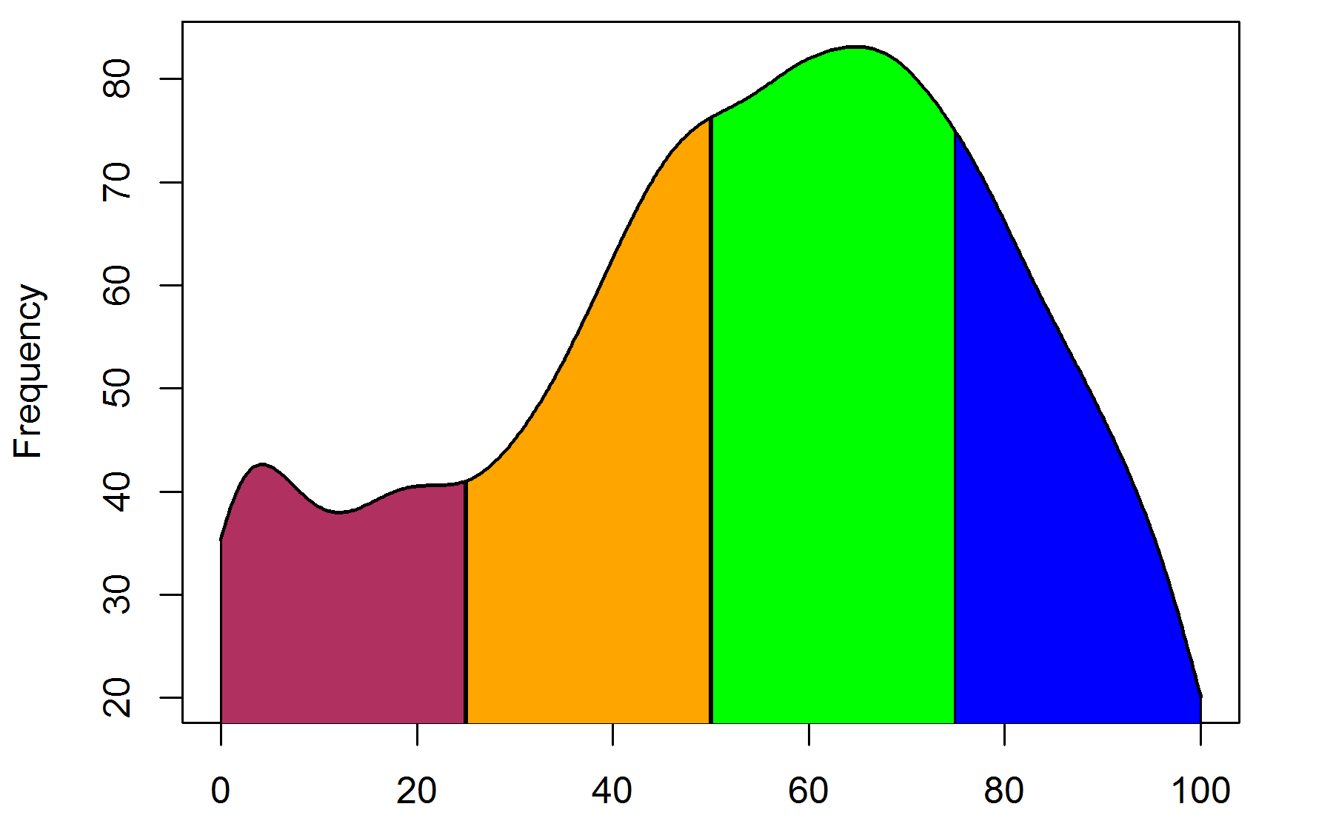
Cognitive Resilience in AAs

Slide 20
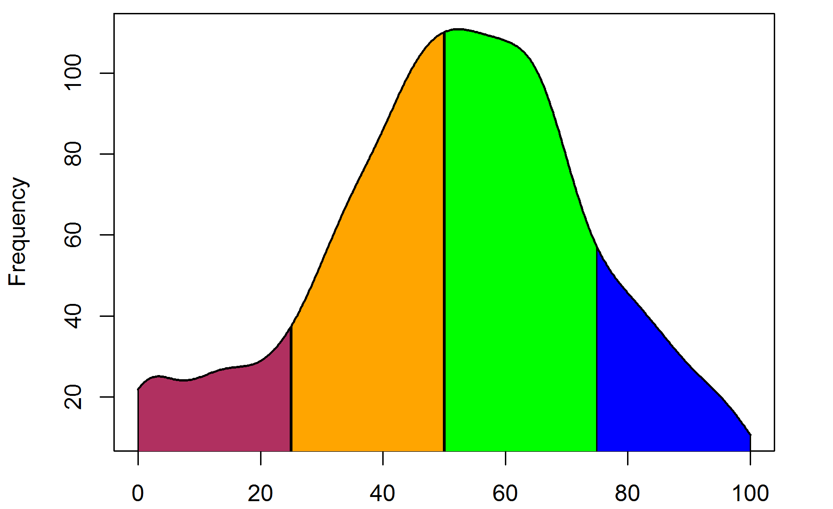
Cognitive Resilience in EAs

Slide 21
Summary
A cognitive resilience score derived using epidemiologic factors that ranges from 0 to 100
Better cognitive functioning and slower decline despite having similar epidemiologic risk factors
Can be derived in epidemiologic study prospectively without neuropathology measures
Comparison of cognitive resilience derived from epidemiologic factors with pathology from autopsy and MRI
Association of lifestyle, genetic, cardiovascular, and other risk factors with cognitive resilience measure
Understand factors that show higher resilience among African Americans
Notes:
Evidence for association of BP and cognition to change at specific values which may be modified by antihypertensive medications use and the APOE E4 allele.
We did not examine if the associations varied by specific classes of antihypertensive medications
Systolic BP may also change over time and we did not look at time-dependent association of systolic BP and cognitive decline
Overall our study shows that the association of systolic BP with cognitive may change at specific values modified by antihypertensive medications and the APOE E4 allele.

