Slide 1



ACTIVE Memory Training and Proximal Outcome Measures
Friday Harbor Conference
June 9-13, 2014
Presenter: George W. Rebok, PhD, MA
Supported By: U01 AG14260

Slide 2
ACTIVE Steering Committee
University of Alabama-Birmingham
Karlene Ball, PhD
Hebrew SeniorLife Boston
John Morris, PhD
Richard Jones, ScD
Indiana University
Fredrick Unverzagt, PhD
Johns Hopkins University
George Rebok, PhD
Pennsylvania State University
Sherry Willis, PhD
University of Florida/Wayne State University
Michael Marsiske, PhD
New England Research Institutes, Coordinating Center
Sharon Tennstedt, PhD
National Institute on Aging
Jonathan King, PhD
National Institute of Nursing Research
Susan Marden, PhD

Slide 3
Disclosure
Dr. Rebok is an Investigator with Compact Disc Incorporated for the development of an electronic version of the ACTIVE memory intervention.

Slide 4
Acknowledgements
Funded in part by Grant R13 AG030995 from the National Institute on Aging
The views expressed in written conference materials or publications and by speakers and moderators do not necessarily reflect the official policies of the Department of Health and Human Services; nor does mention by trade names, commercial practices, or organizations imply endorsement by the U.S. Government.

Slide 5
Overview
Background | Previous studies of memory training with older adults
2. Memory training | Description of the ACTIVE memory training protocol
3. Results | Overview of the results of the ACTIVE memory training
4. Conclusion | Implications for further analysis of the ACTIVE memory training data

Slide 7
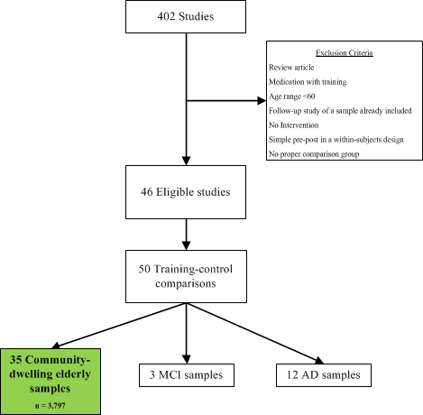
Study Selection

Slide 8
Study-Specific Effect Sizes

Slide 9
Overview
Background | Previous studies of memory training with older adults
2. Memory training | Description of the ACTIVE memory training protocol
3. Results | Overview of the results of the ACTIVE memory training
4. Conclusion | Implications for further analysis of the ACTIVE memory training data

Slide 10
Common Structural Features
Small-groups (3-5 participants per group)
Led by a certified trainer with a scripted manual
10 sessions over a 6-week period
60-75 minutes per session
Pre-specified order of sessions and rules for make-ups
80% adherence for successful completion

Slide 11
Shared Intervention Components
Focus on strategies for solving problems or responding quickly to information
Modeling and demonstration of strategy usage
Practice on exemplar problems
Individual and group exercises
Immediate feedback on performance

Slide 12
Shared Intervention Components
Fostering of self-efficacy
Application of strategies to real-world tasks
Provision of individualized training experiences
Activities focused on social interaction

Slide 13
ACTIVE Memory Training Aims
Improve cognitive processes involved in two types of episodic memory (verbal list learning and text recall)
Enhance mnemonic strategies relevant to both types of memory
Reduce anxiety and increase confidence in ability to deal with memory failures
Increase awareness of the importance of memory abilities in activities of daily life

Slide 14
ACTIVE Memory Training Techniques
Training involves instruction, guided practice, and immediate feedback in the use of memory techniques such as:
Grouping items into meaningful categories
Creating visual imagery and associations
Using hierarchical text organization
Using external aids and environmental modifications

Slide 15
ACTIVE Memory Training Techniques
Techniques are based on the M.O.V.A. principles of memory:
Meaningfulness
Organization
Visualization
Association
Remembering to Pay Attention

Slide 16
ACTIVE Memory Training Techniques
Begin with use of simple memory strategies (such as grouping) and move to more complex techniques (such as method of loci) , progressively fading out external/retrieval cues
Subjects get at least 3 individual and group practice exercises per session, involving both lab-type tasks (word lists) and real-world tasks (shopping lists)
Work with certified trainers in small groups of 3-5 with a manual, posters, and handouts.

Slide 17
Visualization
Seeing something in your ‘mind’s eye’
How many windows are in the house you grew up in?
  Picture yourself walking through a familiar place and noticing items
Describe the directions for completing a familiar task
  Recipe or cooking instructions
  VCR, remote control
  Computer: turning on and setting up

Slide 18
Association
Combining two objects in a meaningful way
Choose two unconnected words and form a visualization between them
  Strange associations are more powerful
    Penny & Banana: penny balancing on the tip of the banana…it falls off when you reach for it
  Motion in the association will make it easier to remember
    Sailboat & Tree: sailboat rocking in the breeze on a tree limb

Slide 19
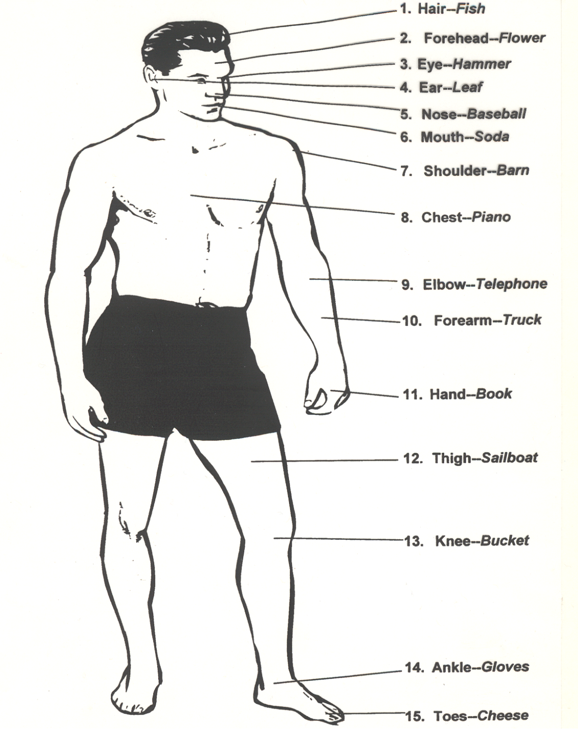
Memory Man

Slide 20
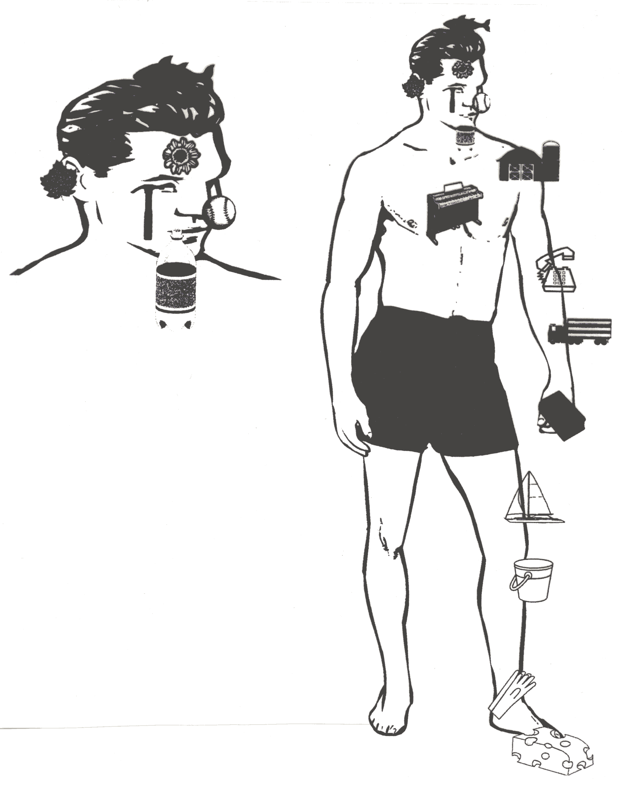
Memory Man

Slide 21
Do Older Adults Use Method of Loci?
Probability of Skipping Spaces on AVLT for Each Assessment by Training Status: Results from ACTIVE (N=1,401)
Legend. Time trend plots of the probability of skipping spaces on the AVLT in the memory trained (solid line) and control (dashed line) groups. The percentage of participants who skipped a space on an AVLT trial is shown on the ordinate. 95% confidence bands are shown for each group.
Source: Gross, A., et al (2014). Do older adults use the Method of Loci?: Results from the ACTIVE study. Experimental Aging Research, 40, 140-163.

Slide 22
Overview
Background | Previous studies of memory training with older adults
2. Memory training | Description of the ACTIVE memory training protocol
3. Results | Overview of the results of the ACTIVE memory training
4. Conclusion | Implications for further analysis of the ACTIVE memory training data

Slide 23
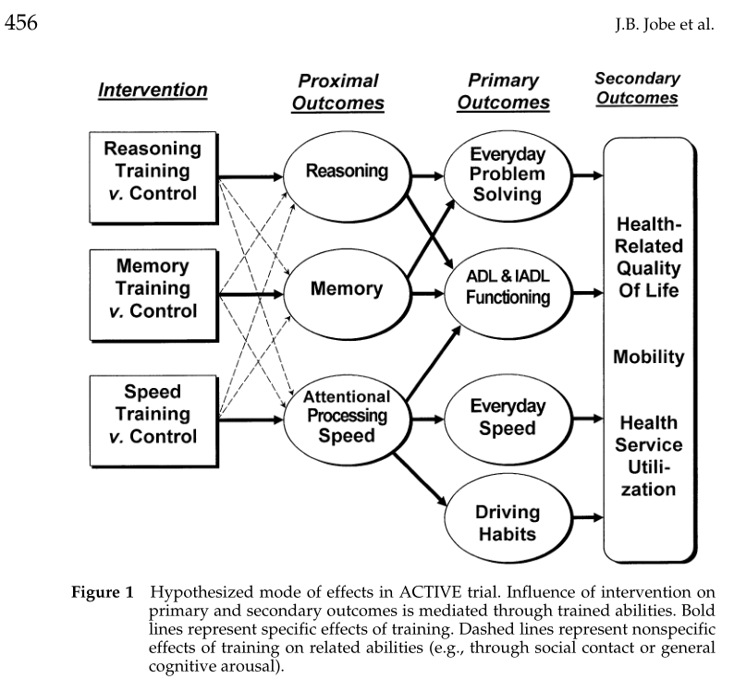
Why would ACTIVE impact Depression and Quality of Life Outcomes?
Jobe et al., Control. Clin. Trials 22, 453 (2001).

Slide 24
Cognitive Abilities
Reasoning
Word Series
Letter Series
Letter Sets
Speed of Processing
Useful Field of View
Memory
Auditory Verbal Learning Test
Hopkins Verbal Learning Test
Rivermead Paragraph Recall

Slide 25
Daily Function
Everyday Problem Solving
Observed Tasks of Daily Living
Everyday Problems Test
Everyday Speed
Complex Reaction Time
Timed IADL Test
IADL/ADL Functioning
Perceived IADL Performance
Perceived IADL Capacity
Perceived ADL Performance

Slide 26
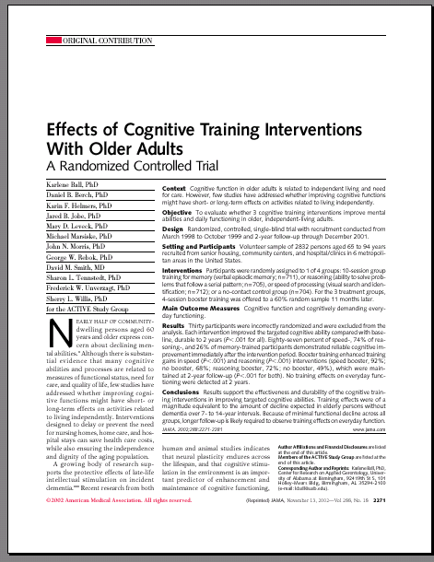
Training effects at 2 years

Slide 27
Initial Effect Sizes (JAMA 2002)
Expected Decline
Training Gains

Slide 28
Effect Sizes at 5 Years (JAMA 2006)

Slide 29
Self-Reported IADL at 5 Years

Slide 30
Effect on Cognitive & Functional Outcomes at 10 years
(JAGS 2014)
 | MEMORY (n=703) | REASONING (n=699) | SPEED OF PROCESSING (n=702) | CONTROL (n=698)
MEMORY (possible range: 0 to 132, N=943)
Effect size (99% CI)* | 0.06 (-0.14,0.27) | -0.11 (-0.31,0.10) | -0.05 (-0.25,0.15)
% at or above baseline level § | 35.9% | 28.6% | 31.0% | 31.0%
REASONING (possible range: 0 to 75, N=938)
Effect size (99% CI)* | -0.02 (-0.17,0.12) | 0.23 (0.09,0.38) | -0.06 (-0.20,0.08)
% at or above baseline level § | 60.0% | 73.6% (p<.01) | 59.3% | 61.7%
SPEED OF PROCESSING (possible range: 0 to 1500, N=883)
Effect size (99% CI)* | -0.07 (-0.29,0.16) | 0.005 (-0.22,0.23) | 0.66 (0.43,0.88)
% at or above baseline level § | 47.2% | 48.5% | 70.7% (p<.01) | 47.8%
IADL DIFFICULTY (possible range: 0 to 38**, N=1211)
Effect size (99% CI)* | 0.48 (0.12,0.84) | 0.38 (0.02,0.74) | 0.36 (0.01,0.72)
% at or above baseline level § | 61.6% (p<.01) | 60.2% (p<.01) | 58.5% (p<.05) | 49.3%
EVERYDAY PROBLEM SOLVING (possible range: 0 to 56, N=1104)
Effect size (99% CI)* | 0.004 (-0.23,0.24) | -0.02 (-0.25,0.22) | 0.008 (-0.23,0.24)
% at or above baseline level § | 59.6% | 63.1% | 61.0% | 61.4%
EVERYDAY SPEED OF PROCESSING (possible range: -3 to 100, N=938)
Effect size (99% CI)* | 0.02 (-0.19,0.23) | -0.004 (-0.21,0.21) | -0.05 (0.26,0.16)
% at or above baseline level § | 34.9% | 30.5% | 29.0% | 30.2%

Slide 31
Memory
10-year Trajectory of Memory, Separately by Training Group

Slide 32
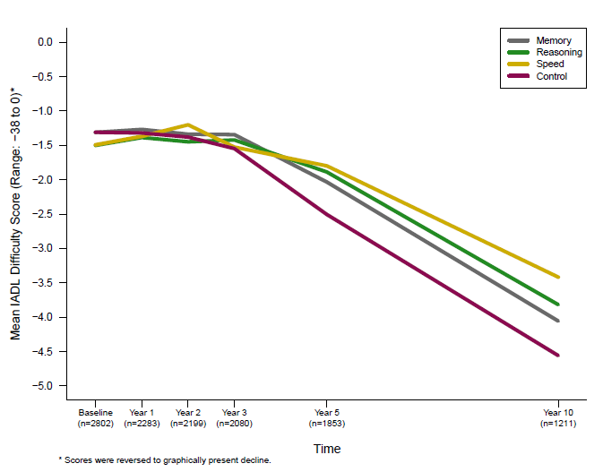
Self-Reported IADL Difficulty
10-year Trajectory of Self-Reported IADL Difficulty, Separately by Training Group

Slide 33
Who Benefits from Memory Training?
Journal of Aging and Health, 2013, 25, 21S-42S
Memory Training in the ACTIVE study: How Much is Needed and Who Benefits?
George W. Rebok, Jessica B.S. Langbaum, Richard N. Jones, Alden L. Gross, Jeanine M. Parisi, Adam P. Spira, Alexandra M. Kueider, Hanno Petras, and Jason Brandt

Slide 34
Definition of Training Adherence
Non-adherent A: completed <8 of 10 initial training sessions
Adherent A: completed >8 of 10 initial training sessions
Non-adherent B: completed <3 of 4 booster training sessions
Adherent B: completed >3 of 4 booster training sessions

Slide 35
LGM Model
Multiple Group Latent Growth Curve Model of Composite Memory Performance

Slide 36
Figure 3
Model-estimated Trajectories of Composite Memory Performance by Adherence: Results from ACTIVE (n = 629)

Slide 37
Summary and Conclusions
Main Findings
Adherence to initial memory training was associated with immediate training benefits
Memory training was associated with improved memory performance through year 5
Neither booster training nor training adherence significantly influenced this effect
Higher education and better self-rated health were associated with greater change in memory performance after training
Booster training and adherence to training do not appear to attenuate rates of normal age-related memory decline.

Slide 38
Modeling Learning and Memory
Journal of Gerontology: Psychological Sciences, 2013, 68, 153-167
Modeling Learning and Memory Using Verbal Learning Tests: Results from ACTIVE
Alden L. Gross, George W. Rebok, Jason Brandt, Doug Tommet, Michael Marsiske, and Richard N. Jones

Slide 39
SEM Diagram for a Second-Order LGM

Slide 40
LGM Results
Longitudinal Trajectories of AVLT Recall and Learning: Results from ACTIVE (n=1,401)
Dashed line: control group; solid red line: memory-trained group

Slide 41
Summary and Conclusions
Main Findings
Trial-level increases in words recalled on the AVLT and HVLT at each follow-up visit followed an approximately logarithmic shape
Memory training was associated with slower decline in Trial 1 AVLT recall over 5 years
Memory training was also associated with steep pre- and post-training acceleration in learning
Results reveal that memory training delays the worsening of memory span and boosts learning.

Slide 42
Memory for Short Stories
Journal of Aging and Health, 2013, 25, 230SD-248S
The Influence of Cognitive Training on Older Adults’ Recall for Short Stories
Shannon M. Sisco, Michael Marsiske, Alden L. Gross, & George W. Rebok

Slide 43
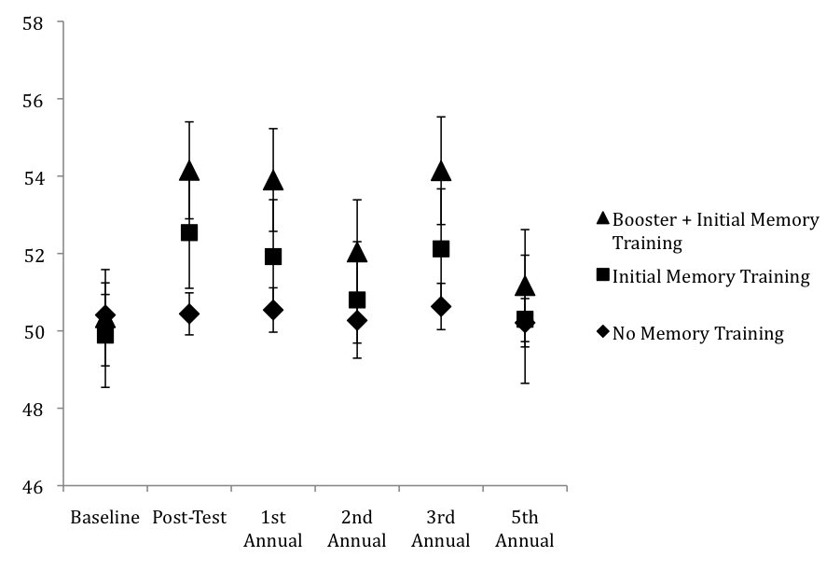
Memory Training Effects on Story Recall
Total Recall T-Scores by Training Group across Occasions

Slide 44
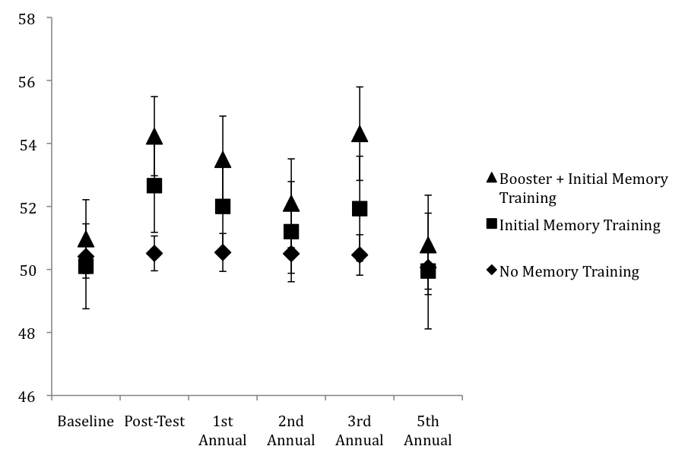
Memory Training Effects on Story Recall
Verbatim Recall T-Scores by Training Group across Occasions

Slide 45
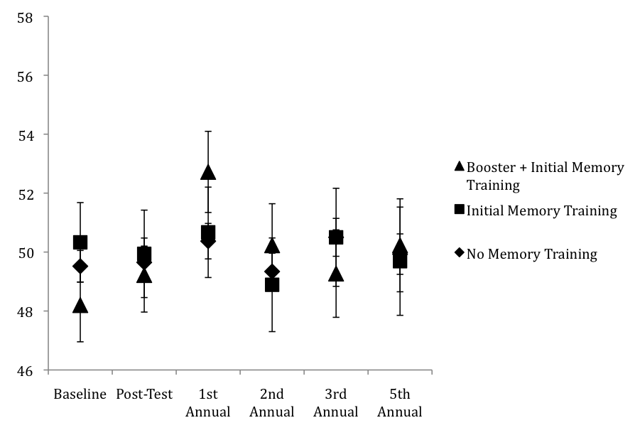
Memory Training Effects on Story Recall
Paraphrase Recall T-Scores by Training Group across Occasions

Slide 46
Summary and Conclusions
Memory-trained participants showed higher verbatim recall than non-memory-trained participants at immediate post-test
Booster-memory training led to higher verbatim recall at 1st and 3rd annual follow-ups
Memory training effects were evident immediately following training but not after 1 year following training
Results suggest that multifactorial memory training can improve verbatim recall for prose, but the effect does not last without continued intervention.

Slide 47
Memory Impairment Effects
Journal of the International Neurospychological Society, 2007, 13, 953-960
Effect of Memory Impairment on Training Outcomes in ACTIVE
F. Unverzagt, L. Kasten, K.E. Johnson, G.W. Rebok, M. Marsiske, K.M. Koepke, J.W. Elias, J.N. Morris, S.L. Willis, K. Ball, D.F. Rexroth, D.M. Smith, F.D. Wolinsky, & S.L. Tennstedt

Slide 48
Memory Processes
Cognitive interventions vary in the type of memory processes invoked
Memory System ACTIVE
Declarative
Procedural
Memory Training
Reasoning Training
Speed Training

Slide 49
MCI Subgroup Response to Training
Subgroups based on memory ability:
  Rey-AVLT
  T1+T2+T3+T4+T5 = Sum Recall
  Age, education, ethnicity, ETS Vocabulary regressed on baseline Sum Recall score
  Memory Impaired: actual Sum Recall 1.5 SD below predicted level
  Memory Normal: actual Sum Recall at or
  above -1.5 SD of predicted level

Slide 50
Responsiveness to Training
Memory and Reasoning training are mediated by declarative memory systems
Hypothesis: S’s with impaired declarative memory will have smaller training gains on Memory and Reasoning than non-memory impaired subjects
Speed training is mediated by procedural memory systems
Hypothesis: S’s with impaired declarative memory will not differ from non-memory impaired subjects on Speed training gains

Slide 51
Normal Impaired
Memory Impairment Impact on Cognitive Training
Inteven | Time | Memory | Reasoning | Speed
Memory | PT | -.012 | -.117 | 0.105
 | A1 | -.175 | -.163 | 0.107
 | A2 | -.100 | -.015 | 0.400*
Reason | PT | -.048 | .573*** | -0.277
 | A1 | -.230 | .208 | -0.155
 | A2 | -.331 | .276* | -0.434*
Speed | PT | -.108 | -.111 | -1.420***
 | A1 | -.163 | -.097 | -1.100***
 | A2 | -.298 | .079 | -0.755***
Interven | Time | Memory | Reasoning | Speed
Memory | PT | .300*** | -.009 | -0.050
 | A1 | .254*** | .033 | -0.061
 | A2 | .214*** | .052 | -0.057
Reason | PT | .001 | .477*** | 0.025
 | A1 | .013 | .416*** | -0.026
 | A2 | -.003 | .262*** | -0.021
Speed | PT | .004 | -.017 | -1.488***
 | A1 | .004 | .009 | -1.238***
 | A2 | -.024 | -.013 | -0.886***
(Unverzagt et al., 2007, JINS)

Slide 52
Overview
Background | Previous studies of memory training with older adults
2. Memory training | Description of the ACTIVE memory training protocol
3. Results | Overview of the results of the ACTIVE memory training
4. Conclusion | Implications for further analysis of the ACTIVE memory training data

Slide 53
Summary and Conclusions
Main Findings
Memory training effects were maintained up to 5 years but were no longer significant at 10 years
Booster training did not produce additional and durable improvement for the memory intervention for memory performance
Participants in the memory training group reported less IADL difficulty at 10 years
Training effects were found for both word list-recall and story memory
Memory impairment at baseline attenuates memory training effects on memory performance

Slide 54
Summary and Conclusions
Implications
Results provide support for the development of other interventions, particularly those that target multiple memory and cognitive abilities
Such interventions hold potential to delay onset of functional decline and possibly dementia
Even small delays in the onset of functional impairment may have a major public health impact

Slide 55
Challenges
Challenges in Analyzing and Interpreting the ACTIVE Memory Training Data
Non-equivalence of alternate forms of the memory tests (see Gross et al., 2012)
Non-standard administration of the memory tests
Differences in Replicate 1 vs Replicates 2-6 administration of word list-recall tests
No delayed recall data available
No formal diagnostic assessment of AD

Slide 56
ACTIVE Memory Works Study
Proposal responds to PA-11-124 Translational Research to Help Older Adults Maintain Their Health and Independence in the Community (R21)
Seeks to test a web-based version of the ACTIVE memory training intervention for use by community organizations to promote memory health and fitness among the elderly.
Study will field test an online program called ACTIVE Memory Works (AMW) to help older adult users increase and monitor changes in memory and cognition and assess their effects on daily functional activities.

Slide 57
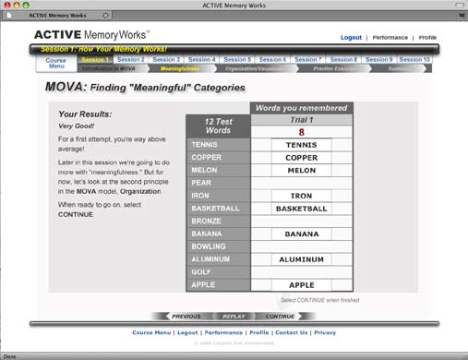
User Performance-Specific Feedback

Slide 58
References: Main Outcomes
¹ Ball K, Berch DB, Helmers KF, Jobe JB, Leveck MD, Marsiske M, Morris JN, Rebok GW, Smith DM, Tennstedt SL, Unverzagt FW, Willis SL. Effects of cognitive training interventions with older adults: A randomized controlled trial. JAMA, 2002; 288(18):2271-81.
² Rebok GW, Ball K, Guey LT, Jones RN, Kim H-Y, King JW, Marsiske M, Morris JN, Tennstedt SL, Unverzagt FW, Willis SL. Ten-year effects of the ACTIVE cognitive training trial on cognition and everyday functioning in older adults. Journal of the American Geriatrics Society, 2014; Jan 13 [Epub ahead of print].
³Willis SL, Tennstedt SL, Marsiske M, Ball K, Elias J, Mann Koepke K, Morris JN, Rebok GW, Unverzagt FW, Stoddard AM, Wright E. Long-term effects of cognitive training on everyday functional outcomes in older adults. JAMA, 2006; 296(23):2805-14.

Slide 59
References: Memory Training Outcomes
⁴Cahn-Weiner DA, Malloy PF, Rebok GW, Ott BR. Results of a randomized placebo-controlled study of memory training for mildly impaired Alzheimer’s disease patients. Applied Neuropsychology, 2003; 10:215-23.
⁵Gross AL, Brandt J, Bandeen-Roche K, Carlson MC, Stuart EA, Marsiske M, Rebok GW. Do older adults use the Method of Loci? Results from the ACTIVE study. Experimental Aging Research, 2014; 40:140-63.
⁶Gross AL, Parisi JM, Spira AP, Kueider AM, Ko JY, Saczynski JS, Samus QM, Rebok GW. Memory training interventions for older adults: A meta-analysis. Aging and Mental Health, 2012; 16:722-34.

Slide 60
References: Memory Training Outcomes
⁷Gross AL, Rebok GW. Memory training and strategy use in older adults: Results from the ACTIVE study. Psychology and Aging, 2011; 26:503-17.
⁸Gross AL, Rebok GW, Brandt J, Tommet D, Marsiske M, Jones RN. Modeling learning and memory using verbal learning tests: Results from ACTIVE. Journal of Gerontology: Psychological Sciences, 2013; 68:153-67.
⁹Gross AL, Rebok GW, Unverzagt FW, Willis SL, Brandt J. Cognitive predictors of everyday functioning in older adults: Results from the ACTIVE cognitive intervention trial. Journal of Gerontology: Psychological Sciences, 2011; 66:557-66.

Slide 61
References: Memory Training Outcomes
¹⁰Gross AL, Rebok GW, Unverzagt FW, Willis SL, Brandt J. Word list memory predicts everyday function and problem-solving in the elderly: Results from the ACTIVE cognitive intervention trial. Aging, Neuropsychology, and Cognition, 2011; 18:129-46.
¹¹Jones R, Marsiske M, Ball K, Rebok G, Willis SL. The ACTIVE cognitive training interventions and trajectories of performance among older adults. Journal of Aging and Health, 2013; 25:186S-08S.
¹²Jones RN, Rosenberg AL, Morris JN, Allaire JC, McCoy KJM, Marsiske M, Kleinman KP, Rebok GW, Malloy PF. A growth curve model of learning acquisition among cognitively normal older adults. Experimental Aging Research, 2005; 31:291-12.

Slide 62
References: Memory Training Outcomes
¹³Langbaum JB, Rebok GW, Bandeen-Roche K, Carlson MC. Predicting memory training response patterns: Results from ACTIVE. Journal of Gerontology: Psychological Sciences, 2009; 64:14-23.
¹⁴Lohman M, Rebok GW, Spira AP, Parisi JM, Gross AL, Kueider AM. Depressive symptoms and memory performance among older adults: Results from the ACTIVE memory training intervention. Journal of Aging and Health, 2013; 25:209S- 29S.
¹⁵Payne BR, Gross AL, Parisi JM, Sisco S, Stine-Morrow EAL, Marsiske M, Rebok GW. Modeling longitudinal changes in older adults’ memory for spoken discourse: Findings from the ACTIVE cohort. Memory, 2013; Dec 4 [Epub ahead of print].

Slide 63
References: Memory Training Outcomes
¹⁶Parisi JM, Gross AL, Rebok GW, Saczynski JS, Crowe M, Cook SE, Langbaum JBS, Sartori A, Unverzagt FW. Modeling change in memory performance and memory perceptions: Findings from the ACTIVE study. Psychology and Aging, 2011; 26:518- 24.
¹⁷Rebok GW, Carlson MC, Langbaum JBS. Training and maintaining memory abilities in healthy older adults: Traditional and novel approaches. Journal of Gerontology: Psychological Sciences, 2007; Spec No.1:53-61.
¹⁸Rebok GW, Langbaum JBS, Jones RN, Gross AL, Parisi JN, Spira AP, Kueider AM, Petras H, Brandt J. Memory training in the ACTIVE study: How much is needed and who benefits? Journal of Aging and Health, 2013; 25:21S-42S.

Slide 64
References: Memory Training Outcomes
¹⁹Sisco SM, Marsiske M, Gross AL, Rebok GW. The influence of cognitive training on older adults’ recall for short stories. Journal of Aging and Health, 2013; 25:230S-48S.
²⁰Unverzagt FW, Guey LT, Jones RN, Marsiske M, King J, Wadley V, Crowe M, Rebok GW, Tennstedt SL. ACTIVE cognitive training and rates of incident dementia. Journal of the International Neuropsychological Society, 2012; 18, 669-77.
²¹Unverzagt F, Kasten L, Johnson KE, Rebok GW, Marsiske M, Koepke KM, Elias JW, Morris JN, Willis SL, Ball K, Rexroth DF, Smith DM, Wolinsky FD, Tennstedt SL. Effect of memory impairment on training outcomes in ACTIVE. Journal of the International Neuropsychological Society, 2007; 13:953-60.

Slide 65
Contact:
George W. Rebok, PhD, MA
grebok1@jhu.edu

