Slide 1
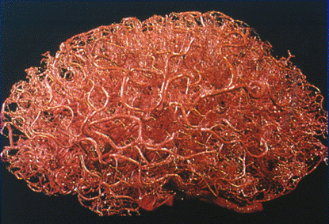
What’s this?

Slide 2
Memory Health and Aging Study &
Autopsy Brain Donation Program
Friday Harbor Advanced Psychometrics Methods Workshop, 2012
Heather Romero
Notes:
H. Romero, neuropsychologist, difference b/t studies

Slide 3
Disclosures
The views expressed in written conference materials or publications and by speakers and moderators do not necessarily reflect the official policies of the Department of Health and Human Services; nor does mention by trade names, commercial practices, or organizations imply endorsement by the U.S. Government.

Slide 4

Acknowledgements
This study was supported by the National Institute on Aging (NIA) for the Joseph and Kathleen Bryan Alzheimer’s Disease Core Center (P30AG028377)
NIA grant: P30AG028377-04S1, Research Supplement to Promote Diversity in Health-Related Research (Dr. Romero)
National Alzheimer’s Coordinating Center (NACC) Jr Investigator Award (Dr. Romero)
Large and small private gifts from families and supporters,
the Alzheimer’s Association, and collaborations with
pharmaceutical companies in Durham/Raleigh

Slide 5
Outline
Background
Genetic studies at Duke with IGSP & ADCs
  GWAS (Goldstein et al)
  GWAS- ADCs (Schellenberg)
  Genetics of Successful Aging (Oregon & ADCs)
  Gene Splicing (Erin Heinzen)
  Ellison Successful Aging project (Chiba-Falek, PI)
  PD-AD onset (Chiba-Falek PI)
  Functional Expression (Greg Wray)
  Endophenotypes of AD (Kathleen Hayden)
Biomarkers: Behavioral Neuroscience
  fMRI in MCI (BRAIN: Dr. Browndyke & Tupler)
  fMRI collaborative studies (Lihong Wang- Beeson; K award Giovanello at UNC; Scott Hayes at Duke)
  Metabolomics (Rima Kaddurah-Daouk & Murali Doraiswamy)
prAD study
EXIT study
Notes:
Most publications from data are either the contribution to NACC or to GWAS studies (genetic studies) with Duke and other collaborators, a few get funneled to MRI studies. ADRC data is only recently in good shape to analyze for longitudinal data analysis.

Slide 6
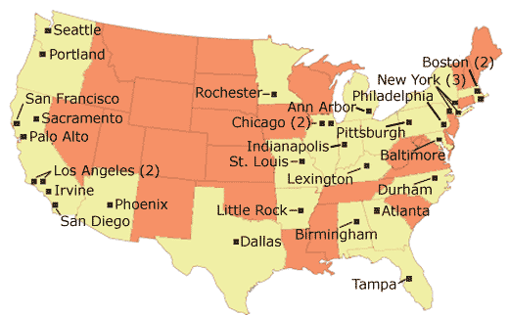
History
Established in 1985, the Bryan ADRC is one of the 32 national Alzheimer's Disease Centers (ADC) funded by the National Institute on Aging (NIA).
Goals:
  Improve the diagnosis, care, and treatment for AD patients
  Translate genetic and other basic science discoveries into practical treatments and disease prevention.
  Examine factors influencing early transitions in disease (normal-prodAD-full disease)

Slide 7



Bryan ADRC team, Administrative Core
Administrative Core
  Kathleen Welsh-Bohmer, PhD, ABCN (director)
  James R. Burke, MD, PhD (associate director)
  Brenda Plassman, PhD
  Roberta Demery (administrative assistant)
Notes:
Also PI

Slide 8
Bryan ADRC team, Clinical Core
The major aims of the Bryan ADRC's Clinical Core are to accurately phenotype ("characterize"), obtain biological specimens, and longitudinally evaluate individuals with mild neurocognitive disorders facilitating the research efforts of the Bryan ADRC.
The Clinical Core’s goals are:
Growth and maintenance of a well characterized data repository of individuals with memory complaints and dementia (+2500) for inclusion in genetic studies and referral into clinical trials and other funded investigations in the Bryan ADRC. (aka Tier I)
Fostering an elaborate established database comprised of individuals with mild neurocognitive syndromes (+500) for detailed genomic medicine studies. (aka Tier II)
mixed clinical and community sample
Share all data with NACC – Uniform Data Set
Actively encourage and facilitate collaborative studies which draw from the Clinical Core resources of biologic and clinical data.
Continue our successful enrollment and follow-up of research participants into the autopsy program, and increase minority enrollment into our research program through our strengthened focus on recruitment. (all autopsy participants are part of Tier II)
Engage in collaborative therapeutic clinical trials related to AD and other dementias with other Alzheimer’s Disease Centers and private industry.
Notes:
UDS + local variables

Slide 9





Bryan ADRC team, Clinical Core
James R. Burke, M.D., Ph.D. (director / neurologist)
Heather Romero, PhD (neuropsychologist)
Pete Gaskell, PA-C (clinical assessor)
Michelle McCart (regulatory/IRB head)
Charles “Chip” Loughlin (psychometrist)
Ron Nelson (psychometrist)
Mari Szymanski, R.N. (autopsy program director)
Clinical Fellows & Interns

Slide 10




Bryan ADRC team
Bioinformatics Core; Neuropathology Core
Bioinformatics
statistical support (programming, analysis and design)
database management
Carl Pieper, Ph.D. (director / statistician)
Ornit Chiba-Falek, Ph.D. (research geneticist)
Kathleen Hayden, Ph.D. (psychiatric epidemiologist)
Lawrence R. Whitley (IT)
Heather MacDonald (IT)
Neuropathology Core
Diagnostic and tissue banking functions and has successfully developed standardized protocols for tissue processing, analysis, and diagnosis.
John F. Ervin (laboratory director)
Mari Szymanski, R.N. (autopsy program director)
Notes:
Item-level entered – major strent=gth of the data

Slide 11


Bryan ADRC team; Education Core
A major component of the Bryan ADRC Education Core, the African-American Community Outreach Program (AACOP), was established in 1995 with its network community partners and 20 geographically dispersed African-American community leaders. Addresses dementia-related caregiver education, research, and community needs among African-Americans residing in North Carolina.
Lisa Gwyther, M.S.W. (core director)
Rev. Henry Edmonds (African-American outreach director)
Cheryl Copeland (outreach coordinator)
Notes:
Key role in boosting recruitment of AA participants

Slide 12
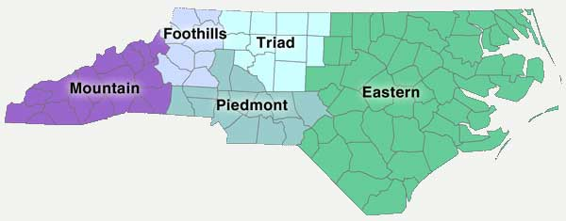
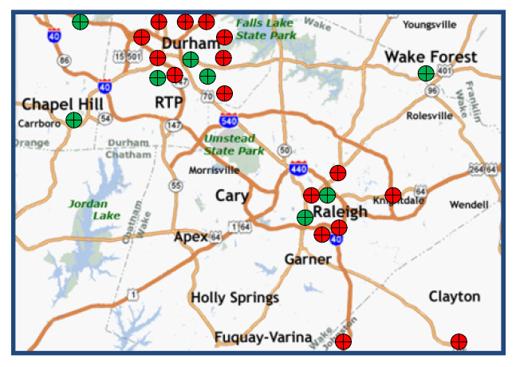

African American Community Outreach Program (AACOP)
The research of the Bryan ADRC reflects the population of North Carolina. Tier II: AA 20% of sample
Other ADRC projects: AA 50%
Eastern & Western North Carolina Chapters of the Alzheimer’s Association
AACOP Recruitment Events in the Triangle Area
Jacksonville
Western North Carolina Chapter, Charlotte, NC | Eastern Carolina Chapter, Raleigh, NC
Serving: Triad, Piedmont, Foothills, and Mountains areas | Serving: Chatham, Durham, Johnston, Lee, Orange, and Wake Counties and 44 other counties from the Triangle to the coast

Slide 13
Design of Tier II study
Baseline 1yr 2yr 3yr 4yr 5yr
White 462 W 359 W 290 W 195W 118W 38W
Black 118B 94B 65B 36B 5B 0B
Total 580 453 355 231 123 38

Slide 14
Design of Tier II study, protocol
Demographic information
Medical history
Medication
Family history
Selected environmental exposures
Examination findings
Neuropsychologic test results
Diagnosis
DNA bank
Approximately 40% autopsy rate

Slide 15
Design of Tier II study, Cognitive variables
Memory: WMS-R Logical memory, CERAD word lists (total learning, delayed, recognition), Benton Visual Retention Test, Constructional Praxis (delayed recall and recognition)
Executive Function: Trails B, Digit Symbol Substitution Speed, EXIT25, Ascending digits
Language: Animal fluency, Lexical fluency (MAE controlled oral word association - letters CFL), UDS Vegetable fluency, Boston Naming-30 item
Visual/Spatial: Constructional Praxis copy
Global: MMSE
Attention/Speed: Trails A, digits forward
Crystallized ability / Pre-morbid IQ: Shipley Vocabulary

Slide 16
Design of Tier II study, Other variables
ADL: Blessed DRS items - Personal Care, Feeding
IADL: Functional Activities Questionnaire (FAQ), Blessed Dementia Rating Scale, and CDR
Physical function: UDS form B1 collected, e.g. vitals, vision, hearing
Comorbid Diseases (other than vascular): UDS (Form A5) health history collected, for example, vascular risk conditions, CVD, neurological disorders, substance use, psychiatric disorders, and UPDRS

Slide 17
Detection of Prodromal Alzheimer’s Disease in Diverse Populations
Heather R Romero, PhD • Carl Pieper, DrPH• Linda Sanders • Kathleen M. Hayden, PhD • Kathleen A Welsh-Bohmer, PhD • International Conference on Alzheimer’s Disease (2010)
BACKGROUND
Previous research in our population-based work has described criteria for the prodromal stage of Alzheimer’s disease expression (prAD) which has good diagnostic stability and predictive value for incident dementia three years later.
The prAD criteria require demonstration of memory impairment and/or evidence of impairment in instrumental activities of daily living (IADLs).
OBJECTIVES
The current investigation examined the criteria for prAD in a more diverse sample of African Americans (AfAms) and Caucasians, and tested the utility of a revised prAD diagnosis in identifying cases that converted to AD over a 3-year follow-up period.
METHODS
Participants: (n=300) cognitively normal, not demented at baseline
Participants were 18% AfAm, mean age = 75
Diagnoses were algorithmically applied retrospectively, based on the following CRITERIA:
prAD: Memory AND/OR functional impairment
prAD-r: Memory AND either functional or executive impairment
fMCI: Functional impairment (e.g. CDR=0.5)
Accuracy in identifying incident AD (based on consensus dx), was calculated by: sensitivity, specificitypositive and negative predictive values (PPV, NPV) over 3 years, also: reversion to normal cognition,
Demographic Characteristics | fMCI N=159 | prAD N=176 | prAD –r N=28 | Full sample N=300
Age, mean (SD) | 76.7 (8.5) | 76.4 (8.5) | 76.1(6.9) | 75.1 (8.8)
Female (%) | 57% | 57% | 62% | 60.4%
Education, mean (SD) | 15.9 (2.5) | 15.8 (2.5) | 15.3(2.6) | 15.7 (2.5)
Ethnicity
Caucasian | 80.7% | 79% | 71.4% | 81.3%
African American | 18.7% | 20.4% | 25% | 18.3%
Notes:
MCI = prAD, categories were not exclusive

Slide 18
Detection of Prodromal Alzheimer’s Disease in Diverse Populations
Heather R Romero, PhD • Carl Pieper, DrPH• Linda Sanders • Kathleen M. Hayden, PhD • Kathleen A Welsh-Bohmer, PhD • International Conference on Alzheimer’s Disease (2010)
RESULTS
At baseline, approximately ½ of the participants met criteria for prAD and fMCI, while only 9% met criteria for revised prAD.
The reversion rate to cognitively normal status in each impaired group was low (10-16%), but was substantially higher in AfAms (30%).
Prediction of later dementia at 1 year was highest for the revised prAD criteria (ppv=0.32) compared to fMCI (ppv=.09) and the original formulation of prAD (ppv= 0.08).
NPVs were consistently high across all diagnostic entities (.96 - 1.0).

Slide 19
Detection of Prodromal Alzheimer’s Disease in Diverse Populations
Heather R Romero, PhD • Carl Pieper, DrPH• Linda Sanders • Kathleen M. Hayden, PhD • Kathleen A Welsh-Bohmer, PhD • International Conference on Alzheimer’s Disease (2010)
CONCLUSIONS
Diagnosing early AD in its prodromal stage across diverse groups is facilitated by clinical criteria which require objective evidence of both memory disorder and either executive dysfunction or functional decline.
However, there is a higher degree of variability in AfAms using this approach,
Notes:
(Adjust for race somehow, or…psychometrics) Demographic correction, adjust for ethnicity in the analysis, or, even better, applying modern psychometric methods – more to be unpacked here

Slide 20
EXIT25 study (in progress)
Objective: to identify whether baseline performance on the Executive Interview (EXIT), a brief neurobehavioral exam that measures executive control, differentiated individuals with incident MCI from those who maintain normal cognition over a short follow-up interval.
Notes:
Diff between Exit and other exec tasks

Slide 21
EXIT25 study (in progress)
Definition of vascular risk conditions
Cardiovascular disease: history of one or more of the following conditions: cardiac arrest/heart attack, atrial fibrillation, angioplasty/endarterectomy/stent, cardiac bypass procedure, pacemaker, congestive heart failure, or other cardiovascular condition.
Cerebrovascular disease: history of one or more conditions including stroke, transient ischemic attack, or other cerebrovascular disease.
Metabolic disorders: history of one or more of the following conditions: hypertension, hypercholesterole:mia, diabetes, B12 deficiency, thyroid disease, or incontinence.

Slide 22
EXIT25 study
Two-sided t-Approximation for the Wilcoxon Rank Sum test was used to determine association between baseline EXIT interview and later outcomes.
Results: The Incident MCI group (n = 15) had lower EXIT total scores at baseline compared to the Stable group (n = 234) that maintained normal cognition.
When the EXIT interview was examined by subcategories (cognitive flexibility, inhibitory control, language control, motor control, and frontal release plus utilization behaviors), the Incident MCI group had particularly low scores on measures of cognitive flexibility compared to the Stable group, Z = 2.87, p < 0.01.
An analysis of vascular co-morbidity indicated a higher prevalence of cardiovascular disease in the incident MCI group.

Slide 23
EXIT25 study

Slide 24
EXIT25 study
Executive control, and measures of cognitive flexibility in particular, may be sensitive in detecting pre-symptomatic cognitive change among individuals who develop mild cognitive impairment. Further, the EXIT interview is a clinically useful tool in determining executive dysfunction

Slide 25
Questions???

Slide 26
NACC
  African American and Latino AD Patients have longer survival than white AD patients
Mehta, KM, Yaffe, K, Perez-Stable, EJ, Stewart, A, Barnes, D, Kurland, BF and Miller, BL. Race/ethnic differences in AD survival in US Alzheimer's Disease Centers. Neurology, 70:1163-1170, 2008, PMC2830859.
Ontaneda, D. Race/ethnic differences in AD survival in us Alzheimer's disease centers. Neurology, 72:1620, 2009.
Others
Sayegh, P. The Functional Assessment Questionnaire: Measurement Properties in Hispanics and Non-Hispanic Whites. GSA meeting 2012,submitted 2012. (Abstract)
Sayegh P, Knight BG. Differences in dementia diagnosis predictors in Hispanics and non-Hispanic Whites. Alzheimers and Dementia,submitted 2012.
Sayegh, P. Assessing the Cross-Cultural Measurement Properties of the Neuropsychiatric Inventory Questionnaire. GSA meeting 2012,submitted 2012. (Abstract)

