Slide 1
Processing Speed Training: Does it work? Lesley A. Ross, PhD Center for Healthy Aging Department of Human Development and Family Studies College of Health and Human Development The Pennsylvania State University
Conflict of Interest: None

Slide 2
Acknowledgements
Funded in part by Grant R13 AG030995 from the National Institute on Aging
The views expressed in written conference materials or publications and by speakers and moderators do not necessarily reflect the official policies of the Department of Health and Human Services; nor does mention by trade names, commercial practices, or organizations imply endorsement by the U.S. Government.

Slide 3
Acknowledgements
Funded in part by Grant R13 AG030995 from the National Institute on Aging
The views expressed in written conference materials or publications and by speakers and moderators do not necessarily reflect the official policies of the Department of Health and Human Services; nor does mention by trade names, commercial practices, or organizations imply endorsement by the U.S. Government.

Slide 4
Theory
Processing speed is the ability to accurately perceive and interpret a range of complex sensory information
Schaie, 2004

Slide 5
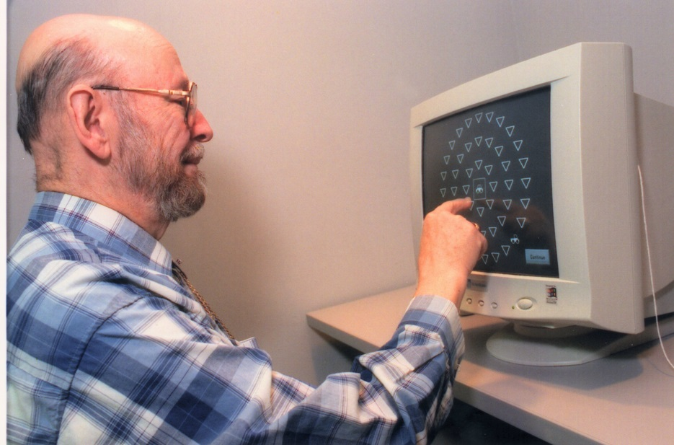
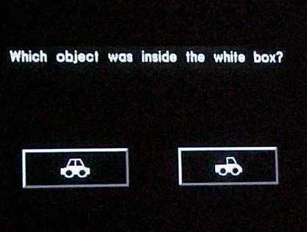
Welcome to UFOV® Test 1
This exercise will measure how fast you can identify a single object.

Slide 6
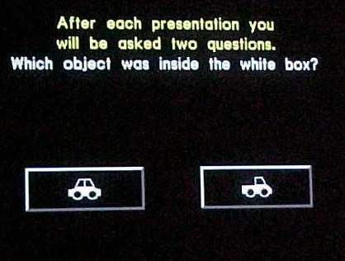
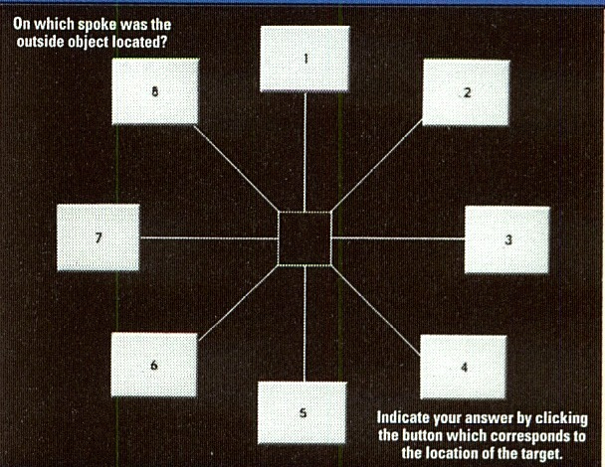
Welcome to UFOV® Test 2
This exercise will measure how fast you can divide your attention between two objects.

Slide 7
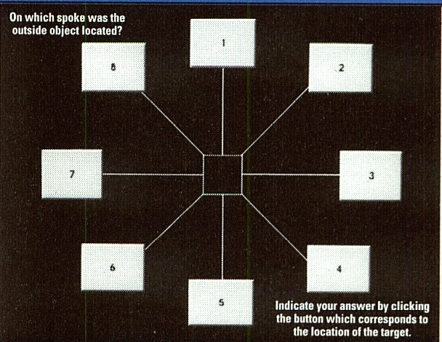
Welcome to UFOV® Test 3
This exercise will measure how fast you can divide your attention between two objects when the outside object is
surrounded by clutter.

Slide 8
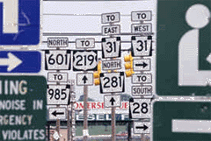

Slide 9
What is Speed of Processing Training?
Trainer-guided practice of computer-based nonverbal exercises involving target detection, identification, discrimination and localization
Modifiable exercises that are customized to the individual’s level and current needs
Can be conducted in groups of three or individually
Usually done in 10 sessions across 5 weeks
Effective regardless of education level, race, or gender
Strongest effects in ‘at-risk’ individuals

Slide 10
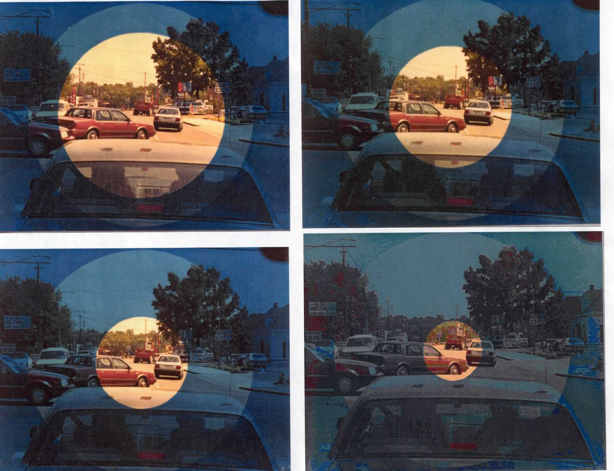

Slide 11
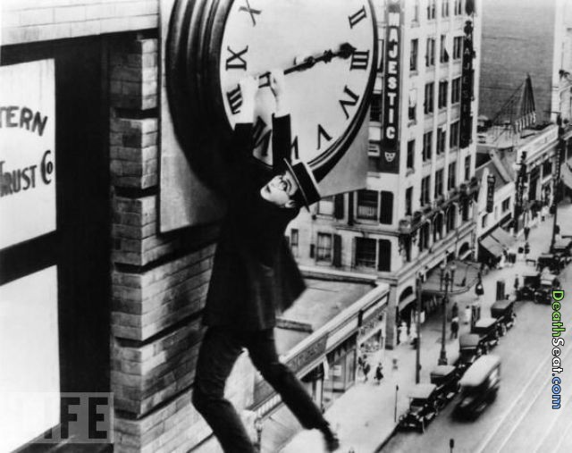
The Center for Healthy Aging
Fighting the clock?
The Department of Human Development and Family Studies

Slide 12
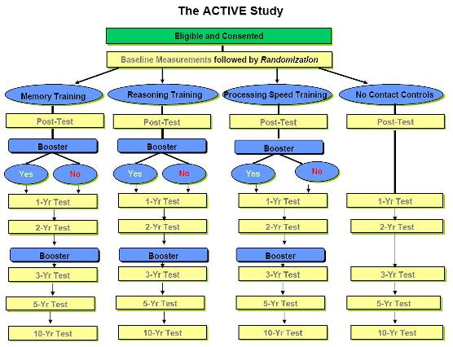
The Center for Healthy Aging
The Department of Human Development and Family Studies
Notes:
Posttest: Near transfer for all training arm (87% speed, 74% reasoning & 26% memory)
Two Year Posttest: maintained
Booster: Near transfer increased for speed and reasoning training.

Slide 13
The Center for Healthy Aging
Near Transfer?
Five year Post-Test: (Willis et al, 2006; Ball et al., 2013)
Each intervention demonstrated near transfer to cognitive domains trained (Memory= 0.23, Reasoning=0.26, Speed=0.76)
Booster increased effect size for Reasoning (0.28) and Speed (0.85)
Ten year Post-Test: (Rebok et al, 2014)
Reasoning (0.23) and Speed (0.66) training maintained near transfer
Booster increased effect size for Reasoning (0.21) and Speed (0.62)
The Department of Human Development and Family Studies

Slide 14
The Center for Healthy Aging
Far or Everyday Transfer?
Reasoning:
Less reported difficulty with everyday activities (IADLs) at 5 years and 10 years (Willis et al, 2006; Rebok et al., 2014)
Speed:
Booster trained demonstrated better performance on IADLs (Willis et al, 2006)
Less reported difficulty with IADLs at 10 years (Rebok et al., 2014)
Memory:
Less reported difficulty with IADLs at 10 years (Rebok et al., 2014)
Reasoning (0.23) and speed (0.66) training maintained near transfer
Booster increased effect size for reasoning (0.21) and speed (0.62)
The Department of Human Development and Family Studies

Slide 15
The Center for Healthy Aging
Far or Everyday Transfer?
Improvements in internal locus of control at 5 years:
Reasoning and Speed training (Wolinsky et al., 2009)
Health:
Protective effects for self-rated health in years 2, 3 and 5 for Speed training (Wolinksy et al, 2010)
Reduced health expenditures (Wolinksy et al, 2009)
Depression:
Reduced depressive symptoms and risk of clinical depression for Speed training (Wolinsky et al., 2009; 2009)
The Department of Human Development and Family Studies
Notes:
Cognitive training that targets reasoning and speed of processing can improve the cognitive-specific sense of personal control over one's life in older adults.

Slide 16
The Center for Healthy Aging
Far or Everyday Transfer?
Driving Cessation
At-risk older adults who completed 8 or more sessions of Speed of Processing Training were 40% less likely to cease driving over the next three years (Edwards et al., 2009)
The Department of Human Development and Family Studies

Slide 17
The Center for Healthy Aging
Far or Everyday Transfer?
p=.016
Ross et al., under revision
The Department of Human Development and Family Studies
Notes:
Cognitive training that targets reasoning and speed of processing can improve the cognitive-specific sense of personal control over one's life in older adults.

Slide 18
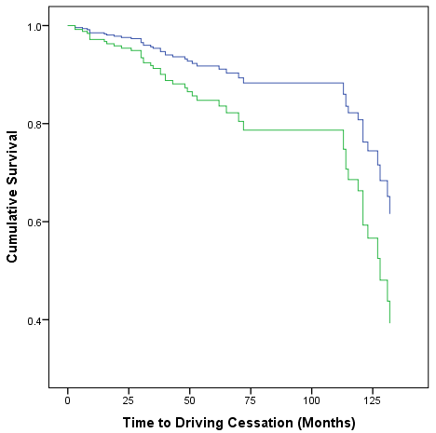
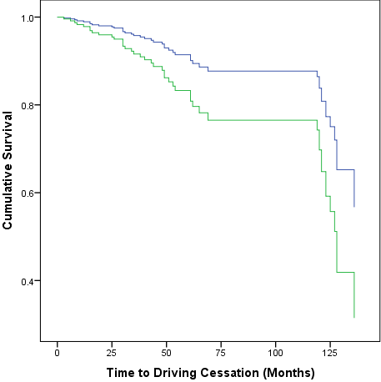
The Center for Healthy Aging
Far or Everyday Transfer: 10 Years
HR=0.52, 95%CI=(0.28-0.95), p=.03
Adj. for education, gender and baseline mileage (n=263)
HR=0.49, 95%CI=(0.26-0.92), p=.03
Adj. for education, gender and baseline mileage (n=254)
The Department of Human Development and Family Studies

Slide 19
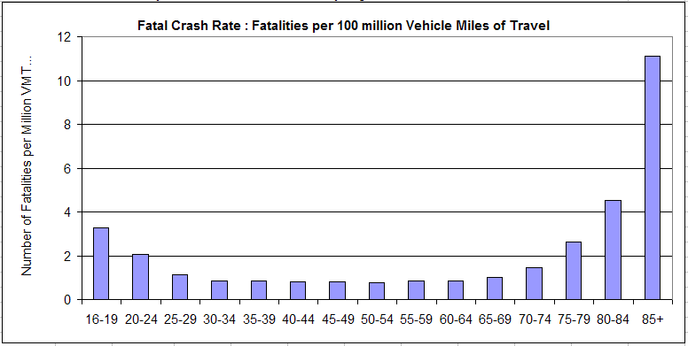
The Center for Healthy Aging
Far or Everyday Transfer?
National Household Travel Survey VMT by Age and NHTSA FARS
The Department of Human Development and Family Studies

Slide 20
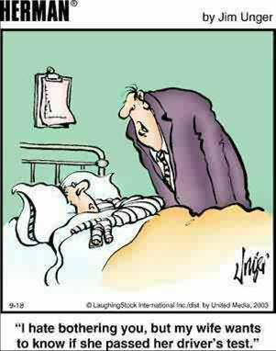
The Center for Healthy Aging
The Department of Human Development and Family Studies

Slide 21
The Center for Healthy Aging
Five Year Crash Results: Unadjusted
 | Control N=409 | Memory N=175 | Reasoning N=145 | Speed N=179
Person-time
Any crash | 1.00 ( - ) | 0.77 (0.52-1.16) | 0.73 (0.46-1.14) | 0.87 (0.59-1.29)
At-fault crash | 1.00 ( - ) | 0.86 (0.56-1.32) | 0.67 (0.40-1.12) | 0.55 (0.33-0.92)
Person-miles
Any crash | 1.00 ( - ) | 0.84 (0.56-1.27) | 0.81 (0.51-1.26) | 0.91 (0.62-1.35)
At-fault crash | 1.00 ( - ) | 0.93 (0.61-1.44) | 0.74 (0.44-1.24) | 0.58 (0.35-0.97)
Ball et al., 2010
The Department of Human Development and Family Studies

Slide 22
The Center for Healthy Aging
Five Year Crash Results: Adjusted
 | Control N=409 | Memory N=175 | Reasoning N=145 | Speed N=179
Person-time
Any crash | 1.00 ( - ) | 0.73 (0.48-1.10) | 0.67 (0.43-1.05) | 0.79 (0.53-1.17)
At-fault crash | 1.00 ( - ) | 0.82 (0.53-1.27) | 0.44 (0.24-0.82) | 0.52 (0.31-0.87)
Person-mile
Any crash | 1.00 ( - ) | 0.80 (0.53-1.21) | 0.71 (0.45-1.11) | 0.82 (0.55-1.22)
At-fault crash | 1.00 ( - ) | 0.93 (0.60-1.45) | 0.50 (0.27-0.92) | 0.57 (0.34-0.96)
Ball et al., 2010
The Department of Human Development and Family Studies

Slide 23
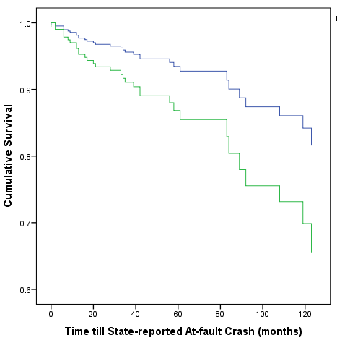
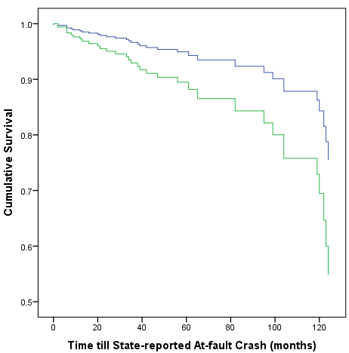
The Center for Healthy Aging
10 Year State-reported Crashes
HR=0.48, 95%CI=(0.24-0.98), p=.04
Adj. for gender, study site, health and baseline mileage (n=270)
HR=0.47, 95%CI=(0.23-0.96), p=.04
Adj. for gender, study site, health and baseline mileage (n=263)
The Department of Human Development and Family Studies

Slide 25
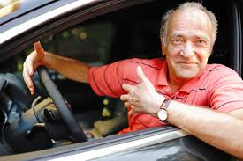
Questions? Contact: Lesley Ross, PhD lross@psu.edu Study of Health Aging & Applied Research Programs lab www.SHAARP.org

