Slide 1

Studying Cognitive Reserve
Yaakov Stern
Cognitive Neuroscience Division, Department of Neurology
Columbia University College of Physicians and Surgeons
academiccommons.columbia.edu

Slide 2
Acknowledgements
Funded in part by Grant R13AG030995 from the National Institute on Aging
The views expressed in written conference materials or publications and by speakers and moderators do not necessarily reflect the official policies of the Department of Health and Human Services; nor does mention by trade names, commercial practices, or organizations imply endorsement by the U.S. Government.

Slide 3
Thanks to:
Co-Investigators:
Christian Habeck
Qolomreza Razlighi
Yunglin Gazes
Jason Steffener
Seonjoo Lee
Teal Eich
Assistance:
Emil Agarunov
Lamia Haider
Ann Okawa
Ashley Mensing
David Parker
Maria Pleshkevich
Jayant Sakhardande
Angeliki Tsapanou
Support: National Institute on Aging

Slide 4
Whitepaper: Defining and investigating cognitive reserve, brain reserve and brain maintenance
Brain reserve: More neurobiological capital (e.g. neurons/ synapses) to lose
Brain maintenance: Reduced development of primary age-related brain changes and pathologies
Cognitive Reserve: Adaptability (i.e., flexibility, efficiency, capacity, compensation) of functional brain processes (i.e. cognition)
Also offers potential measures and research approaches
Addresses some issues; e.g, are BR and CR separable?
Stern et al, Alz & Dementia, in press

Slide 5
Need for common terminology
It is important to work with common definitions/terminology
This is particularly important when searching for brain mechanisms
Example: recent paper “Dendritic spines provide cognitive resilience against Alzheimer's disease”
  increased spine extent distinguished pathologic AD cases who did and did not have clinical AD during life
  “These observations provide cellular evidence to support the hypothesis that dendritic spine plasticity is a mechanism of cognitive resilience that protects older individuals with AD pathology from developing dementia”
  Cognitive resilience or brain reserve?
Boros et al, Ann Neurol. 2017.

Slide 6
Cognitive reserve proxies
Life experiences or other factors shown to impart reserve in epidemiologic studies are often used as CR proxies
  IQ, education/literacy, occupational attainment and leisure activity
It is important to note that these are not direct measures of CR.
Just showing that some task correlates with one of these proxies does not indicate that that task measures CR
Rather it has to “act like” CR: moderate between brain and clinical outcome
Instruments have been created that attempt to collect all of these various experiences, and summary scores have been created

Slide 7
Reflective versus formative variables
Reflective model
e.g. attention
Formative model
e.g. CR, SES
Cognitive reserve is a formative latent variable, so summary scores based on factor analysis can be misguided
Jones at al, JINS 2011

Slide 8
Lifetime antecedents of cognitive reserve
Richards, JCEN 2003

Slide 9
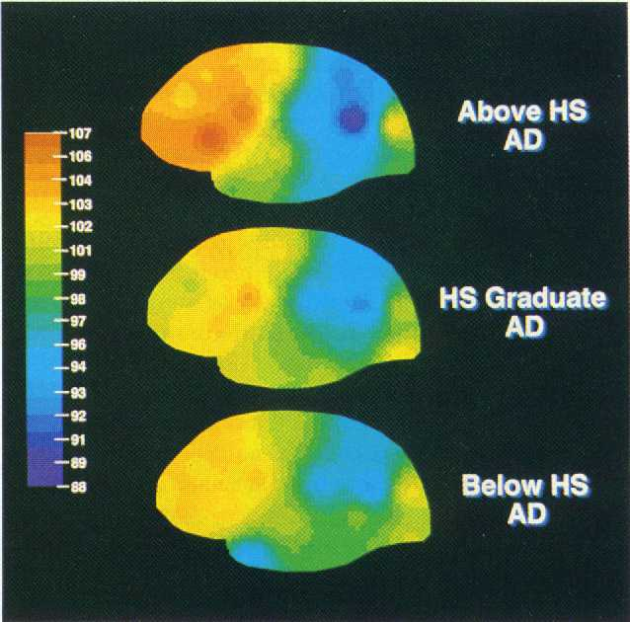
Education and regional cerebral blood flow: CR proxy explains additional variance
Predictors of P3 detector flow: R²
mMMS, BDRS, age, age at onset, duration .190
+ education .304
Predictors of PI Index flow: R²
mMMS, BDRS, age, age at onset, duration .187
+ education .251
Stern et al, Ann Neurol 1992

Slide 10
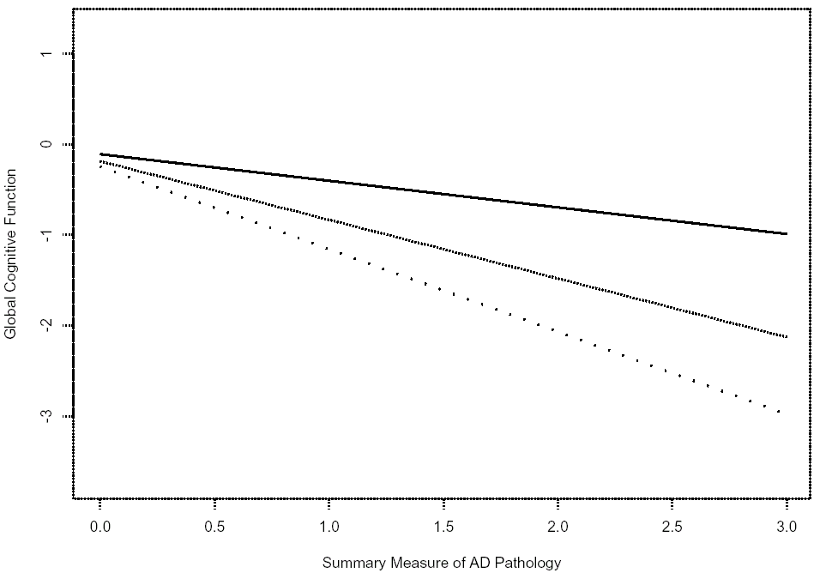
Interaction of AD pathology and education: CR proxy moderates
Education * AD path = 0.088, p<.01
22 years
Global Cognitive Function
18 years
15 years
Summary Measure of AD Pathology
Bennett DA et al, Neurology 2003

Slide 11
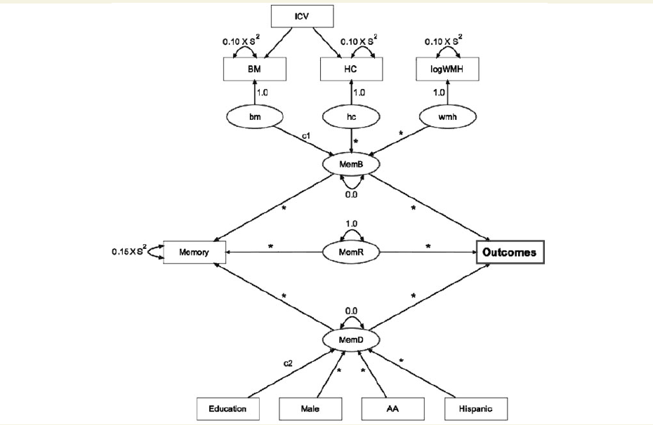
Residual models of CR
ICV: Intracranial Volume
BM: Brain Volume
HC: Hippocampal Volume
component of episodic memory related to demographic variables
residual component of episodic memory not explained by demographic and MRI variables = CR!
component of episodic memory related to demographic variables
This residual “acts like” CR: correlates with NART, predicts risk of dementia
Reed et al, Brain 2010

Slide 12
Strengths and weaknesses of residual measures of CR
Strengths
  The residual is a quantitative measure of the effect of CR at the present time, rather than just a CR proxy
  The residual can change as CR is increased or depleted
Weakness
  Brain and demographic measures account for a small proportion of the variance in cognition
    This is particularly the case in “normal” aging
  The residual always harbors a lot more that CR
  There are a lot of “moving parts”
    Can yield unexpected findings in longitudinal studies
    e.g., learning effect on tests yield increasing CR

Slide 13
CR and BM are orthogonal, but have common influences: Estimating brain maintenance
Illustration of the algorithm for computing BM, explained on mock data for one participant, marked with a large bolded dot.
The participant is 45 years old and her brain-structural variable is 1.33 of the mean of her age-matched peers in the 10-year age window [40,50]; her BM value thus is positive with BM = 0.33, that is, her brain structure compares favorably to her age-matched peers.
The computation depicted in this figure is performed for 3 modalities (cortical thickness, cortical volume, white matter tract integrity) and the resulting BM values are averaged to result in one overall BM value.
Habeck et al, Cerebral Cortex 2016

Slide 14
CR and BM are orthogonal, but have common influences: Estimating CR
cog is our cognitive measure of interest (=memory, fluid reasoning, processing speed, or vocabulary)
We predict cog with the brain measures
The residual is our estimate of CR
The 4 derived CR measures could be described by one underlying construct (latent variable)
Habeck et al, Cerebral Cortex 2016

Slide 15
Cognitive reserve and brain maintenance are orthogonal, but have common influences
Habeck et al, Cerebral Cortex 2016

Slide 16
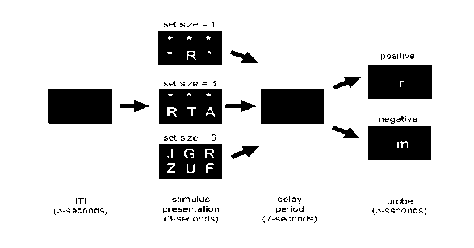
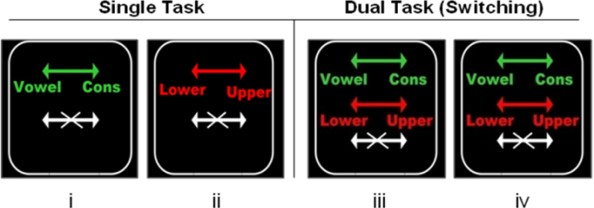
A scheme for the study of CR, incorporating imaging
Age
Task-related
activation,
connectivity
Gray Matter Volume
Cortical Thickness
WMH Burden
WM Tract integrity
Resting CBF
Amyloid/Tau burden
Activation Task Performance
Cognitive Domains
Function / ADL
Cognitive decline over time/
Incident MCI/AD
Brain morphology,
integrity or
pathology
Task or NP
performance,
Clinical Outcome
CR proxy or
CR-specific
network
Genetics
Life Experience/
Exposures
Stern, Brain Imaging and Behavior (2017)

Slide 17
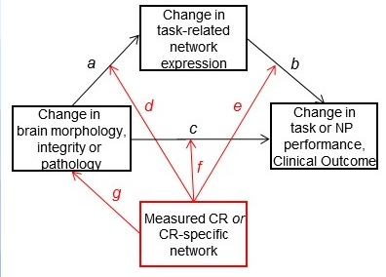
Longitudinal version
Stern, Brain Imaging and Behavior (2017)

Slide 18
Steffener et al, PLOS ONE, 2014

Slide 19
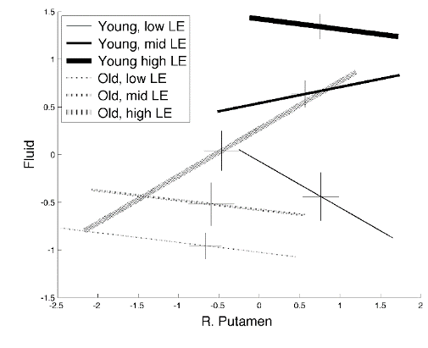
Steffener et al, PLOS ONE, 2014

Slide 20
Neural implementations of CR: Neural reserve
Represents normally occurring individual differences in the capacity to perform tasks or cope with increases in task difficulty.
These differences may result from innate differences (e.g. in intelligence) or may be modulated through life exposures
Might be characterized in terms of
  differential efficiency and/or capacity
  flexibility of solution strategies
Networks that subserve neural reserve are present in young and older healthy individuals, as well as those suffering from pathology
should be comparable in young and old subjects
Those with higher neural reserve can better maintain performance when challenged by aging or brain pathology,
Compare to the STAC model
Stern et al, Cerebral Cortex 2005
Notes:
20

Slide 21
Neural implementations of CR: Neural Compensation
The use of alternate networks, not normally used, as a response to disruption of normal networks
Can consist of
  Reorganization of brain areas in existing network
  Recruitment of alternate brain areas
Compensation may be beneficial or an indicator or deficit
The ability or need to recruit compensatory networks may vary as function of CR
Notes:
21

Slide 22
Exploring neural reserve and compensation using the modified Sternberg task
40 young and 18 old subjects performing a modified letter Sternberg task
fMRI measures: Slope of fMRI signal with respect to set size, during retention
A covariance analytic approach (MLM) determined the number of spatial patterns representing brain activity
Zarahn et al., Neurobiol Aging 2007

Slide 23
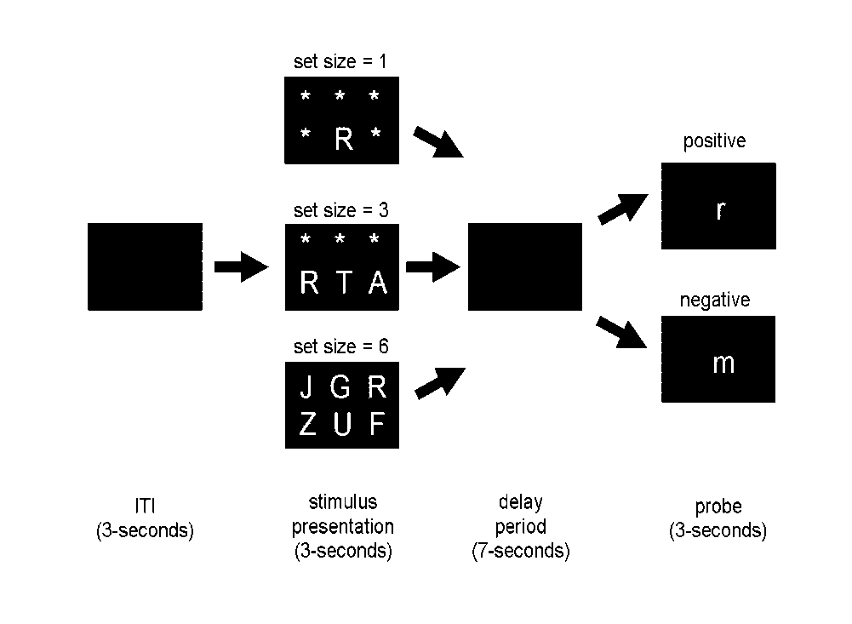
Modified Sternberg task
”Load-related” activation: the change in activation as set size increases
We focus on load-related activation because CR might be more related to the coping with increases in task demand than to task-specific features.
Notes:
23

Slide 24
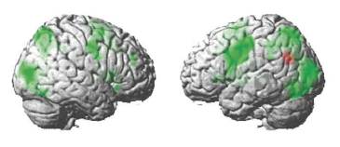
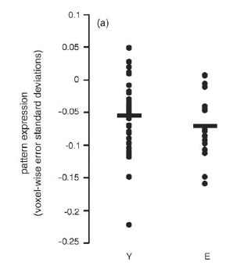
Load-related activation during encoding: Neural reserve
Both young and old expressed the same pattern during encoding
Older subjects expressed this pattern to a greater degree, although their performance was poorer
This network becomes more inefficient with aging
Neural reserve
Greater Network Expression
Young Old
Zarahn et al., Neurobiol Aging 2007
Notes:
24

Slide 25
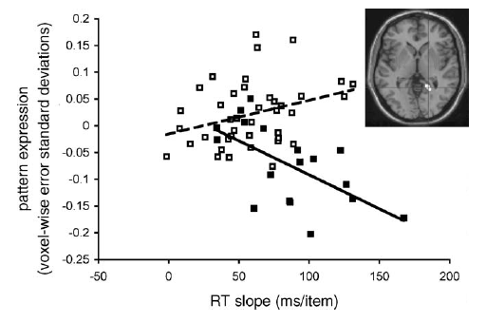
Load-related activation during encoding: a second pattern
A second pattern was expressed primarily by the elders
Higher expression was associated with poorer performance
--> Neural compensation or de-differentiation?
Greater Network Expression
Elder
Young
Less Efficient Processing (RT slope)
Zarahn et al., Neurobiology of Aging 2007
Notes:
25

Slide 26
Is the increased expression of Pattern 2 dedifferentiation or neural compensation?
Overlays show an outline in black of the primary retention network. This defined the search space for a voxel-based morphometry analyses.
In the yellow voxels (left SMA), decreased grey matter density was related to increased expression of pattern 2: as grey matter density decreased in a portion of pattern 1, expression of pattern 2 increased
This suggests that pattern 2 is compensatory, and may help maintain performance
Neural Compensation
Steffener at al., Brain Imaging and Behavior 2009

Slide 27
A task invariant CR network
CR allows people to better maintain function in multiple activities and cognitive domains in the face of brain pathology.
If a particular brain network subserves CR, it should be active across tasks with varying processing demands.
Goal: Can we identify a pattern of CR-related brain activity :
  that is common across 12 different tasks
  whose expression correlates with a CR proxy
  whose expression moderates the relationship between cortical thickness and cognition
  whose expression in other tasks correlates with that proxy

Slide 28
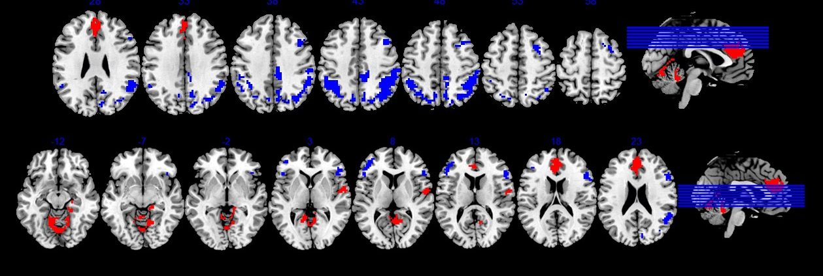
Deriving a task-invariant CR network
255 subjects, age 20-80, with complete neuroimaging for 12 different tasks
Randomly divide data into derivation and test samples
In derivation sample, derive best-fit NART patterns
Project derived pattern into test sample and estimate NART in all 12 tasks
Repeat steps 500 times, each time storing the derived patterns and the test prediction quality
Compute weighted Z-map of pattern loadings for the 500 patterns

Slide 29
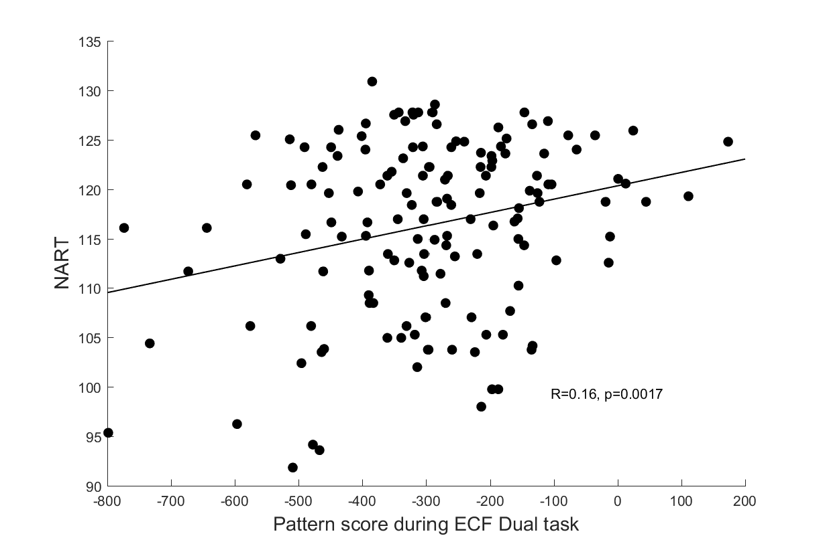
Expression of the task-invariant CR network in a different fMRI activation task correlates with NART IQ
Expression of the task-invariant CR network moderates between cortical thickness and task performance
Stern et al, Neuroimage 2018

Slide 30
Requirements/testbeds for functional models of CR
Correlate with a CR proxy
  Crucial when correlation is used for derivation
  Important when derivation is based on moderation
Moderate between brain and cognition
  Crucial for the CR assumption
  Are there situations where it is sufficient to simply account for additional variance over brain aging/pathology?
  We need standardized testbeds that all can use
Forward apply and replicate in other data sets
  An important level of proof
  Requires sharing of data/CR candidates across research groups

Slide 31
Can we derive task-invariant CR networks in resting BOLD?
Analytic strategy:
298 people aged 40-80
Take resting-state connectomes in Power’s 264 ROIs
Perform SSM-PCA on the connectomes with education and NART IQ as the dependent variables
Check whether expression of connectivity pattern contributed directly to the 4 cognitive outcomes, or moderates the relationship between mean cortical thickness and the outcomes
Check that pattern expression is uncorrelated with mean cortical thickness

Slide 32
Connectome for Education PC1-10, p=0.0028
Negative loadings at Z<-1.5
Positive loadings at Z>1.5

Slide 33
Does the education resting BOLD CR pattern relate to cognition or moderate between cortical thickness and cognition
Total
cognition
T p
4.6113 0.0000 mean cortical thickness
3.5136 0.0005 pattern score
-3.0355 0.0026 pattern score * mean thickness
Memory
T p
3.8267 0.0002 mean cortical thickness
0.3550 0.7229 pattern score
-2.3302 0.0205 pattern score * mean thickness
Vocabulary
T p
0.6963 0.4868 mean cortical thickness
5.4564 0.0000 pattern score
-2.9167 0.0038 pattern score * mean thickness

Slide 34
Moderation of the vocabulary-thickness relationship by expression of the education CR pattern

Slide 35
No relationship between the
pattern score and mean cortical thickness

Slide 36
Connectome for IQ PC1-9, p=0.0058
Negative loadings at Z<-1.5
Positive loadings at Z>1.5

Slide 37
Does the IQ resting BOLD CR pattern relate to cognition or moderate between cortical thickness and cognition
T p
4.6207 0.0000 mean thickness
3.4667 0.0006 pattern score
-2.0424 0.0420 interaction
Total cognition
3.7438 0.0002 mean thickness
3.2702 0.0012 pattern score
-0.9003 0.3687 interaction
Fluid reasoning
5.1287 0.0000 mean thickness
0.9065 0.3654 pattern score
-2.0757 0.0388 interaction
Speed
Vocabulary
0.6177 0.5372 mean thickness
5.7769 0.0000 pattern score
-2.6867 0.0076 interaction

Slide 38
Is expression of the education and IQ patterns related? YES

Slide 39
Moderation analysis with simultaneous entry and all interaction terms: Total cognition
T p
-2.4413 0.0153 intercept
4.1905 0.0000 mean cortical thickness (THX)
1.1746 0.2412 education pattern (EDU)
1.3931 0.1647 IQ pattern (NART)
-2.0989 0.0367 THX * EDU
0.2982 0.7658 THX * NART
-0.2460 0.8059 EDU * NART
0.1130 0.9101 THX * EDU * NART

Slide 40
Moderation analyses by cognitive domain
Memory
Speed
T p
-3.5282 0.0005
3.7002 0.0003
0.3461 0.7295
-0.2276 0.8201
-3.7128 0.0002
3.0577 0.0025
0.0976 0.9223
-0.0951 0.9243
T p
-4.6496 0.0000
4.9252 0.0000
0.0440 0.9650
0.5856 0.5587
0.0490 0.9610
-1.4351 0.1524
0.3883 0.6981
-0.6096 0.5426
intercept
mean cortical thickness (THX)
education pattern (EDU)
IQ pattern (NART)
THX * EDU
THX * NART
EDU * NART
THX * EDU * NART
intercept
mean cortical thickness (THX)
education pattern (EDU)
IQ pattern (NART)
THX * EDU
THX * NART
EDU * NART
THX * EDU * NART
Fluid Reasoning
Vocabulary
T p
-2.6530 0.0084
3.8181 0.0002
-0.6529 0.5144
2.5725 0.0106
-1.9596 0.0511
0.7634 0.4459
-0.1028 0.9182
-1.0259 0.3059
T p
4.1370 0.0000
0.3050 0.7606
1.6907 0.0920
2.1733 0.0306
-1.3842 0.1674
-0.5960 0.5517
-1.6417 0.1018
0.8627 0.3891
intercept
mean cortical thickness (THX)
education pattern (EDU)
IQ pattern (NART)
THX * EDU
THX * NART
EDU * NART
THX * EDU * NART
intercept
mean cortical thickness (THX)
education pattern (EDU)
IQ pattern (NART)
THX * EDU
THX * NART
EDU * NART
THX * EDU * NART

Slide 41
Summary 1
The concept of reserve is promising, because it provides resilience against yet untreatable diseases
Quantifying reserve is complex
Life experiences that appear to impart reserve have been used as proxy measures for CR, but do not directly measure CR
Residual measures for CR have some promise, but rely on the assumption that all variance that is not accounted for by demographic or brain measures is CR
Functional or resting bold imaging may identify networks that directly quantify/characterize some aspects of reserve
At this point, care must be taken to use potential reserve measures in the appropriate research context: moderating between brain changes and clinical changes

Slide 42
Summary 2
Accepted, consistent definitions for CR, BR and BM will be extremely helpful
Similarly, consensus on research paradigms is needed
Common accepted testbeds will be of great use. For example, we need accepted data sets in which to test whether a network, or any other variable, moderates between brain and behavior.
Similarly, forward application of findings to “test” datasets will be crucial
It is exciting to see this area of research expand and become more methodologically and analytically sophisticated
Influencing reserve may delay or reverse the effects of aging or brain pathology. Careful, focused research will help us maximize the chance for successful intervention

