Slide 1
Marginal structural models for differential attrition, time-varying exposures, and time-dependent confounding
Another talk
Jennifer Weuve, MPH, ScD
jweuve@bu.edu
http://jweuve.tumblr.com/

Slide 2
Objectives (primary)
Define selection bias in the context of causal questions embedded in longitudinal studies
Explain why conventional methods fail when differential selection is present

Slide 3
Objectives (primary)
Work through the logic of:
  What inverse probability-of-continuation weights (IPCW) encode
  How using them can correct bias from differential selection
Explore the major steps of applying IPCW using real-life examples

Slide 4
The search for modifiable risk factors for adverse health outcomes in older age
Counterintuitive findings of “neutered” risk factors in older populations.
  E.g., Nybo H et al. JAGS, 2003;51(10):1365–73. Marang-van de Mheen PJ et al. J Epidemiol Community Health, 2001;55(1):24–8. Tate RB Ann Epidemiol, 1998;8(7):415–21. Hernan MA, et al. Epidemiology, 2008;19:448-50.
  In longitudinal studies of aging, people who drop out typically have worse cognitive and physical function.
    E.g., Euser SM et al., Epidemiology 2008;19:440–7. Chattfield MD et al. J Clin Epidemiol 2005; 58: 13-9.
  Smoking?
  From a socioeconomically disadvantaged group?
  How about bacon?
Not so bad if you’re 85.

Slide 5
Does cigarette smoking hasten cognitive decline?
Example 1

Slide 6
Smoking: a risk factor – or is it?
++ nicotine-mediated effects on cognition
Null or “protective” associations with some neurologic conditions, incl dementia
Cerebrovascular effects
Adverse nicotine-mediated effects on cognition
Sabia S (2008) Arch Int Med 168:1165-1173.
Sacco KA (2004) J Psychopharmacol 18:457-474.
In longitudinal studies of smoking and cognitive decline, smokers are differentially lost to follow-up (e.g., Sabia S (2008) Arch Int Med 168:1165-1173).

Slide 7
Let’s think about this, using a causal DAG
gene
survival/ continuation
cognitive decline₂
smoking
U
diet
sloth
–
smoking is associated with reduced survival (RR=0.5) and continuation
This is the STRATUM of people/observations we analyze.
Restricting to continuing survivors can lead to collider bias.
Notes:
NBA example. Collider bias shows up in NBA players, but probably not non-players. This is because the bias can exist in one stratum of the collider, not nec both (but *can* it?). In affected stratum there seems to be a need for an additional interaction between the 2 causes.

Slide 8
How the mechanics of the bias might work
… and because K is related to more cognitive decline, continuing and surviving smokers will have experienced less than expected cognitive decline
Surviving / continuing people who smoke
are less likely to have factors that hasten their demise (K)
-
K (or U) is associated with future cognitive decline
+
-
smoking
U or K₁
–
K (or U) is associated with reduced survival
survival/ continuation
cognitive decline₂
–
smoking is associated with reduced survival
This is the STRATUM of people/observations we analyze.
→ Surviving and continuing smokers and never smokers are not exchangeable, given covariates
Notes:
If I tell you that someone who is alive and continuing in my cohort of older adults is a current smoker, then, conditional on a bunch of coavariates such as age, race, education and sex, you might guess that this person is blessed to have factors that are promoting their survival and blessed not to have factors that would hasten their demise.

Slide 9
In some populations (e.g., younger adults), most people continue and/or predictors of survival/continuation are weak …
smoking
U
survival/ continuation
cognitive decline₂
–
smoking is associated with reduced survival (RR=0.5) and continuation

Slide 10
In other situations, we have measures of U (meaning U is really a K [known]) and can adjust for it.
smoking
gene(s)
survival/ continuation
cognitive decline₂
–
smoking is associated with reduced survival (RR=0.5) and continuation

Slide 11
But in many situations, U is not known. Or U is known and measured, but adjusting for it is problematic.
smoking
survival/ continuation
cognitive decline₂
disability
Likely intermediate
–
smoking is associated with reduced survival (RR=0.5) and continuation

Slide 12
But in many situations, U is not known. Or U is known and measured, but adjusting for it is problematic.
Meas. error
Baseline adjustment bias
Observed cognitive function
smoking
cognitive function₁
survival/ continuation
cognitive decline₂
–
smoking is associated with reduced survival (RR=0.5) and continuation
Glymour MM (2005) AJE. 2005;162:267-278.

Slide 13
Upshot: diminished (or inverse!) estimated association between smoking and cognitive decline
… and because K is related to more cognitive decline, continuing and surviving smokers will have experienced less than expected cognitive decline
Surviving / continuing people who smoke are less likely to have factors that hasten their demise (K)
-
K (or U) is associated with future cognitive decline
+
-
smoking
U or K₁
–
K (or U) is associated with reduced survival
survival/ continuation
cognitive decline₂
–
smoking is associated with reduced survival
Hernán MA (2004) Epidemiology 15:615-625.
Glymour MM (2008) Neuropsychol Rev. 18(3):194-213.
Sabia S (2008) Arch Int Med 168:1165-1173.
Notes:
We are assuming exchangeability at 2 levels. First, if the positivity assumption is met (at least one person with any realized combo of covariates at each wave continues on to the next) and our attrition model correctly specified, then we assume that those who died or censored were exchangeable with those who continued, conditional on the covars in the attrition model. This is the whole premise of weighting. (right?) Second, conditional on the covars in the effect estimation (cog decline) model, we assume exchangeability between smokers and never smokers (the "ultimate exchangeability asumption"). The weighting serves this "ultimate" goal by redistributing the proportion of characteristics in the study population after differential mortality has made them unexchangeable.

Slide 14
Does exposure to air pollution hasten decline in physical function?
Example 2

Slide 15

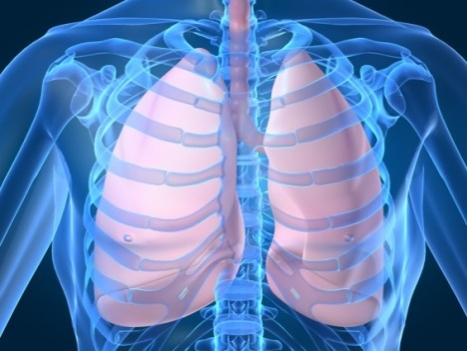
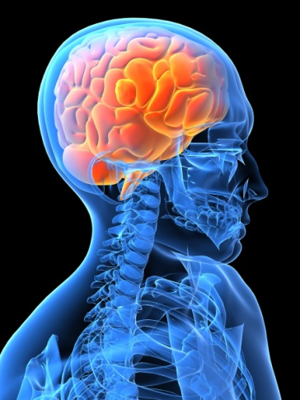
exposure to air pollution
physical disability
Notes:
15
Disability is a central focus of geriatric research and clinical care. It represents the combined impact of common, often co-morbid chronic diseases and subclinical pathologic processes on a person’s ability to perform usual tasks and activi¬ties that are essential for self-care and independent living. Disability is widely regarded as a key indicator of overall physical health in older age.16-17 Its prevalence increases rapidly with age, from about 10% among 65-74-year-olds to >50% in those aged >85,18-19 and disability is more common and appears to progress more ra¬pidly among African Americans than among whites.20 While mortality remains a canonical outcome of interest in health research, reducing the number of disability-affected years during late life—i.e., the “compression of morbidity,”—is of interest due to disability’s impact on loss of independence, burden on informal caregivers, and health care utilization.21 Some progress has been made in the effective postponement of disability,21 but that progress has slowed,18 and disability remains a substantial public health burden. Indeed, it is the primary cause of long term care,22-23 and is projected to account for $350 billion in Medicare costs in 2009.24

Slide 16
Might selection bias be a problem for these analyses?
Surviving / continuing people with higher exposure are more likely to have better physical function at previous visit
… and because previous function is related to less physical decline, continuing and surviving who were highly exposed will have experienced less than expected physical decline
-
-
+
+
HR per SD in prior score, 1.27 (95% CI, 1.18-1.35)
NO_{X} exposure
Physical fn₁
survival/ continuation
Decline in physical fn₂
-
HR per 10 ppb NO_{X},
0.88 (95% CI, 0.76-1.01)

Slide 17
Recap of Example 1:
Smoking and cognitive decline in older adulthood
How to estimate the causal effect of smoking on rate of cognitive decline, given that:
Attrition is not rare
Smoking influences probability of continuation
Continuation/survival and cognitive decline have common causes
  And it is problematic to adjust for some or all of those causes
Weuve J, et al. Epidemiology. 2012 Jan;23(1):119-28.
Notes:
The keys for time-dependent confounding are the first 2 points

Slide 18
Recap of Example 2:
Air pollution exposure and decline in physical function
How to estimate the causal effect of air pollution exposure on rate of physical function decline, given that:
Attrition is not rare
Exposure influences probability of continuation
Continuation/survival and physical decline have common causes
  And it is problematic to adjust for some or all of those causes
Weuve J, et al. Environ Health Perspect. 2016 Mar 29 [epub ahead of print].
Notes:
The keys for time-dependent confounding are the first 2 points

Slide 19
Example 3:
Alcohol consumption and dementia risk
How to estimate the causal effect of alcohol consumption* on risk of dementia, given that:
Attrition is not rare
Alcohol consumption (none, heavy) influences probability of continuation
Continuation/survival and dementia risk have common causes
  And it is problematic to adjust for some or all of those causes
  * Heavy vs moderate; None vs moderate
Notes:
In this example, the none vs mod problem could be solved in part by adjusting for health status prior to alc assessment, because it is the ill health of non-drinkers that is linked to survival.

Slide 20
These examples share these features
They pose causal questions involving
  exposures that affect risk of continuation/survival
  outcomes whose predictors affect risk of continuation/survival
Answering those questions correctly involves contending with time-dependent confounding

Slide 21
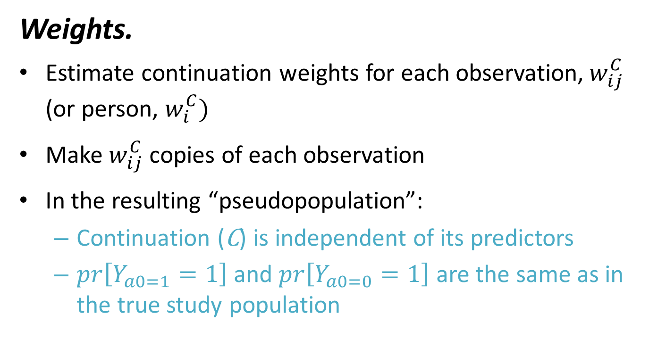
One way to solve this problem? Manipulate the data structure, using ...
Weights.
Estimate continuation weights for each observation,$w_{ij}^{C}$ (or person, $w_{i}^{C})$
Make $w_{ij}^{C}$copies of each observation
In the resulting “pseudopopulation”:
  Continuation (C) is independent of its predictors
  $pr\left[Y_{a0=1}=1\right]$ and $pr\left[Y_{a0=0}=1\right]$ are the same as in the true study population

Slide 22
What information is encoded in the continuation weights?
Observations (or people) get larger weights when their exposure and covariate levels are ?????? consistent with attrition.
Observations (or people) get smaller weights when their covariate levels are ?????? consistent with attrition.
MORE
LESS
If the observation looks like
a typical observation of a person who subsequently dropped out,
we make more copies of it.

Slide 23
Upshot of IPCW, in DAGs
-
-
+
+
HR per SD in prior score, 1.27 (95% CI, 1.18-1.35)
NO_{X} exposure
Physical fn₁
survival/ continuation
Decline in physical fn₂
-
HR per 10 ppb NO_{X},
0.88 (95% CI, 0.76-1.01)

Slide 24
Steps to estimate the continuation weights
Build model(s) of continuation.
Why continuation (and not censoring)?
  You can model either. In the end, the weights use probabilities of continuation.
A pooled logistic regression model works well.
confusing convention alert:
C=0 to indicate continuation.
C=1 to indicate censoring.
Weuve J, et al. Epidemiology. 2012 Jan;23(1):119-28.

Slide 25
Build model(s) of continuation (continued, unironically).
Can include anything that predicts continuation.
  In studies of normally distributed outcomes (e.g., cognitive score), predictors can include previous outcome measure.
Can develop distinct models for different types of attrition processes
  E.g., Not dying, not dropping out
Weuve J, et al. Epidemiology. 2012 Jan;23(1):119-28.

Slide 26
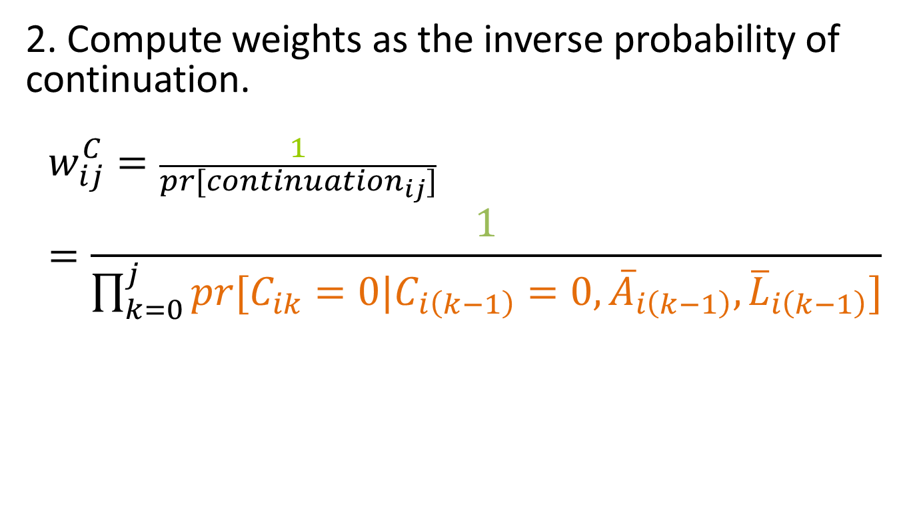
Steps to estimate the continuation weights
2. Compute weights as the inverse probability of continuation.
$$w_{ij}^{C}=\frac{1}{pr[{continuation}_{ij}]}=\frac{1}{\prod_{k=0}^{j}{pr[C_{ik}=0|C_{i\left(k−1\right)}=0,{\overline{A}}_{i\left(k−1\right)},{\overline{L}}_{i\left(k−1\right)}]}}$$
Continued as of time k
Exposure history through time k − 1
Time-dependent covariate history through time k − 1
Still in study as of time k − 1

Slide 27
i | j | X_{i} | L_{i(k-1)} | Pr(C_{death}=0)_{i,k} | Pr(C_{dropout}=0) _{i,k} | Pr(continuation)_{i,j}
1 | 0 | X₁ | - | 1, by definition | 1, by definition | 1
1 | 1 | X₁ | L_{1,0} | Pr(C_{1,1,death}=0|C_{1,0,death}=0, C_{1,0,dropout}=0, X₁, L_{1,0}) | Pr(C_{1,1,dropout}=0|C_{1,0,dropout}=0, C_{1,1,death}=0, X₁, L_{1,0}) | Pr(C_{death})_{1,1}*Pr(C_{dropout})_{1,1}
1 | 2 | X₁ | L_{1,1} | Pr(C_{1,2,death}=0|C_{1,1,death}=0, C_{1,1,dropout}=0, X₁, L_{1,1}) | Pr(C_{1,2,dropout}=0|C_{1,1,dropout}=0, C_{1,2,death}=0, X₁, L_{1,1}) | Pr(C_{death})_{1,1}*Pr(C_{dropout})_{1,1}* Pr(C_{death})_{1,2}*Pr(C_{dropout})_{1,2}
1 | 3 | X₁ | L_{1,2} | Pr(C_{1,3,death}=0|C_{1,2,death}=0, C_{1,2,dropout}=0, X₁, L_{1,2}) | Pr(C_{1,3,dropout}=0|C_{1,2,dropout}=0, C_{1,3,death}=0, X₁, L_{1,2}) | Pr(C_{death})_{1,1}*Pr(C_{dropout})_{1,1}*Pr(C_{death})_{1,2}*Pr(C_{dropout})_{1,2}* Pr(C_{death})_{1,3}*Pr(C_{dropout})_{1,3}
2 | 0 | X₂ | - | 1, by definition | 1, by definition | 1
2 | 1 | X₂ | L_{2,0} | Pr(C_{2,1,death}=0|C_{2,0,death}=0, C_{2,0,dropout}=0, X₂, L_{2,0}) | Pr(C_{2,1,dropout}=0|C_{2,0,dropout}=0, C_{2,1,death}=0, X₂, L_{2,0}) | Pr(C_{death})_{2,1}*Pr(C_{dropout})_{2,1}

Slide 28
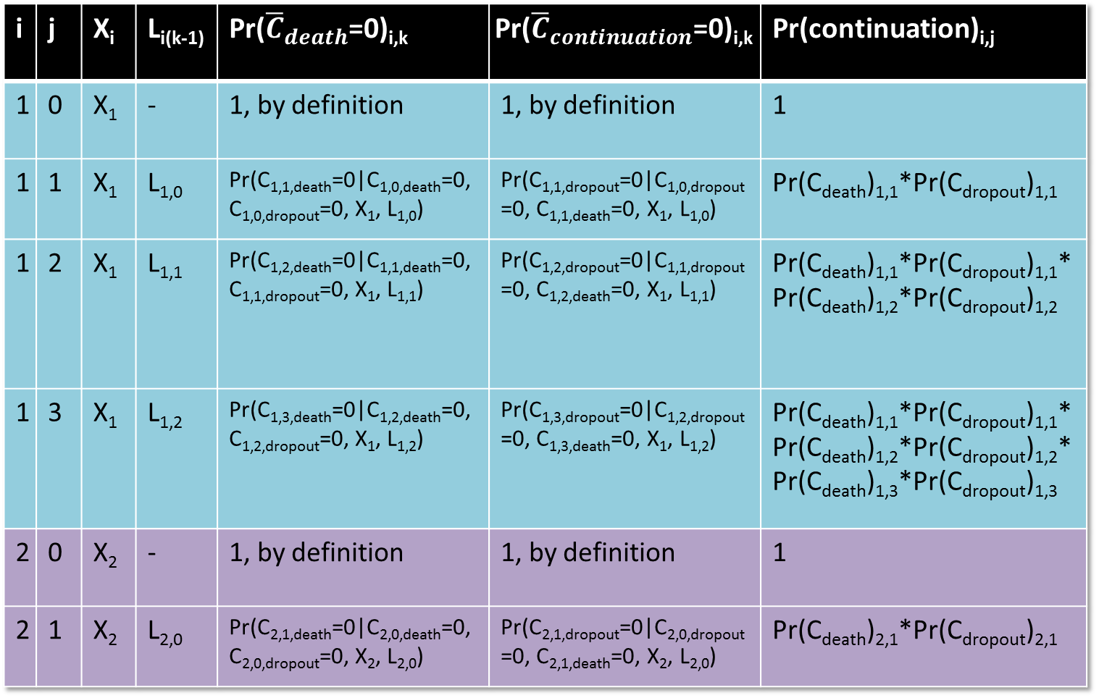
i | j | X_{i} | L_{i(k-1)} | Pr(${\overline{C}}_{death}$=0)_{i,k} | Pr(${\overline{C}}_{continuation}$=0)_{i,k} | Pr(continuation)_{i,j}
1 | 0 | X₁ | - | 1, by definition | 1, by definition | 1
1 | 1 | X₁ | L_{1,0} | Pr(C_{1,1,death}=0|C_{1,0,death}=0, C_{1,0,dropout}=0, X₁, L_{1,0}) | Pr(C_{1,1,dropout}=0|C_{1,0,dropout}=0, C_{1,1,death}=0, X₁, L_{1,0}) | Pr(C_{death})_{1,1}*Pr(C_{dropout})_{1,1}
1 | 2 | X₁ | L_{1,1} | Pr(C_{1,2,death}=0|C_{1,1,death}=0, C_{1,1,dropout}=0, X₁, L_{1,1}) | Pr(C_{1,2,dropout}=0|C_{1,1,dropout}=0, C_{1,2,death}=0, X₁, L_{1,1}) | Pr(C_{death})_{1,1}*Pr(C_{dropout})_{1,1}* Pr(C_{death})_{1,2}*Pr(C_{dropout})_{1,2}
1 | 3 | X₁ | L_{1,2} | Pr(C_{1,3,death}=0|C_{1,2,death}=0, C_{1,2,dropout}=0, X₁, L_{1,2}) | Pr(C_{1,3,dropout}=0|C_{1,2,dropout}=0, C_{1,3,death}=0, X₁, L_{1,2}) | Pr(C_{death})_{1,1}*Pr(C_{dropout})_{1,1}*Pr(C_{death})_{1,2}*Pr(C_{dropout})_{1,2}* Pr(C_{death})_{1,3}*Pr(C_{dropout})_{1,3}
2 | 0 | X₂ | - | 1, by definition | 1, by definition | 1
2 | 1 | X₂ | L_{2,0} | Pr(C_{2,1,death}=0|C_{2,0,death}=0, C_{2,0,dropout}=0, X₂, L_{2,0}) | Pr(C_{2,1,dropout}=0|C_{2,0,dropout}=0, C_{2,1,death}=0, X₂, L_{2,0}) | Pr(C_{death})_{2,1}*Pr(C_{dropout})_{2,1}

Slide 29
The challenges of extreme weights
Large variance in the IPCW estimator (exposure’s estimated effect on the outcome).
Reliance on the heavily weighted observations’
  Measurement accuracy
  Satisfaction of the positivity and exchangeability assumptions

Slide 30
One solution: stabilize the weights by altering the numerator
Notes:
Sometimes:
non-stabilized weight called unstabilized weight
Non-stabilized weight is defined as the stabilized weight shown, without conditioning on V.

Slide 31

non-stabilized
$$w_{ij}^{C}=\frac{1}{\prod_{k=0}^{j}{pr[C_{ik}=0|C_{i\left(k−1\right)}=0,{\overline{A}}_{i\left(k−1\right)},{\overline{L}}_{i\left(k−1\right)}]}}$$
$${sw}_{ij}^{C}=\frac{\prod_{k=0}^{j}{pr[C_{ik}=0|C_{i\left(k−1\right)}=0,V_{i}]}}{\prod_{k=0}^{j}{pr[C_{ik}=0|C_{i\left(k−1\right)}=0,{\overline{A}}_{i\left(k−1\right)},{\overline{L}}_{i\left(k−1\right)}]}}$$
Again, the time-invariant covariates $V$are a subset of $L_{0}$.
Continued as of time k
Still in study as of time k − 1
Exposure and time-dependent covariate history through time k − 1
Time-invariant covariates
stabilized

Slide 32
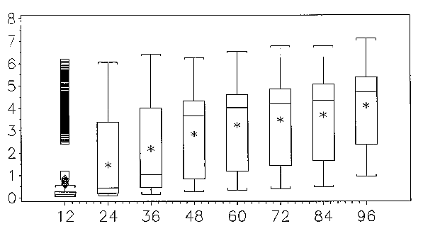
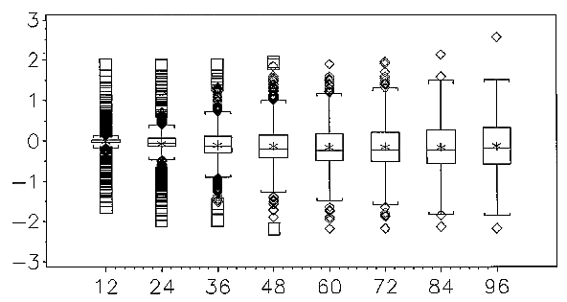
Effect of stabilization on the distribution of the weights
8
Non-stabilized weights
3rd q + 1.5 iqr
log w_{ij}
median
mean
quartiles
1st q ‒ 1.5 iqr
3
Stabilized weights
log sw_{ij}
Months since baseline
Hernán MA, Brumback B, Robins J. Epidemiology 2000;11:561–70.
Notes:
Distribution of nonstabilized W and stabilized weights SW. The box for each group shows the location of the mean (*), median (middle horizontal bar) and quartiles (border horizontal bars). Vertical lines extend to the most extreme observations which are no more than 1.5 3 IQR beyond the quartiles. Observations beyond the vertical lines are plotted individually, if they lie within the limits of the frame.

Slide 33
Effect of stabilization on the IPW estimator
Using non-stabilized weights
0.76 (95% CI, 0.54-1.05)
Using stabilized weights
0.74 (95% CI, 0.57-0.96)
IP-weighted mortality rate ratio, 95% CI (HAART use vs non-use)
Increased precision
No cost in terms of bias*
Hernán MA, Brumback B, Robins J. Epidemiology 2000;11:561–70.

Slide 34
How the stabilization works (and doesn’t): some intuition
A nonstabilized weight gets very large as the denominator gets very small, or, equivalently, as the difference between the numerator and denominator widens.
Stabilization shrinks this difference
The numerator and denominator are highly correlated
But the numerator contains no information about the time-varying predictors of continuation
So the denominator—and the stabilized weight—retain information about the set of time-varying predictors of continuation
And dividing something by a number close in value yields a value that is ?close to/far from? 1.
Notes:
Answer: close to
Informally, to achieve stabilization, one wishes to minimize the difference between the numerator and denominator of the weights such that the remaining difference reflects only the confounding due to the time-varying covariates Lij, which cannot be appropriately adjusted for by standard regression or stratification. Colloquially, one wishes the numerator of the weight to chase the denominator but stop short of following the denominator when it comes to the set of time-varying confounders one wishes to adjust for by weighting.”
Stabilizing the weights reduces the variance because the numerator (the probability of survival given time-constant covariates) and denominator (the probability of survival given time-constant and time-varying covariates) of the weights are usually correlated.

Slide 35
Results from unweighted analyses and analyses weighted by IPCWs
So?

Slide 36
Current (vs never) smoking and cognitive decline
smokers declined less
Weighted results
unweighted
nonstabilized
stabilized
Difference* in cognitive score trajectory over 10 years: current vs never smokers
56% larger
86% larger
smokers declined more

Slide 37
Current (vs never) smoking and cognitive decline
smokers declined less
Weighted results
unweighted
nonstabilized
stabilized
Difference* in cognitive score trajectory over 10 years: current vs never smokers
76% larger
91% larger
smokers declined more

Slide 38
Long-term exposure to NO_{x} in relation to decline in physical performance, unweighted analyses (N=5708, obs=10911)
Declined more slowly
P_{trend} = 0.12
Difference in annual rate of change in physical performance, by increasing quartile of NO_{x} exposure
(ref: lowest quartile)
Per 10 ppb in exposure:
-0.05 (-0.12 to 0.01)
Declined more quickly
Adjusted for age, sex, race, education, income, smoking, and interactions of time with age, sex, race, and education.
5-year average exposure to NO_{x}
Notes:
38
REDO (but N and obs are correct)

Slide 39
Key assumptions
For every covariate combination for which there is discontinuation, there are observations that continued.
Ignorability
Positivity
Correct specification of the models
There is no combination of covariates such that everyone with that combination is predicted to drop out, or, conversely, nobody with that combination is predicted to drop out.
Both structural and exposure models are correctly specified.

Slide 40
Tips for using IPC weights (1)
Confirm positivity. There is no combination of covariates such that everyone with that combination is predicted to drop out, or, conversely, nobody with that combination is predicted to drop out.
Assess the possibility of model misspecification, for example, by exploring more flexible functional forms for the covariates.
Cole & Hernán. Am J Epidemiol 2008, 168(6):656-664
Notes:
Check wave-specific results

Slide 41
Tips for using IPC weights (2)
Confirm that the mean stabilized weight at each wave is close to 1.0. If it is not, revisit possible misspecifications.
Consider the variance of the weights and their impact on the variance of the estimator. Sometimes, truncation of the weights (e.g., at the 1st and 99th percentile) can be a worthwhile tradeoff, increasing bias slightly and increasing efficiency substantially.
Cole & Hernán. Am J Epidemiol 2008, 168(6):656-664
Notes:
Check wave-specific results

Slide 42
CONTROVERSY
“Statistical cruelty”
  IPCW “weights up the dead” and does not allow people to die.
  Death is different from drop-out, because it is an absorbing state (with outcomes undefined). -- Chaix B et al. Epidemiology 2012
    Weighting is of real observations,
      BUT at a certain point, plausibility (and positivity) fail.
      Sensitivity analysis with truncation at different ages.
Notes:
Solutions: truncate follow-up to a given age.
Death as an “absorbing” state. What is the right counterfactual when you’re old?
Bootstrapping
Former smokers
Smoking dose

Slide 43
CONTROVERSY
“Statistical cruelty” (continued)
        “Should use Principal Stratification method” (analysis of people who would survive irrespective of exposure status) -- Chaix B et al. 2012
    IPCW recovers the PS effects -- Tchetgen Tchetgen EJ et al. Epidemiology 2012
Notes:
Solutions: truncate follow-up to a given age.
Death as an “absorbing” state. What is the right counterfactual when you’re old?
Bootstrapping
Former smokers
Smoking dose

Slide 44
CONTROVERSY
Survival to enrollment and who enrolls
Survival to enrollment /decision to enroll
smoking
U
dementia
–
smoking is associated with reduced survival (RR=0.5) and continuation
Notes:
Solutions: truncate follow-up to a given age.
Death as an “absorbing” state. What is the right counterfactual when you’re old?
Bootstrapping
Former smokers
Smoking dose

Slide 45
Objectives (as needed)
Explore the types of causal questions embedded in “time-varying exposures”
Define the conditions underlying time-dependent confounding
Explain why conventional methods fail when time-depending confounding is present

Slide 46
Objectives (as needed)
Work through the logic of:
  What inverse probability-of-treatment weights (IPTW) encode
  How using them can correct bias from time-dependent confounding
Explore the major steps of applying IPTW using several real-life examples

Slide 47


Marginal structural models: what they are
$$logit\left(pr\left[Y_{a0}=1\right]\right)=φ_{0}+φ_{1}a_{0}$$
Encodes the marginal contrast of outcomes
when entire source population is exposed ($a0=1$) vs when the entire source population is not exposed ($a0=0$).
This is why there are no covariates.
The ability to make this contrast without modeling covariates comes from the structure of the data.
Manipulated so that distribution of $a0$ does not depend on covariate history
Notes:
in a simple stratified point exposure analysis, their estimator is identical to the standardized estimator with the total group as the standard population. Hence, the marginal structural model is interpretable as a nonparametric multivariate standardization method
Psi0 is the logit(pr[Y(a0=0)])

