Slide 1
HONOLULU-ASIA AGING STUDY (HAAS) history and design
Lon White, founding director and PI for NIA grants
Lenore Launer, lead intramural NIA investigator
Advanced workshop for psychometric analyses, Friday Harbor, 2016

Slide 2
HAAS
A longitudinal epidemiologic study of aging in a fixed cohort of Japanese American Men born 1900 through 1919, operated 1991-2012 (now completed, with ~ 90% having died). N=3734
Utilized the surviving members of the Honolulu Heart Program cohort (HHP), which operated 1965-1991. N=8006 at inception, 4100 alive at HAAS baseline.
9 comprehensive, standardized interview and exam cycles q 2-3 years, focused on cognitive and physical function, dementia, and candidate factors associated with these endpoints.
Primary goals: assess prevalence, incidence, trajectories, and risk factors for dementing illness and declines in cognitive and physical function.
Includes comprehensive brain autopsy on 852/3400 HAAS decedents

Slide 3
HHP and HAAS exams: dates and numbers
1965-67, 1969-71, 1972-73 HHP exams 1, 2, and 3 n=8006, 7816, 7424
1991-93 exam 4, baseline HAAS n=3734
1994-96 exam 5, n= 2693
1997-99 exam 6, n= 1982
1999-01 exam 7, n= 1518
2002-04 exam 8, n= 1175
2005-06 exam 9, n= 907
2007-09 exam 10, n= 545
2009-10 exam 11, n= 378
2011-12 exam 12, n= 291

Slide 4
Cognitive testing
No cognitive testing done until 1991 (the HAAS baseline)
Cognitive Assessment and Screening Instrument (CASI) administered at every exam
The CASI was created by merging the modified mini mental (MMMSE), the Hasegawa dementia scale, and a few additional items to represent all essential cognitive domains for dementia evaluation
Range: 0-100 >=74 normal or low normal
<60 definitely impaired or demented 60-73.9 marginal or mild impairment
A full CERAD battery was done on: (1) a stratified sample at baseline, (2) as part of all full dementia evaluations (based on CASI<74), and (3) on all HAAS participants at the 8th exam (2005-07; n=997)

Slide 5
Spagetti plot, CASI scores

Slide 6
other variables, many obtained at multiple exams
Dates and ages for all events
Education, usual occupation (by complexity, 6 levels)
Birth order, marital status and history, fecundity
Anthropometry, with BMIs at all contacts
Childhood residence, Hawaii or Japan: Issei, Nisei, Kibei
Medical conditions: hypertension, diabetes, stroke, Parkinsons
Trauma with loss of consciousness (with ages, other)
Labs (ApoE, lipids, Hbg, glucose, insulin, hormones, ECG, etc)
Electrocardiography measures, exam 1,2,3,4,5
Physical activity, general + grip strength, timed walk, etc.
Polysomnography and repeated spirometry
Diet, 3 assessments in middle adult life
Etc.

Slide 7
HAAS analyses now underway
DoD grant to examine head injury (concussion), WWII military experience, and combat exposure as related to dementia, brain lesions, longevity, and life course (marital, social, fecundity, medical conditions, etc. )
NIH grant to examine diabetes and its relationship with dementia, motor and cognitive function, brain lesions
NIH grant on RESEarly childhood in Japan (yrs)
Later childhood in Japan (yrs)
ILIENCE – to explain different patterns of relationships between brain lesions and cognition
Alzheimer Association grant – a search for risk factors for brain lesions (NFT, amyloid load, microinfarcts, hippocampal sclerosis, Lewy bodies, TDP-43, and generalized brain atrophy)
Relationship of motor impairments with cognitive impairment, and with brain lesions

Slide 8
Analyses needing to be done – examining factors possibly associated with late life cognitive or motor decline, brain lesions, longevity, stroke
Childhood culture, growth, language and residence (Issei, Nisei, Kibei)
Handedness (sinistrality)
Midlife electrocardiographic measures
Longitudinal changes in pulmonary function (spirometry)
Longitudinal variability in BMI (gains and losses)
Neuropathologic determinants of motor vs cognitive
Genetic factors (transthyretin, TOMM-40, apoE related, clotting factors, etc)

Slide 9
Do childhood growth, culture and language affect late life cognitive decline and dementia?
Most of the 3734 HAAS men were born in Hawaii, some in Japan.
Of the 259 born in Japan, nearly all were brought to Hawaii at age 15-30 to work on plantations, having spoken only Japanese. (= Issei)
Of the 3475 born in Hawaii, nearly all of their fathers had been recruited to work on plantations. While their first language was Japanese, nearly all were exposed to English and Japanese-English pigeon at ages 2-5 years.
3140 spent their entire childhood and adult lives in Hawaii (Nisei).
335 were sent back to Japan at ~ age 5-6 years, to receive a Japanese education; they then returned to Hawaii at age 17-29 years (Kibei).

Slide 10
Issei Nisei Kibei
N= 259 3140 335
Age at HAAS baseline (yrs) 86.1 (4.5) 77.6 (4.1) 78.5 (4.0)
Age at death (yrs) 93.0 (4.4) 87.6 (5.6) 88.2 (5.3)
Height (cm) 159.0 (5.1) 162.2 (5.5) 159.2 (4.9)
BMI at HAAS baseline 22.2 (3.2) 23.6 (3.1) 23.0 (3.2)
Education (yrs) 8.7 (3.4) 10.7 (3.1) 9.5 (3.1)
Diabetes (at HAAS baseline) 12.8 % 18.2 % 13.4 %
Heart disease (at HAAS baseline) 12.7 % 17.6 % 11.6 %
Hx of stroke (at HAAS baseline) 10.9 % 11.1 % 9.1 %
CASI score HAAS baseline 67.3 (24.2) 83.9 (14.9) 78.5 (15.1)
CASI score, last examination 56.6 (26.7) 70.0 (23.3) 64.4 (24.7)
Cognitively impaired %, baseline 26.6 % 4.9 % 6.3 %
Cognitively impaired %, final 43.6 % 21.8 % 27.8 %

Slide 11
Five common disease processes that cause dementia in late life
Alzheimer disease process – amyloid plaques, neurofibrillary tangles
prevalence at autopsy: 25-50%
Small vessel ischemic disease -- microinfarcts, lacunar infarcts
prevalence at autopsy: 20-60%
Hippocampal sclerosis -- neuronal loss and gliosis
Prevalence at autopsy: 8-12%
Lewy body dementia, a synucleinopathy -- neocortical Lewy bodies
prevalence at autopsy: 8-14%
Generalized brain atrophy --dilated ventricles, widened sulci, neuronal loss + gliosis
prevalence at autopsy: 30-65%

Slide 12
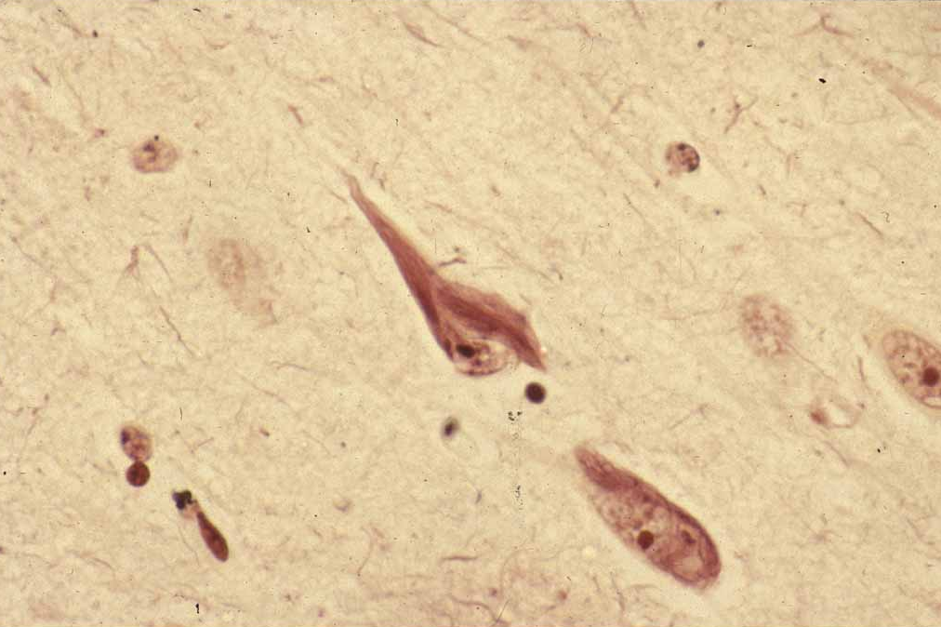
Neurofibrillary Tangle
Notes:
Neurond with neurofibrillary tangles, Bodian silver impregnation

Slide 13
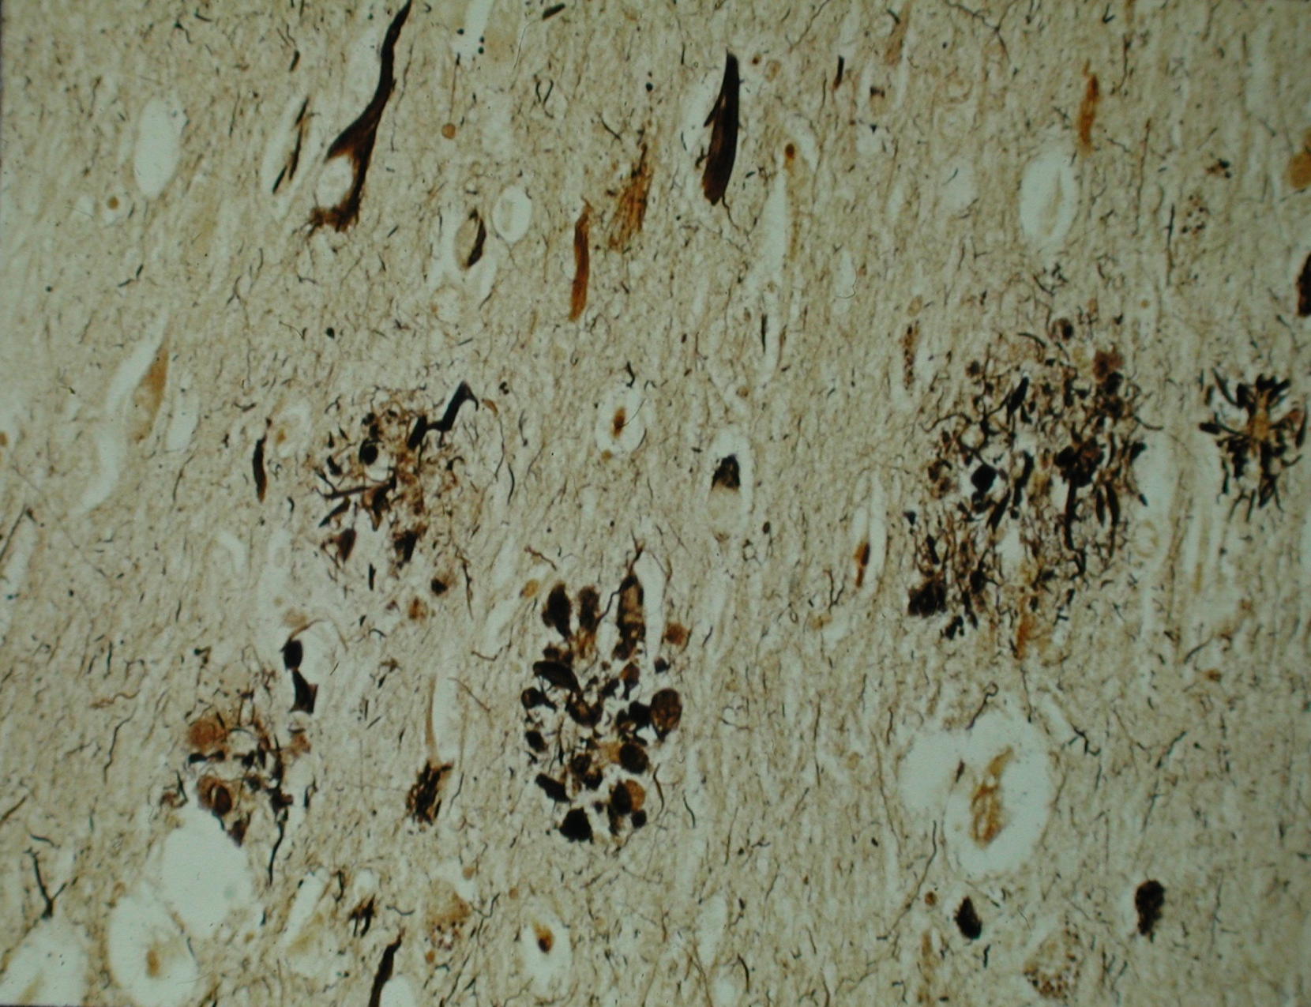
Neuritic Amyloid Plaque

Slide 14
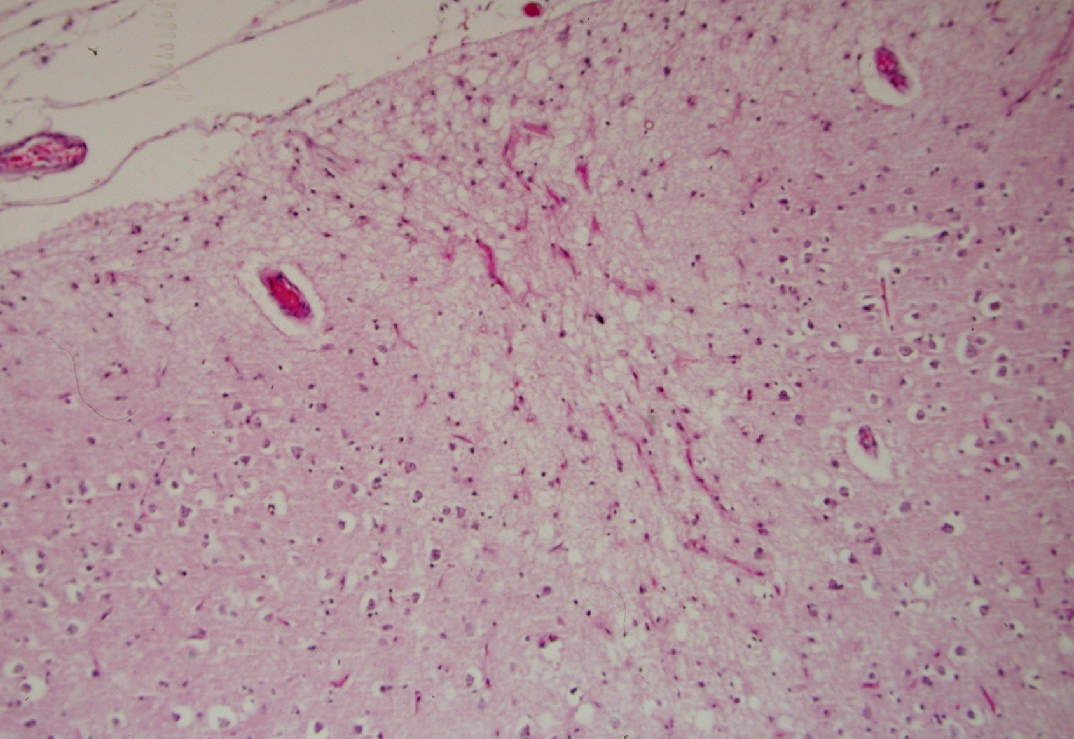
Microinfarct

Slide 15
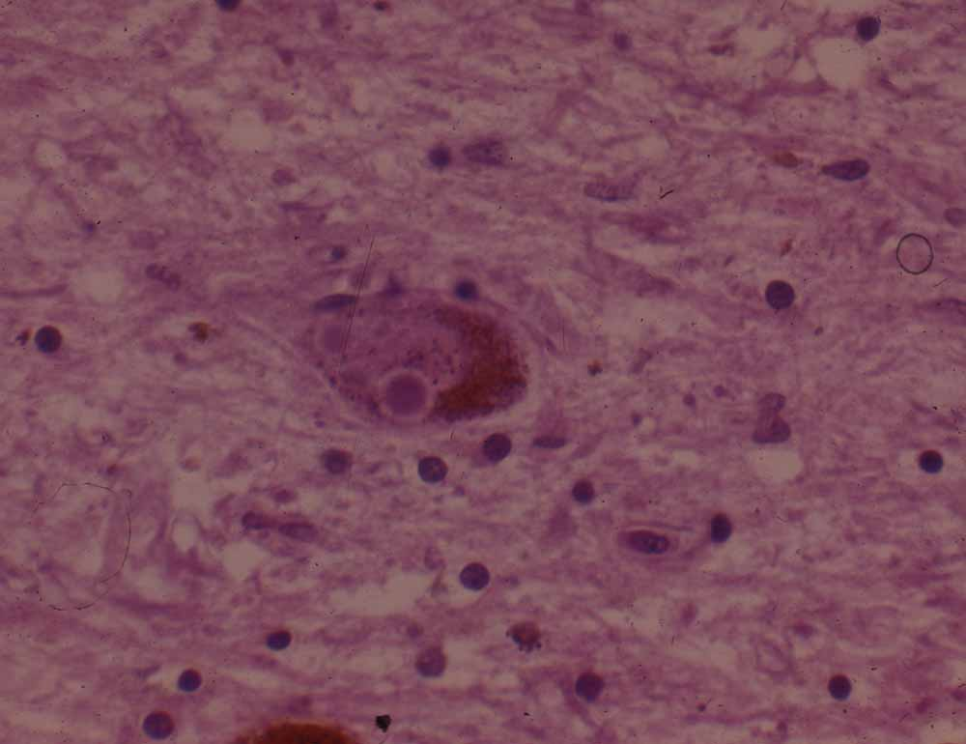
Lewy body

Slide 16
Hippocampal Sclerosis

Slide 17
Pathogenesis and prevention – analytic strategies
Start with examination of factors predicting cognitive decline or impairment -- age at such development (intercept), trajectory of cognitive decline (slope), and final level of function (last CASI)
Multivariate analyses, mediation, etc. – to understand the pathogenic process with all of its complexities
Consider implications for prevention – attributable risk.
Extend or shift the analytic endpoint to the structural brain lesions at autopsy, individually or in combination (co-morbidity burden measure) to distinguish separate disease processes leading to impairment.

