Slide 1
Cognitive Reserve Concepts
Laura B Zahodne
University of Michigan

Slide 2
Acknowledgements
Funded in part by Grant R13AG030995 from the National Institute on Aging
The views expressed in written conference materials or publications and by speakers and moderators do not necessarily reflect the official policies of the Department of Health and Human Services; nor does mention by trade names, commercial practices, or organizations imply endorsement by the U.S. Government.

Slide 3
Outline
Methods for demonstrating cognitive reserve
  Greater pathology in the context of matched cognition
  Weaker associations between pathology and cognition
Mechanisms underlying cognitive reserve
  Efficiency, capacity, compensation
Related concepts
  Brain reserve
  Brain maintenance
  Resilience

Slide 4
Outline
Methods for demonstrating cognitive reserve
  Greater pathology in the context of matched cognition
  Weaker associations between pathology and cognition
Mechanisms underlying cognitive reserve
  Efficiency, capacity, compensation
Related concepts
  Brain reserve
  Brain maintenance
  Resilience

Slide 5
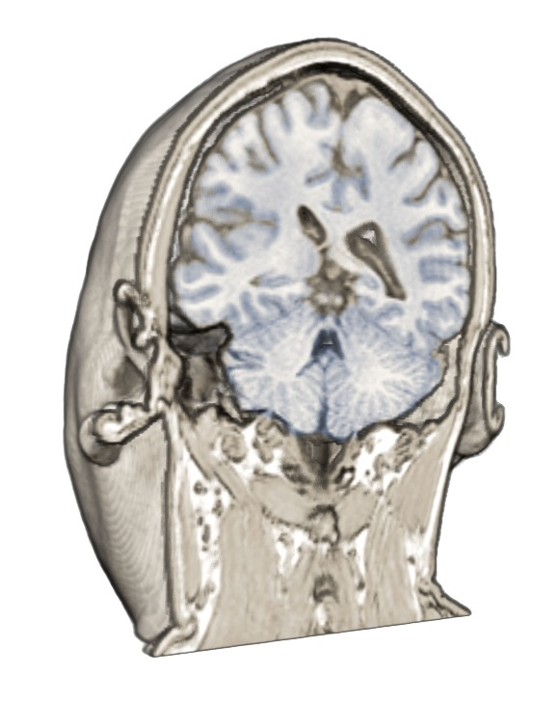
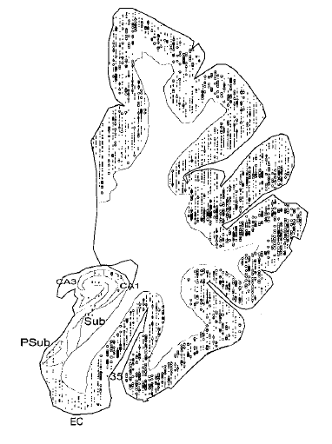
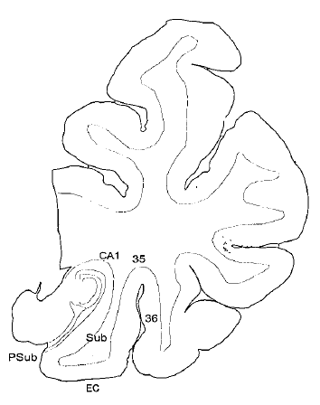
Normal
AD
Price & Morris, Ann Neurology 1999
Notes:
CERAD criteria (1991)

Slide 6
Up to 67% of older adults classified as “normal” during life meet criteria for Alzheimer’s disease at autopsy
Crystal et al., Neurology 1988
Hulette et al., J Neuropathol Exp Neurol 1998
Notes:
Predates Braak staging; considered plaques, tangles, and age (Khachaturian Arch Neurol 1985)
Other two use CERAD criteria (45% with CDR=0 at autopsy meet possible AD)

Slide 7
1. Why do individuals with the same cognitive phenotype differ in their degree of pathology?
2. Why do individuals with the same degree of brain pathology differ in their cognitive status?
Notes:
Need both pathology and cognition to study reserve

Slide 8
Cognitive Reserve Method #1
Why do individuals with the same cognitive phenotype differ in their degree of pathology?
  Compare pathology across individuals matched on cognition
  Estimate association with pathology, controlling for cognition

Slide 9

Cognitive Reserve Method #1a
More pathology at same level of cognition
Stern et al, Ann Neurol 1992

Slide 10
Cognitive Reserve Method #1b
Positive association with pathology when controlling for cognition
Brickman et al., Neurobiology of Aging 2011

Slide 11
Outline
Methods for demonstrating cognitive reserve
  Greater pathology in the context of matched cognition
  Weaker associations between pathology and cognition
Mechanisms underlying cognitive reserve
  Efficiency, capacity, compensation
Related concepts
  Brain reserve
  Brain maintenance
  Resilience

Slide 12
Cognitive Reserve Method #2
Why do individuals with the same degree of brain pathology differ in their cognitive status?
  Moderation of pathology-cognition association (differential impact)
  Residual variance in cognition after accounting for pathology
Notes:
2a advocated by Stern PIA white paper as most rigorous test

Slide 13
Cognitive Reserve Method #2a
Weaker association between pathology and cognition
Bennett, et al., Neurology 2005

Slide 14
Cognitive Reserve Method #2a
CR proxies behave differently depending on disease stage
Mungas et al., Neurobiology of Aging 2018

Slide 15
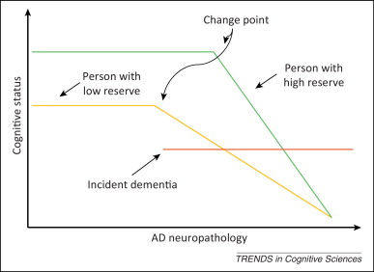
Barulli & Stern, TiCS, 2013

Slide 16
Cognitive Reserve Method #2b
Pathology
Cognition
More residual variance
Cognitive Reserve
Reed et al., JINS 2011
Notes:
Method to study things that promote reserve

Slide 17
Outline
Methods for demonstrating cognitive reserve
  Greater pathology in the context of matched cognition
  Weaker associations between pathology and cognition
Mechanisms underlying cognitive reserve
  Efficiency, capacity, compensation
Related concepts
  Brain reserve
  Brain maintenance
  Resilience
Notes:
Functional mechanisms. Software, not hardware

Slide 18
Mechanisms of cognitive reserve: efficiency and capacity
(Same capacity)
(Same efficiency)
Steffener & Stern, Biochimica et Biophysica Acta 2012
Notes:
Same efficiency, same capacity

Slide 19
Mechanisms of cognitive reserve: compensation
Alternate network
Primary network
Neural activity
Patti Reuter-Lorenz

Slide 20
Mechanisms of cognitive reserve
Efficiency: the degree to which a primary brain network must become activated in order to accomplish a task
Capacity: maximum degree to which a primary brain network can be activated to keep performing a task in the face of increasing demands
Neural compensation: ability to utilize alternate networks to achieve successful task performance
Neural reserve

Slide 21
Outline
Methods for demonstrating cognitive reserve
  Greater pathology in the context of matched cognition
  Weaker associations between pathology and cognition
Mechanisms underlying cognitive reserve
  Efficiency, capacity, compensation
Related concepts
  Brain reserve
  Brain maintenance
  Resilience

Slide 22
Brain Reserve
AKA passive threshold model
Quantitative aspects of brain structure (e.g., brain size, neuron numbers), which could reflect genetic or developmental factors
Satz, Neuropsychology 1993

Slide 23

Brain Reserve
Satz, Neuropsychology 1993

Slide 24
Brain Maintenance
AKA neuroprotection, resistance
Relative lack of age-related brain pathology (e.g., amyloid plaques), which reflects individual differences in disease susceptibility
Nyberg et al., TiCS 2012
Notes:
Problem with cross-sectional studies – not clear if it’s brain reserve or brain maintenance

Slide 25
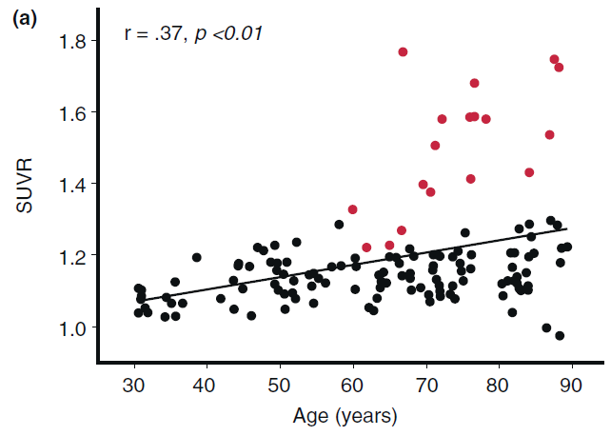
Brain Maintenance
Individuals with elevated amyloid
Nyberg et al., TiCS 2012

Slide 26
Resilience
Psychological term for adapting well in the face of trauma or adversity
There are multiple “adversity” analogies in dementia research
  Brain resilience: healthier brain than expected given genetic and other risk factors
  Cognitive resilience: better cognition than expected given level of brain pathology

Slide 27
Concluding remarks
Cognitive reserve describes mismatch between pathology and cognition
  Studies of cognitive reserve should include measures of both pathology and cognition
Cognitive reserve denotes adaptive response to age/disease-related changes
  Difficult to measure cognitive reserve in healthy, young people
Cognitive reserve is a dynamic construct
  Static proxy measures (e.g., education) are limiting

