Slide 1
Studies of Cognitive Reserve in WHICAP
Laura B Zahodne
University of Michigan

Slide 2
Acknowledgements
Funded in part by Grant R13AG030995 from the National Institute on Aging
The views expressed in written conference materials or publications and by speakers and moderators do not necessarily reflect the official policies of the Department of Health and Human Services; nor does mention by trade names, commercial practices, or organizations imply endorsement by the U.S. Government.

Slide 3
Acknowledgements
WHICAP Investigators
Richard Mayeux (PI)
Nicole Schupf
Jennifer Manly
Adam Brickman
Yian Gu
Yaakov Stern
Nikolaos Scarmeas
WHICAP Funding
RF1 AG054023
R01 AG037212
P01 AG007232

Slide 4
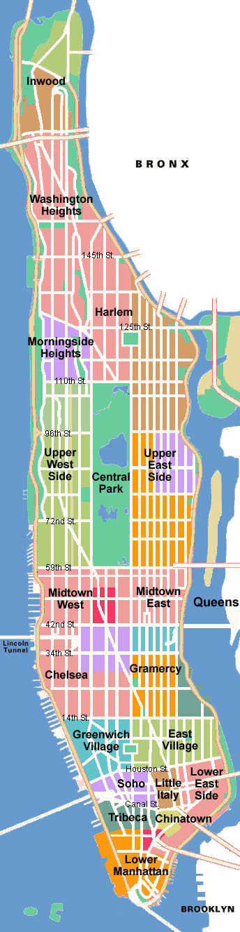
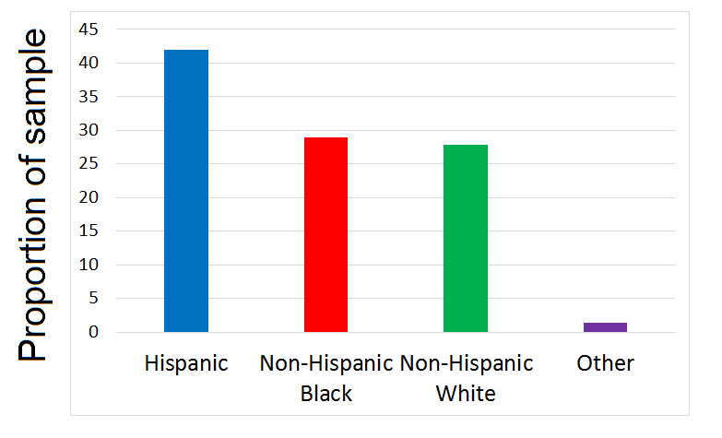
WHICAP
Washington Heights-Inwood Columbia Aging Project
N > 8,000 older adults since 1992
  Inclusion criteria: Medicare-eligible residents, age 65+, Spanish or English speaking
  Seen in home at 18-24 month intervals

Slide 5
Outline
Variance decomposition replication
Longitudinal extension
CR proxies in WHICAP

Slide 6
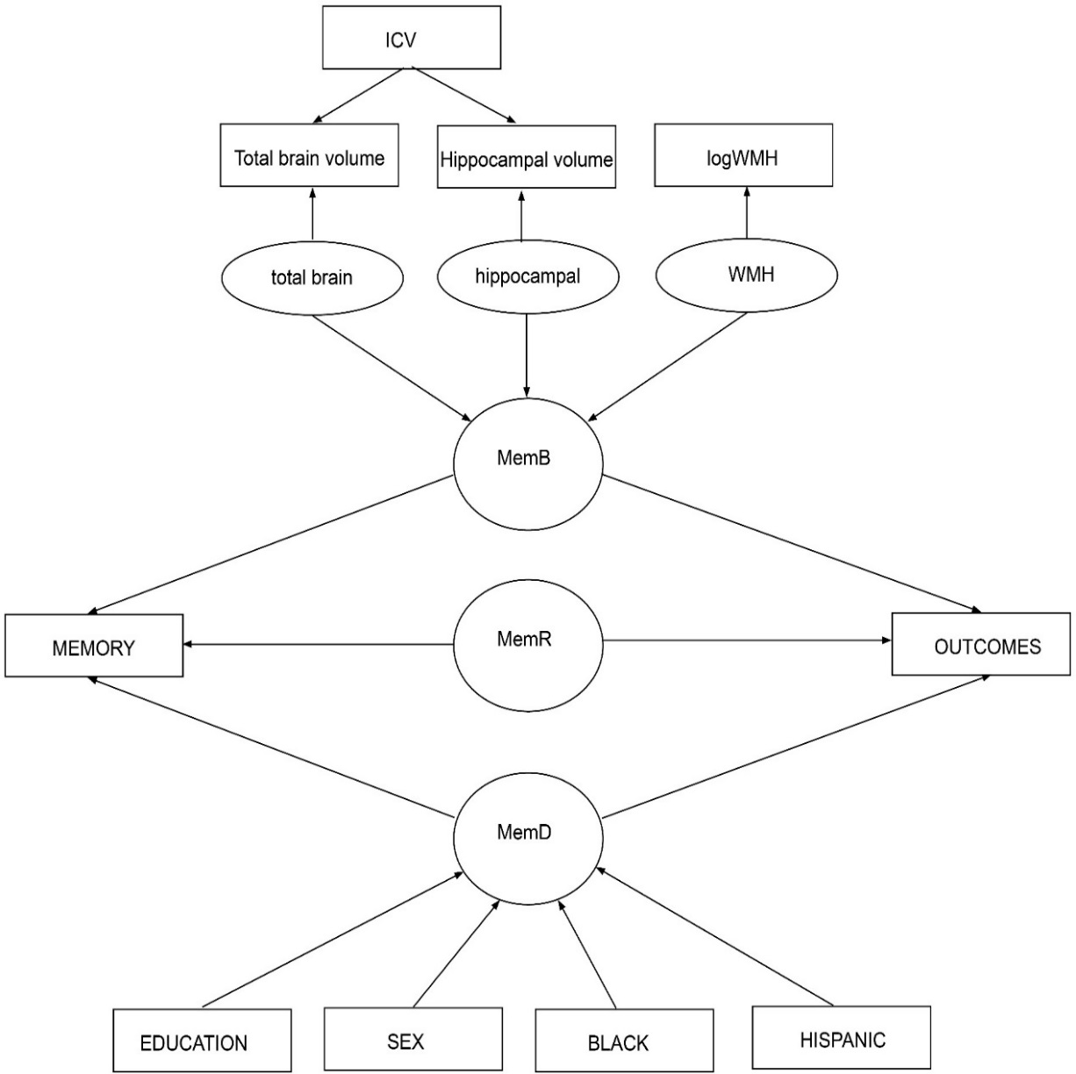
WHICAP replication of Reed et al., 2010
Notes:
Residual variable = 50% of memory variance
Brain – 20-25%
Dem – 20%

Slide 7
WHICAP replication of Reed et al., 2010
 | Whole sample (N=703)
Age | 80.1 (5.5)
Education | 10.8 (4.8)
Sex | 67% Female
Race and ethnicity | 36% Hispanic 35% Black 29% White
Intracranial volume | 1134.1 (123.5)
Total brain volume | 826.9 (95.0)
Hippocampal volume (avg) | 3.3 (0.7)
Total WMH volume | 2.3 (0.9)
MCI | 24%

Slide 8
WHICAP replication of Reed et al., 2010
Brain: 7% of memory variance
Correlated with age: r = −.495
Residual: 79% of memory variance
Correlated with age: r = −.202
Demographics: 14% of memory variance
Not correlated with age: r = −.044
Notes:
Residual variable = 50% of memory variance
Brain – 20-25%
Dem – 20%

Slide 9
WHICAP replication of Reed et al., 2010
Notes:
Residual variable = 50% of memory variance
Brain – 20-25%
Dem – 20%

Slide 10
Independent associations with outcomes
 | MemD | MemB | MemR
MCI | −0.22 | −0.15 | −0.57
Reading | 0.59 | 0.01 | 0.16
Dementia conversion | −0.38 | −0.58 | −0.71
Baseline language | 0.25 | 0.0 | 0.18
3-year language change | 0.65 | 0.16 | 0.37
Zahodne et al. JINS 2013

Slide 11
Moderation of MemB-language change
Cognitive decline over 3 yrs (SD units)
Brain integrity (SD units)
Zahodne et al. JINS 2013

Slide 12
Outline
Variance decomposition replication
Longitudinal extension
CR proxies in WHICAP

Slide 13
Baseline characteristics of longitudinal sample
 | N = 283
Age | 79.4 (5.2)
Education | 11.1 (4.8)
Sex | 67.6% Female
Race and ethnicity | 38.9% Black 33.2% Hispanic 27.9% White
Intracranial volume | 1301.9 (152.4)
Total gray matter volume | 524.8 (48.9)
Hippocampal volume (total) | 6.9 0.8)
White matter hyperintensity volume | 8.6 (10.4)
Memory score | 0.2 (0.7)
Language score | 0.4 (0.6)
Zahodne et al. Neuropsychologia 2015

Slide 14
Step 1: Baseline regression
DV = Episodic memory composite
IVs = Demographics (sex, race, ethnicity, education) and brain variables (WMH, ICV-corrected gray matter volume, ICV-corrected hippocampal volume)
Residual = Baseline residual
Zahodne et al. Neuropsychologia 2015

Slide 15
Step 2: Predict follow-up memory
Regression coefficients taken from baseline regression
Brain variables taken from follow-up MRI
Predicted − Actual = Follow-up residual
Zahodne et al. Neuropsychologia 2015

Slide 16
Actual memory
Memory, as predicted by MRI measures
Residual (i.e., “CR”)
“Depleters”
“Stable”
“Increasers”
Time
Time
Time
Zahodne et al. Neuropsychologia 2015
Notes:
Predictors of residual change:
Memory decline
Higher residual memory variance at baseline
Lower WMH volume at baseline (just stable vs increaser)
All other variables were not associated with decline in the residual
Baseline memory
Baseline gray matter
Baseline hippocampal volume
Gray matter change
Hippocampal volume change
WMH change
REGRESSION TO THE MEAN? Usingthecorrelationbetweenresidualmemoryscores at thetwotime-points(r=0.637),wecalculatedexpectedchanges due toregressiontothemeaninthebottomandtoptertilegroups to be 0.07and þ0.11,respectively.Thus,regressiontothemean likely explains10%and22%ofthechangesobservedinthebottom and toptertilegroups,respectively.

Slide 17
Latent difference scores
Follow-up
1
1
Baseline
Change
Residual
Zahodne et al. Neuropsychologia 2015

Slide 18
Moderation of MemB-language change
“Depleters”
“Stable”
Age
Female
Education
Black
Hispanic
Baseline cog
Age
Female
Education
Black
Hispanic
Baseline cog
r = -.35*
r = -.08
Brain change
Cognitive change
Brain change
Cognitive change
Zahodne et al. Neuropsychologia 2015

Slide 19
Outline
Variance decomposition replication
Longitudinal extension
CR proxies in WHICAP

Slide 20
Education and Occupation
Stern et al., JAMA 1994

Slide 21
Education
Low education
High education
20 years
8 years
Global cognition (T-Scores)
0 years
9 years
Time
Time
Zahodne et al, JINS 2014
Notes:
COVs: Birth cohort, baseline age, sex, race, ethnicity, education, recruitment year
Same results when controlling for health and depressive symptoms
N=2425 initially non-demented

Slide 22
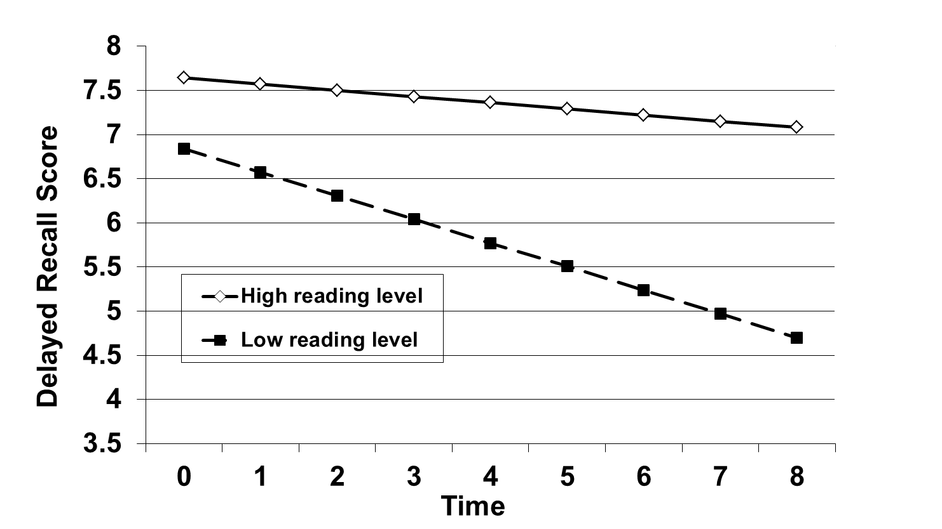
Reading Level
Manly et al., JCEN 2003
Notes:
COVs: age, ethnicity, gender, education

Slide 23
Literacy and educational quality
Sisco et al., J Gerontol Series B 2013

Slide 24
Education and reading
Language
Speed
Brickman et al., Neurobiology of Aging 2011

Slide 25
Leisure activities
More than 6 activities at baseline
6 or fewer activities at baseline
Scarmeas et al., Neurology 2001
Notes:
Covs: ethnicity, education, occupation
Driven by reading, visiting friends/relatives, going out to movies/restaurants, walking
Intellectual, then physical, then social
Still significant when baseline SRT added to the model
Still significant after health limitations, depression, heart disease, hypertension, diabetes, stroke were added to the model
Still significant when CDR=0.5 at BL added to the model

Slide 26
Bilingualism
Zahodne et al, Neuropsychology 2014
Notes:
COVs: age, sex, country of origin, education, time spent in US, recruitment cohort
N=1067 non-demented Hispanic immigrants

Slide 27
State of birth
Liu et al, JINS 2015

Slide 28
Depressive symptoms
Depressive symptoms
Cognition
Education,
Reading
O’Shea et al., Int J Geriatr Psychiatry 2015

Slide 29
Summary
Variance decomposition replication
  Further proof-of-concept for residual method of quantifying cognitive reserve
Longitudinal extension
  Evidence for independent effects of cross-sectional and longitudinal residual
  Depletion of cognitive reserve?
CR proxies in WHICAP
  Education, occupation, reading, leisure activities, bilingualism, depressive symptoms all relevant to cognitive functioning
  Additional studies incorporating brain variables are needed to clarify how these factors relate to the concept of cognitive reserve

